Slide 22
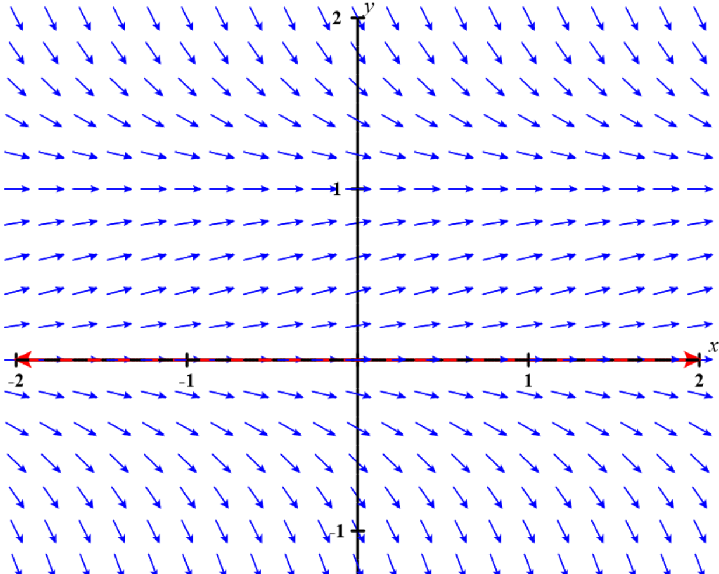
https://c3d.libretexts.org/DirectionField/index.html

Slide 23
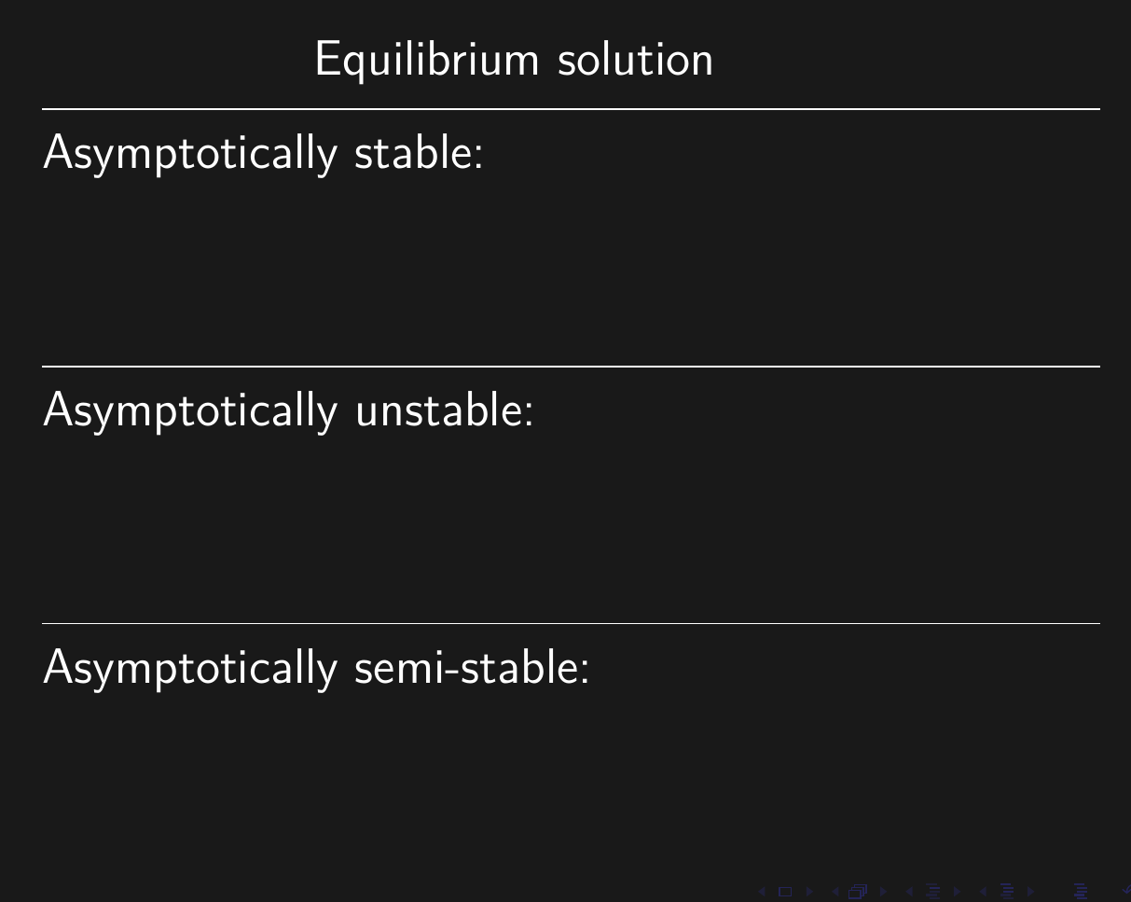

Slide 24
https://c3d.libretexts.org/DirectionField/index.html

