Slide 1
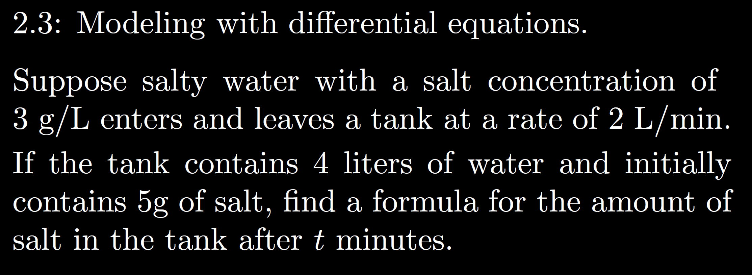

Slide 19
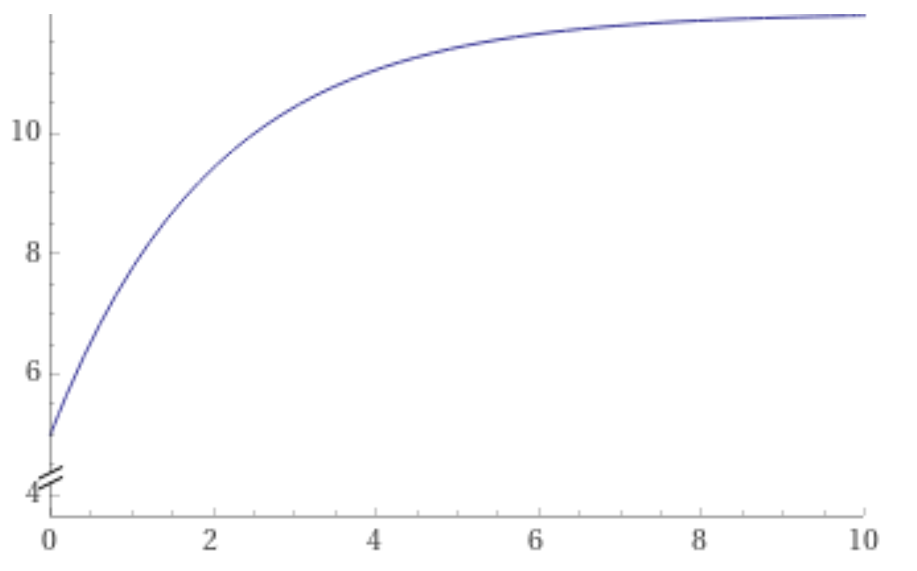
https://www.wolframalpha.com/input/?i=plot+-7+e%5E%7B-x%2F2%7D+%2B+12+from+x%3D0+to+10

Slide 23
