Slide 1
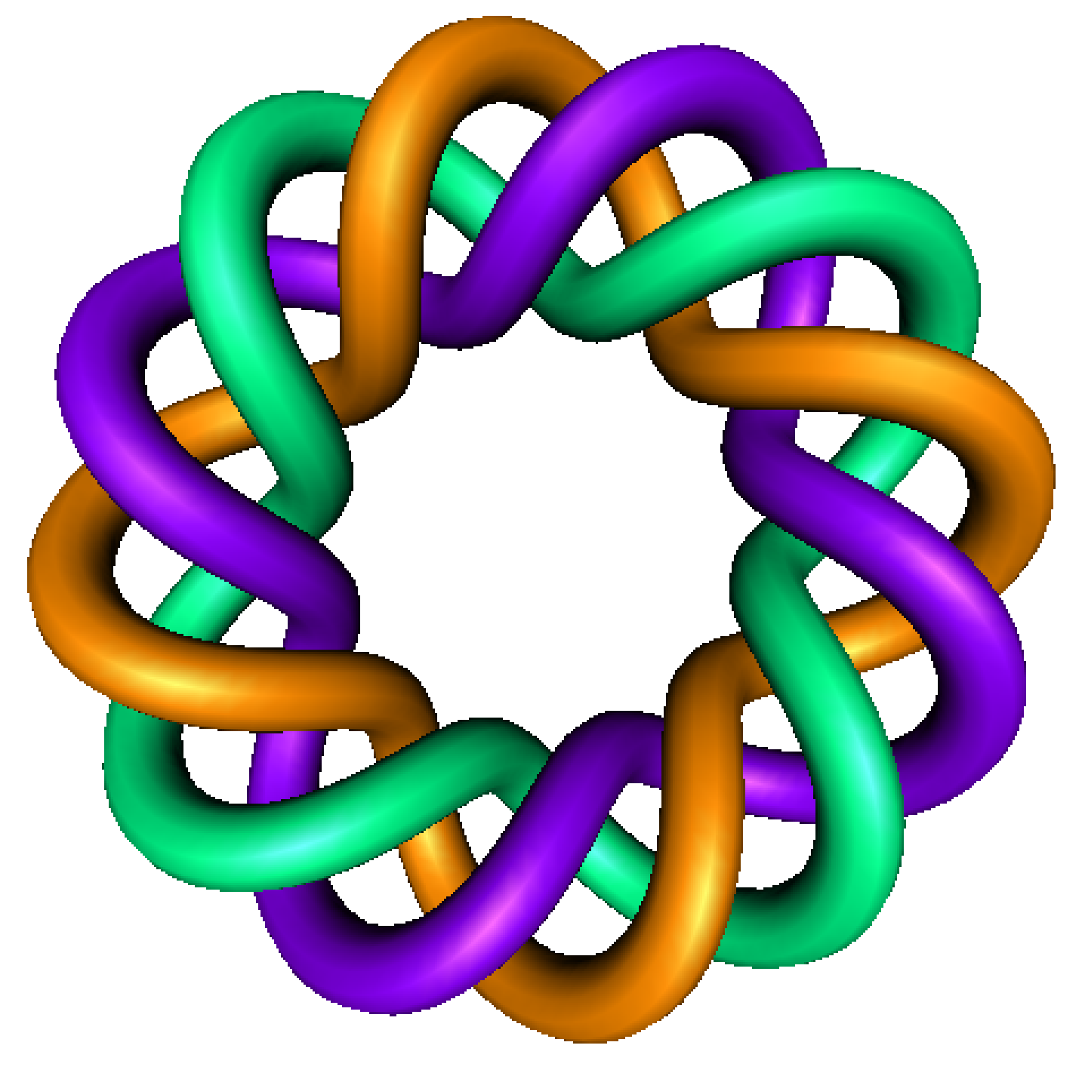
A very elementary introduction to proofs
Part 2
Example: Prove a function is not 1:1
By Dr. Isabel Darcy,
Dept of Mathematics and AMCS,
University of Iowa

Slide 2
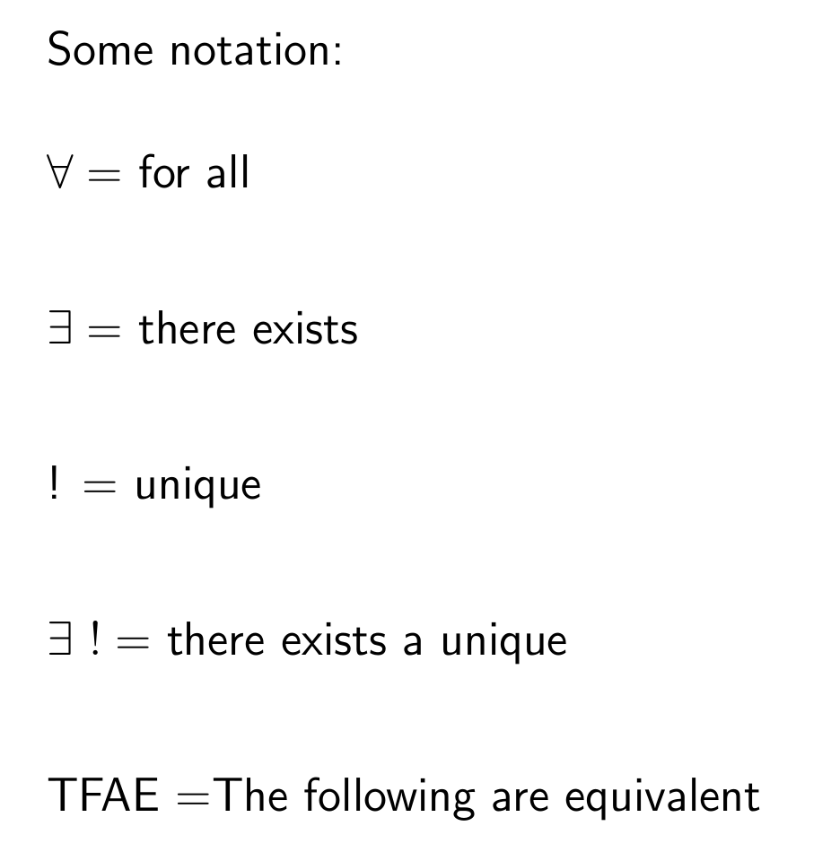

Slide 3
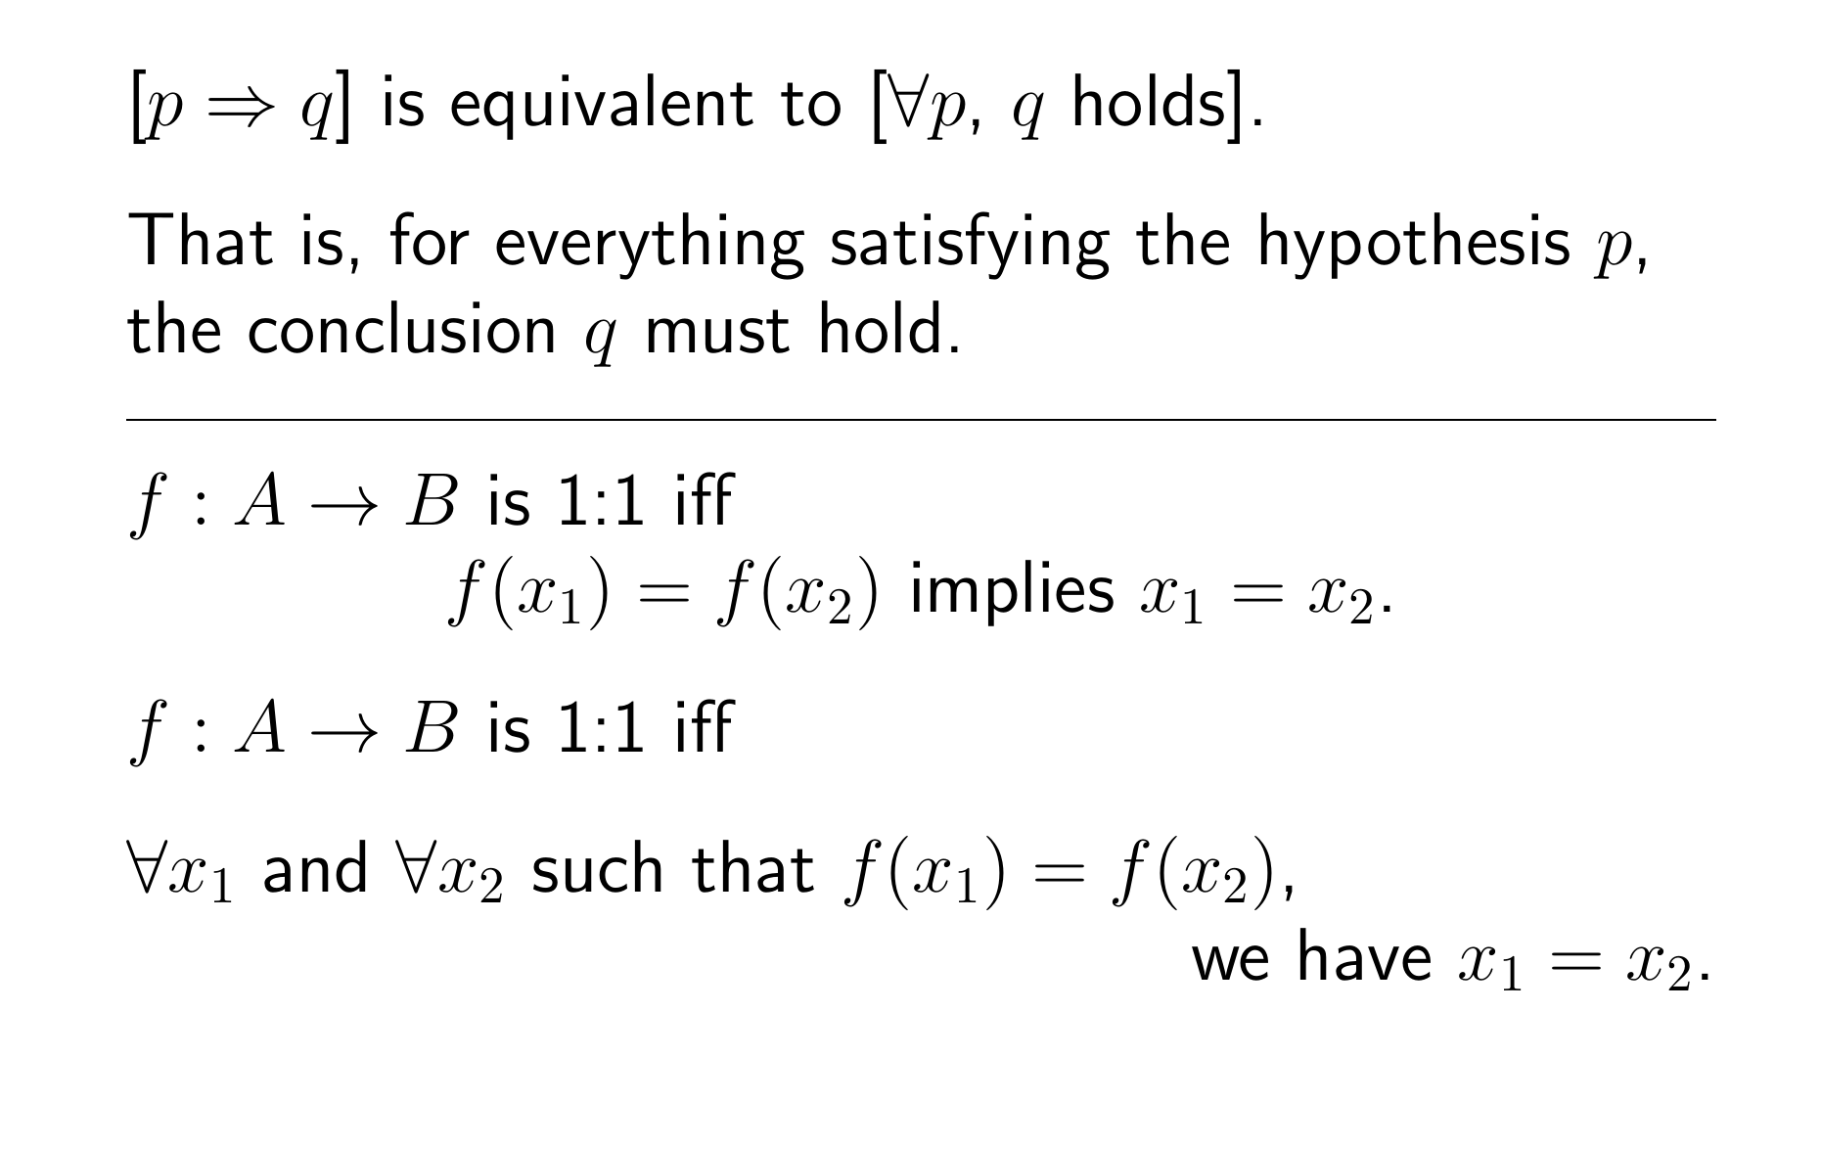
How do we prove a function is NOT 1:1

Slide 5
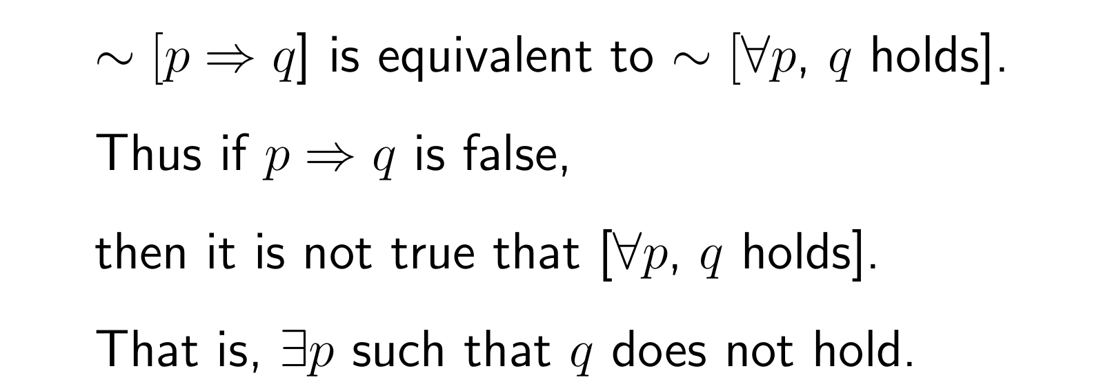

Slide 8
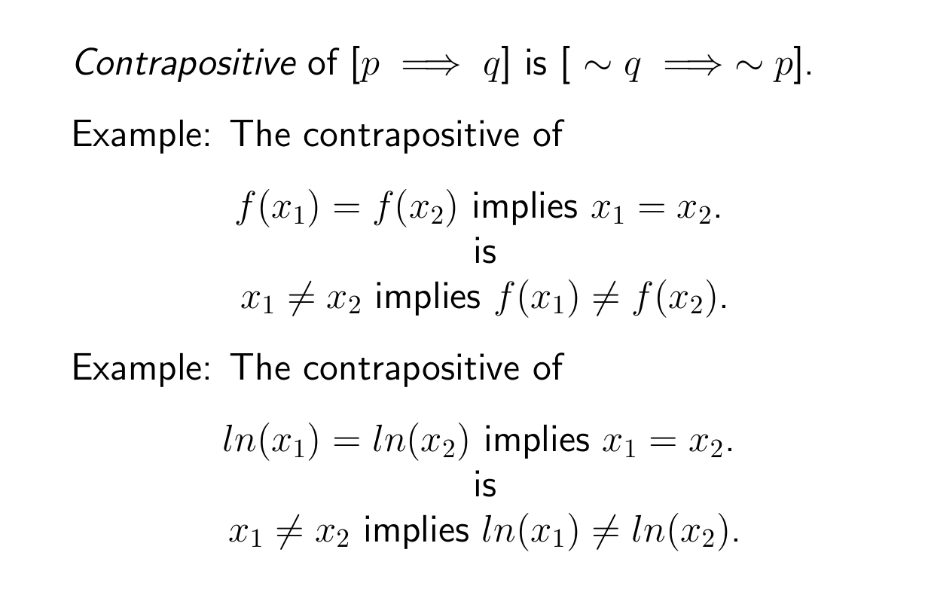

Slide 10
