Slide 1
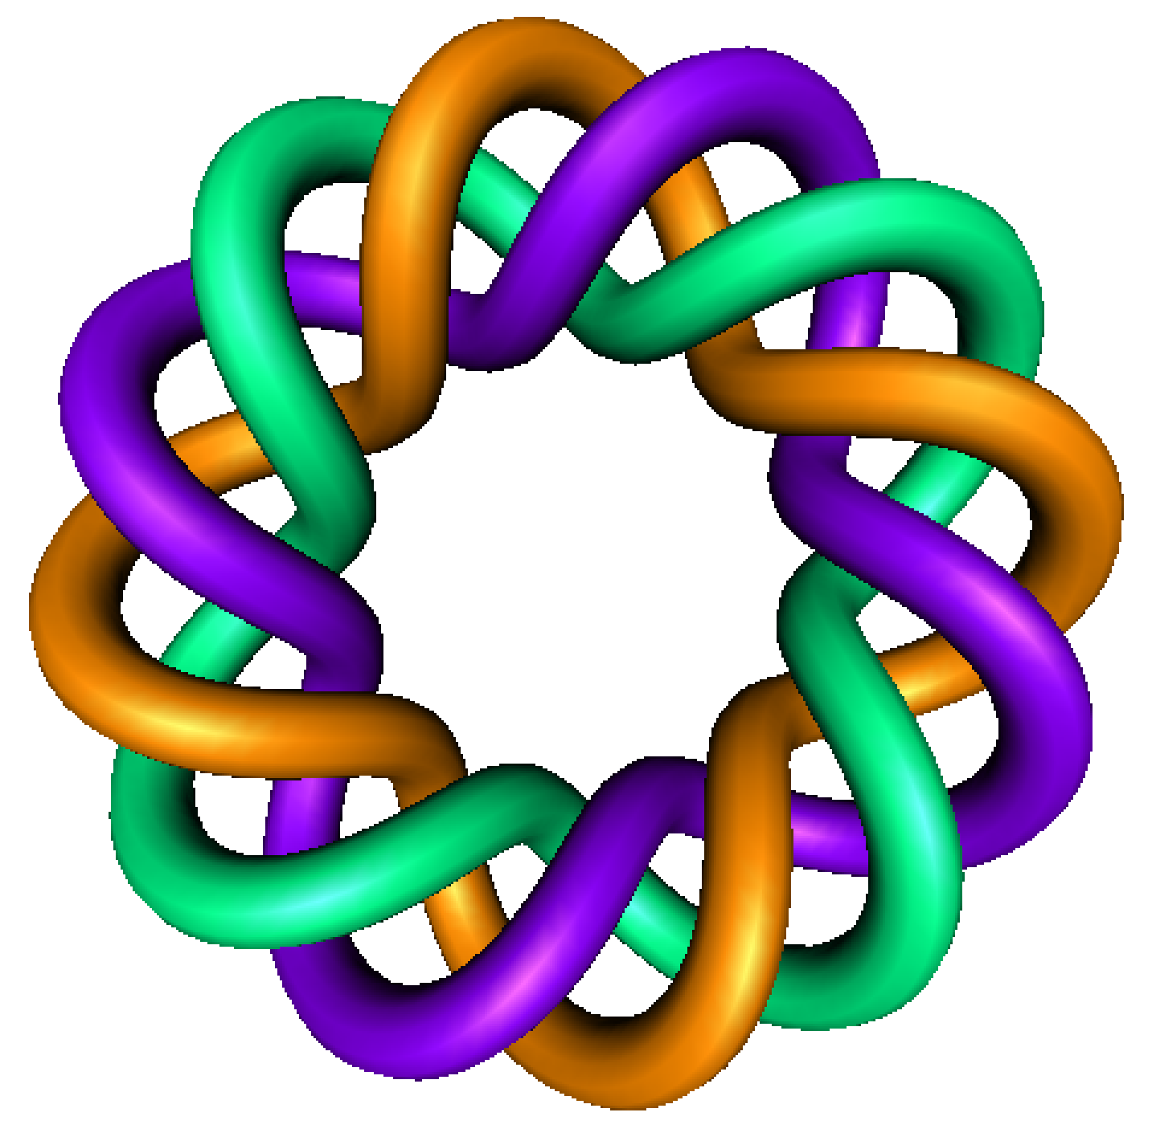
A very elementary introduction to proofs
Part 1
Example: Prove a function is 1:1
By Dr. Isabel Darcy,
Dept of Mathematics and AMCS,
University of Iowa

Slide 4
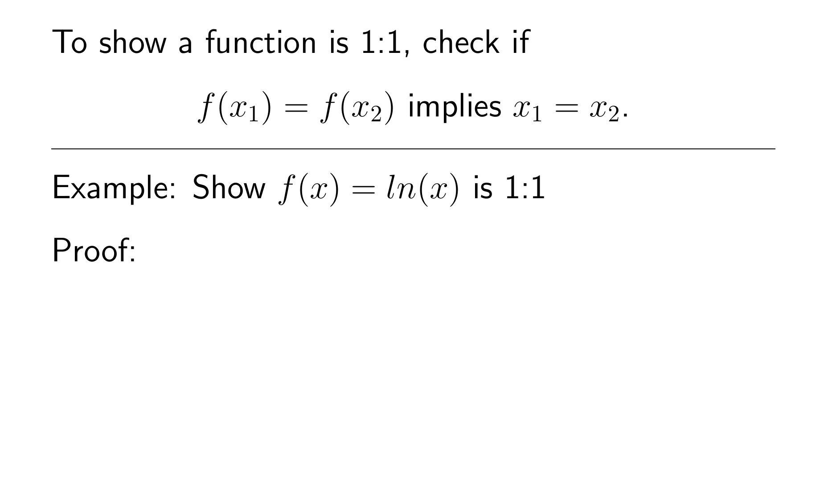

Slide 5
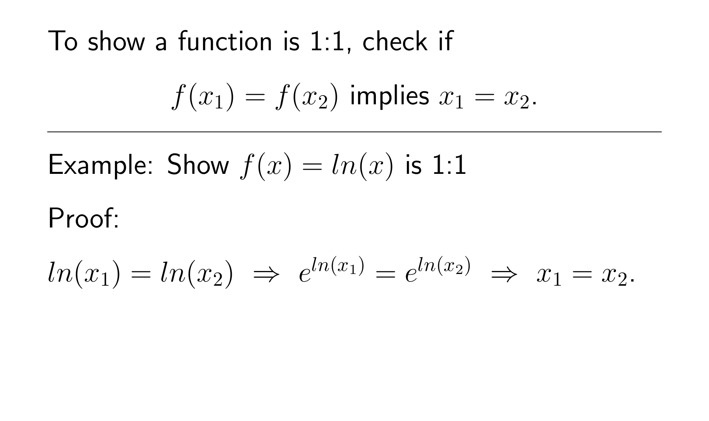

Slide 8
