Slide 1
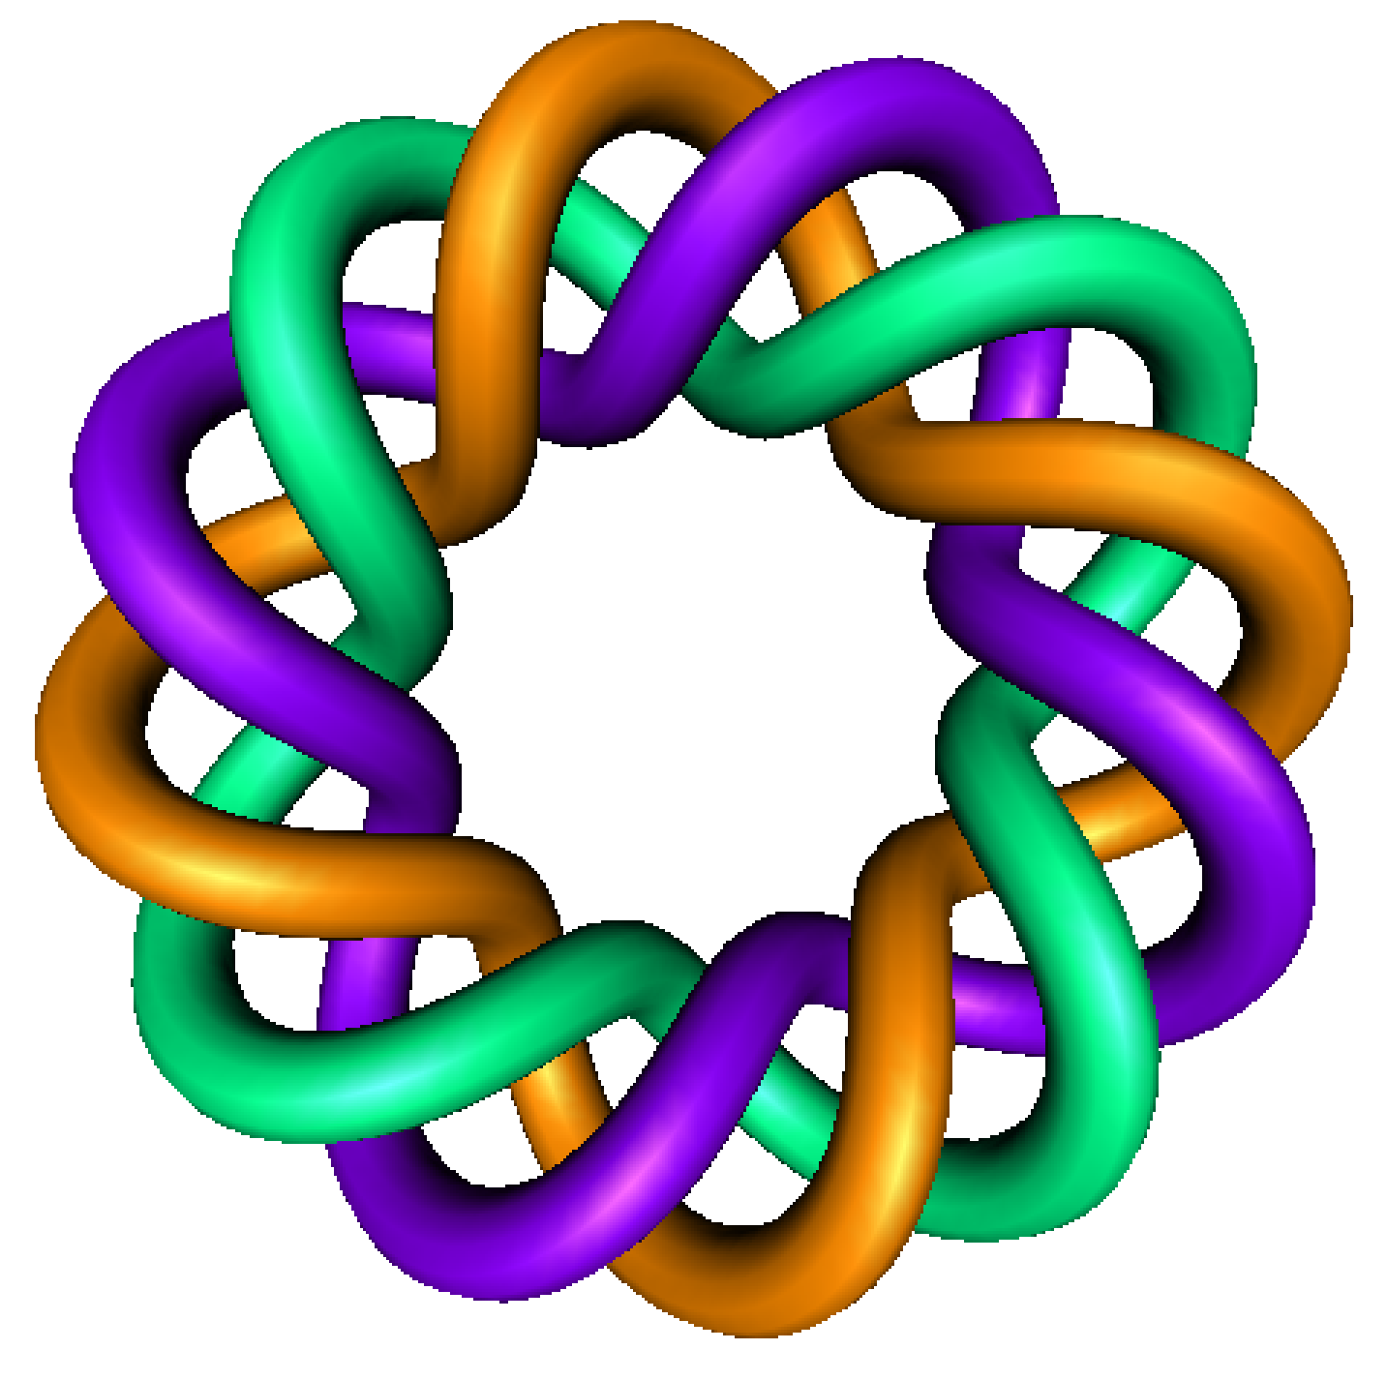
A Quick Review of
Linear Algebra
(linear combination, linear independence, span, basis)
+
Partial Fractions
for
Differential Equations
By Dr. Isabel Darcy,
Dept of Mathematics and AMCS,
University of Iowa

Slide 12
