Slide 1
Exam 1 Wednesday over 2.1, 2.4, 2.5, 2.8 (including induction), ch 3, 4, 7.1 – 7.5
7.2: 17, 19
7.3: 13, 14, 15
7.1 (use matrix form): 3, 4, 5, 6, 12
7.5: 1b, 2b, 5b
Problem session Monday during class.
Problem session Tuesday ??? ( submit survey by Sunday night if you wish to help choose the time).
HW 8, ungraded survey due Sunday night.
Real quiz 3 due Monday night.
In class: All Quizzes 10/7 - 10/21 due Monday night.
HW 9 knowledge due Wednesday (but can turn in Friday – Sunday)

Slide 2
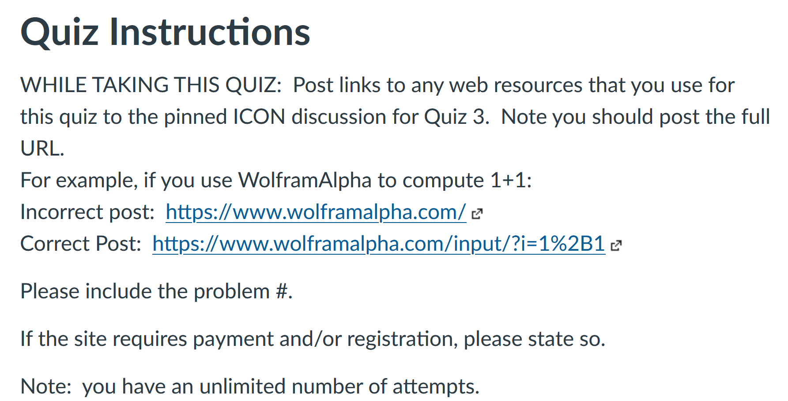

Slide 6
http://www.few.vu.nl/~rbakhshi/teaching/induction-handout.pdf

Slide 7
http://www.few.vu.nl/~rbakhshi/teaching/induction-handout.pdf

Slide 18
