Slide 1
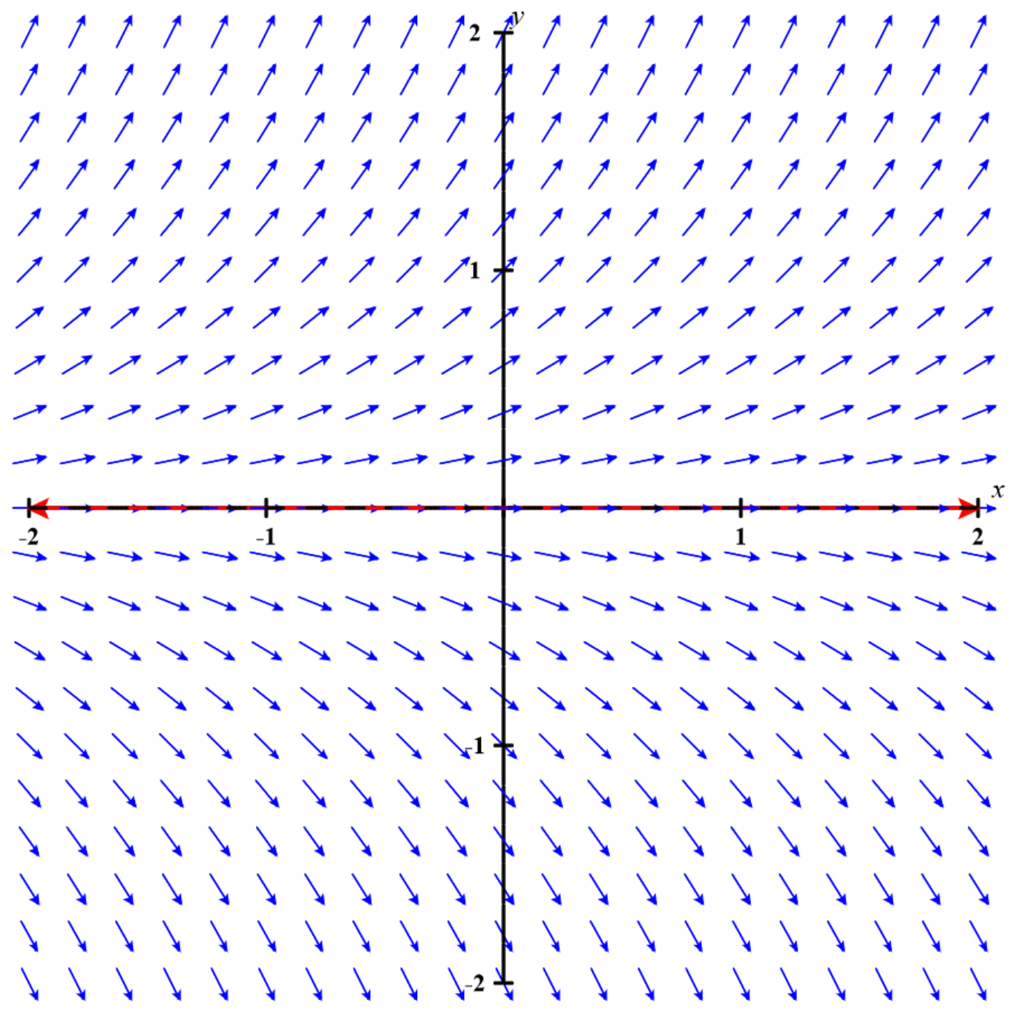
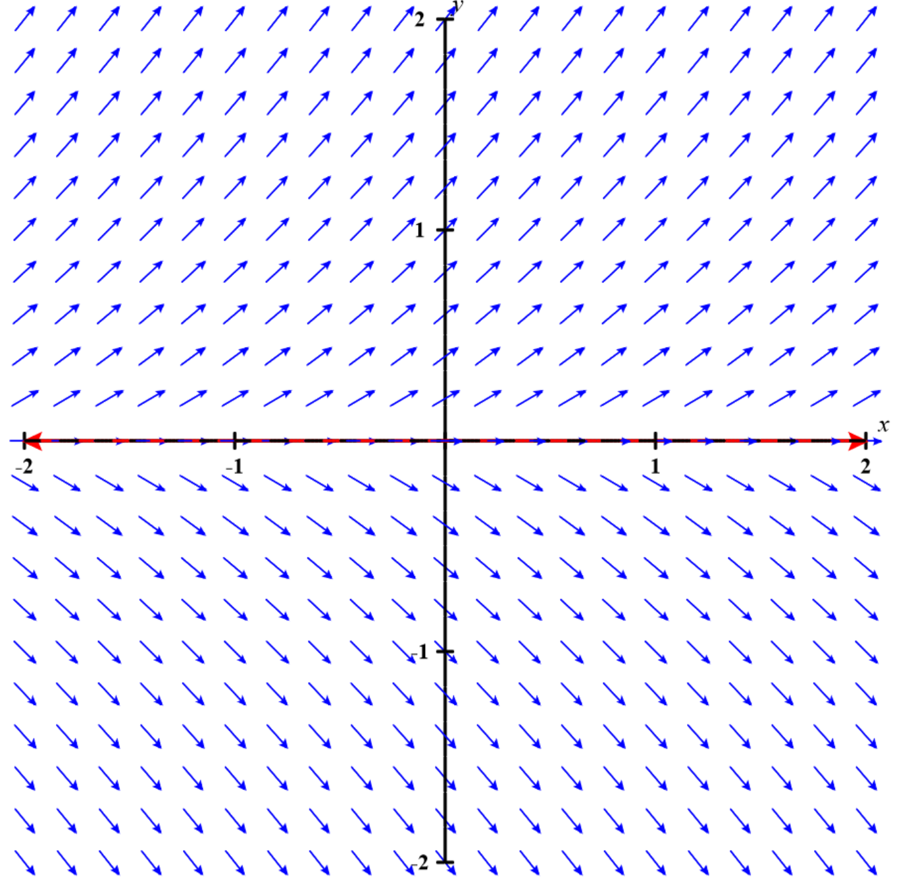
Given the direction fields below, which IVP: y’ = f(y), y(1) = 0 has a unique solution?
A
B

Slide 2
