Slide 3
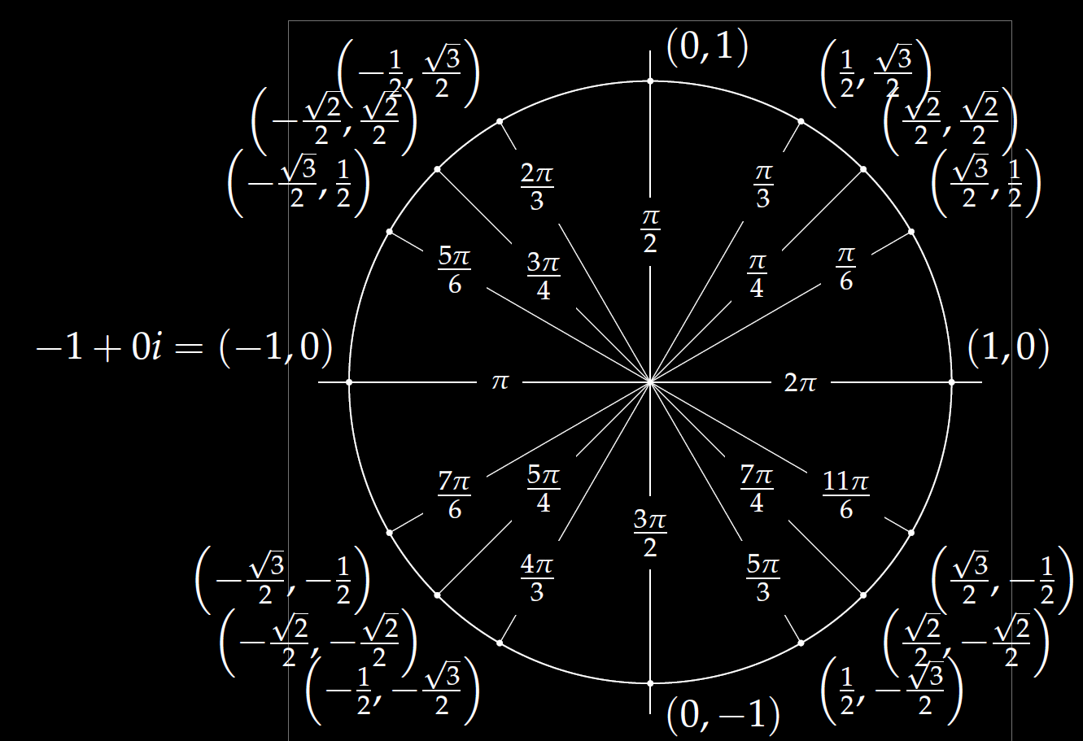
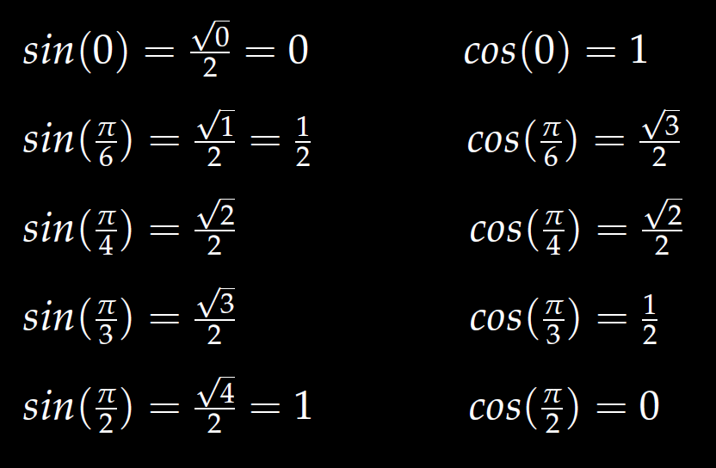
In special cases, you can use the unit circle.

Slide 20
Determine (without solving the problem) an interval in which the solution of the given initial value problem is certain to exist and be unique.
$$\left(1 − t\right)\left(1 + t^{2}\right)y^{′′′}+\ln\left|t − 5\right|y^{′}+2y = \sqrt{t+4} y(0) = 3$$

Slide 33
Linear Independence and the Wronskian

Slide 36
