Slide 1
In Class Quizzes Part 1
In Class Quizzes prior to Midterm 1 on September 23 (ICQs between 8/24 and 9/21), worth 14 points total.
Note that the highest grade on this assignment is 100%.
If your score on this assignment is less than 100%, you can still bring your score up to 100%.
In Class Quizzes Part 2 ( 10/7 - Week 13)
Bonus points: All quizzes 10/7 – 10/21 , All quizzes ? - ?, Final exam all quizzes 8/24 - ??, Posting on ICON discussion page, chats from last Wednesday,

Slide 2
Talk about math and game theory in political science
The AWM (Association for Women in Mathematics) student chapter is hosting a talk this Thursday, October 22 from 3:30 to 4:30 via Zoom (see link below). Dr. Elizabeth Menninga, Assistant Professor in the Department of Political Science, will be talking about how her studies in math led her to research in political science.
This talk will be geared toward undergraduates.
Zoom Meeting Details:
https://uiowa.zoom.us/j/98706452660?pwd=c3ZsUUkzV2FWTW1uV3FoOXBjOG9tQT09
Meeting ID: 987 0645 2660
Passcode: 119820

Slide 3
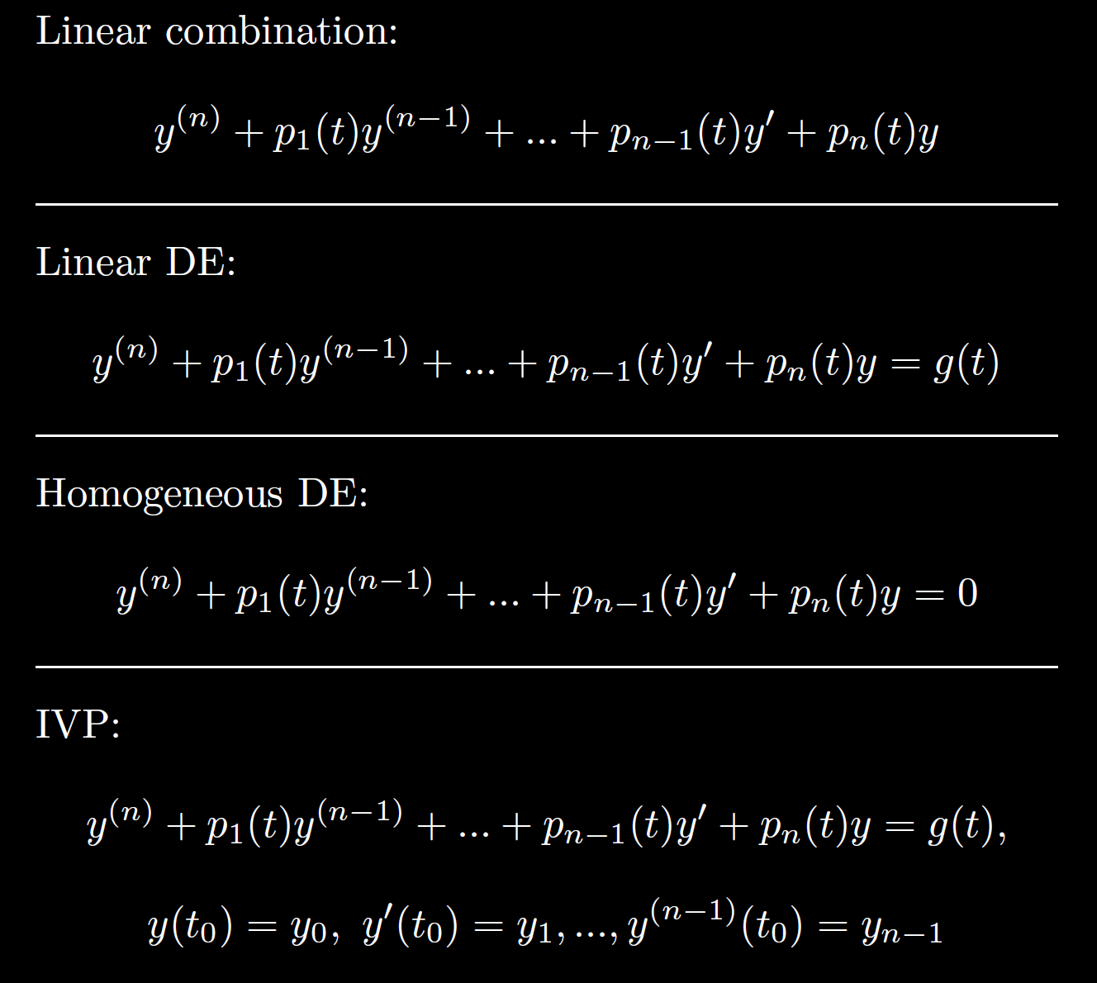

Slide 4
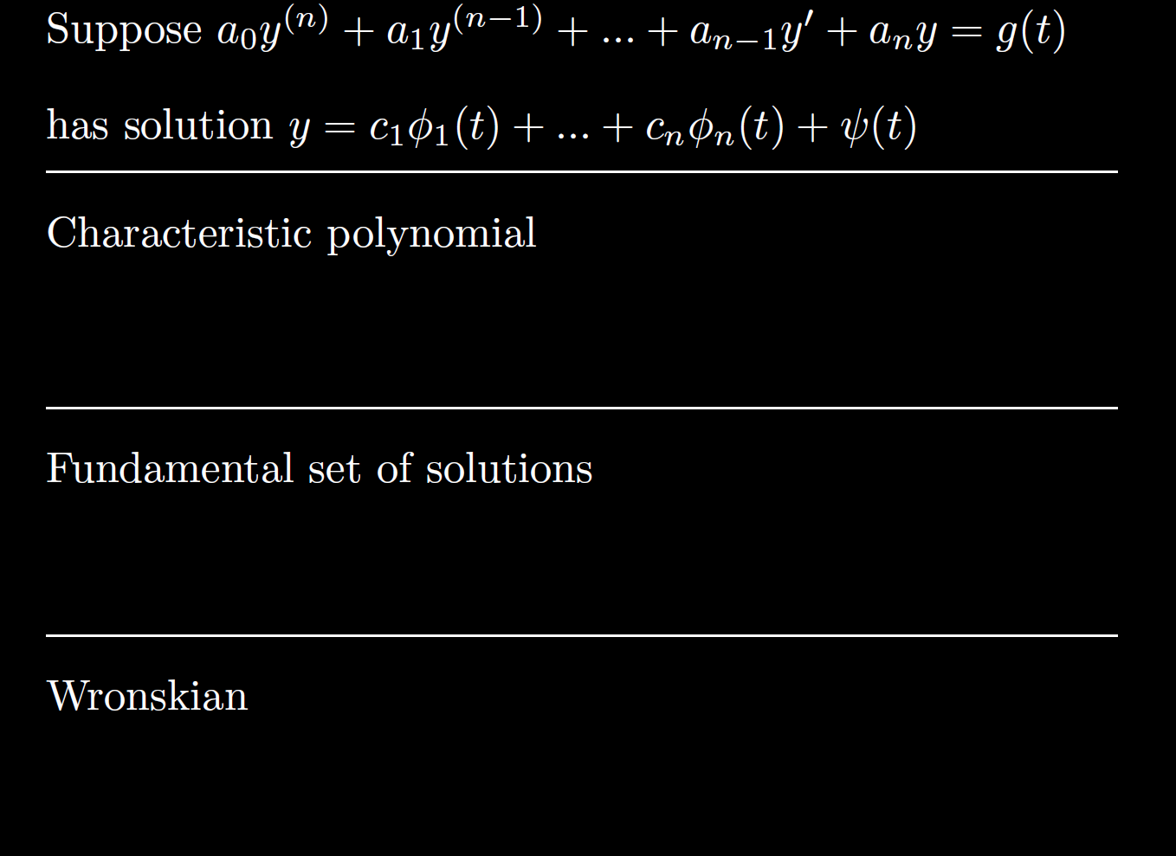

Slide 5


Slide 8

7.1: Transforming an n^{th} order linear DE into a system of n first order linear DEs.
Ex: $y′′′′ – 5y′′ + 6y =sin⁡(t)$

Slide 10
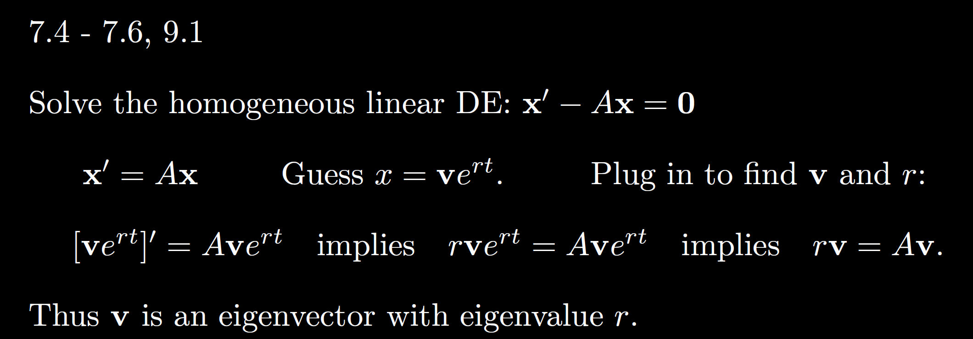

Slide 12
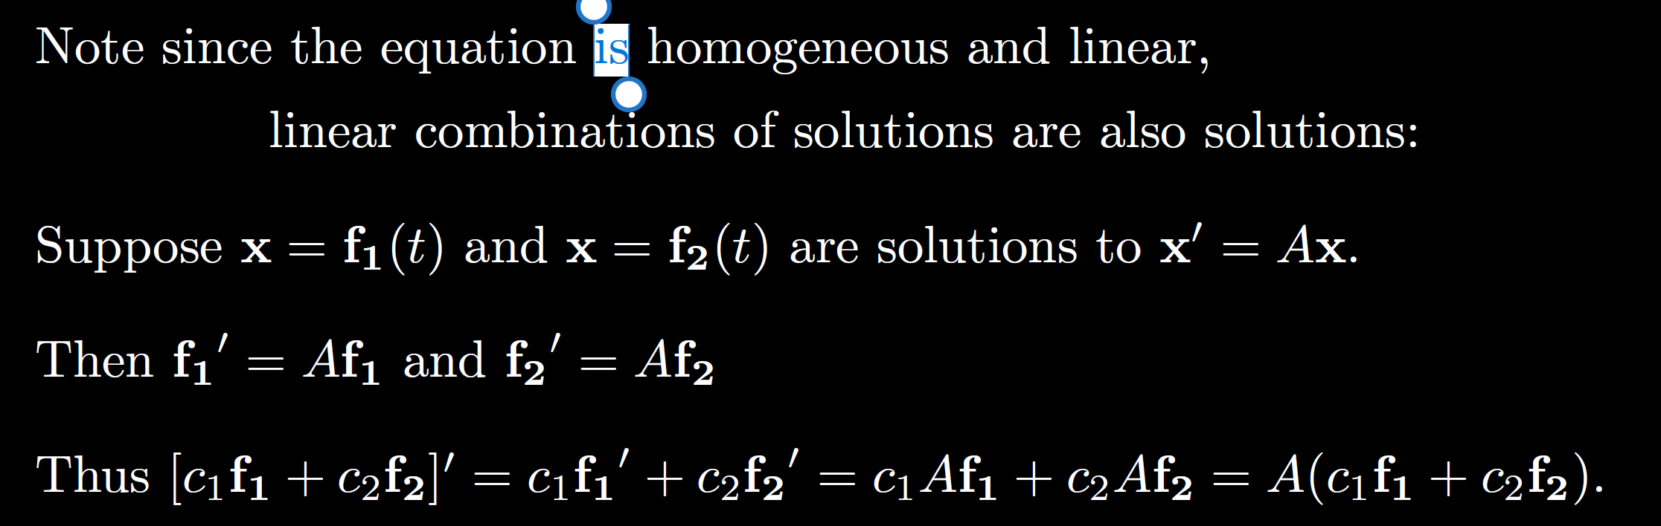

Slide 13
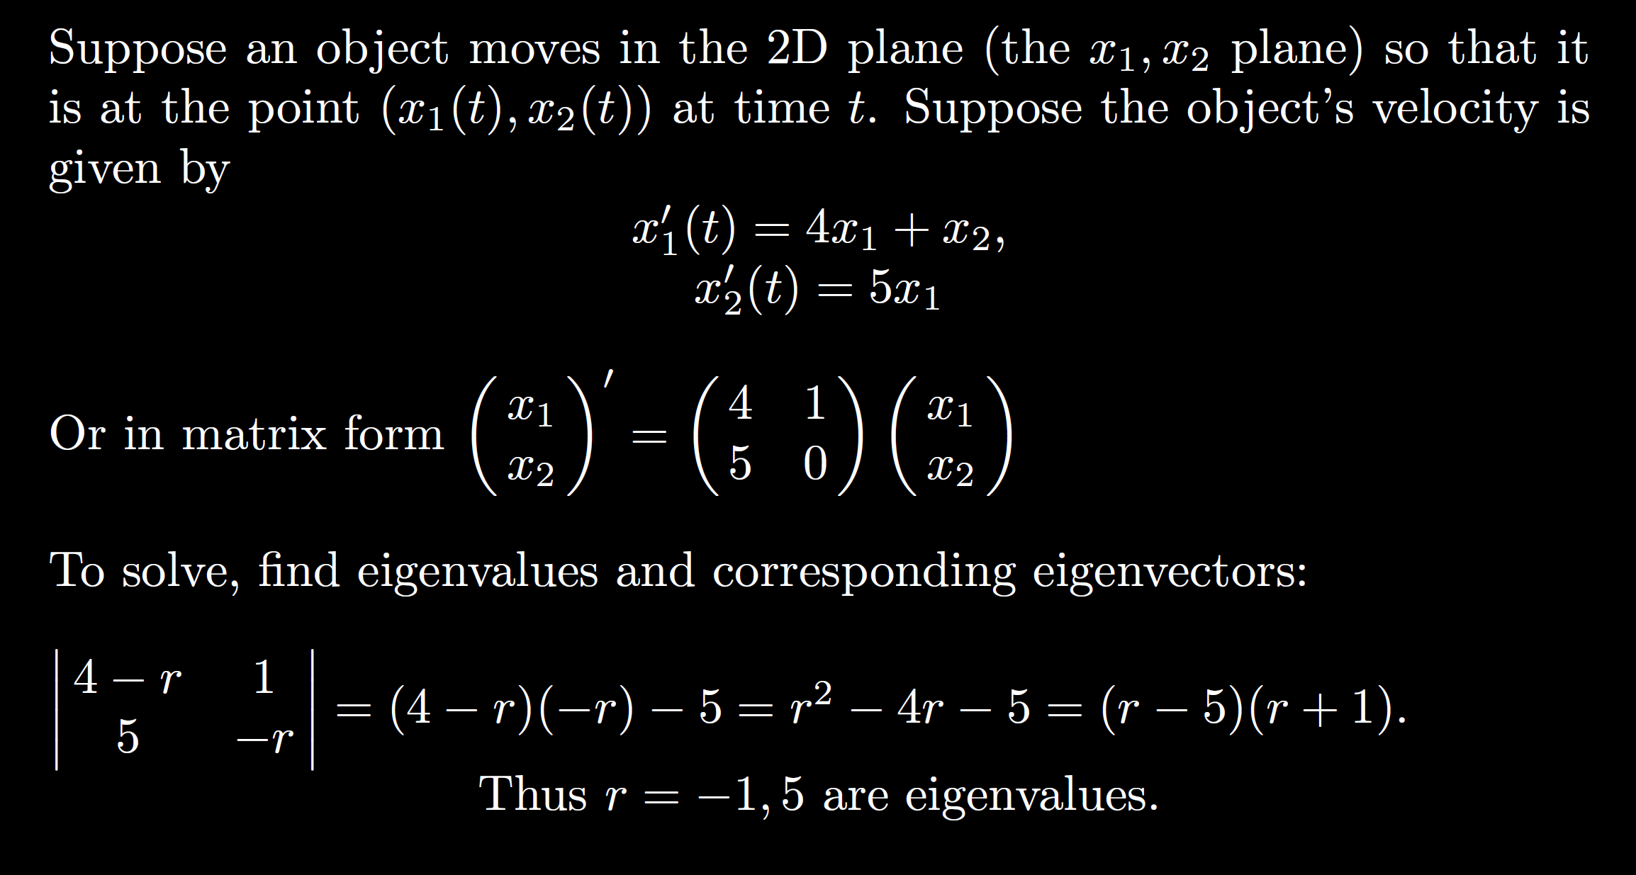


Slide 14
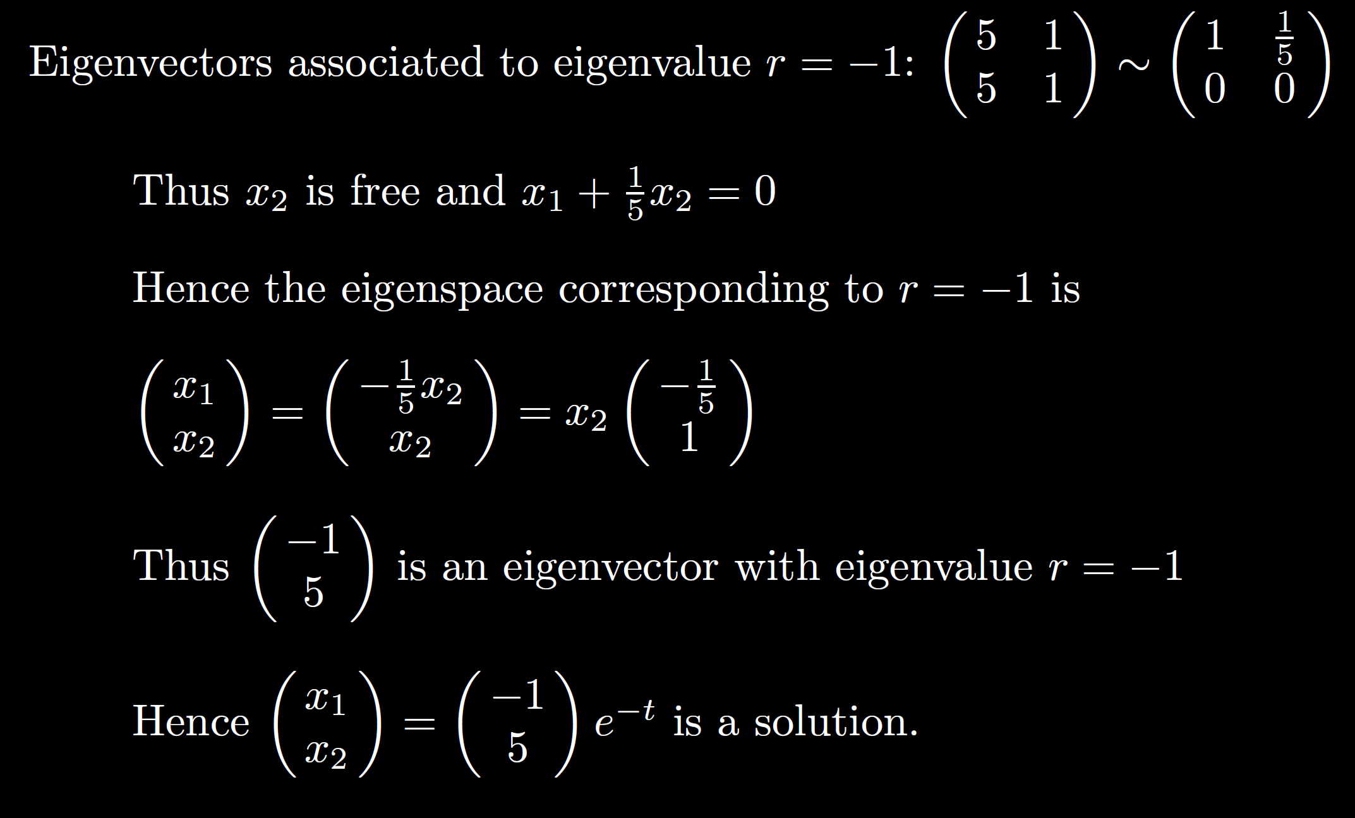

Slide 16
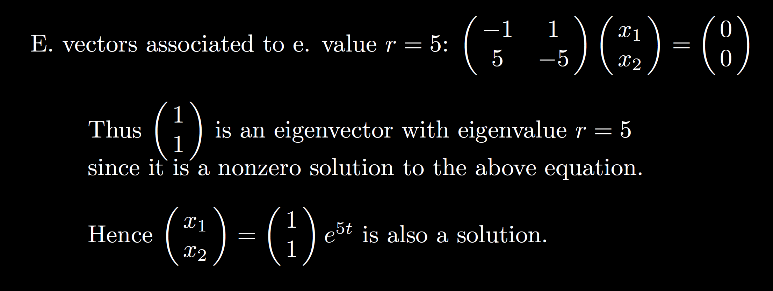

Slide 17
