Slide 1
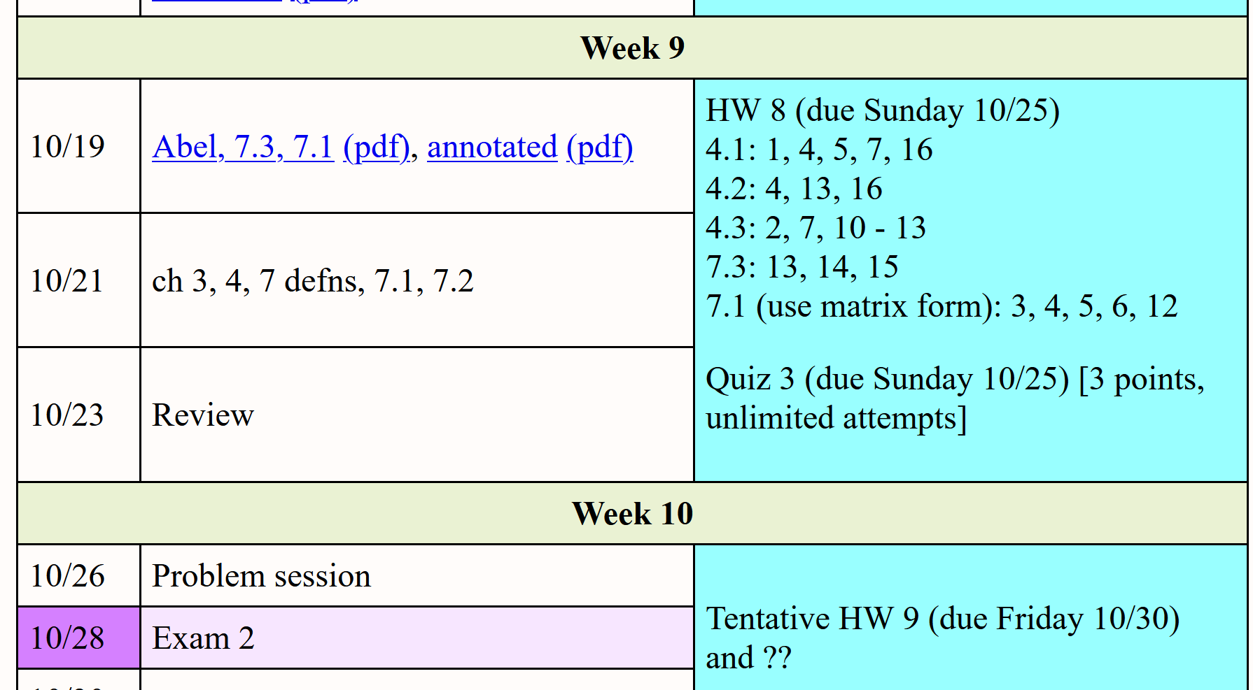

Slide 2
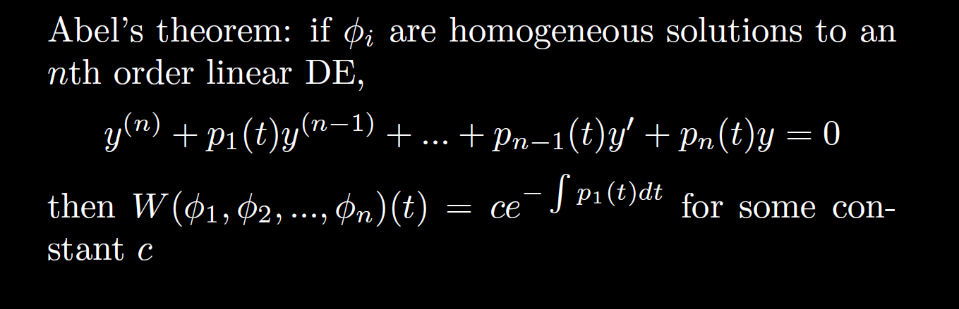

Slide 3
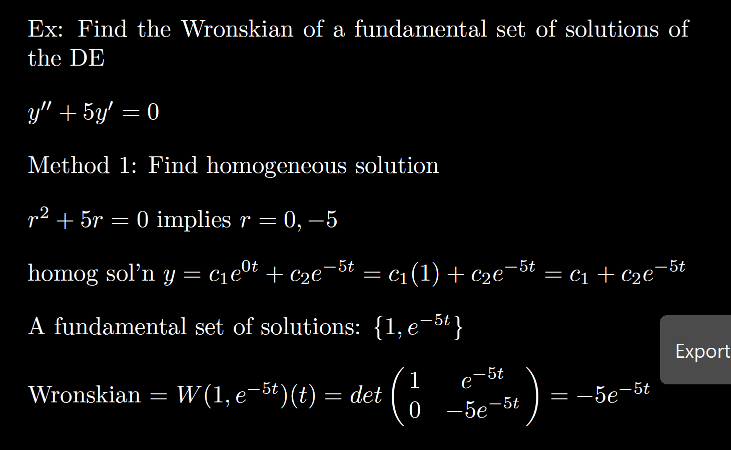

Slide 4
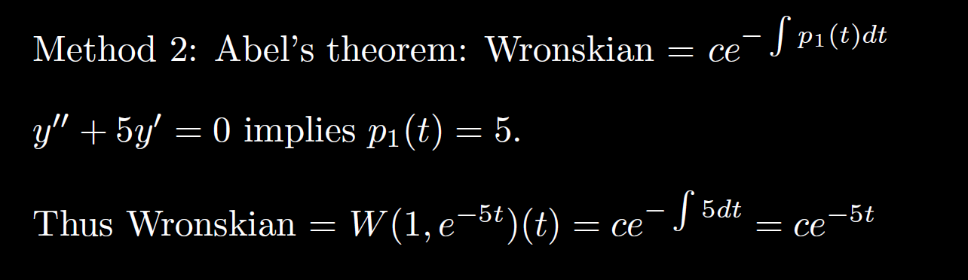

Slide 9
Chapter 7: Systems of
Linear DE

Slide 10
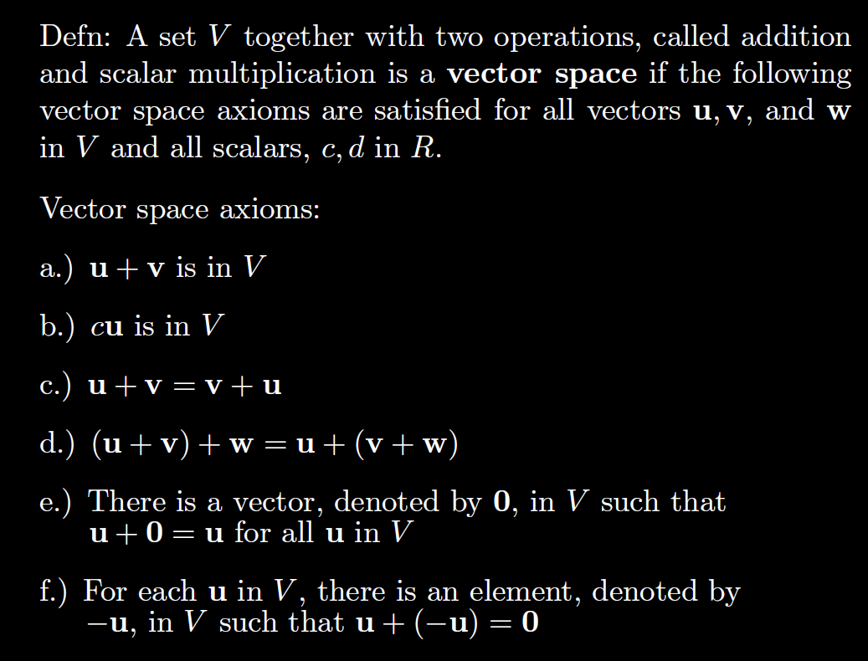
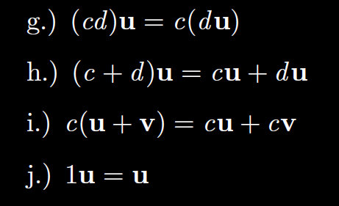

Slide 11
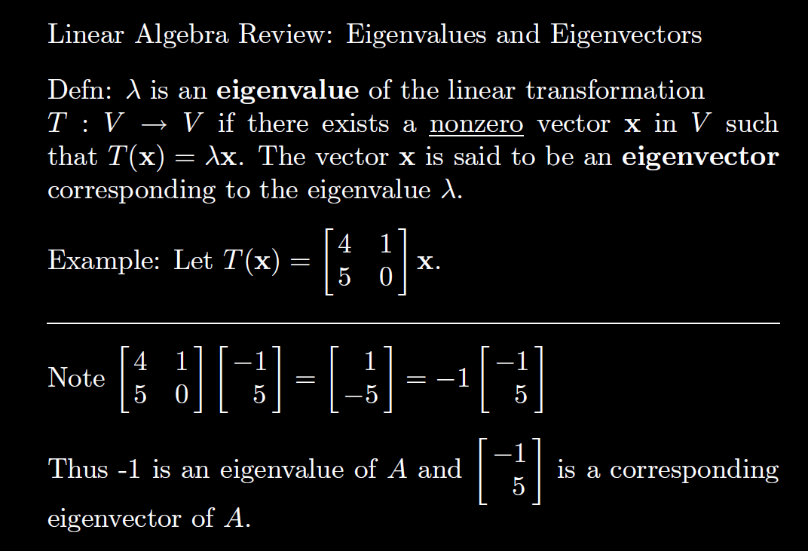

Slide 12
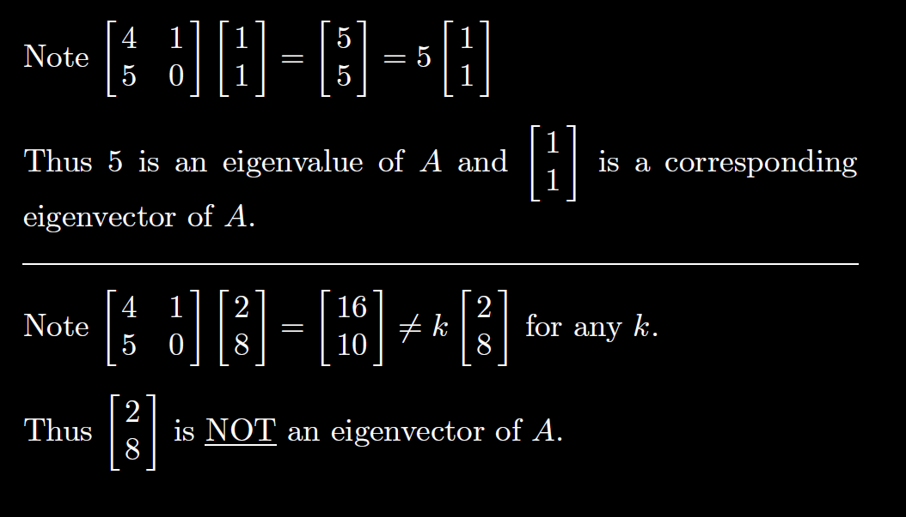

Slide 13
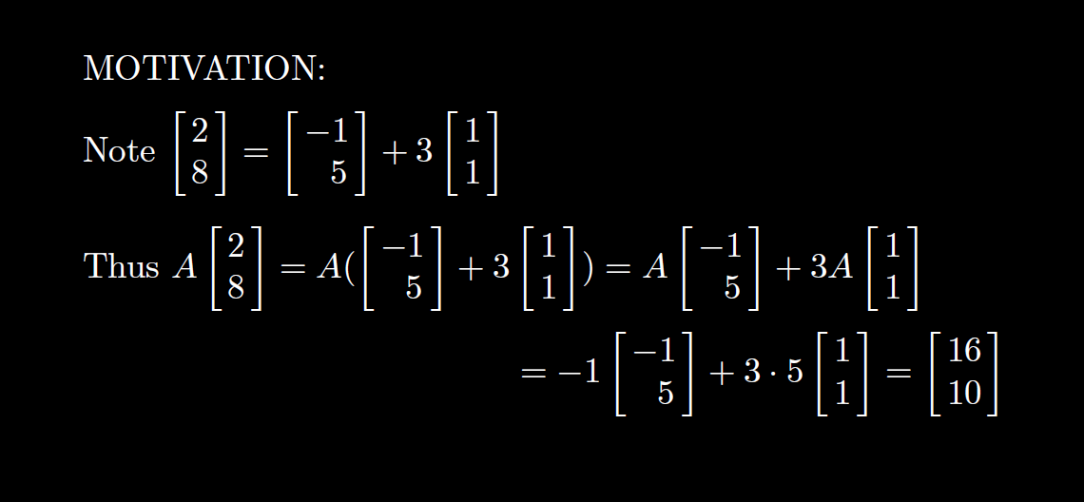

Slide 14
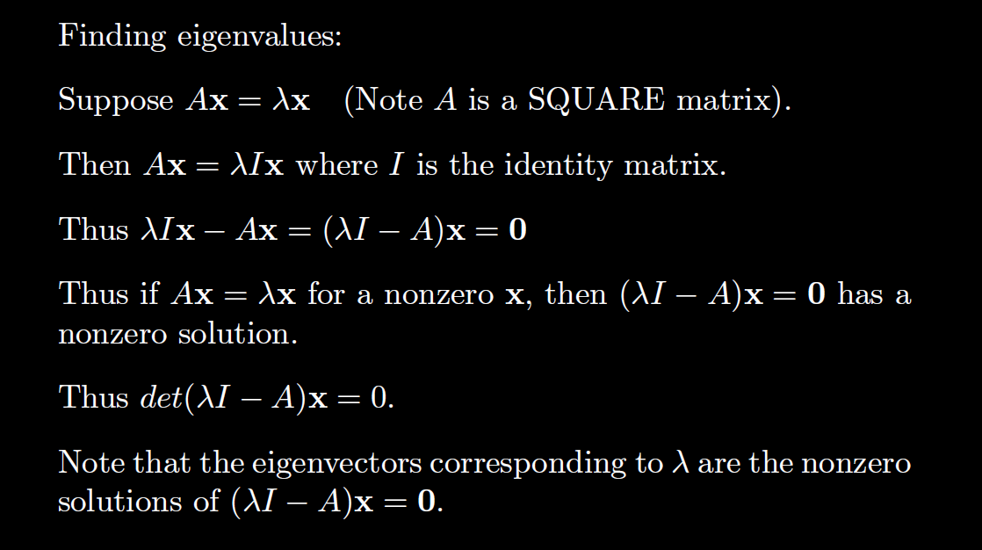

Slide 15
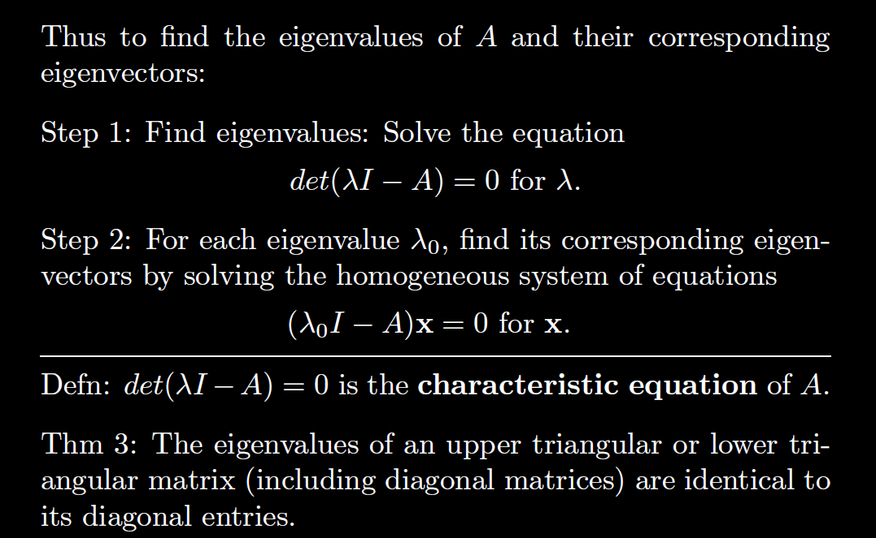

Slide 16
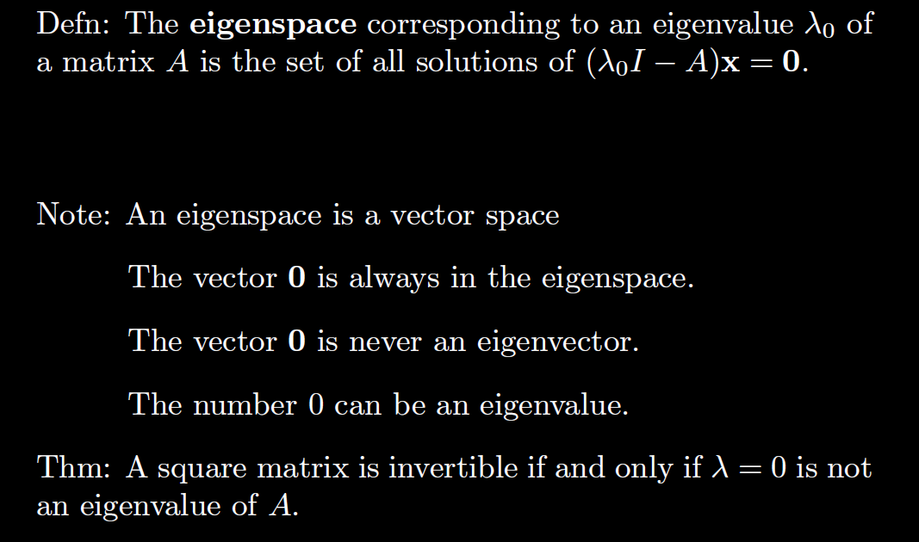

Slide 17
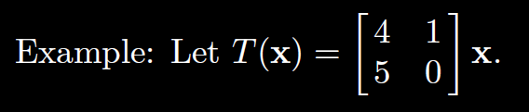

Slide 22
Chapter 7: Systems of
Linear DE

Slide 23
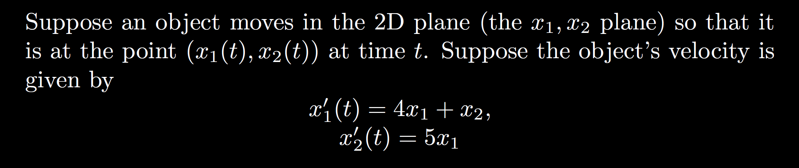
Write in matrix form:

Slide 24
Homogeneous vs non-homogeneous system of linear DE:

Slide 25

7.1: Transforming an n^{th} order linear DE into a system of n first order linear DEs.
Ex: $y′′ – 5y′ + 6y = 0$

Slide 26

7.1: Transforming an n^{th} order linear DE into a system of n first order linear DEs.
Ex: $y′′ – 5y′ + 6y = 0$, $y\left(0\right)=1, { y}^{′}\left(0\right)=2$

Slide 27

7.1: Transforming an n^{th} order linear DE into a system of n first order linear DEs.
Ex: $y′′ – 5y′ + 6y =sin⁡(t)$

Slide 28

7.1: Transforming an n^{th} order linear DE into a system of n first order linear DEs.
Ex: $y′′′′ – 5y′′ + 6y =sin⁡(t)$

