Slide 1
Thus for a 2nd order linear homogeneous differential equation,
we need to find 2 linearly independent solutions
in order to find the general solution

Slide 5
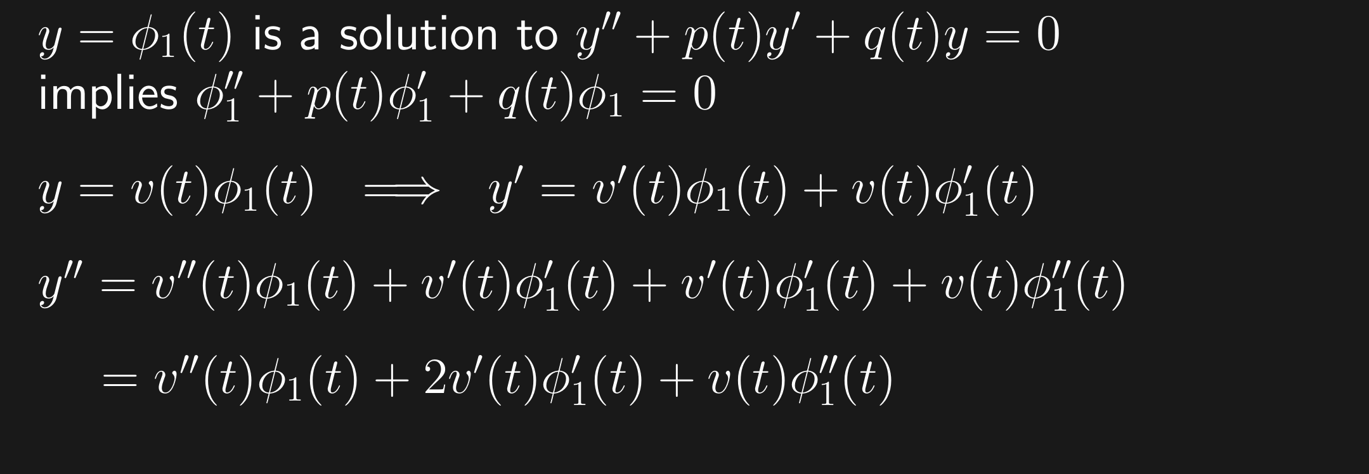

Slide 6
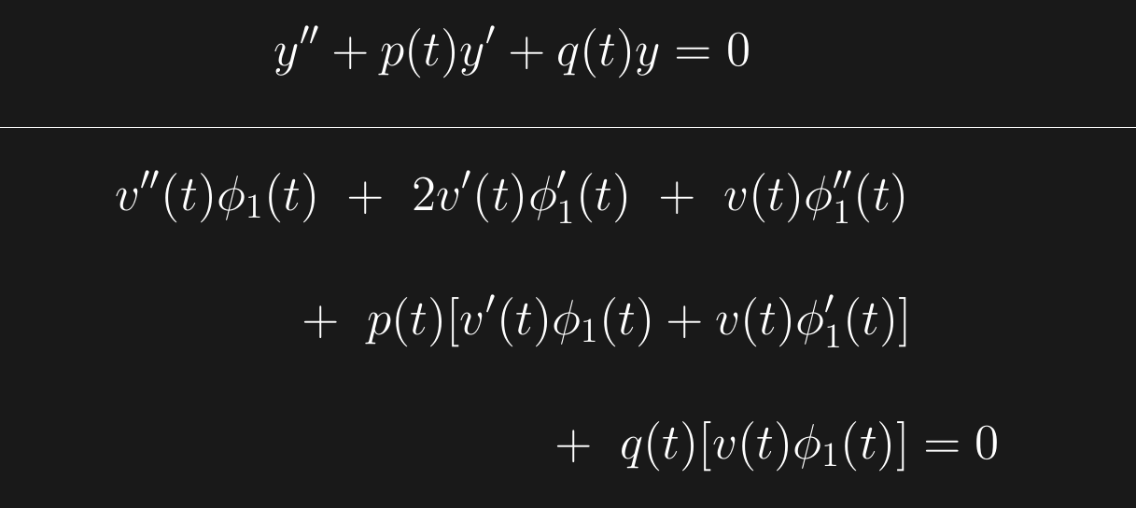

Slide 18
