Slide 1
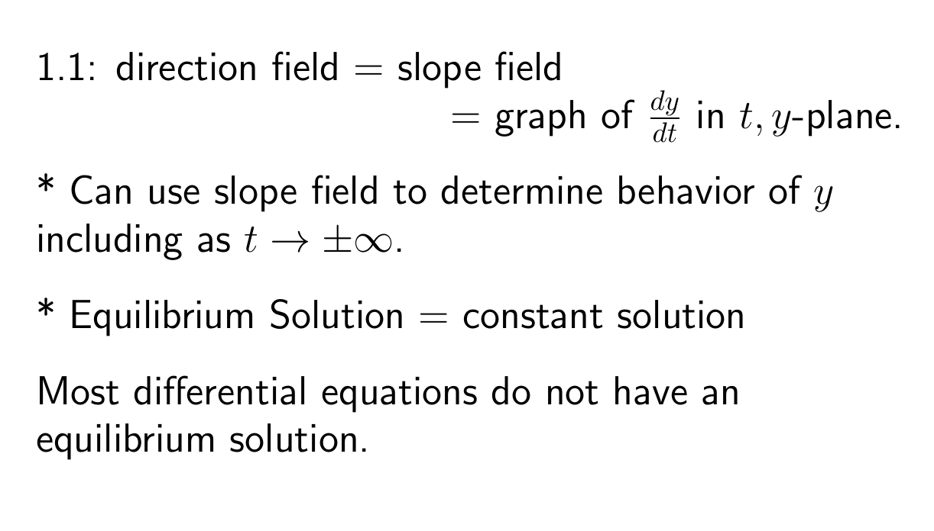

Slide 2
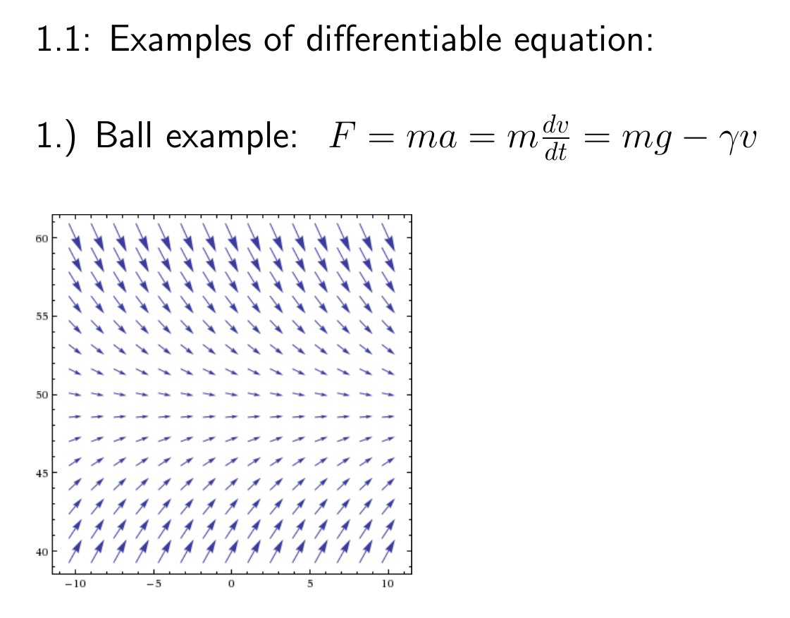

Slide 3
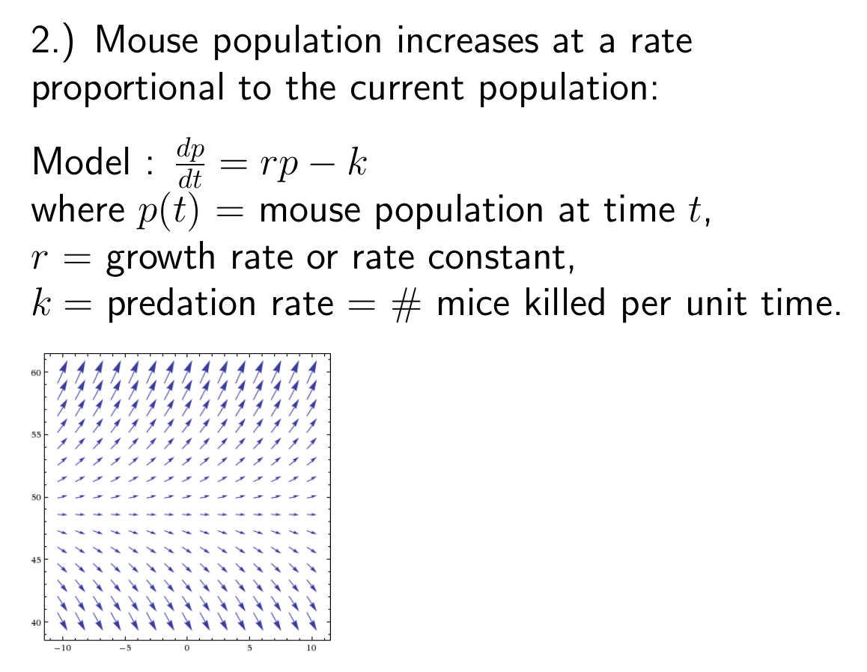

Slide 4
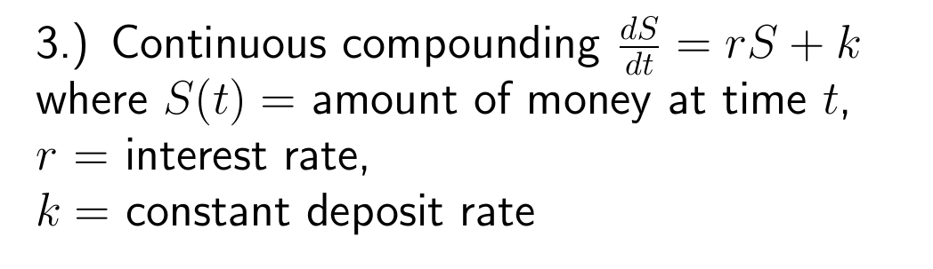

Slide 5
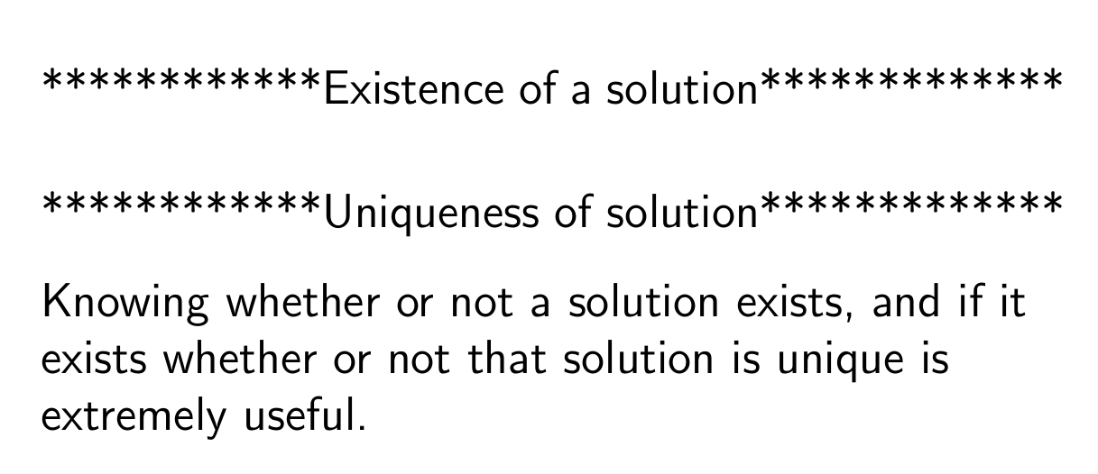

Slide 6
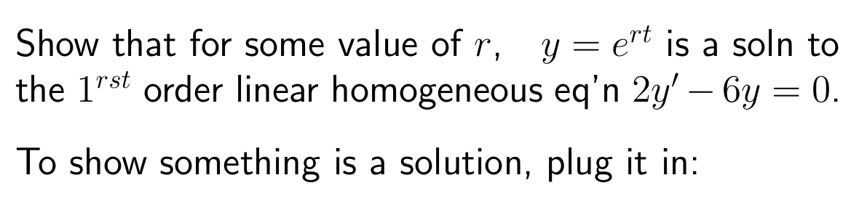

Slide 7
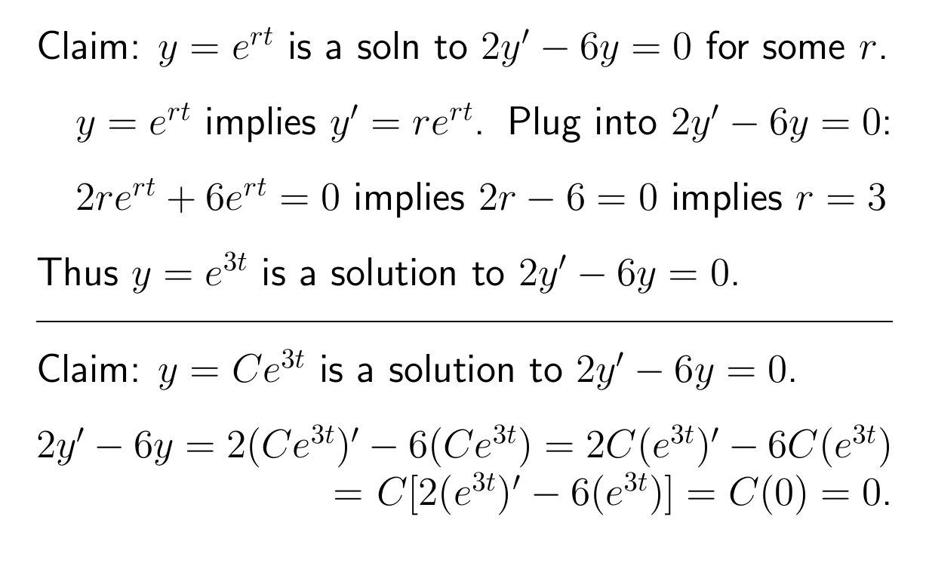

Slide 8
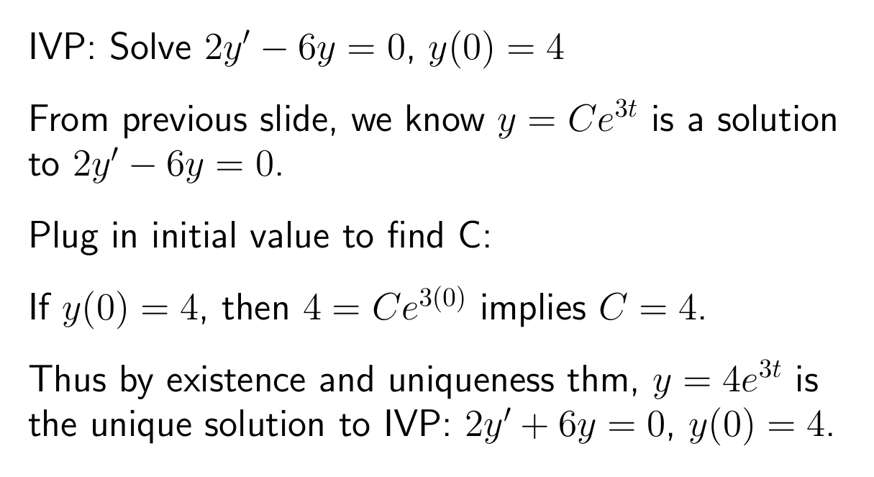

Slide 10
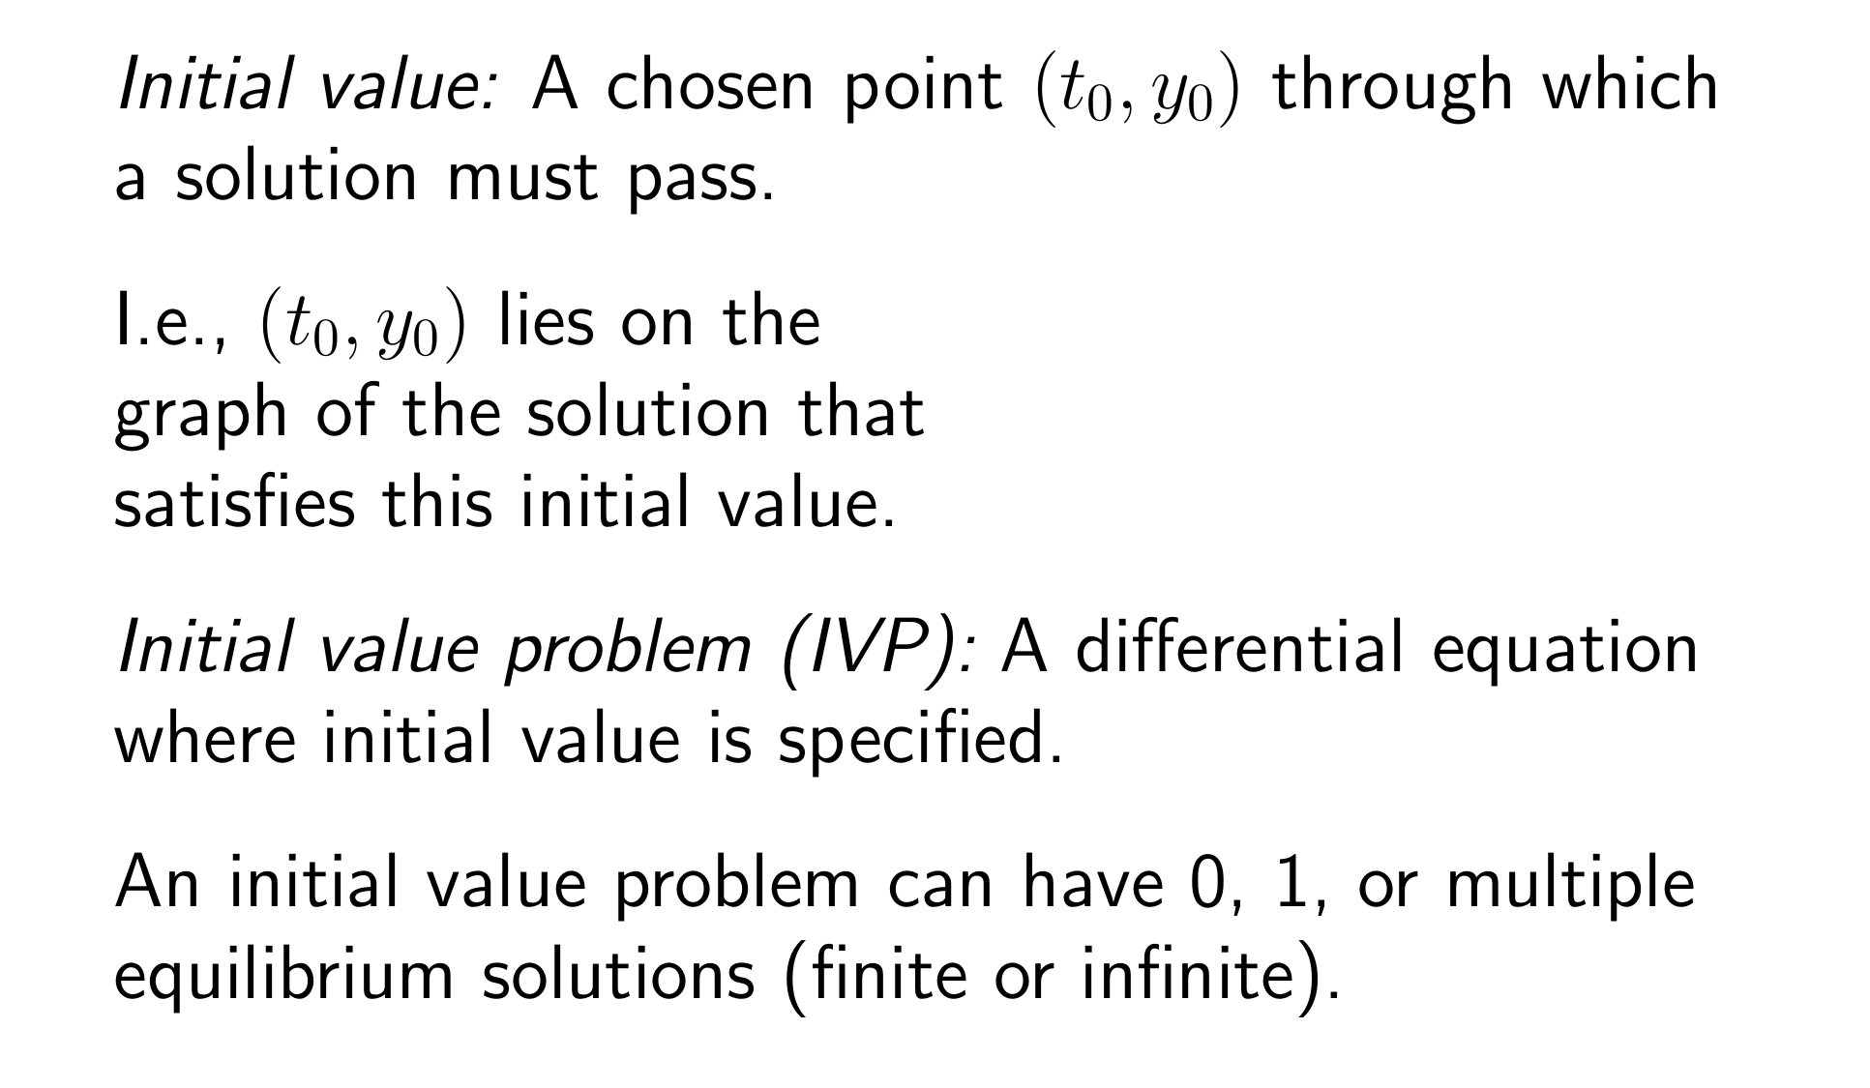
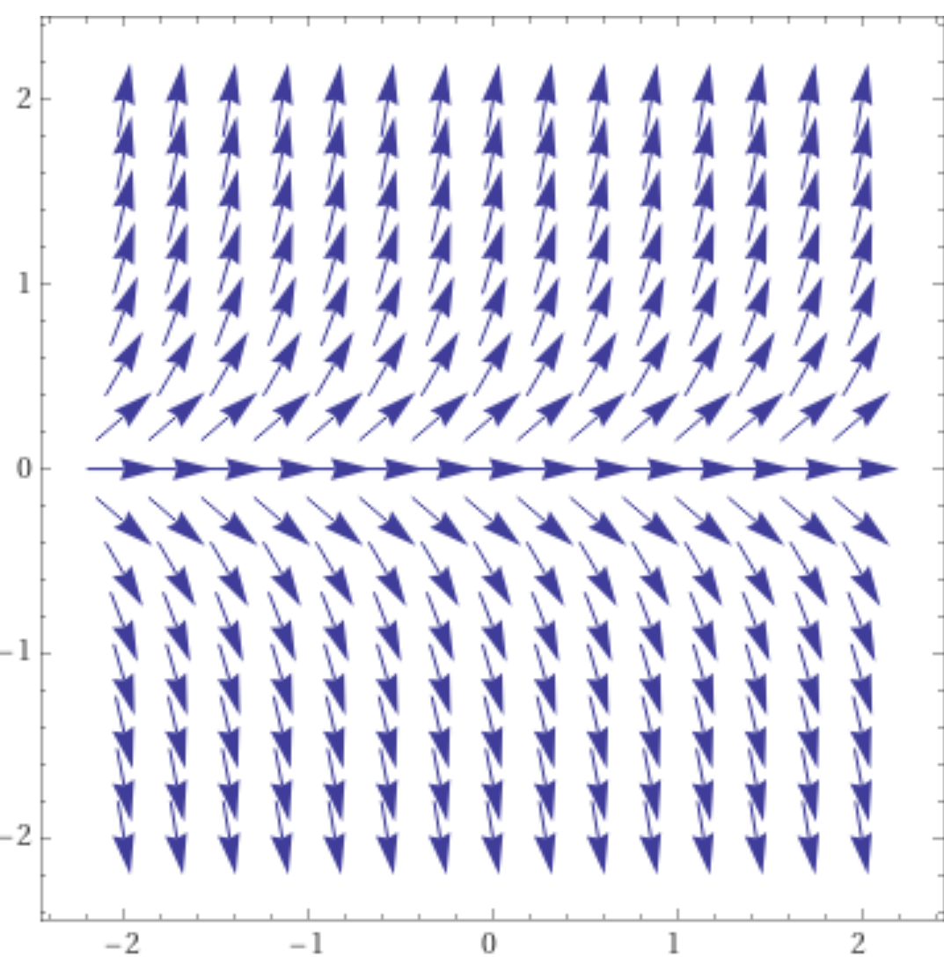
https://www.wolframalpha.com/input/?i=slope%20field

Slide 11
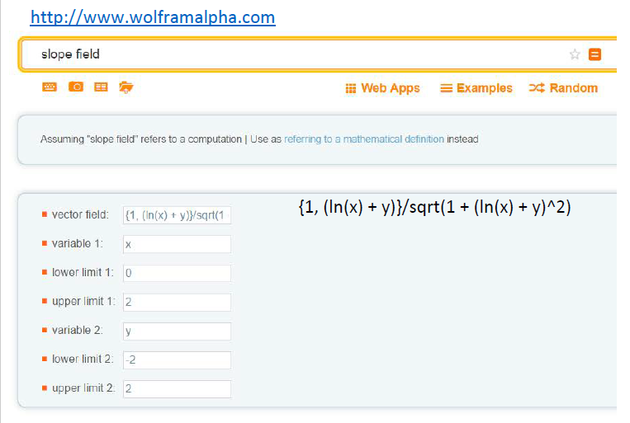

Slide 12
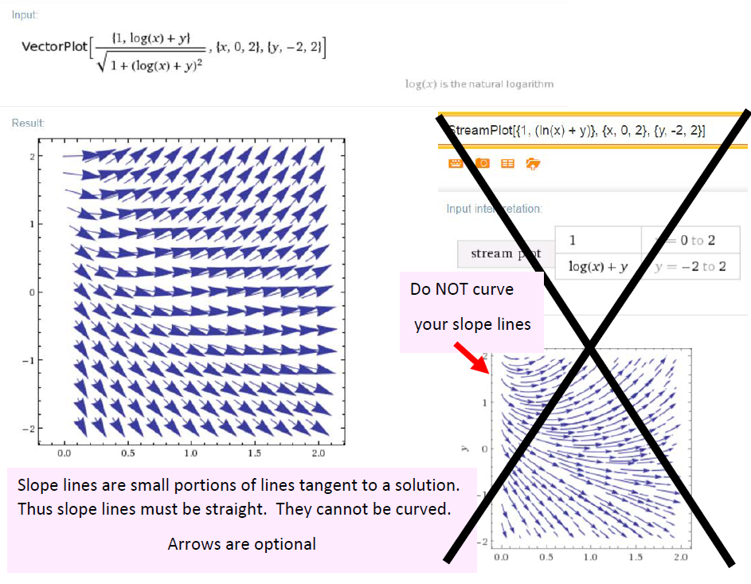

Slide 13
Ch 2.2: Separable Equations
http://bcs.wiley.com/he-bcs/Books?action=resource &bcsId=2026&itemId=047143339X&resourceId=4140
In this section we examine a subclass of linear and nonlinear first order equations. Consider the first order equation
We can rewrite this in the form
For example, let M(x,y) = - f (x,y) and N (x,y) = 1. There may be other ways as well. In differential form,
If M is a function of x only and N is a function of y only, then
In this case, the equation is called separable.

Slide 14
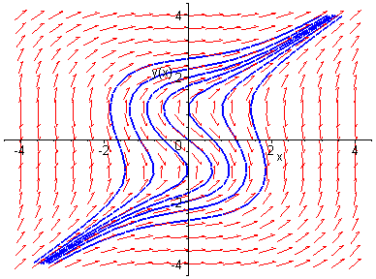
Example 1: Solving a Separable Equation
http://bcs.wiley.com/he-bcs/Books?action=resource &bcsId=2026&itemId=047143339X&resourceId=4140
Solve the following first order nonlinear equation:
Separating variables, and using calculus, we obtain
The equation above defines the solution y implicitly. A graph showing the direction field and implicit plots of several integral curves for the differential equation is given above.

Slide 15
Example 2:
Implicit and Explicit Solutions (1 of 4)
http://bcs.wiley.com/he-bcs/Books?action=resource&bcsId=2026&itemId=047143339X&resourceId=4140
Solve the following first order nonlinear equation:
Separating variables and using calculus, we obtain
The equation above defines the solution y implicitly. An explicit expression for the solution can be found in this case:

Slide 16
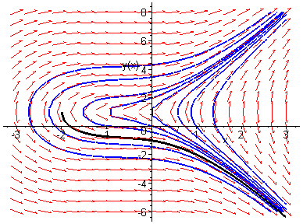
Example 2: Initial Value Problem (2 of 4)
http://bcs.wiley.com/he-bcs/Books?action=resource &bcsId=2026&itemId=047143339X&resourceId=4140
Suppose we seek a solution satisfying y(0) = -1. Using the implicit expression of y, we obtain
Thus the implicit equation defining y is
Using explicit expression of y,
It follows that

Slide 17
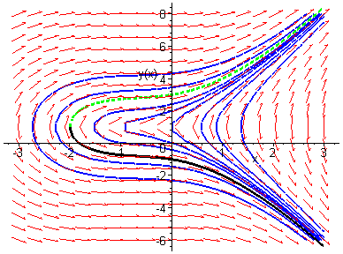
Example 2: Initial Condition y(0) = 3 (3 of 4)
http://bcs.wiley.com/he-bcs/Books?action=resource &bcsId=2026&itemId=047143339X&resourceId=4140
Note that if initial condition is y(0) = 3, then we choose the positive sign, instead of negative sign, on square root term:

Slide 18
Example 2: Domain (4 of 4)
http://bcs.wiley.com/he-bcs/Books?action=resource &bcsId=2026&itemId=047143339X&resourceId=4140
Thus the solutions to the initial value problem
are given by
From explicit representation of y, it follows that
and hence domain of y is (-2, ∞). Note x = -2 yields y = 1, which makes denominator of dy/dx zero (vertical tangent).
Conversely, domain of y can be estimated by locating vertical tangents on graph (useful for implicitly defined solutions).

Slide 19
Example 3: Implicit Solution of Initial Value Problem (1 of 2)
http://bcs.wiley.com/he-bcs/Books?action=resource&bcsId=2026&itemId=047143339X&resourceId=4140
Consider the following initial value problem:
Separating variables and using calculus, we obtain
Using the initial condition, it follows that

Slide 20
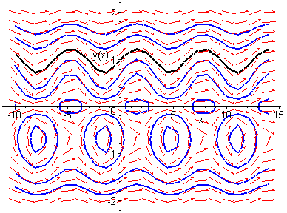
Example 3: Graph of Solutions (2 of 2)
http://bcs.wiley.com/he-bcs/Books?action=resource &bcsId=2026&itemId=047143339X&resourceId=4140
Thus
The graph of this solution (black), along with the graphs of the direction field and several integral curves (blue) for this differential equation, is given below.

Slide 21
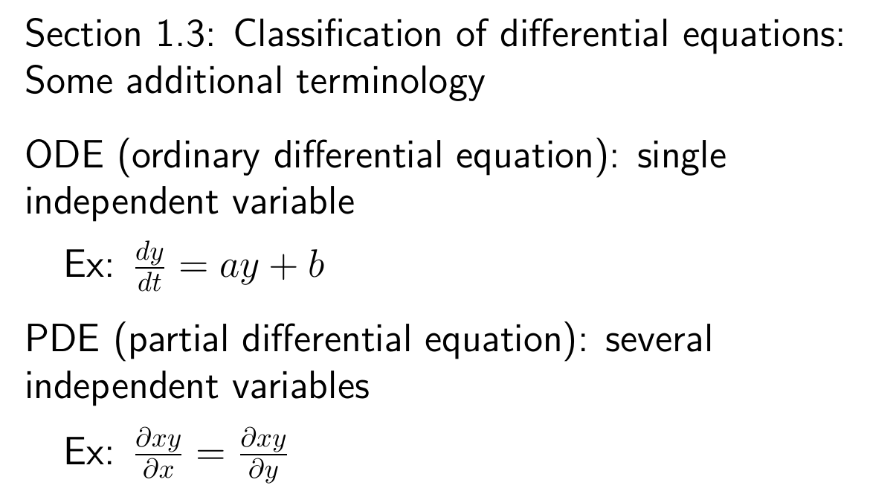

Slide 22
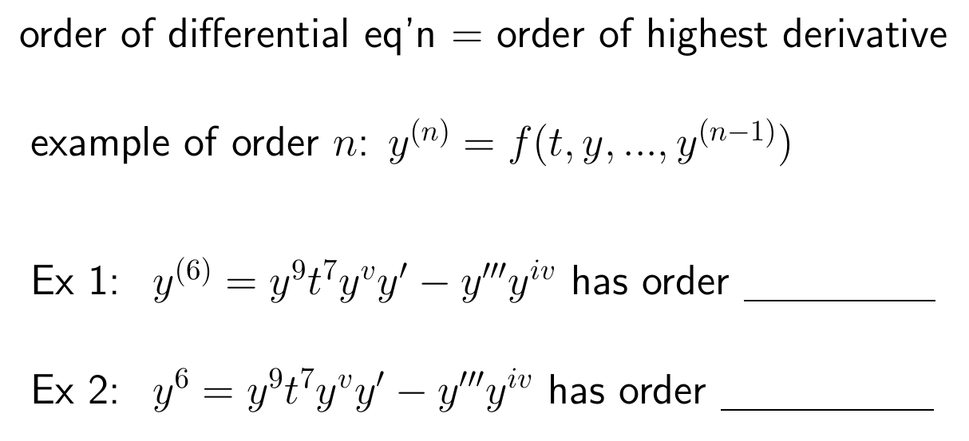

Slide 23
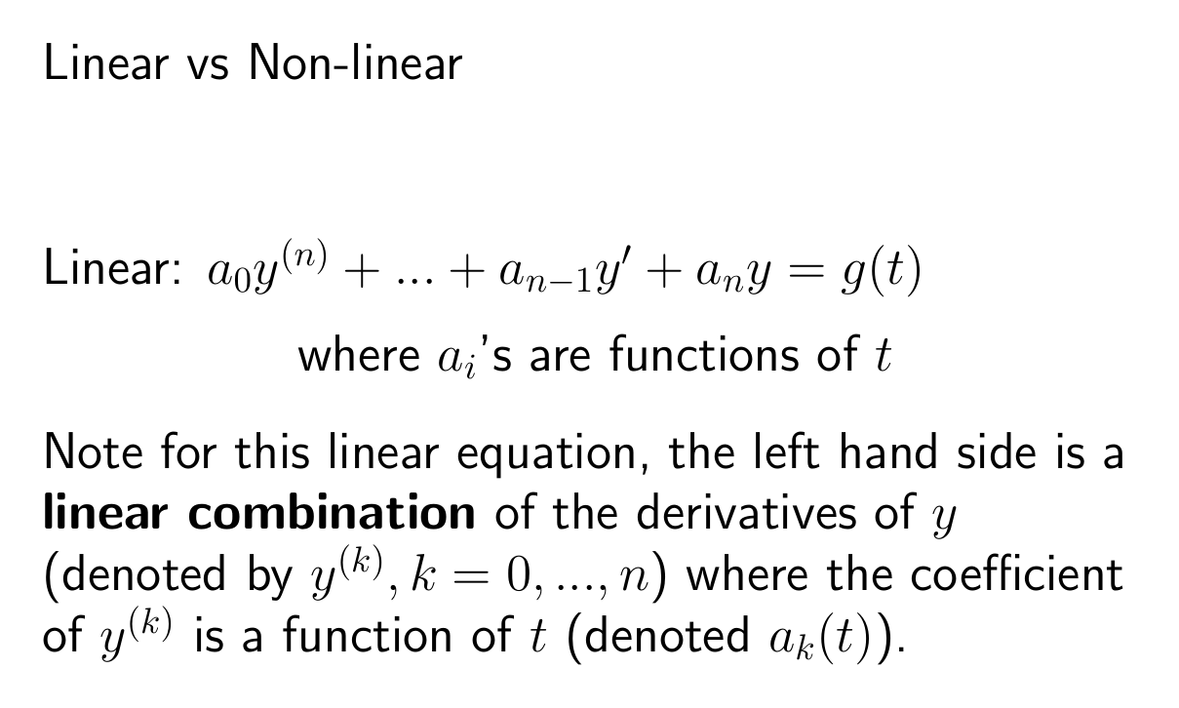

Slide 24
