Slide 1
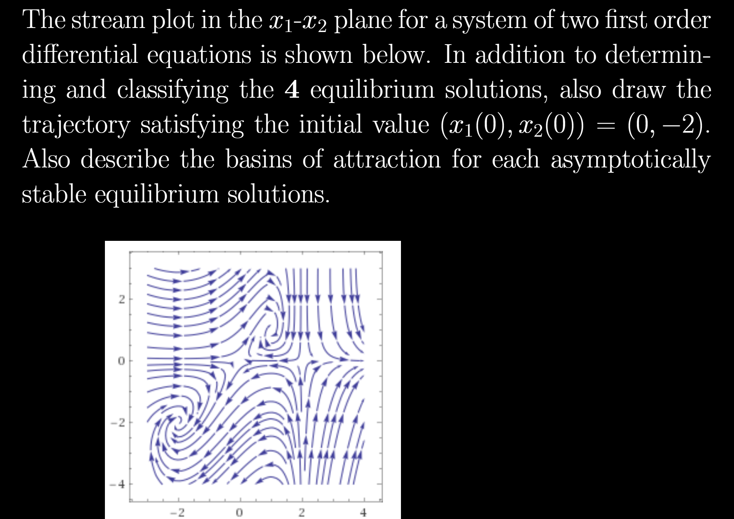
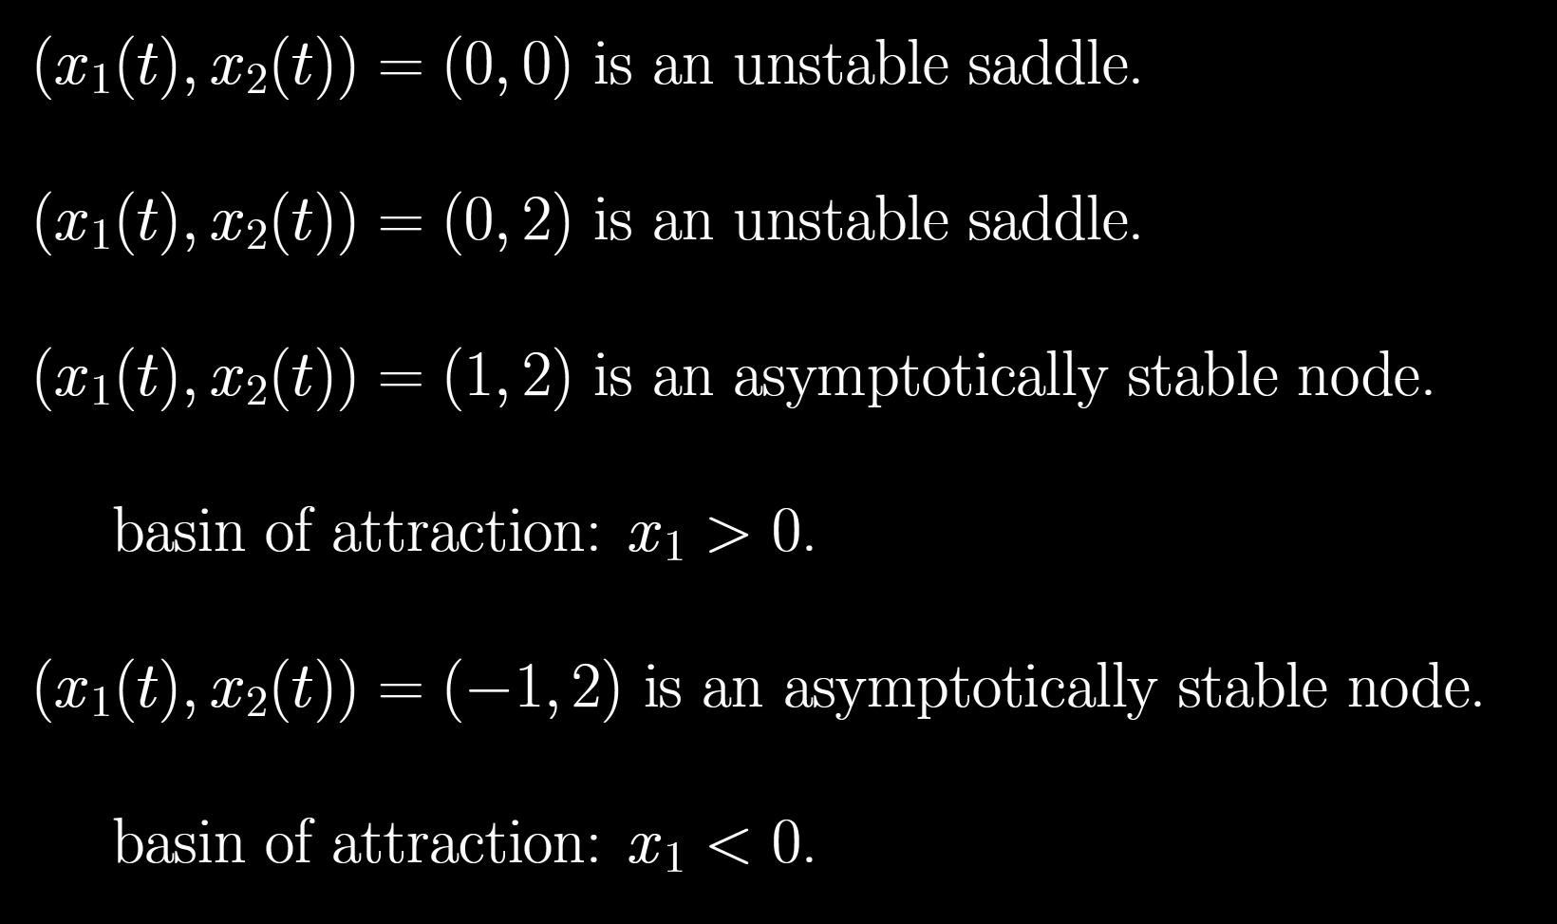





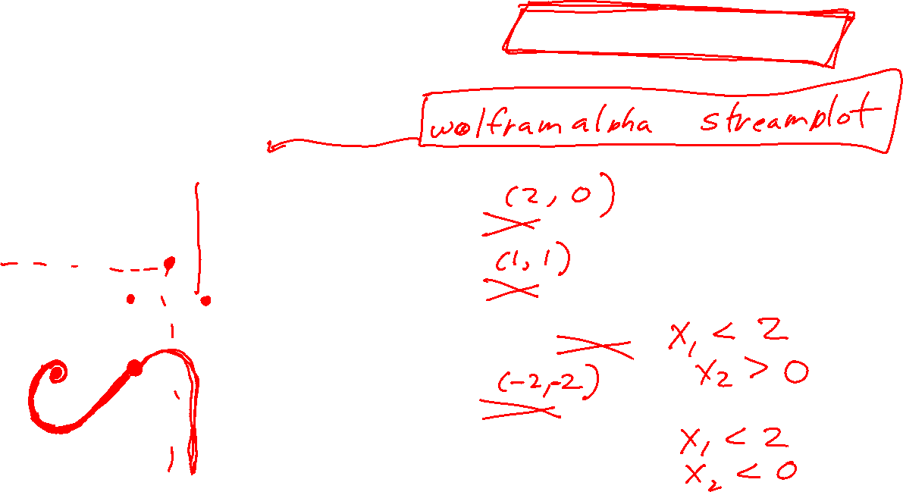


Slide 2

Problem session Thursday at 7pm (will send zoom link Thursday evening).
Exam 3 Friday over ch 7, 9, and 5.2.
Currently written part is about 50% with remaining part
True/False
Multiple Choice (choose the 1 best answer)
Multiple answer (choose the n best answers)
    +5 points for every correct answer,
    -5 points for every wrong answer.

Slide 3
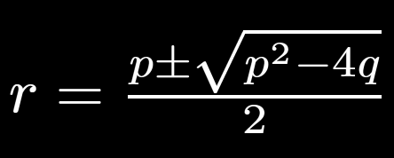
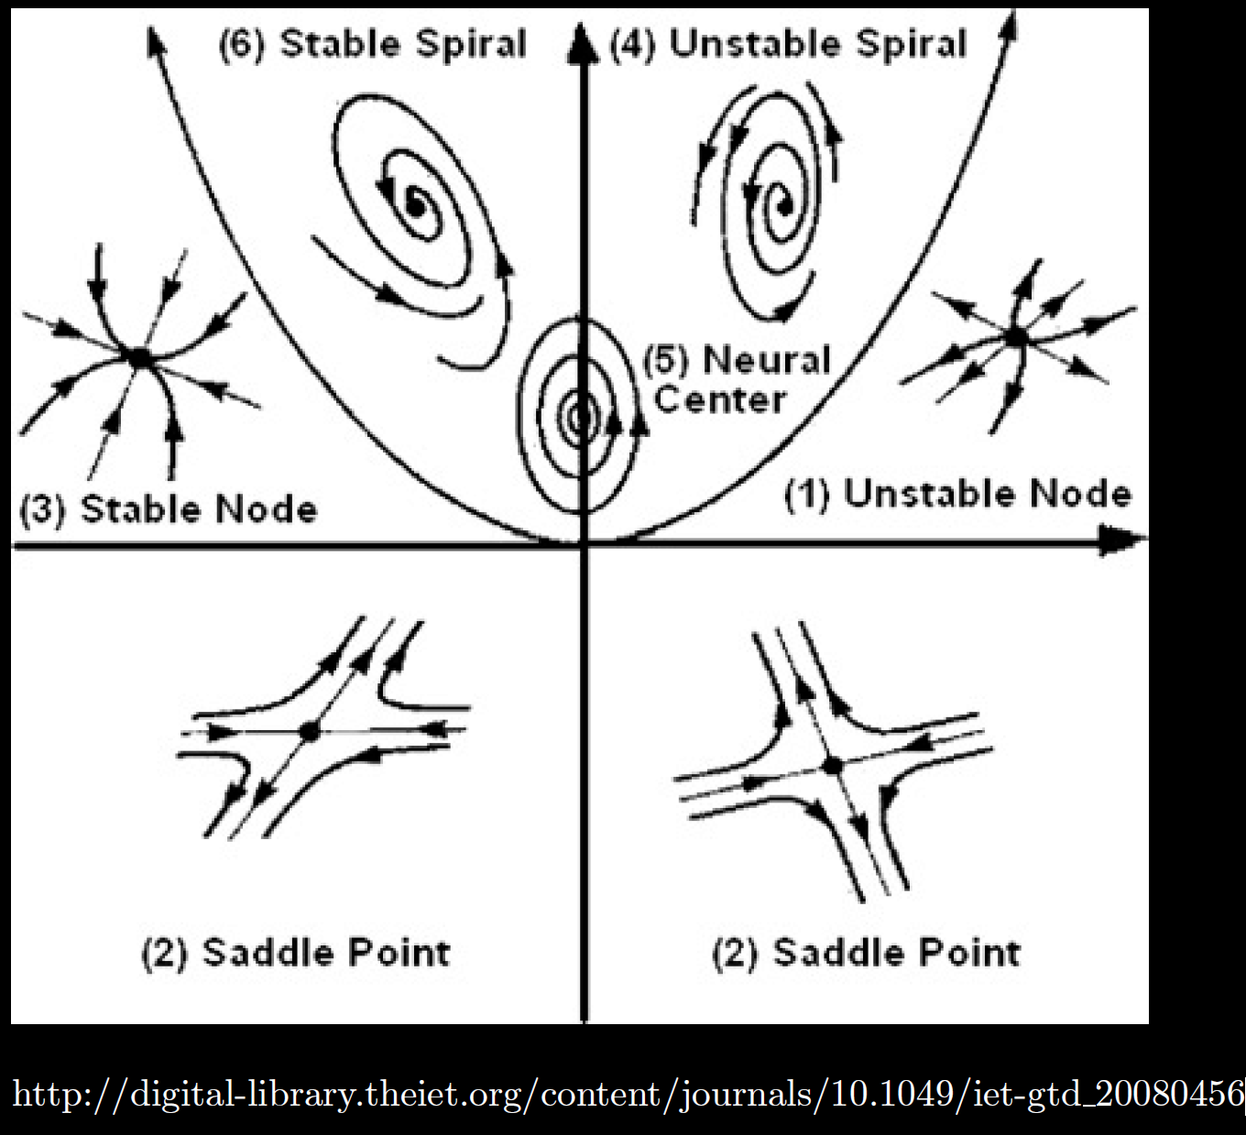

Slide 4
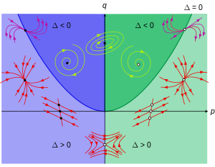
https://en.wikipedia.org/wiki/Phase_plane

Slide 5
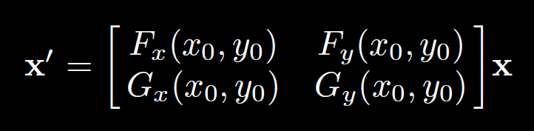
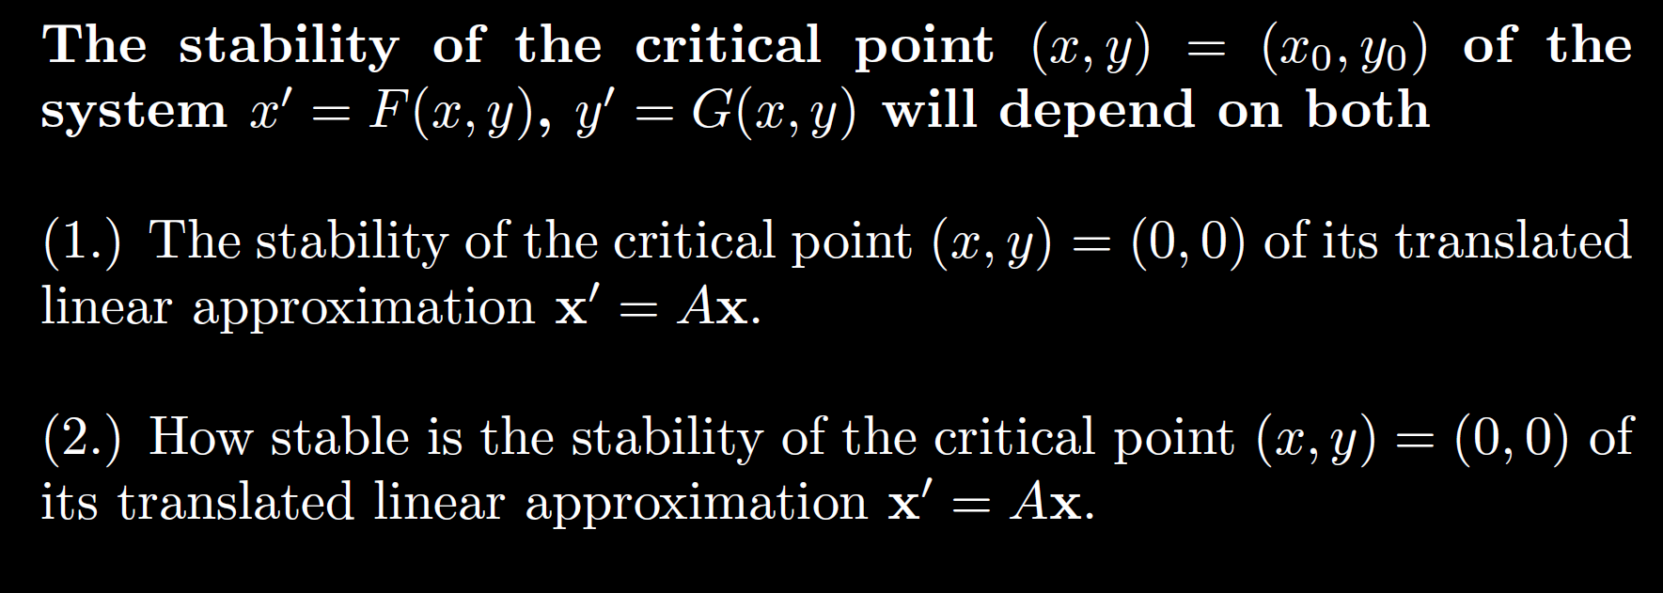
After translating critical point to origin:

Slide 6


Algebraic questions
Can be similar to graphical, but given equations instead. May need to show work.
Ex: $x’ = 10x − 5xy, y’ = 3y + xy − 3y^{2}$
(Or linear).
http://howellkb.uah.edu/DEtext/Additional_Chapters/Part6/NonLinSys1.pdf

Slide 7
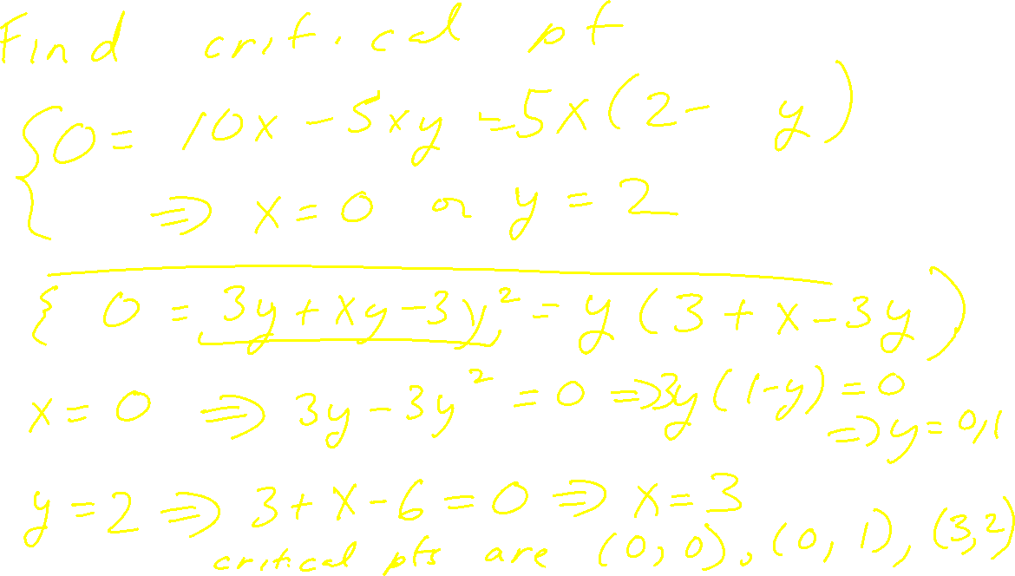
Ex: $x’ = 10x − 5xy, y’ = 3y + xy − 3y^{2}$

Slide 8
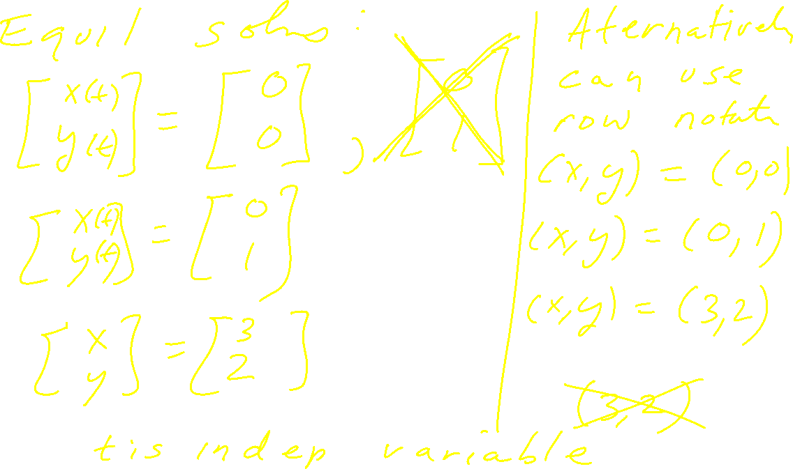
Ex: $x’ = 10x − 5xy, y’ = 3y + xy − 3y^{2}$

Slide 9
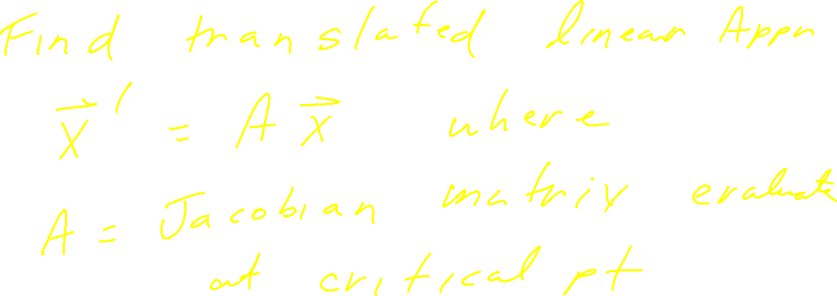
Ex: $x’ = 10x − 5xy, y’ = 3y + xy − 3y^{2}$

Slide 10
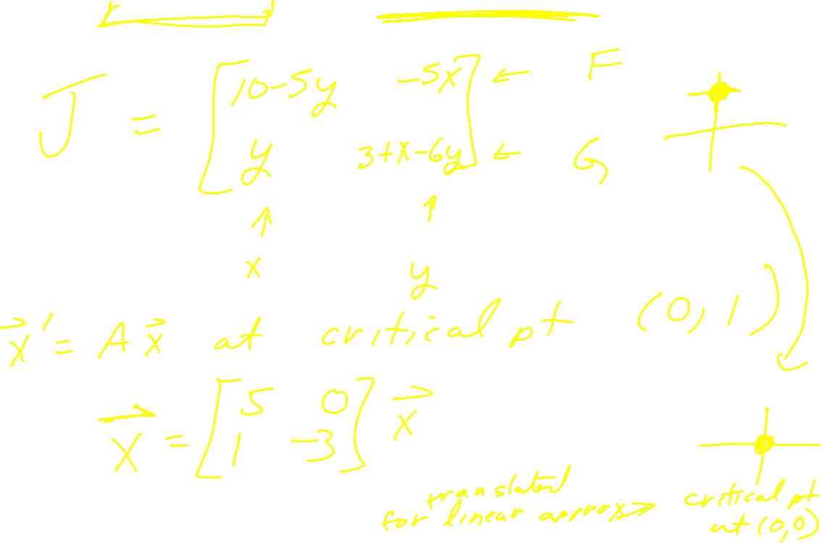
Ex: $x’ = 10x − 5xy, y’ = 3y + xy − 3y^{2}$

Slide 11

Ex: $x’ = 10x − 5xy, y’ = 3y + xy − 3y^{2}$

Slide 12
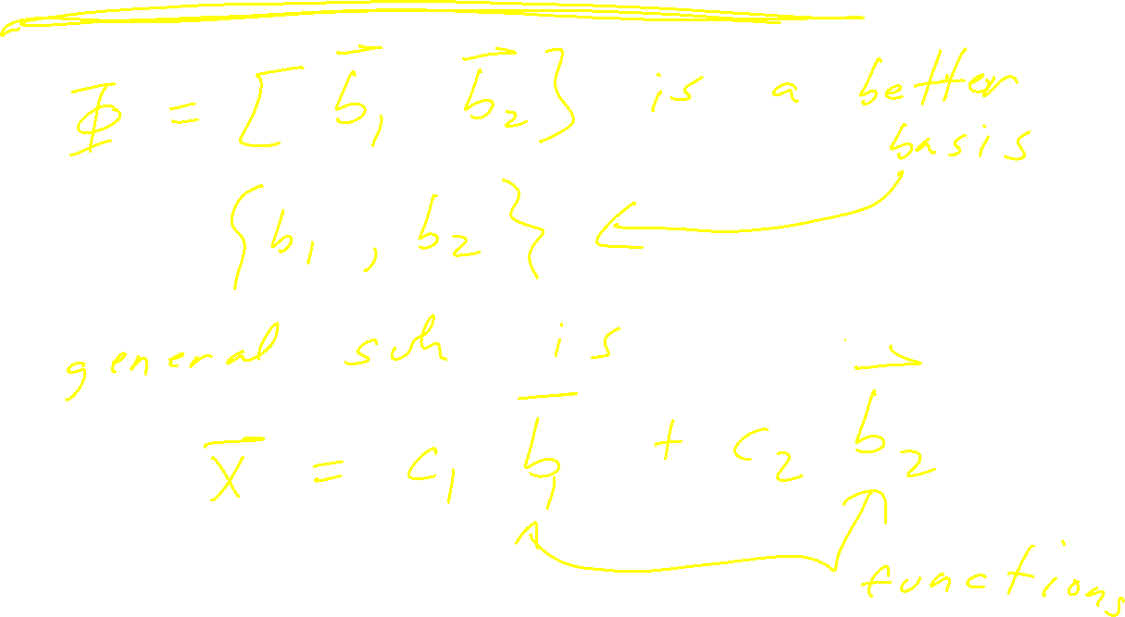
Ex: $x’ = 10x − 5xy, y’ = 3y + xy − 3y^{2}$

Slide 13
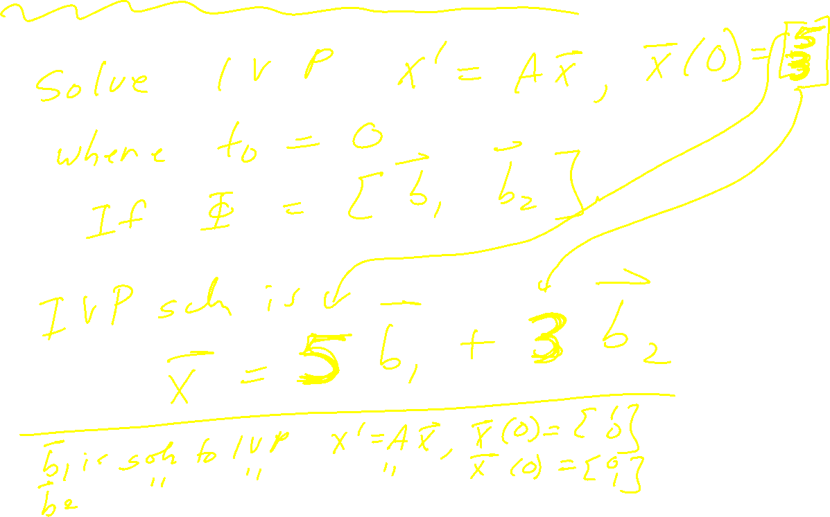
Ex: $x’ = 10x − 5xy, y’ = 3y + xy − 3y^{2}$

Slide 14
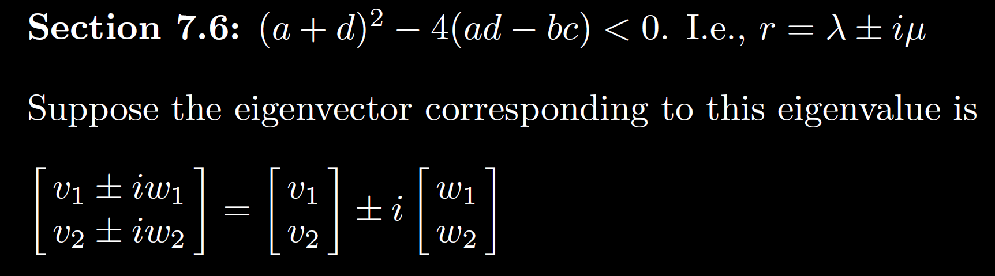
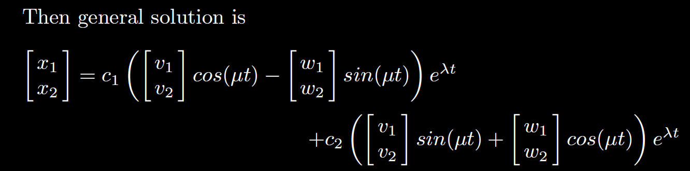
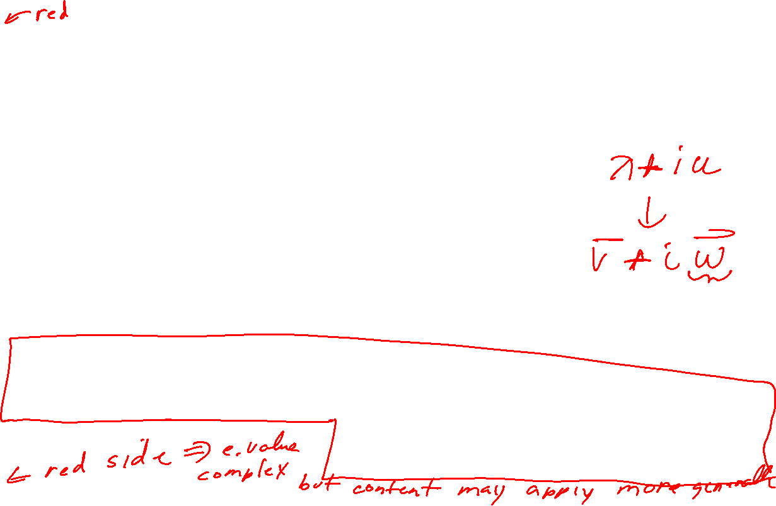

Slide 15
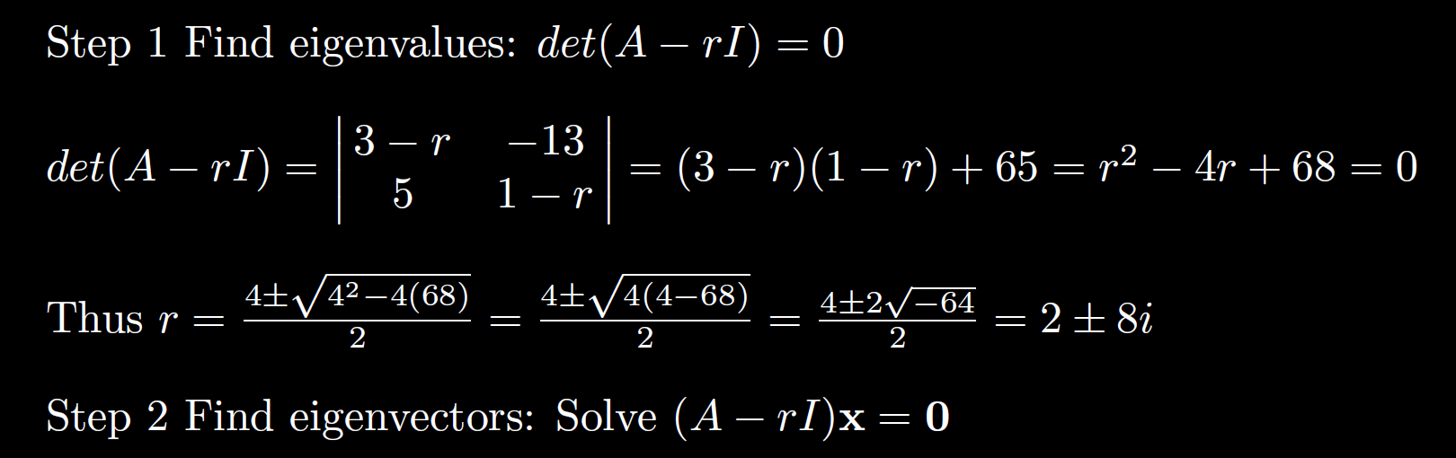
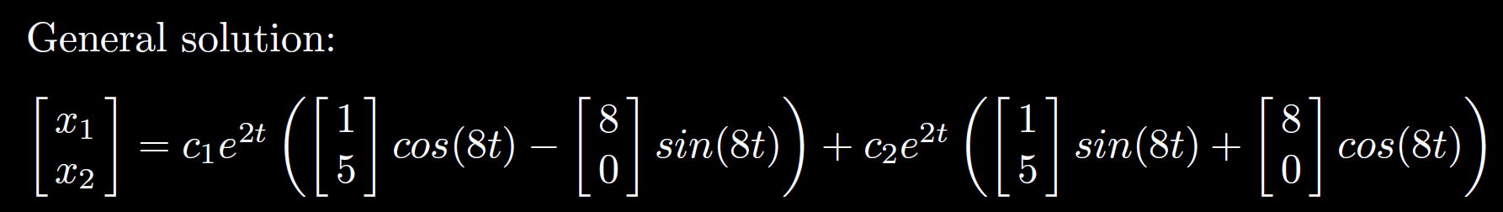
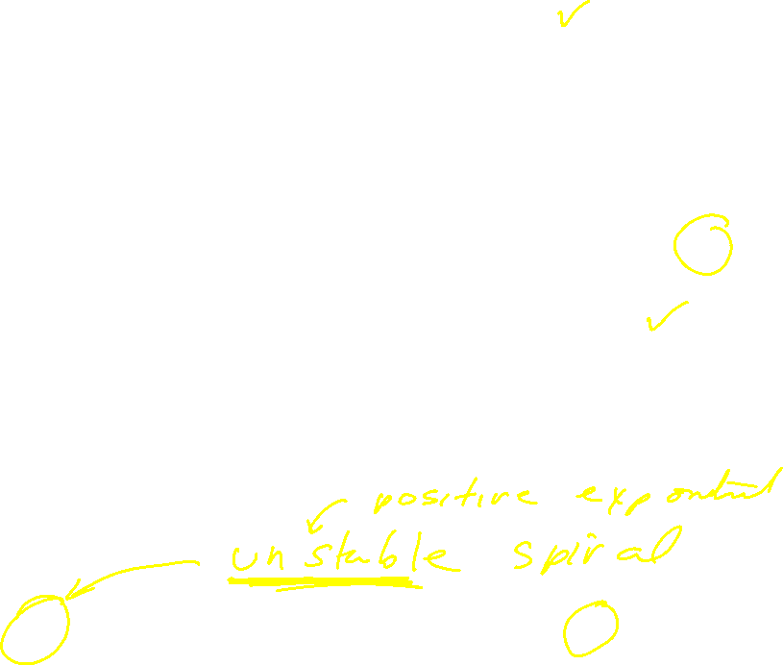

Slide 16
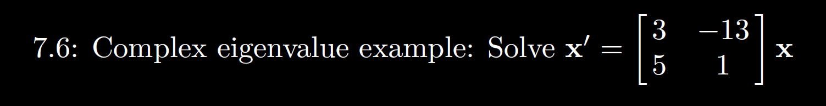
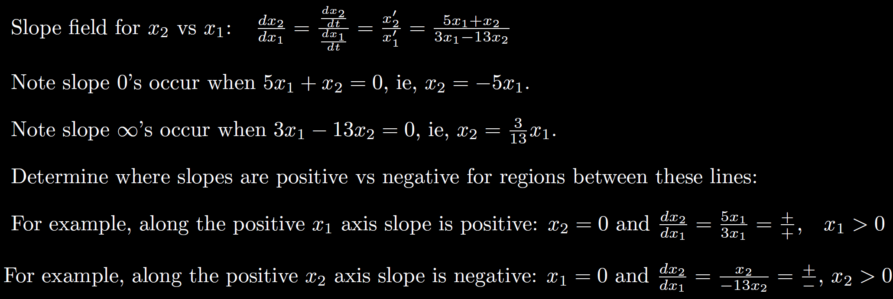

Graph
Slope field:

Slide 17
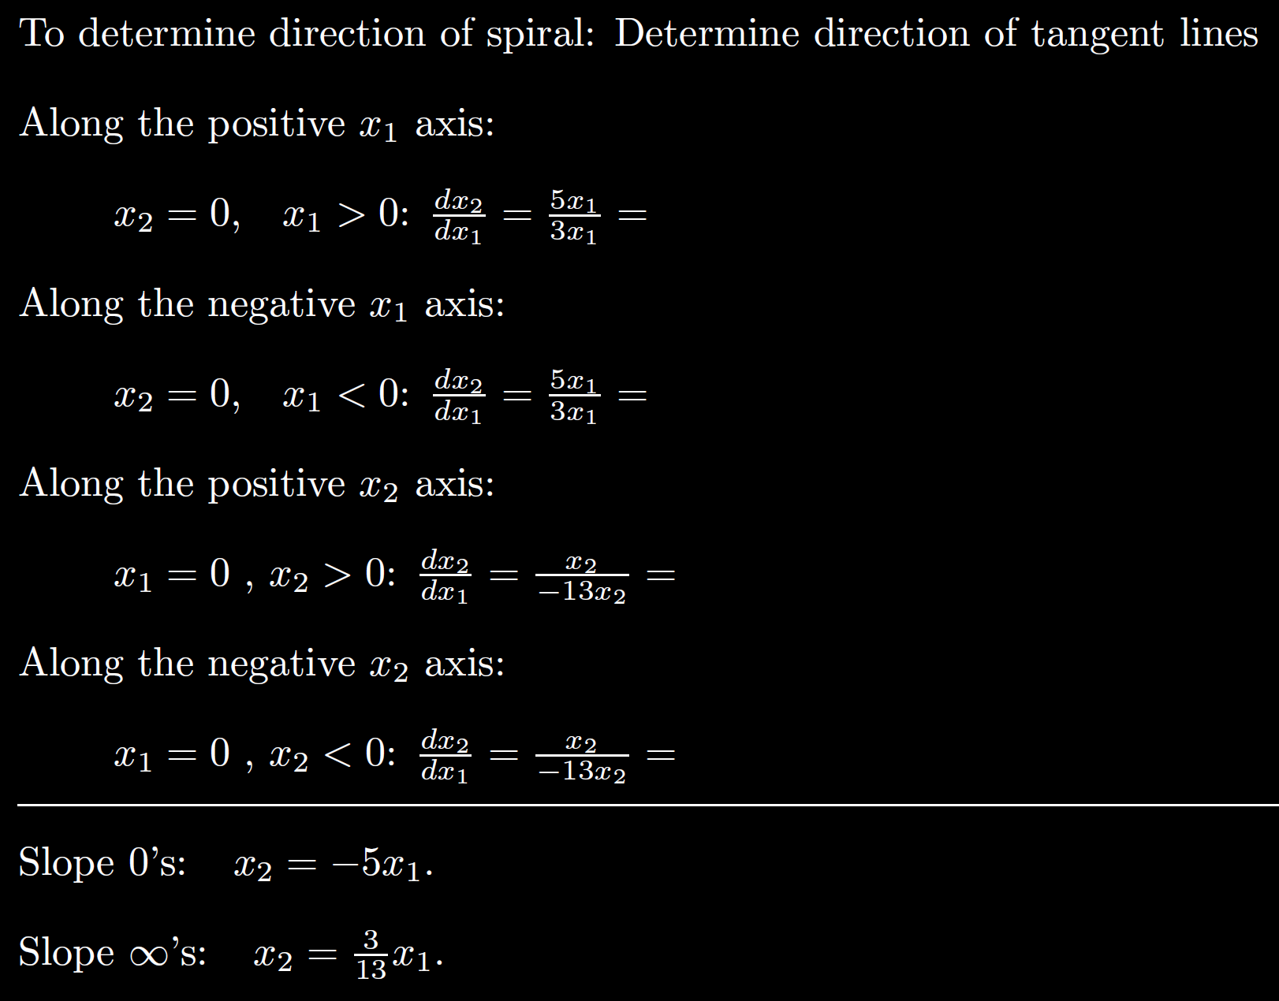
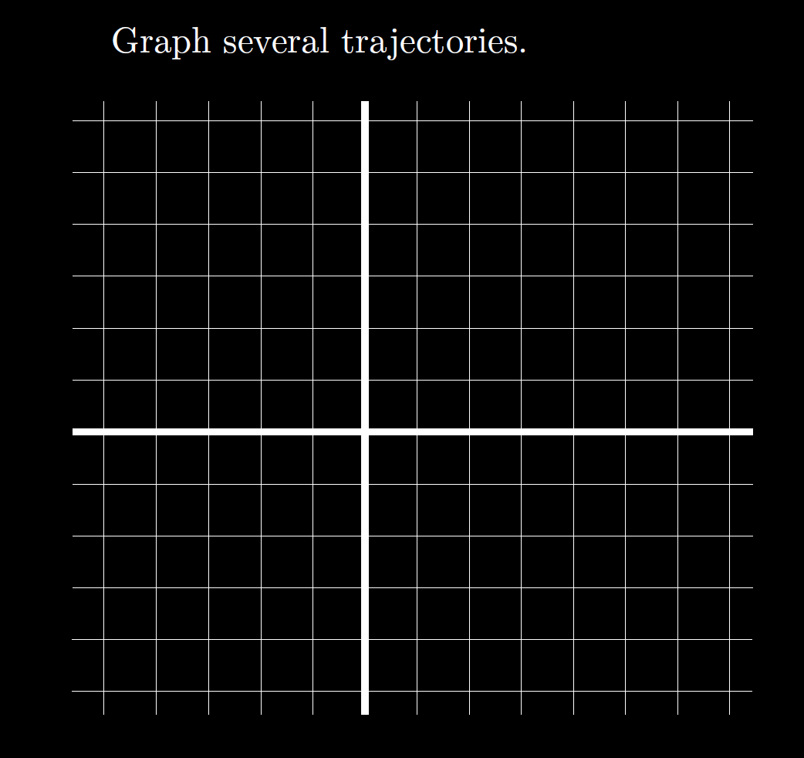
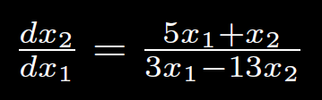
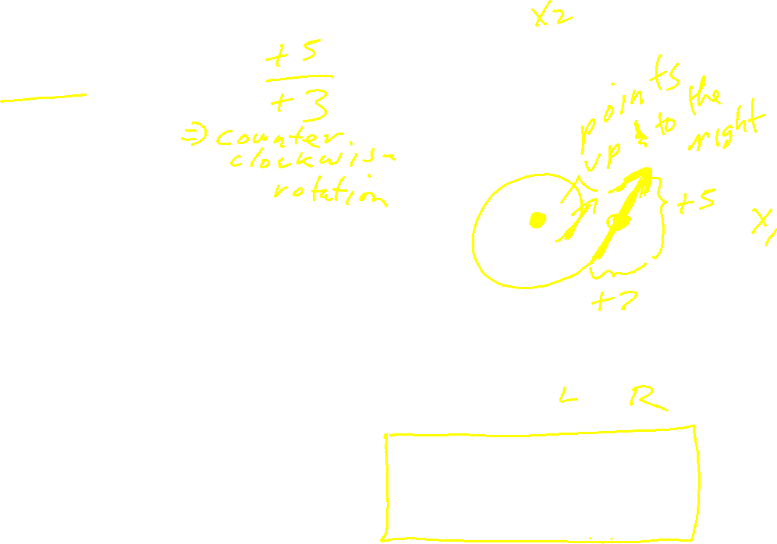

Slide 18
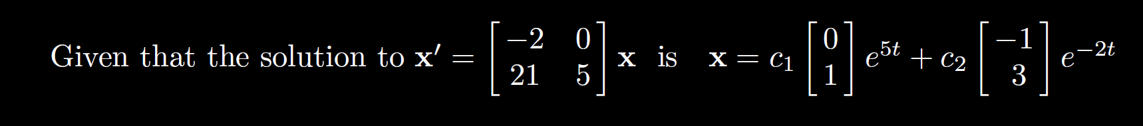
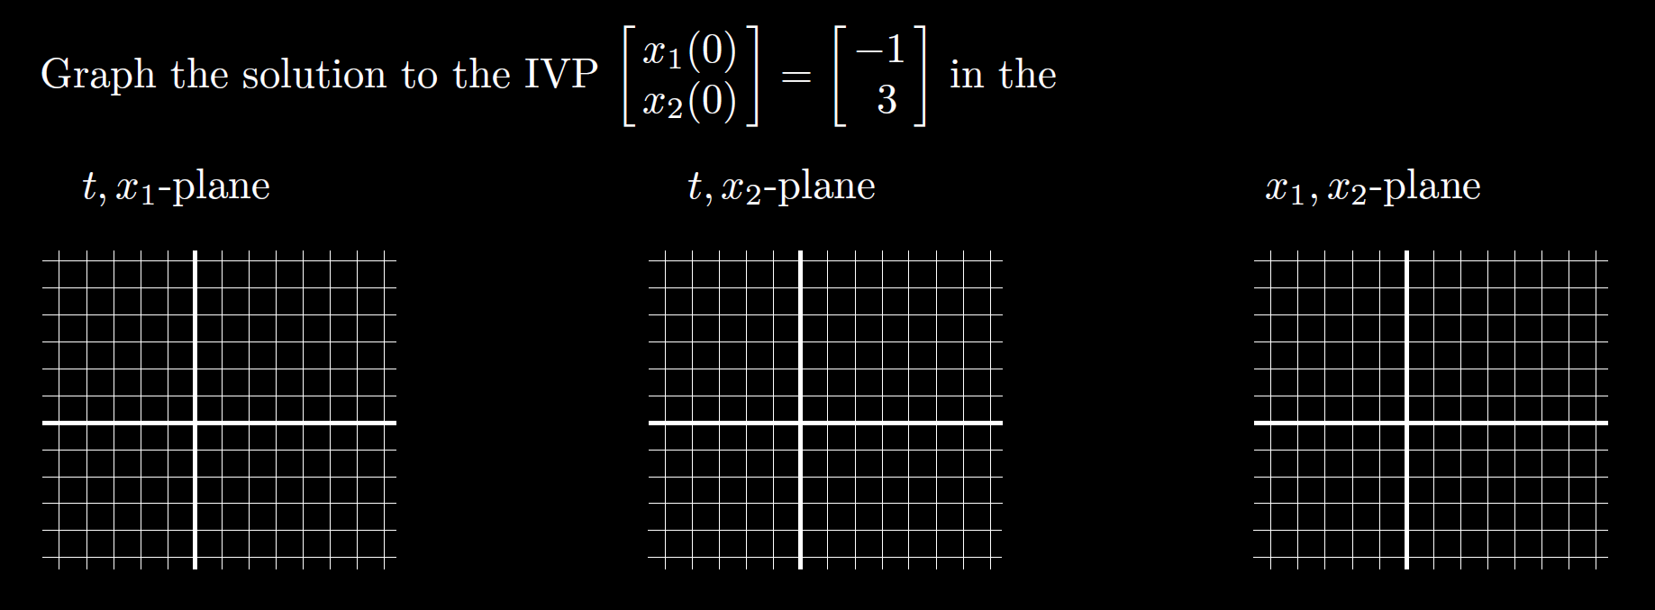
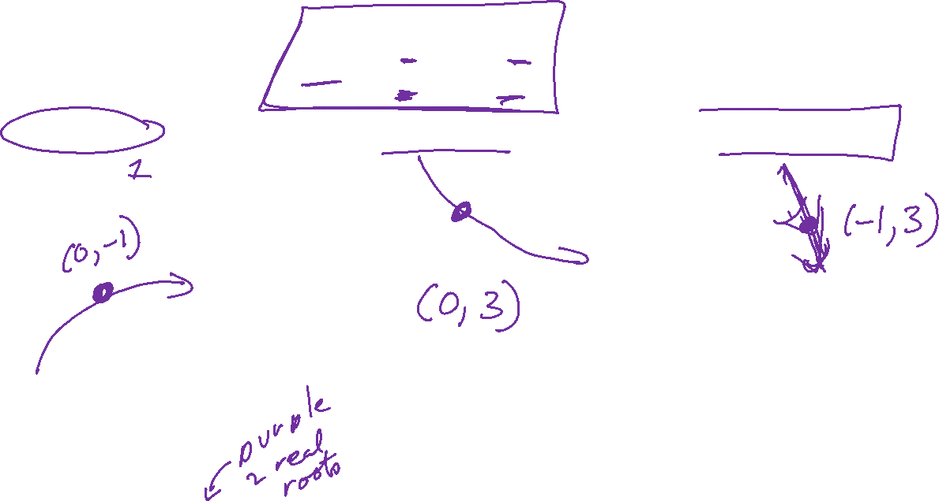
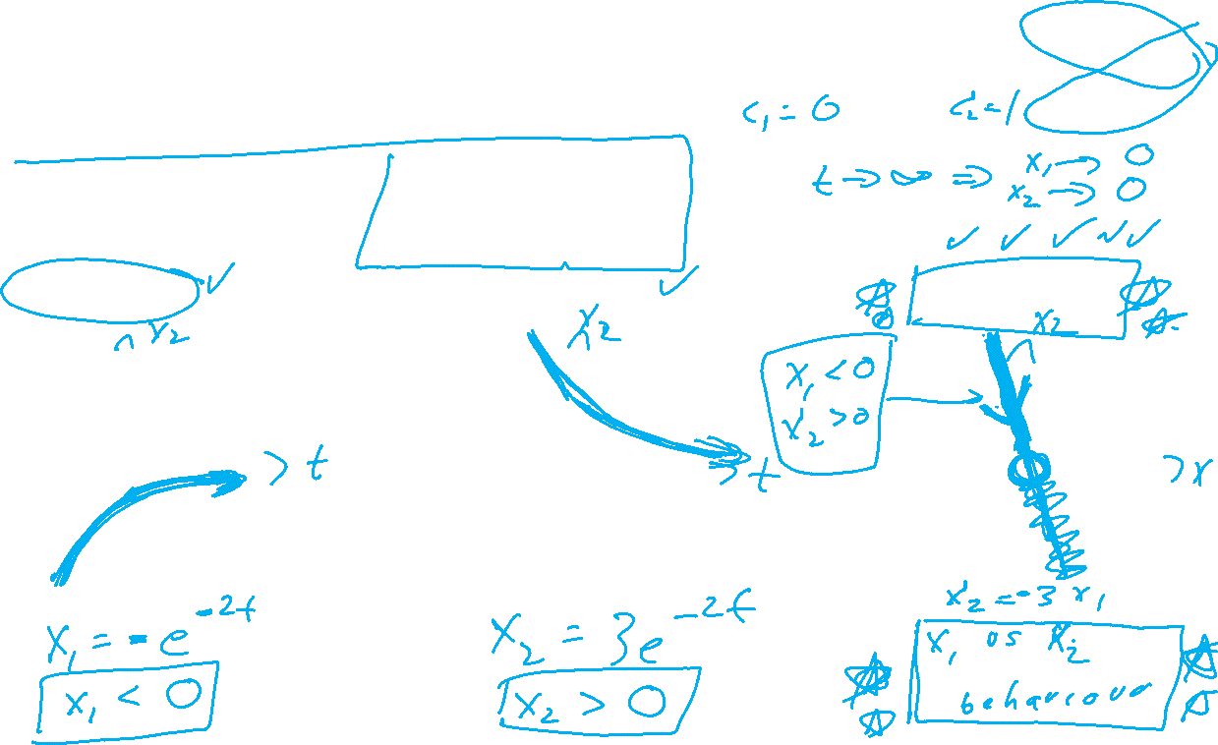

Slide 19
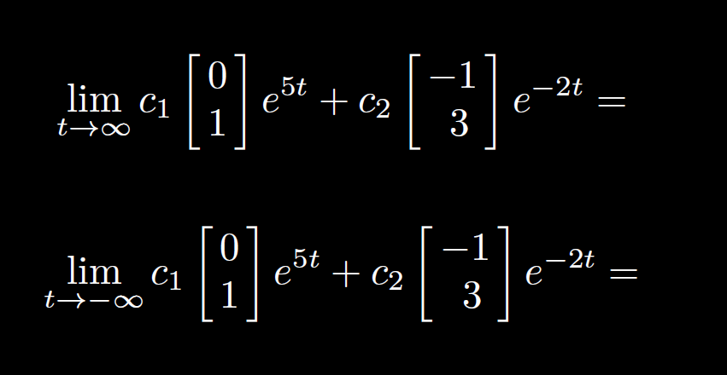

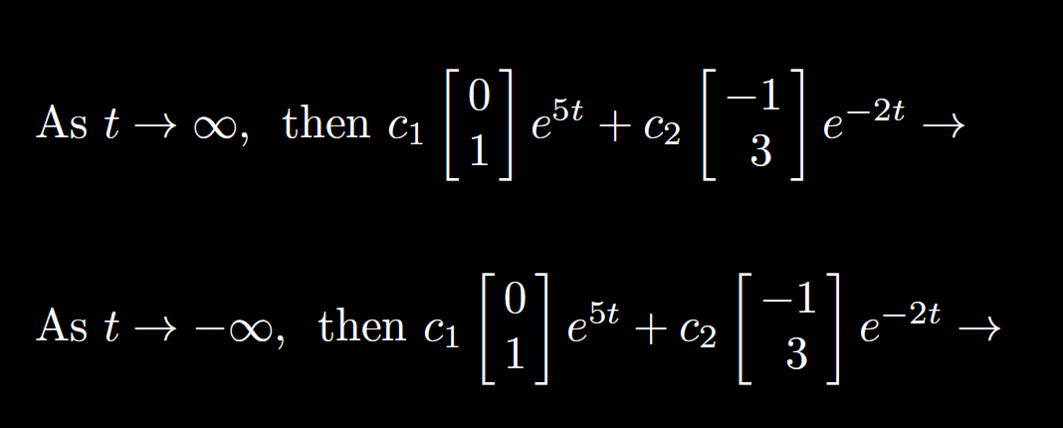
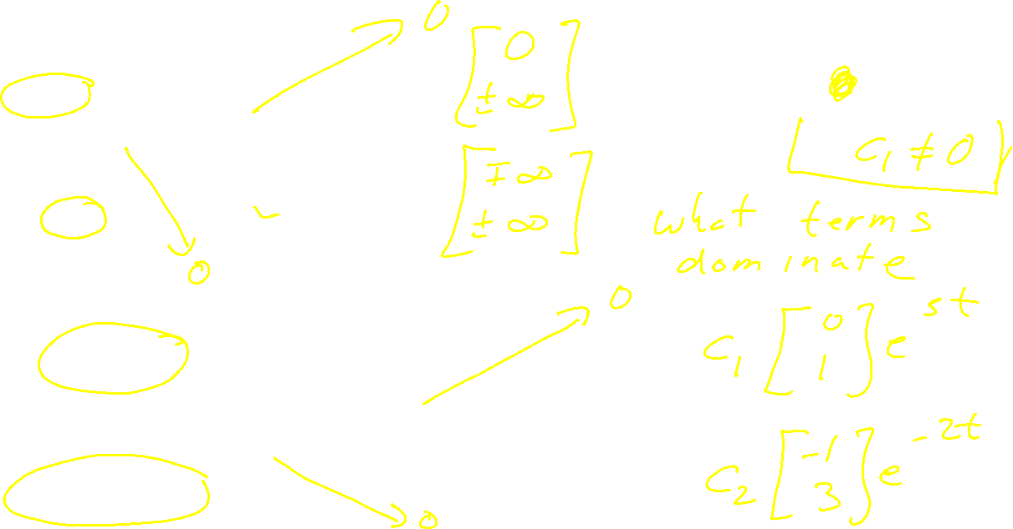


Slide 20
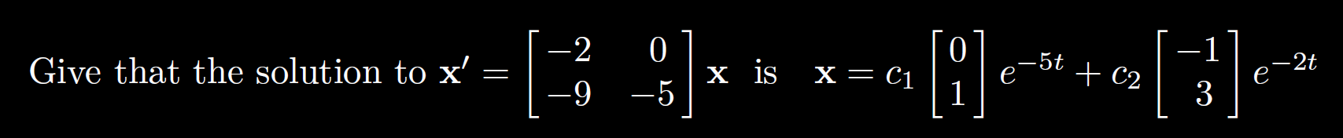
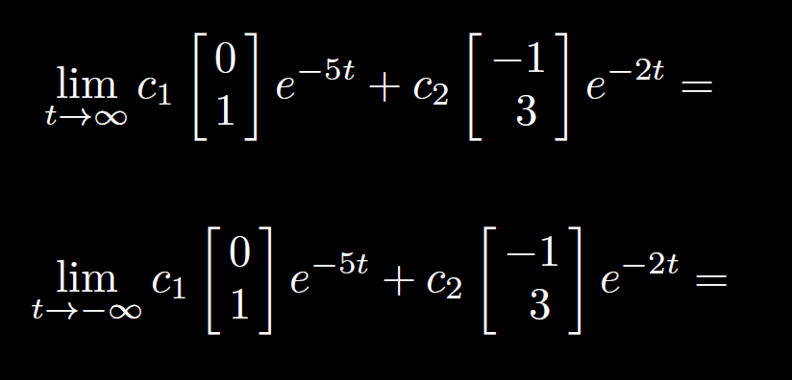
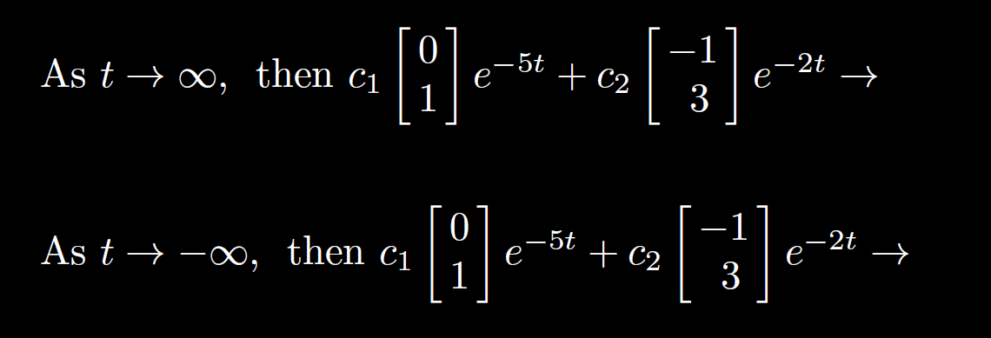
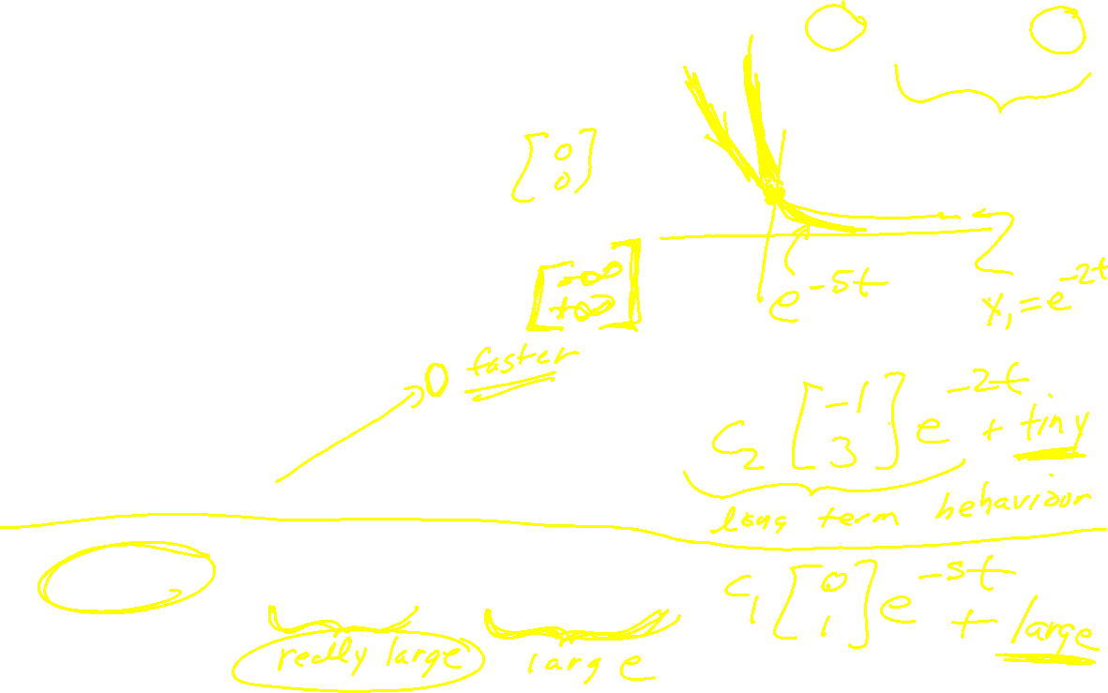

Slide 21
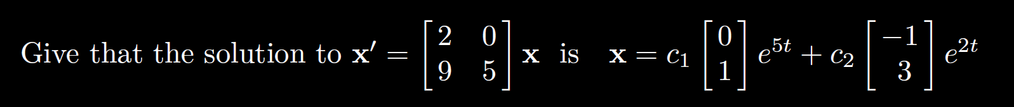
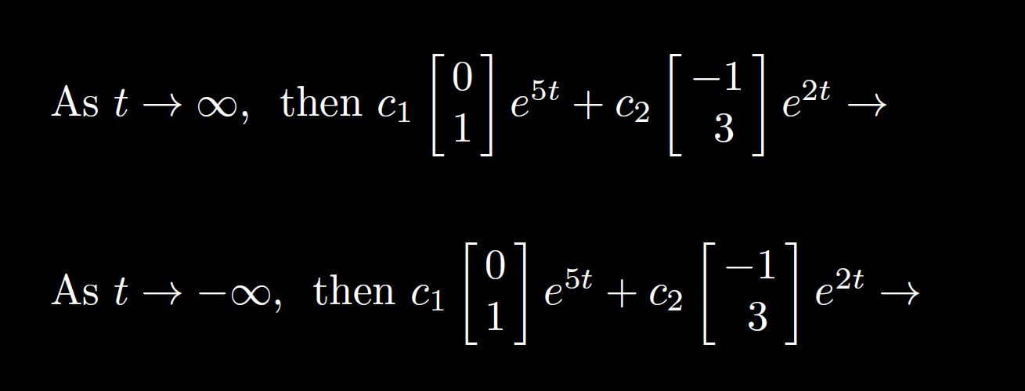
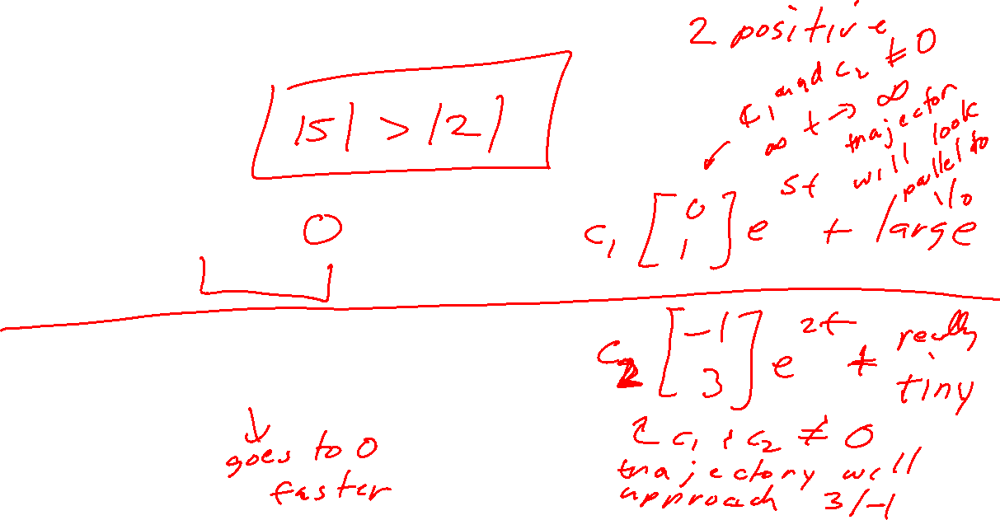

Slide 22
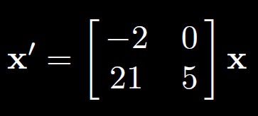
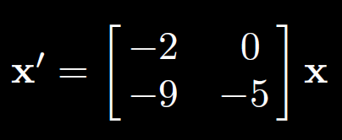
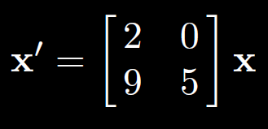

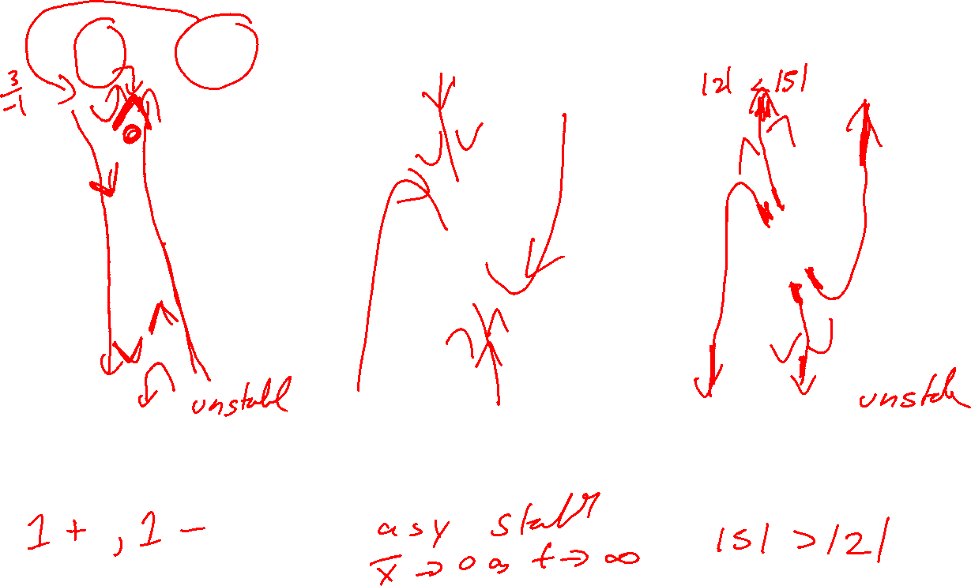

Slide 23
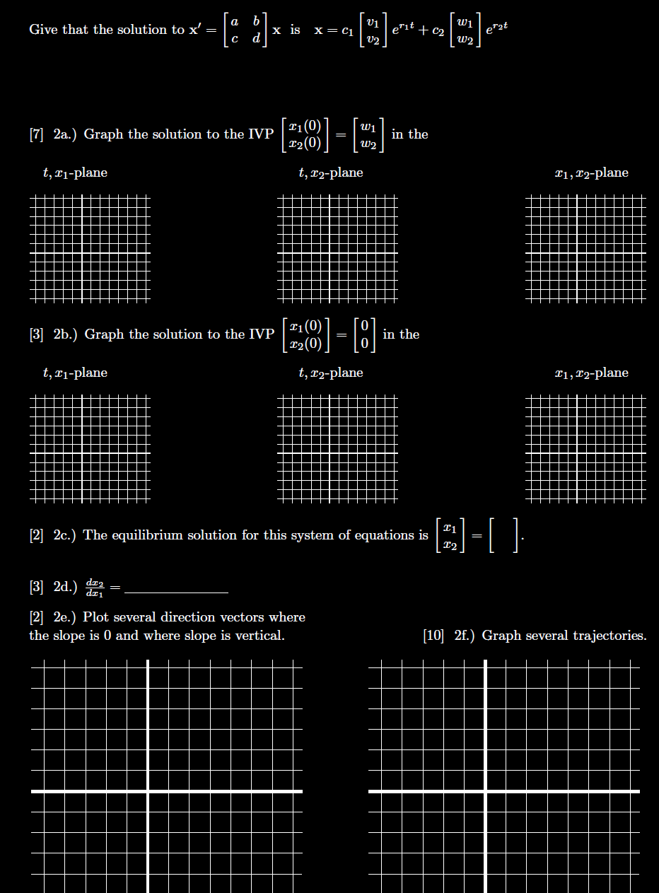

Slide 24
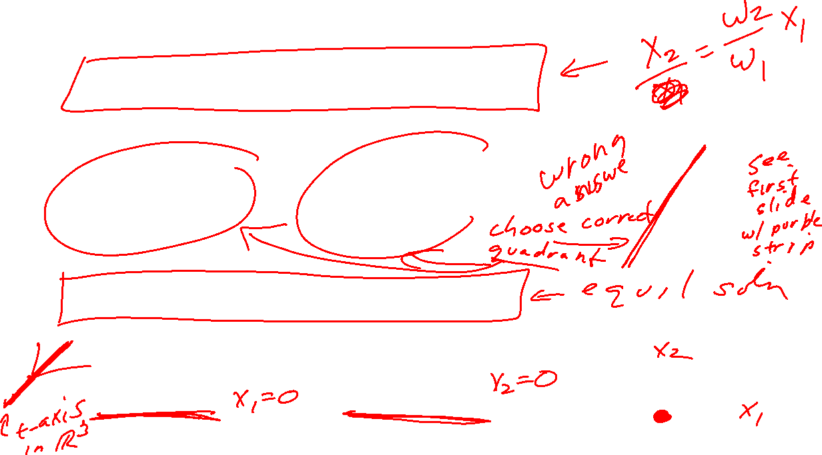

Slide 25
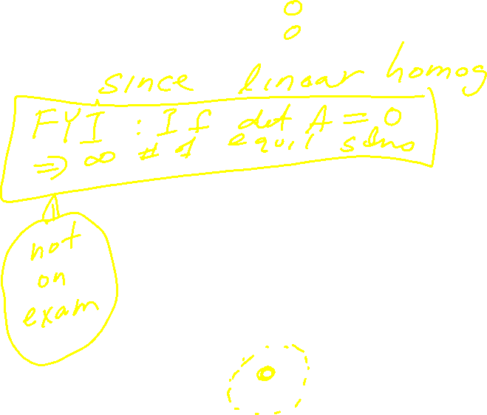

Slide 26
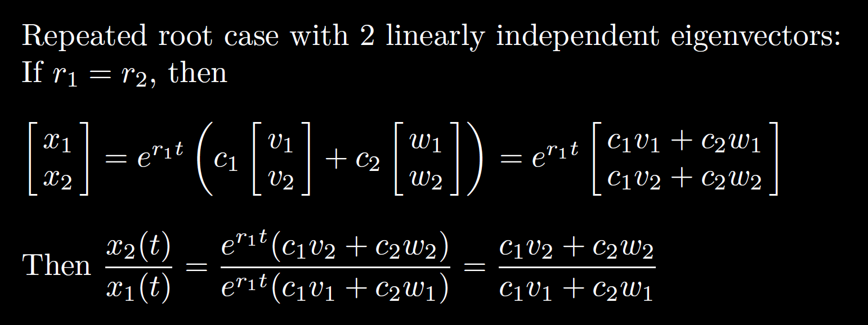
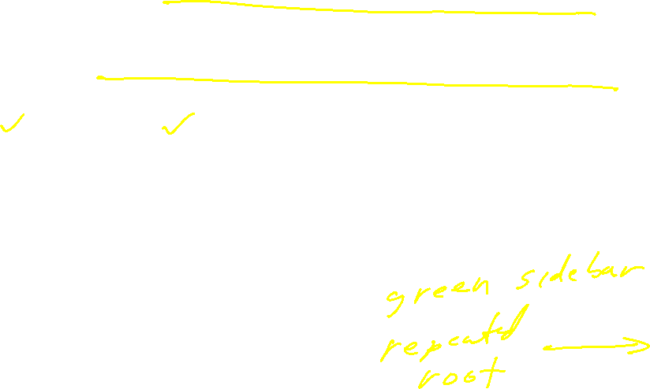
7.8: Repeated root case
2x2 system of equations: Need 2 linearly independent solutions

Slide 27
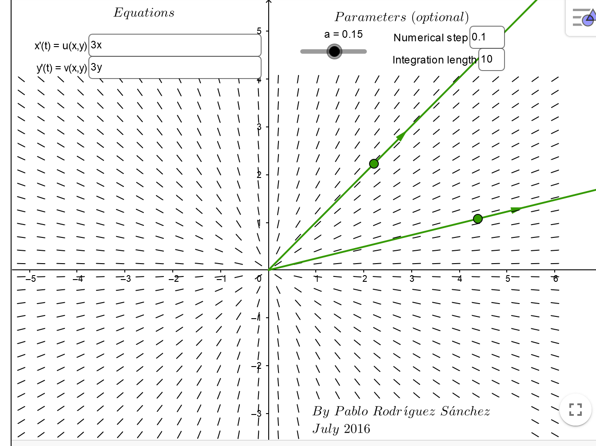

https://www.geogebra.org/m/abg8NJzF

Slide 28



Slide 29


Slide 30




7.7:

Slide 31



Slide 32



Slide 33



