Slide 1



Slide 2





Slide 3
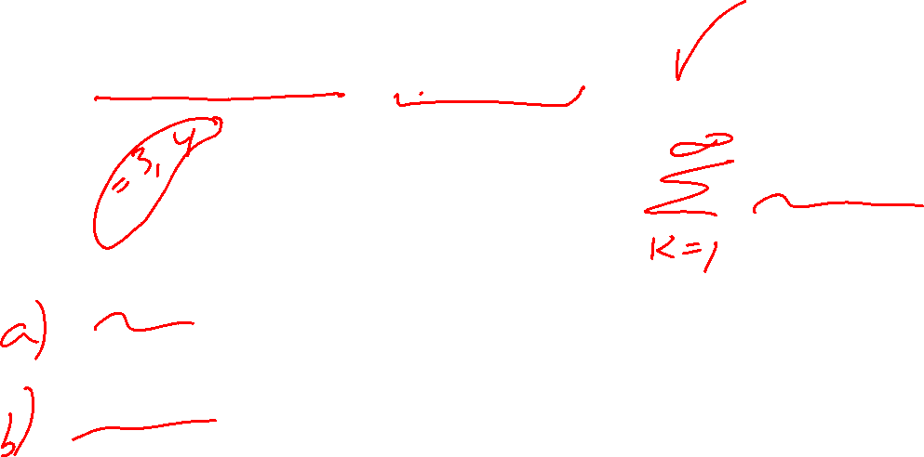
Ch 5: 1 multiple answer (12 – 16pts?):
Which n of the following are equal to

Slide 4

Graphical questions

Slide 5
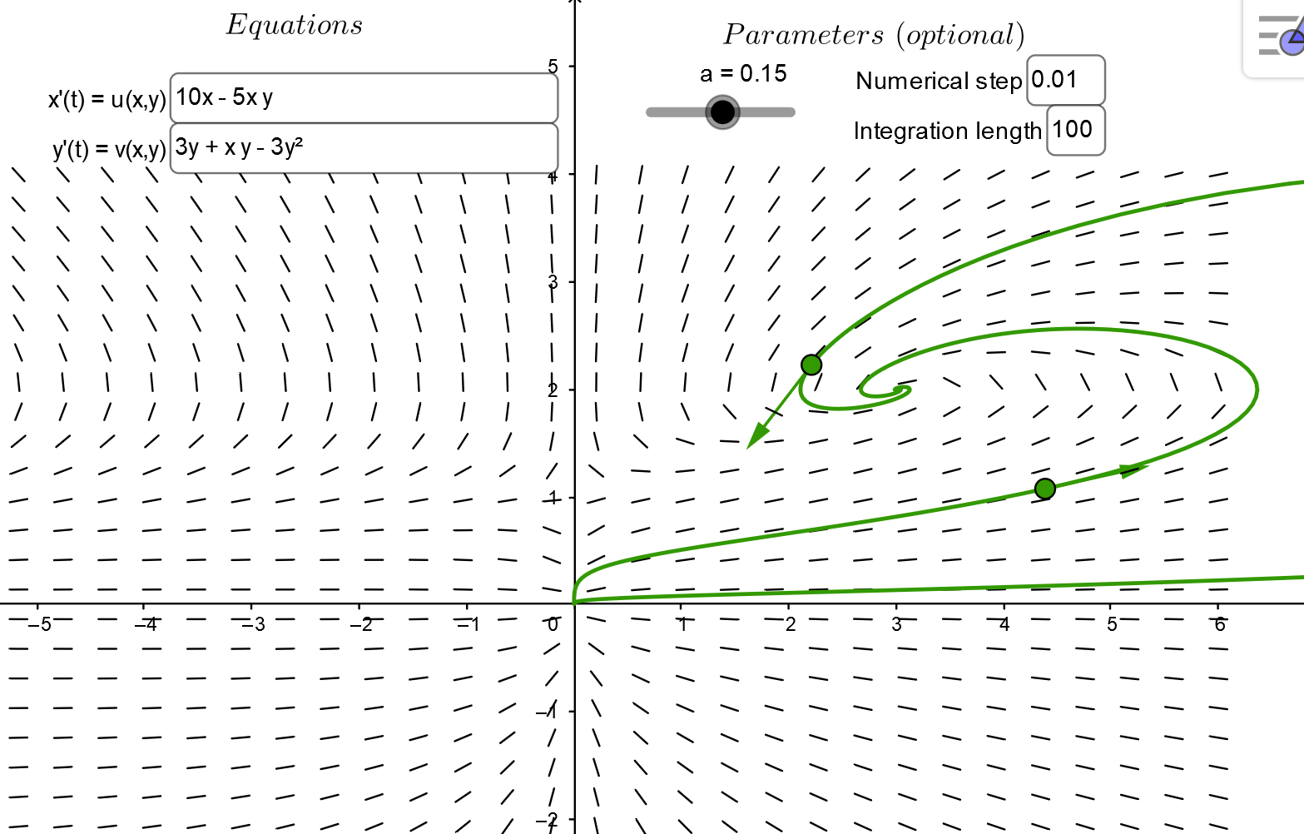
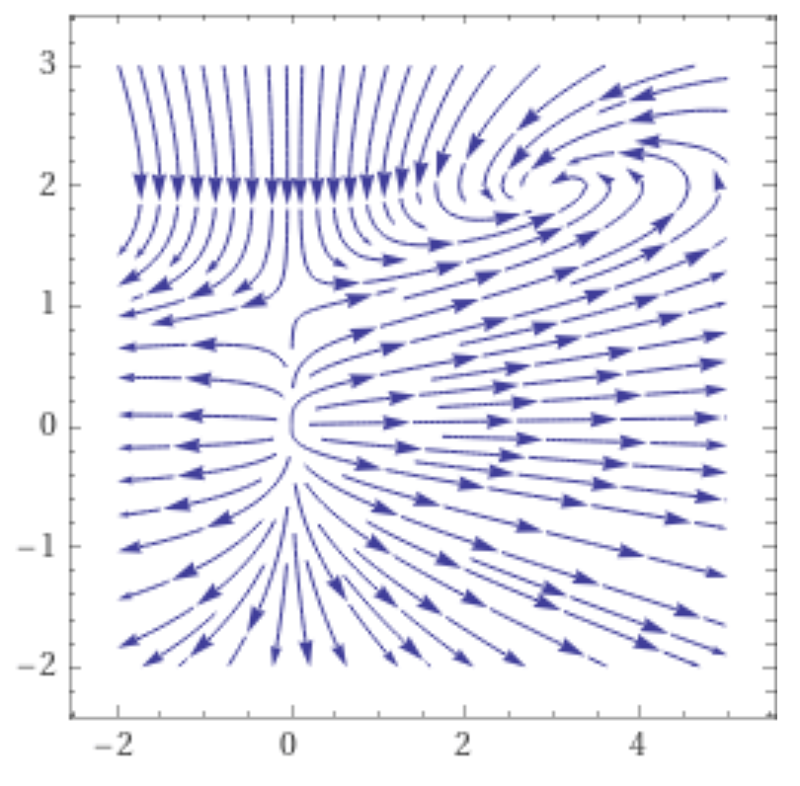
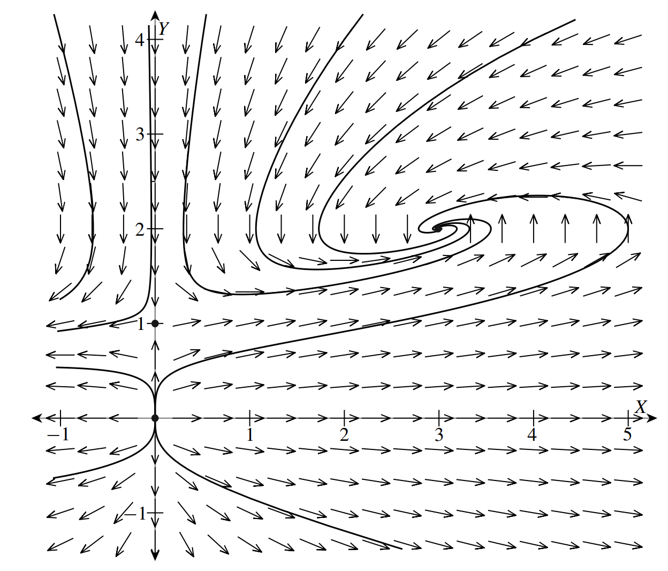


https://www.geogebra.org/m/abg8NJzF
https://www.wolframalpha.com/input/?i=StreamPlot%5B%7B10x+%E2%88%92+5xy%2C+++++3y+%2B+xy+%E2%88%92+3y%5E2%7D%2C+%7Bx%2C+-2%2C+5%7D%2C+%7By%2C+-2%2C+3%7D
http://howellkb.uah.edu/DEtext/Additional_Chapters/Part6/NonLinSys1.pdf

Slide 6
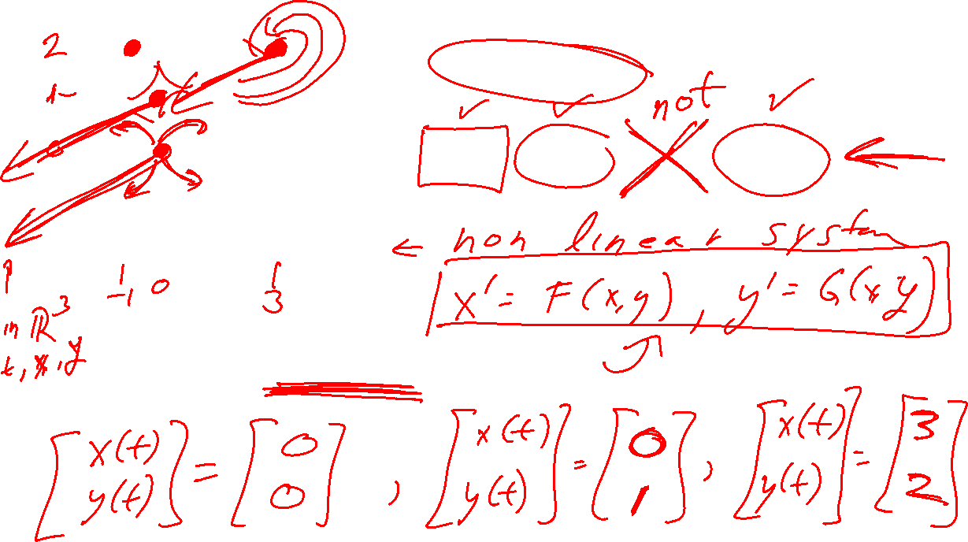
Of the following, which are critical points?
(0, 0), (0, 1), (-1, 2), (3, 2)
What are the equilibrium solutions:

Slide 7
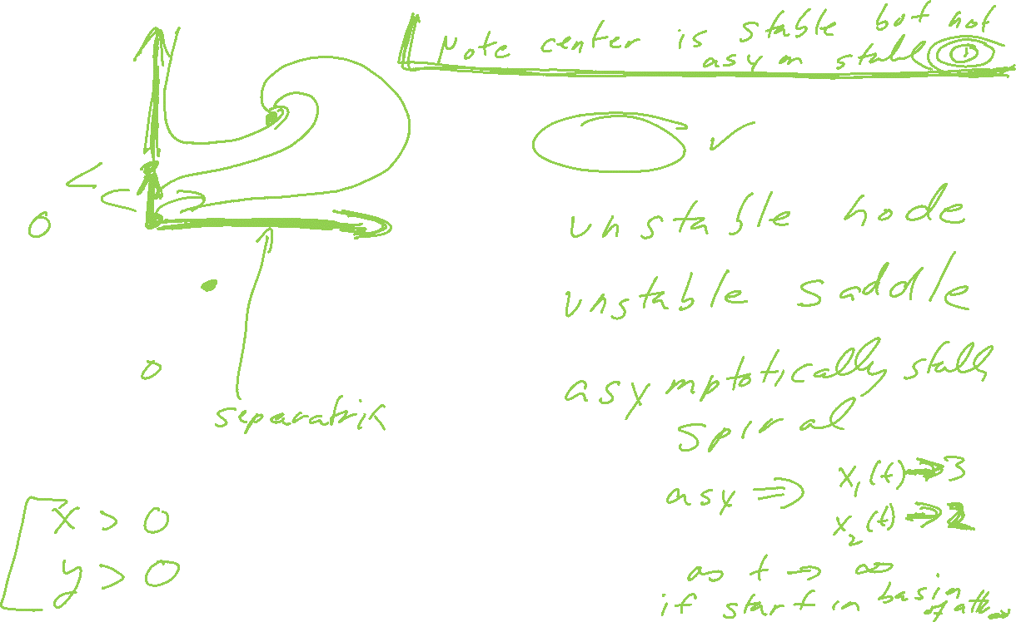

Identify the critical point type and its stability?
(0, 0):
(0, 1):
(3, 2):
The basin of attraction for (3, 2) is
Note only asymptotically stable critical points have a basin of attraction.

Slide 8

Multiple choice:
Given the following streamplot, then (x, y) = (0, 0) is
An asymptotically stable node.
An unstable node.
An unstable saddle.
An asymptotically stable spiral.
An unstable spiral.
A stable center.
Not a critical point.
Note for graphical question, I omitted the repeated real roots case as well as when one of the eigenvalues = 0

Slide 9

Multiple choice:
Given the following streamplot, then (x, y) = (-1, 2) is
An asymptotically stable node.
An unstable node.
An unstable saddle.
An asymptotically stable spiral.
An unstable spiral.
A stable center.
Not a critical point.
Note I omitted the repeated real roots case as well as when one of the eigenvalues = 0

Slide 10
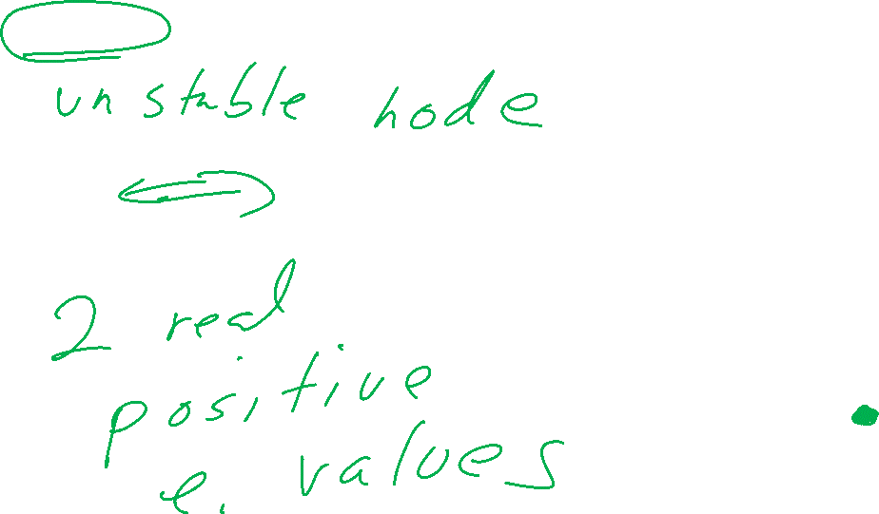
If the system of nonlinear equations x’ = F(x, y), y’ = G(x, y) is approximated near the critical point (0, 0) by the linear system x’ = Ax, then what can you say about the eigenvalues of A?

Slide 11
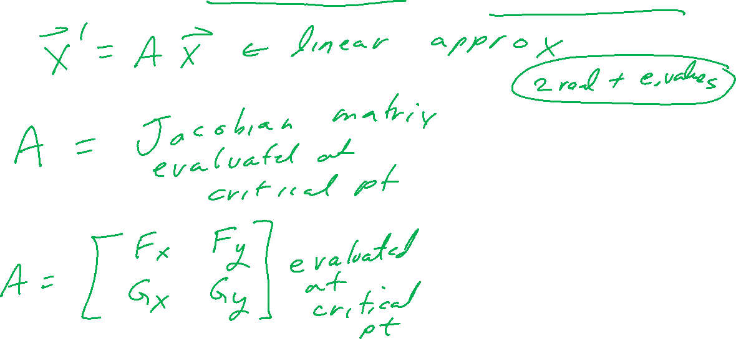
The streamplot for the system of nonlinear equations x’ = F(x, y), y’ = G(x, y) is given below. What can you say about the eigenvalues of the Jacobian matrix for (F, G) evaluated at (0, 0)?

Slide 12
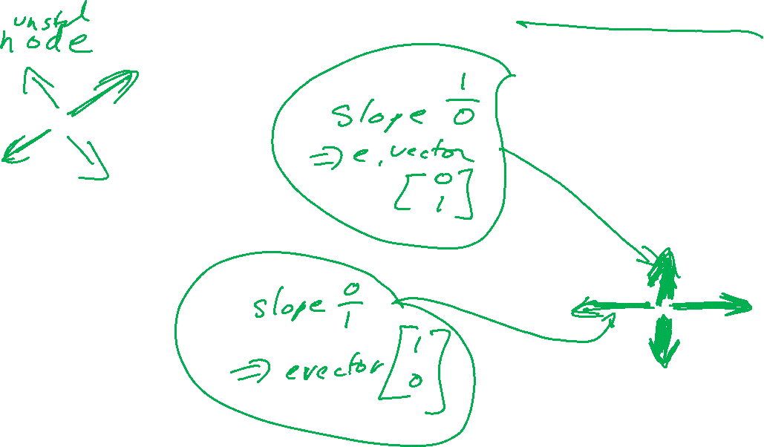
If the system of nonlinear equations x’ = F(x, y), y’ = G(x, y) is approximated near the critical point (0, 0) by the linear system x’ = Ax, then what can you say about the eigenvectors of A?

Slide 13
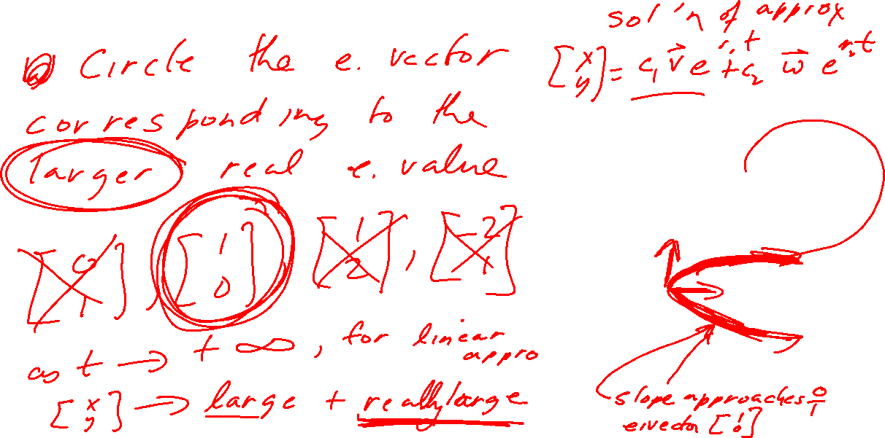
If the system of nonlinear equations x’ = F(x, y), y’ = G(x, y) is approximated near the critical point (0, 0) by the linear system x’ = Ax, then what can you say about the eigenvectors of A?

Slide 14
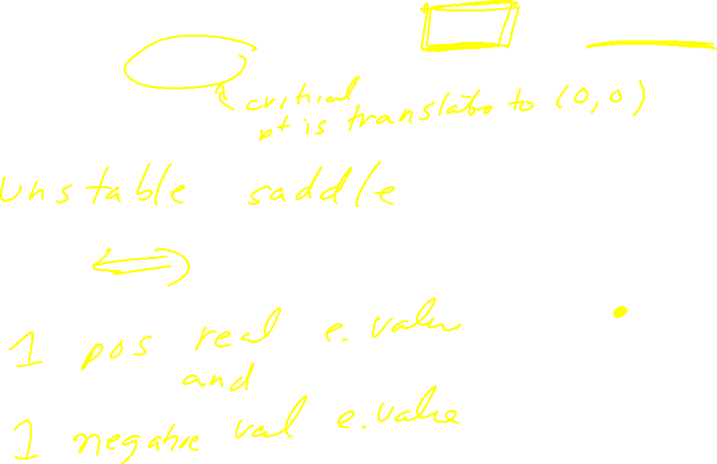
If the system of nonlinear equations x’ = F(x, y), y’ = G(x, y) is approximated near the critical point (0, 1) by the translated linear system x’ = Ax, then what can you say about the eigenvalues of A?

Slide 15

The streamplot for the system of nonlinear equations x’ = F(x, y), y’ = G(x, y) is given below. What can you say about the Jacobian matrix for (F, G) evaluated at (0, 1)?

Slide 16
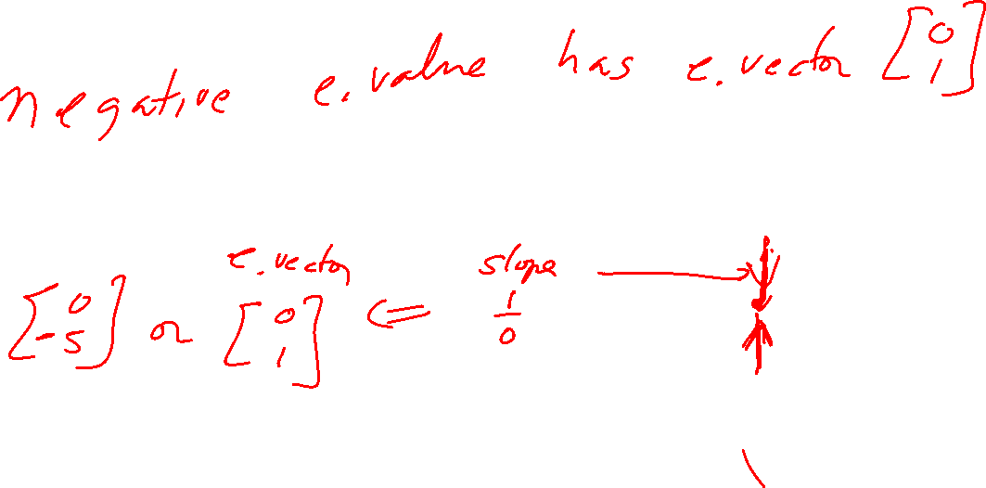
If the system of nonlinear equations x’ = F(x, y), y’ = G(x, y) is approximated near the critical point (0, 1) by the translated linear system x’ = Ax, then what can you say about the eigenvectors of A?

Slide 17
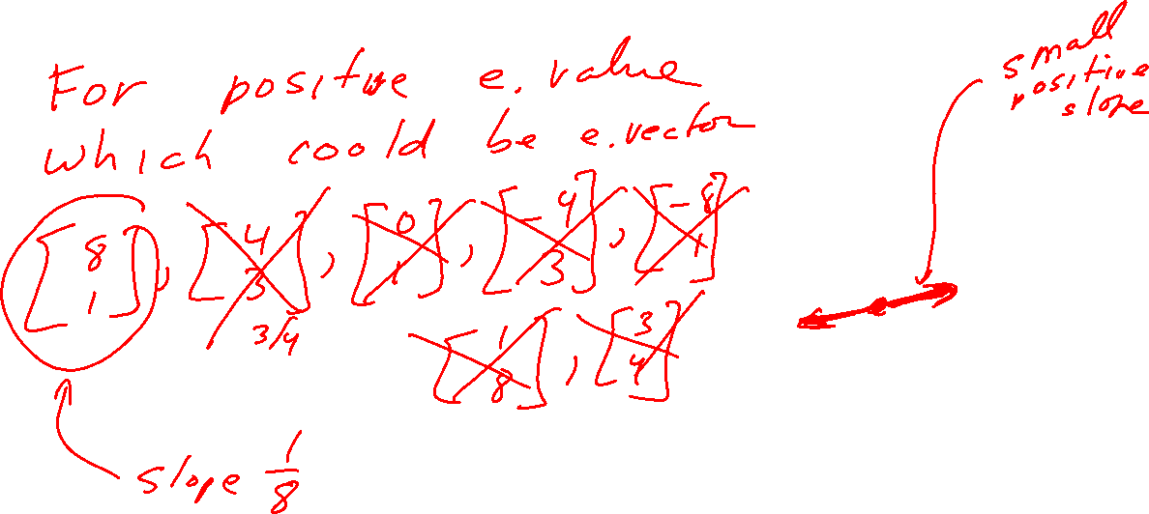
If the system of nonlinear equations x’ = F(x, y), y’ = G(x, y) is approximated near the critical point (0, 1) by the translated linear system x’ = Ax, then what can you say about the eigenvectors of A?

Slide 18
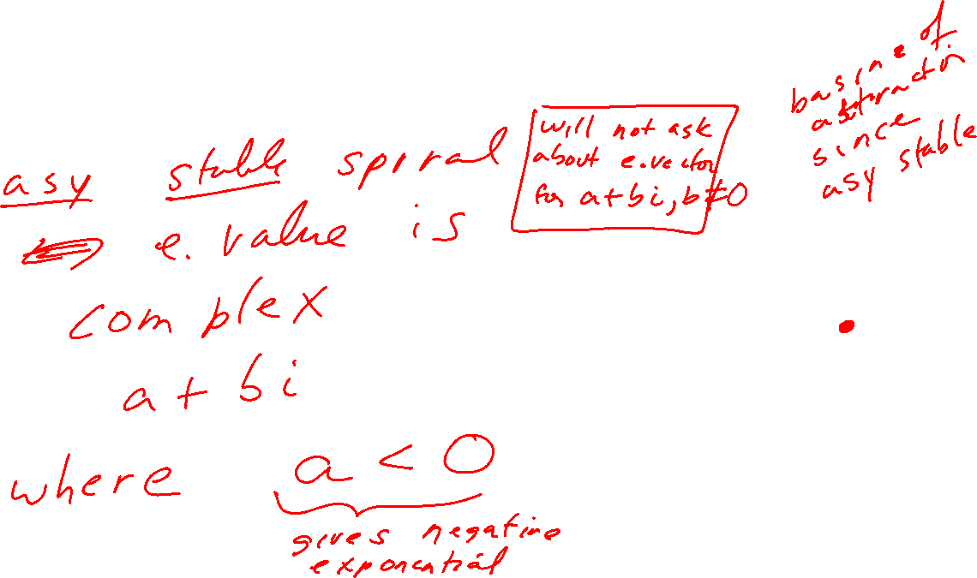
If the system of nonlinear equations x’ = F(x, y), y’ = G(x, y) is approximated near the critical point (3, 2) by the translated linear system x’ = Ax, then what can you say about the eigenvalues of A?

Slide 19
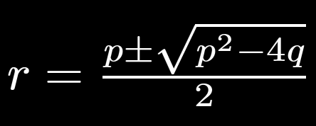
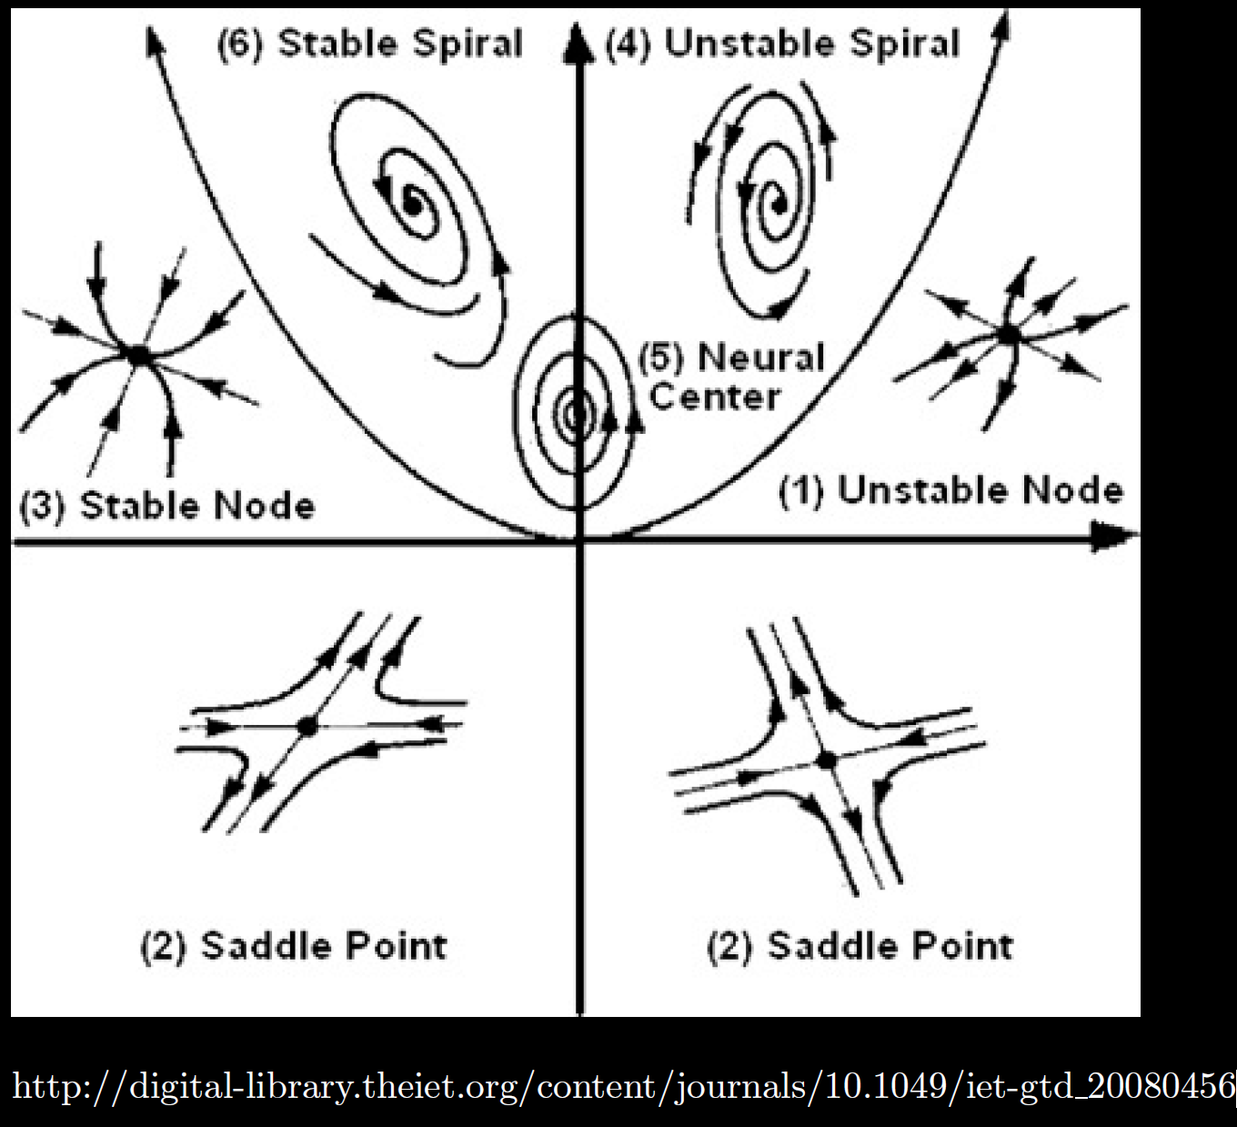
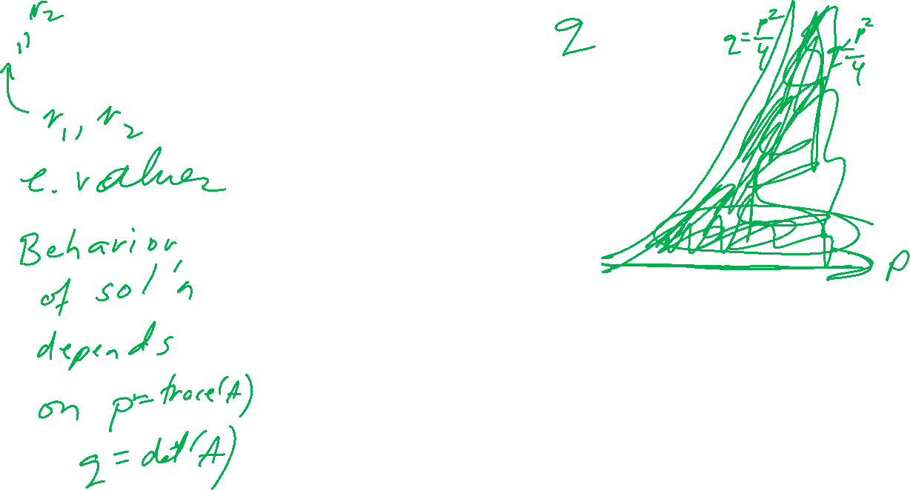

Slide 20
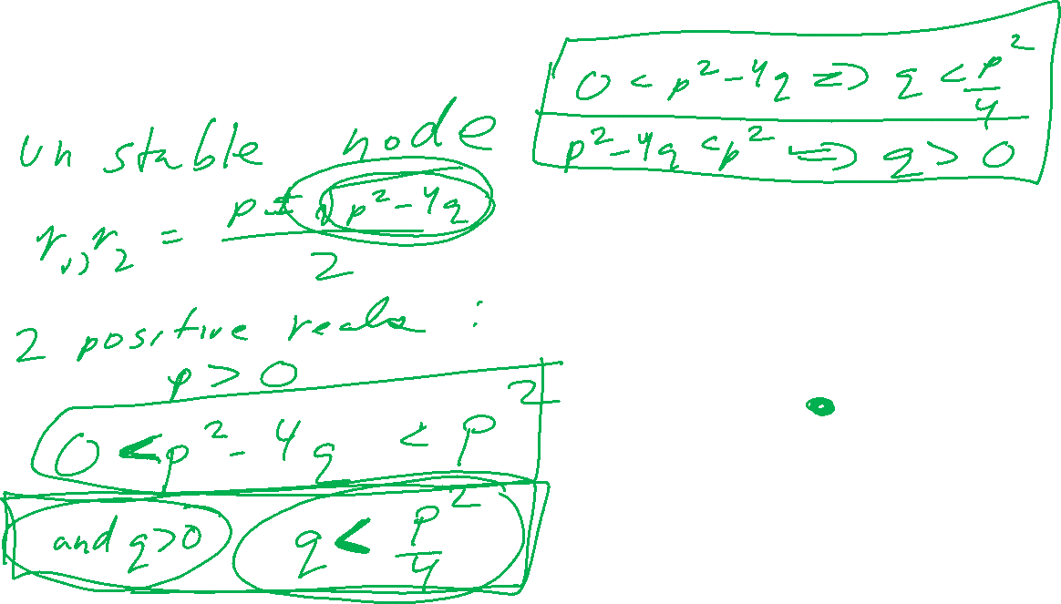
If the system of nonlinear equations x’ = F(x, y), y’ = G(x, y) is approximated near the critical point (0, 0) by the linear system x’ = Ax, then if p = trace(A) and q = det(A), what can you say about (p, q)?

Slide 21
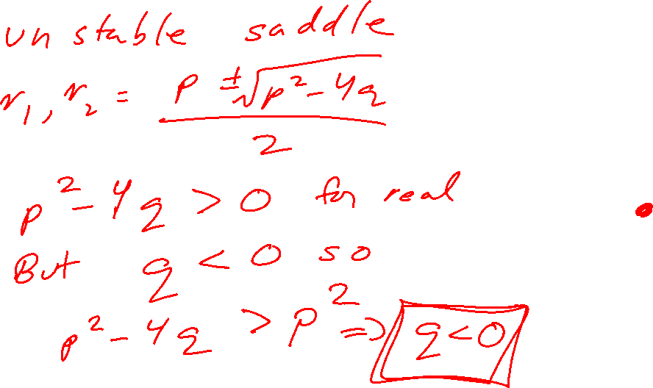
If the system of nonlinear equations x’ = F(x, y), y’ = G(x, y) is approximated near the critical point (0, 1) by the translated linear system x’ = Ax, then if p = trace(A) and q = det(A), what can you say about (p, q)?

Slide 22
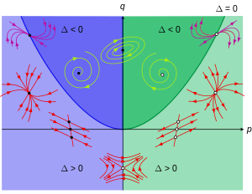

https://en.wikipedia.org/wiki/Phase_plane

Slide 23
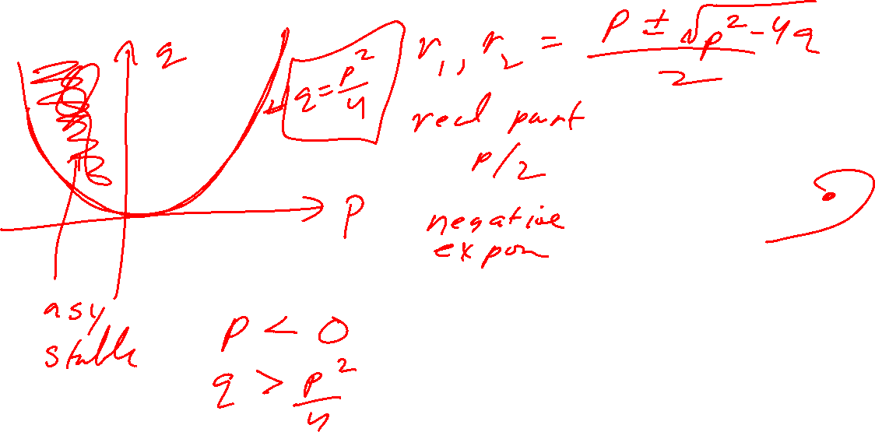
If the system of nonlinear equations x’ = F(x, y), y’ = G(x, y) is approximated near the critical point (3, 2) by the translated linear system x’ = Ax, then if p = trace(A) and q = det(A), what can you say about (p, q)?

Slide 24

https://en.wikipedia.org/wiki/Phase_plane

Slide 25
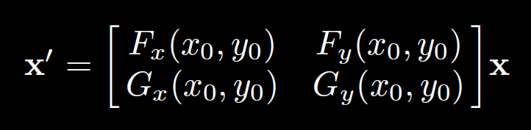
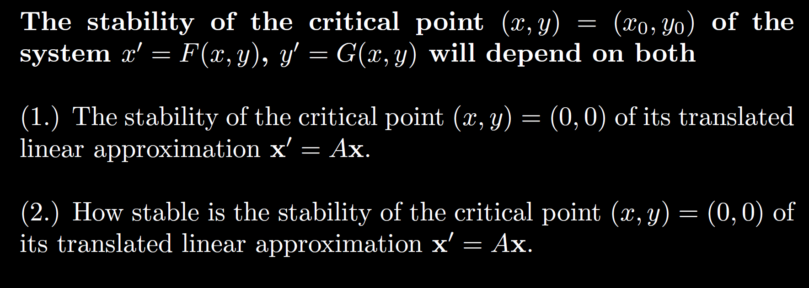
After translating critical point to origin:

Slide 26

Algebraic questions
Can be similar to graphical, but given equations instead. May need to show work.
Ex: $x’ = 10x − 5xy, y’ = 3y + xy − 3y^{2}$
(Or linear).
http://howellkb.uah.edu/DEtext/Additional_Chapters/Part6/NonLinSys1.pdf

Slide 27
Ex: $x’ = 10x − 5xy, y’ = 3y + xy − 3y^{2}$

