Slide 1
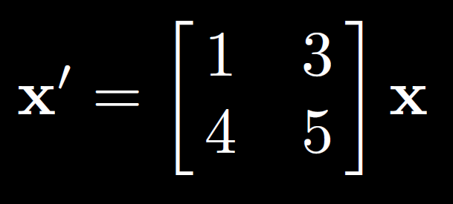
7.7:

Slide 2
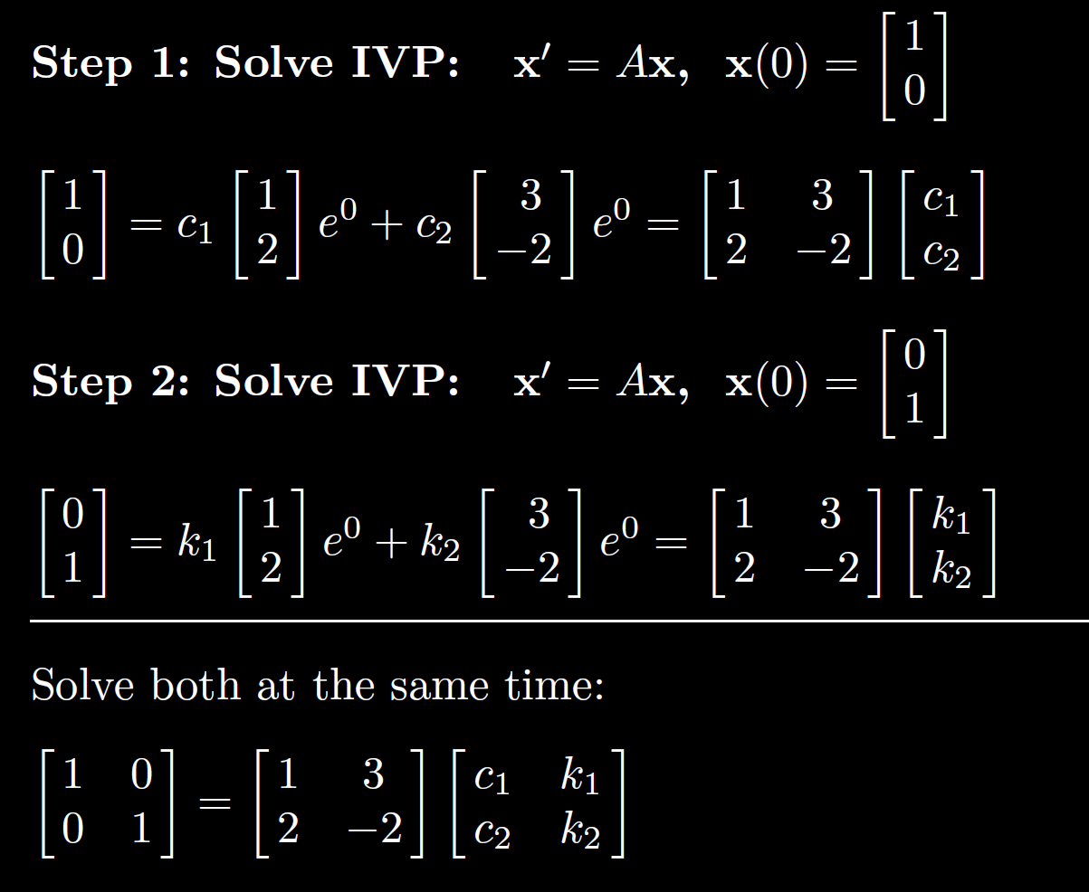

Slide 3
2

Slide 6
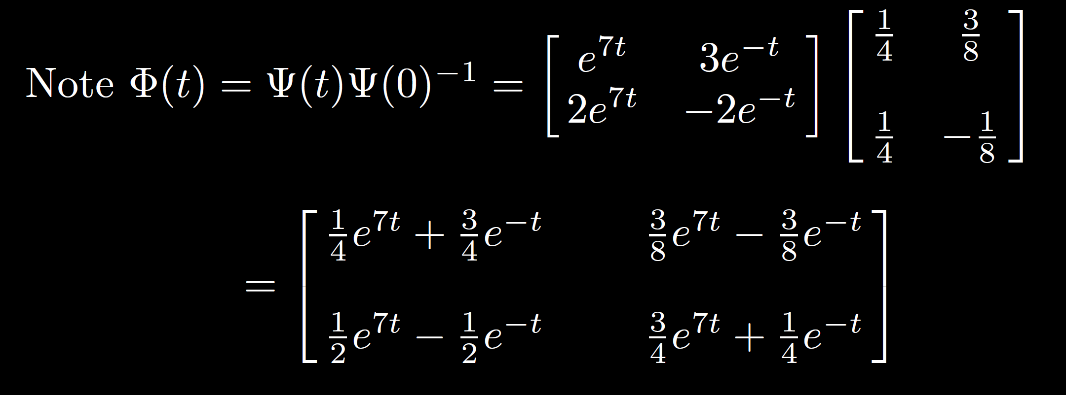

Slide 12
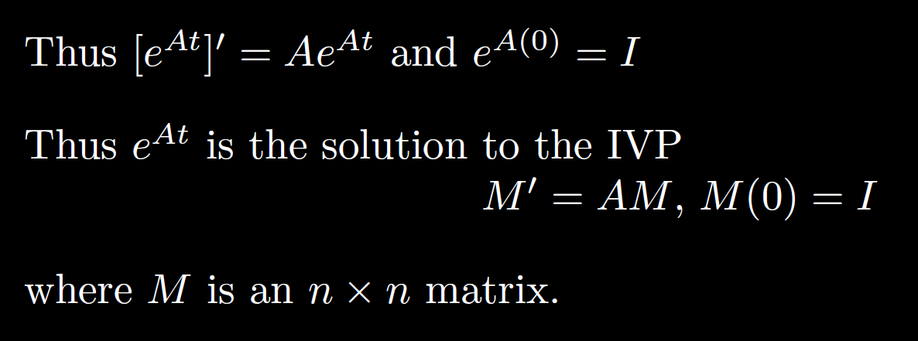

Slide 18
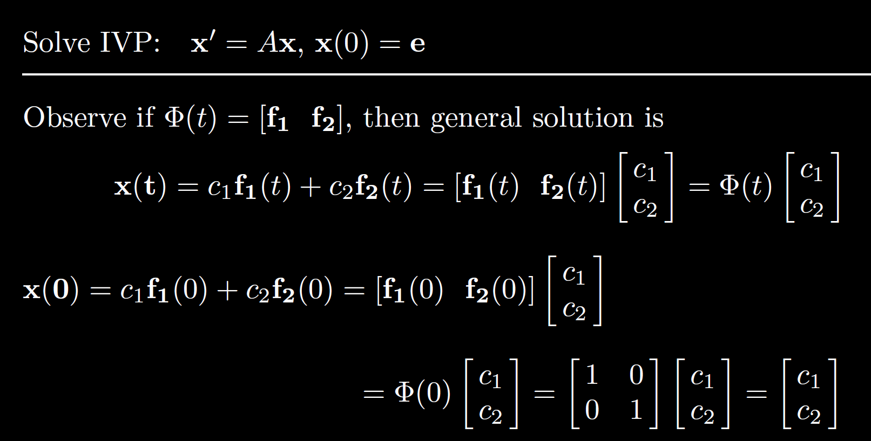
p

Slide 19
p
p

Slide 21
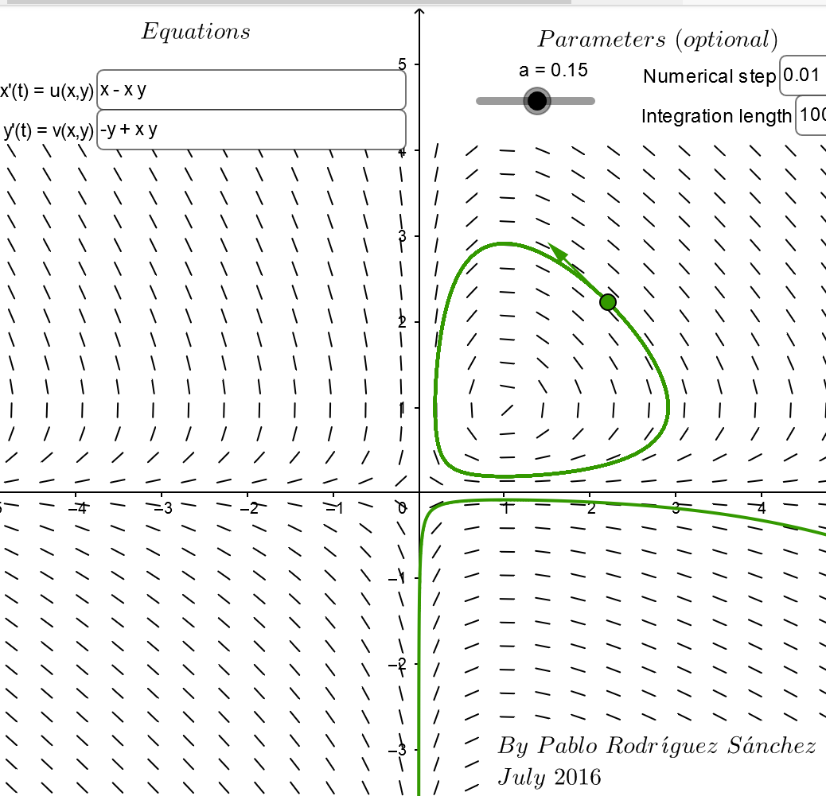
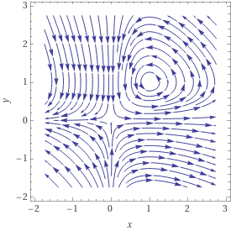
https://www.geogebra.org/m/abg8NJzF
https://www.wolframalpha.com/input/?i=streamplot+%7B+x+-+xy%2C++-y+%2B+xy%7D

Slide 22
