Slide 1
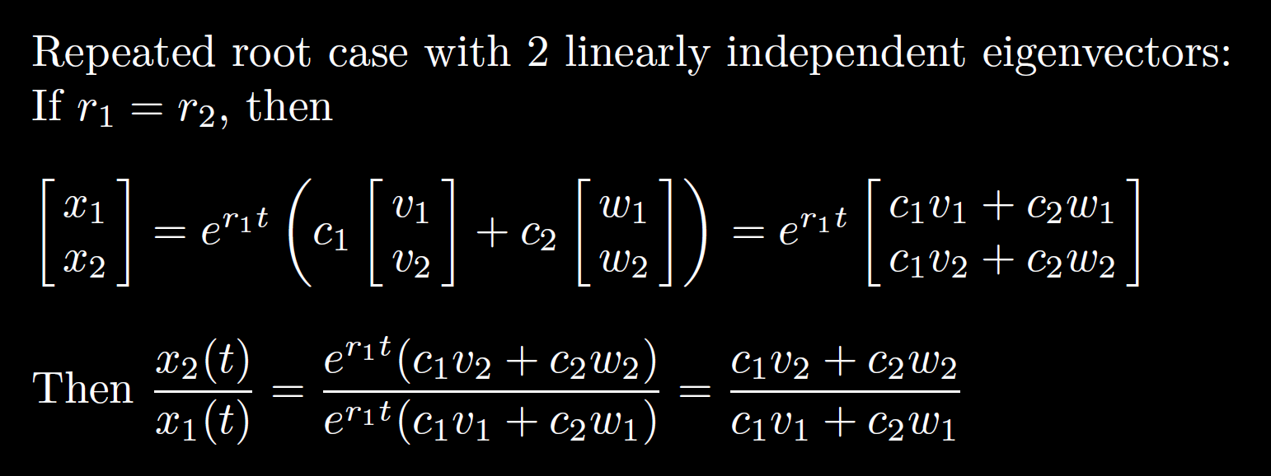
7.8: Repeated root case
2x2 system of equations: Need 2 linearly independent solutions

Slide 2
7.8: Repeated root case
2x2 system of equations: Need 2 linearly independent solutions

Slide 3
7.8: Repeated root case
2x2 system of equations: Need 2 linearly independent solutions

Slide 4
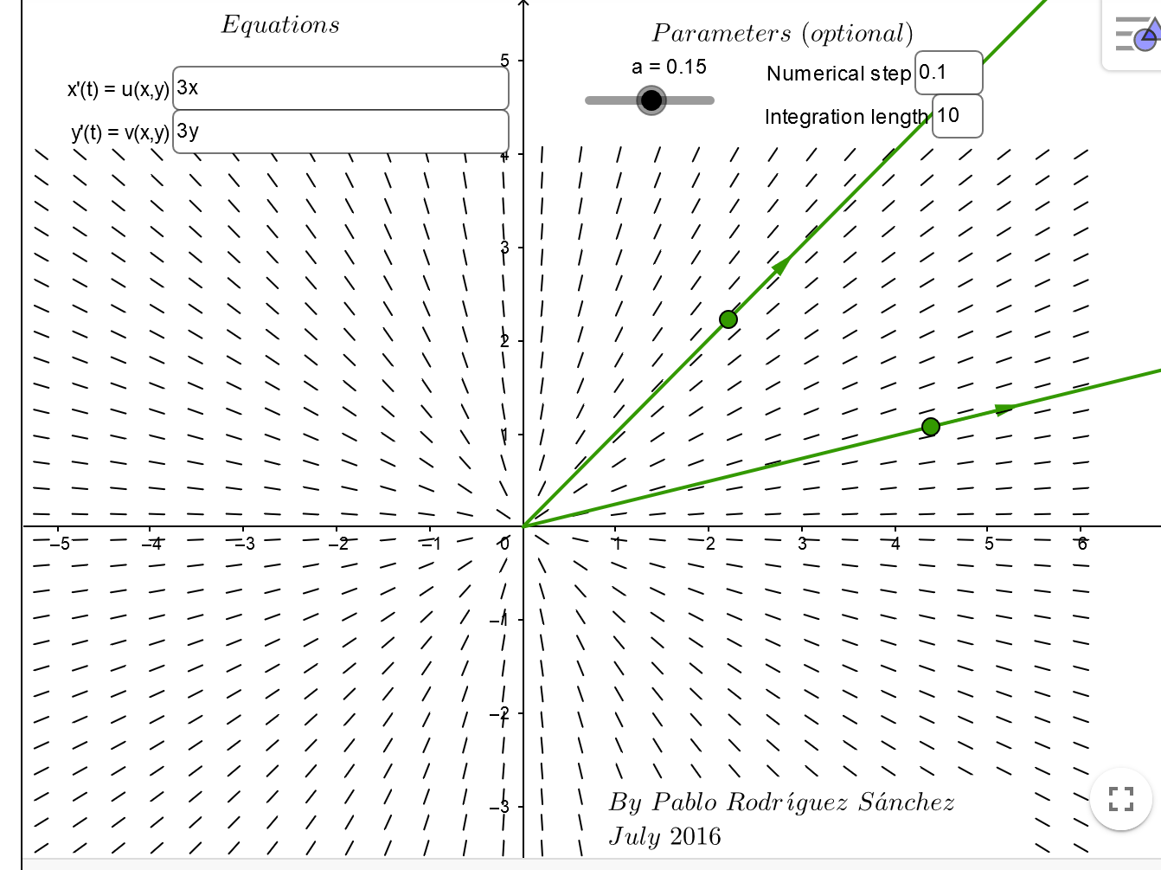
https://www.geogebra.org/m/abg8NJzF

Slide 5
https://www.geogebra.org/m/abg8NJzF

Slide 6
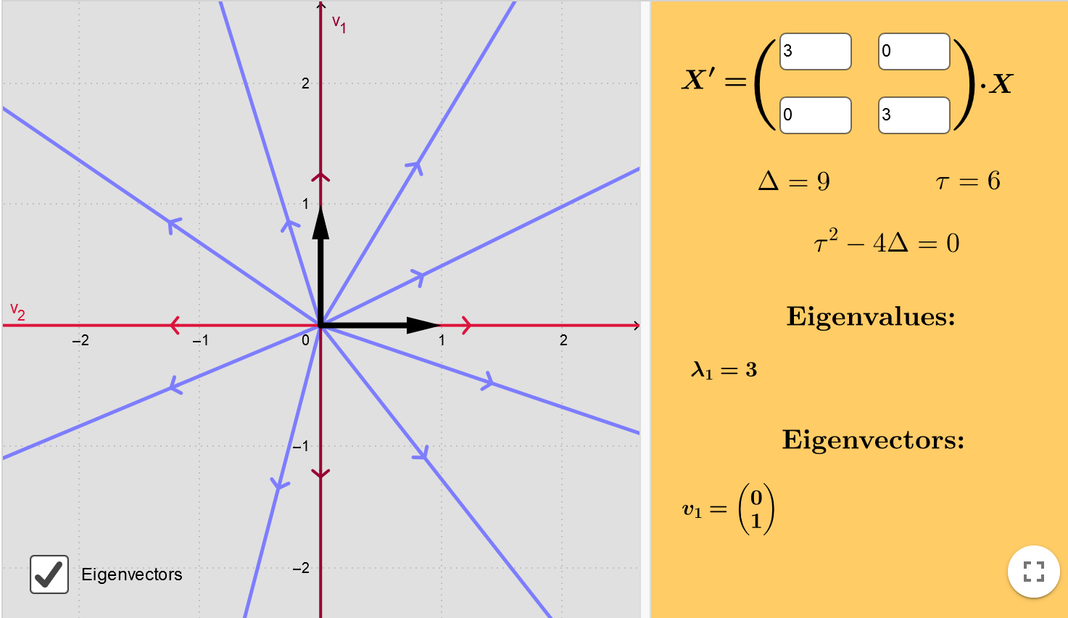
https://www.geogebra.org/m/fYxXgbsU

Slide 7
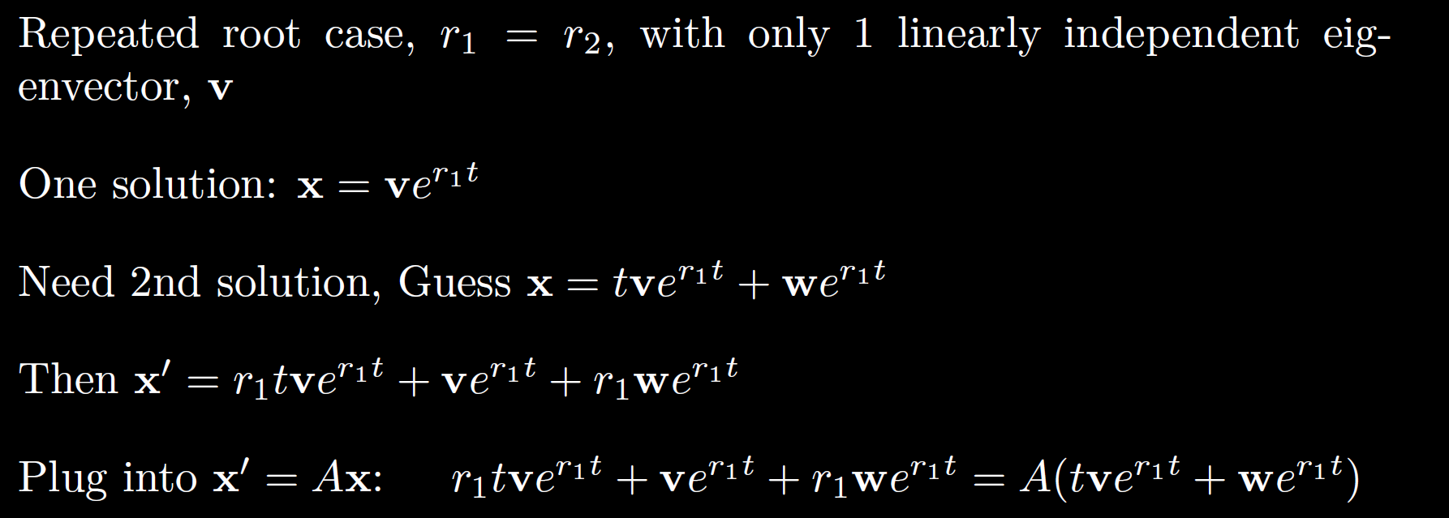

Slide 8


Slide 13

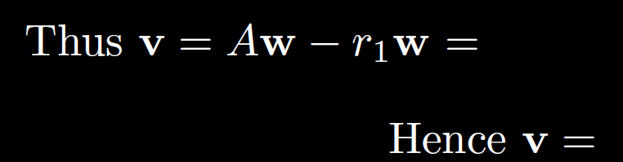
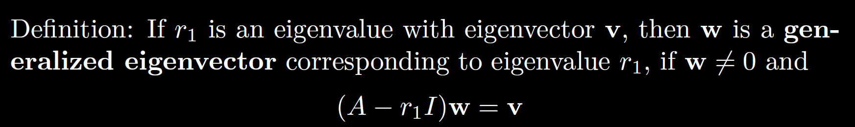

Slide 14
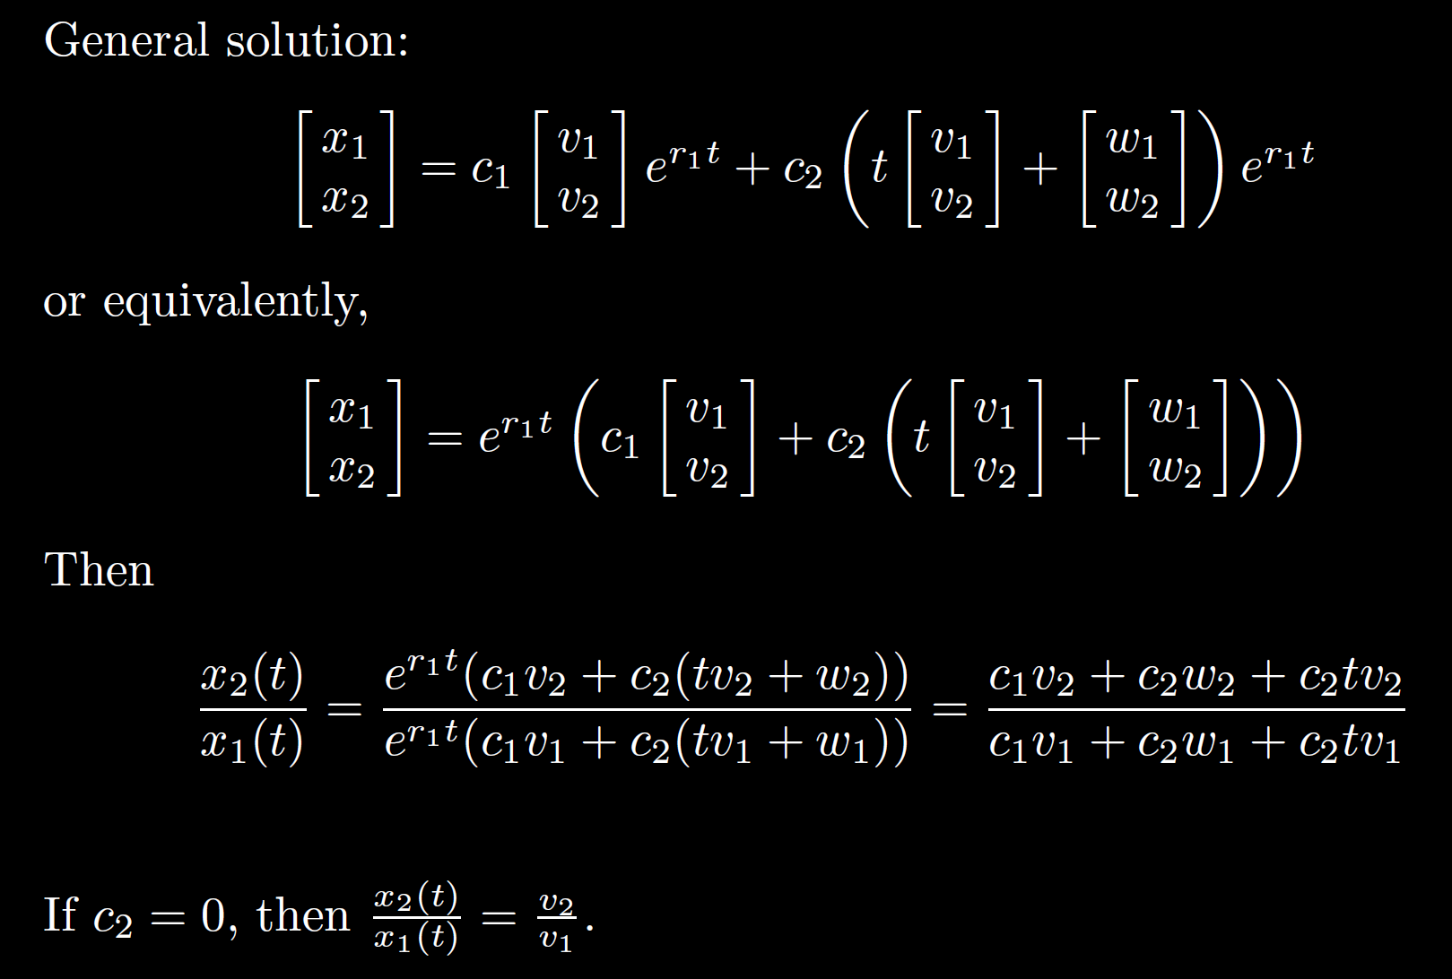

Slide 16
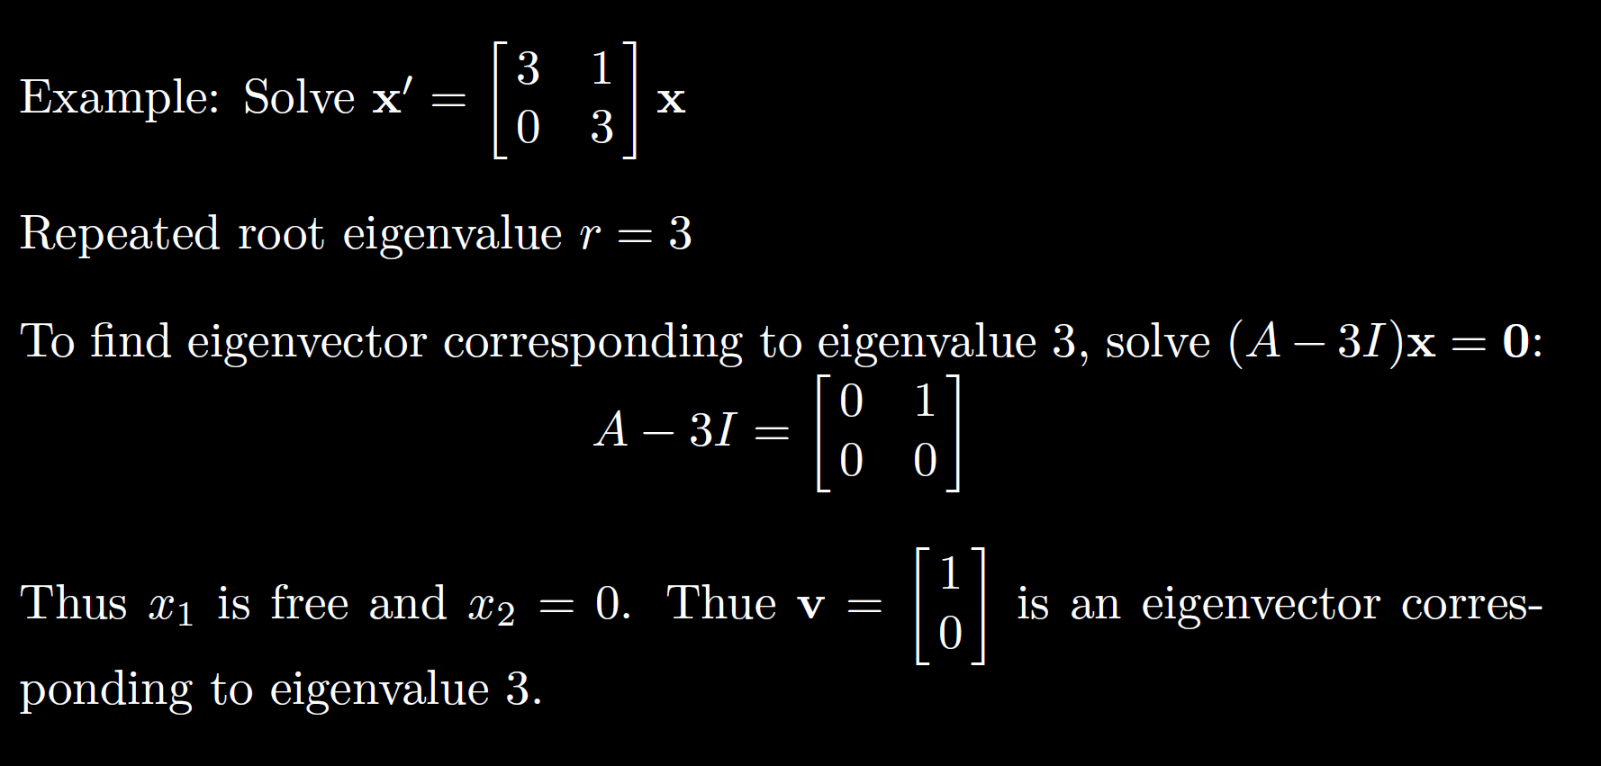

Slide 18
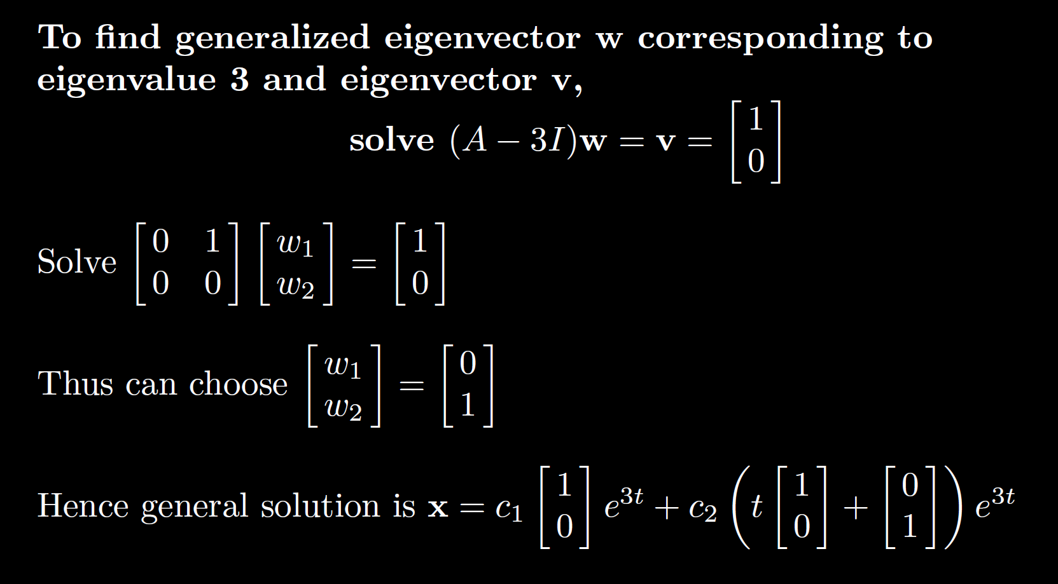

Slide 20
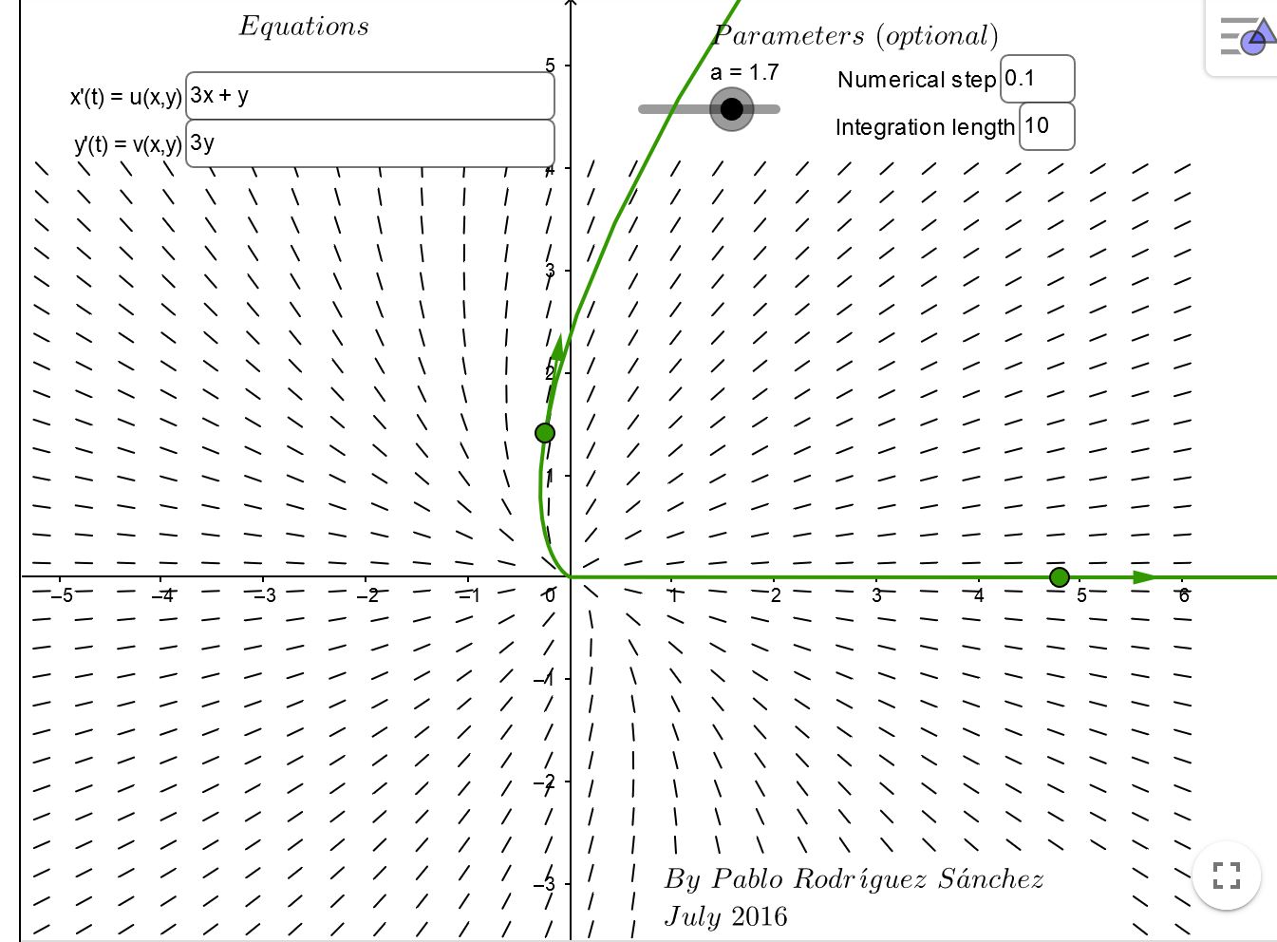
https://www.geogebra.org/m/abg8NJzF

Slide 22
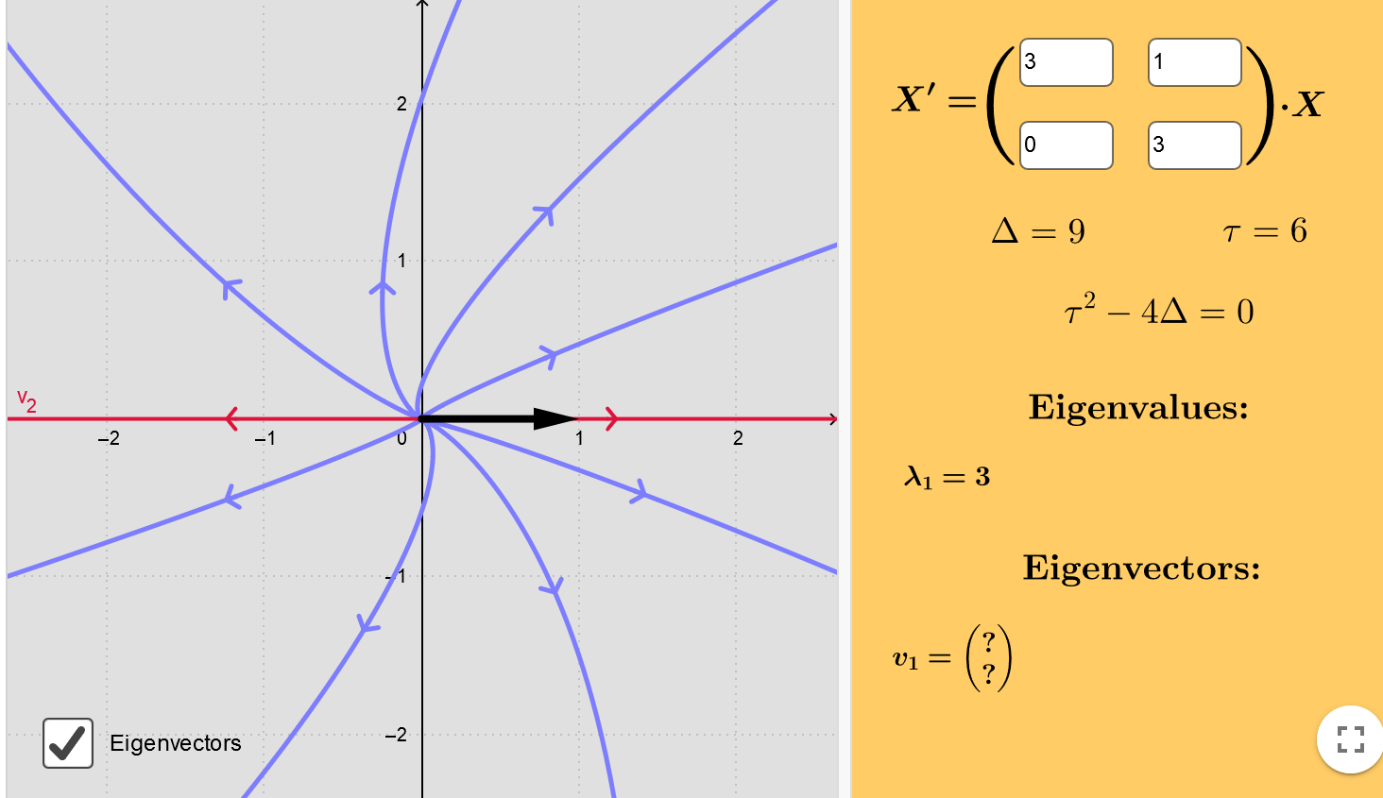
https://www.geogebra.org/m/fYxXgbsU

Slide 23
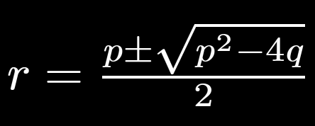
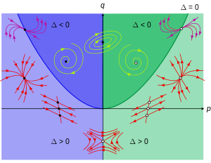
https://en.wikipedia.org/wiki/Phase_plane

Slide 25
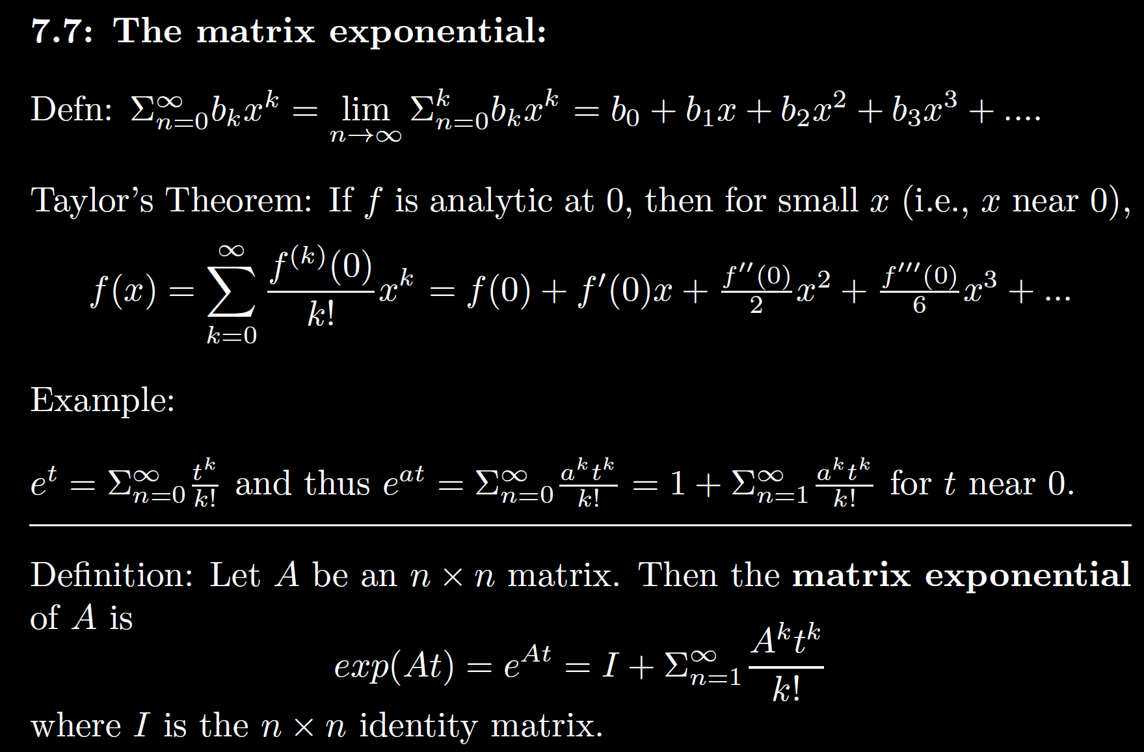

Slide 28
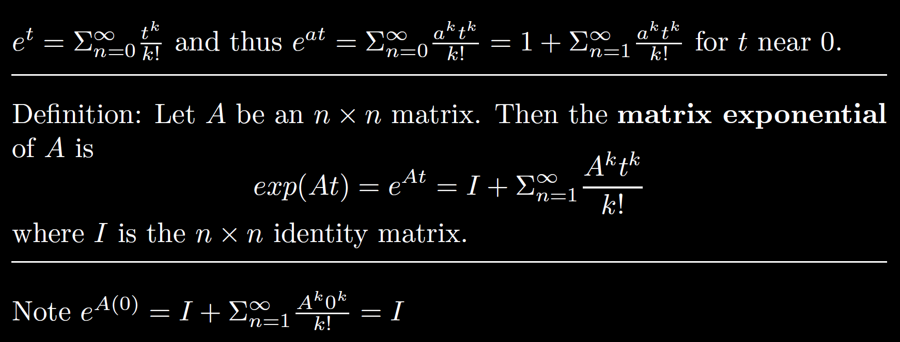

Slide 32
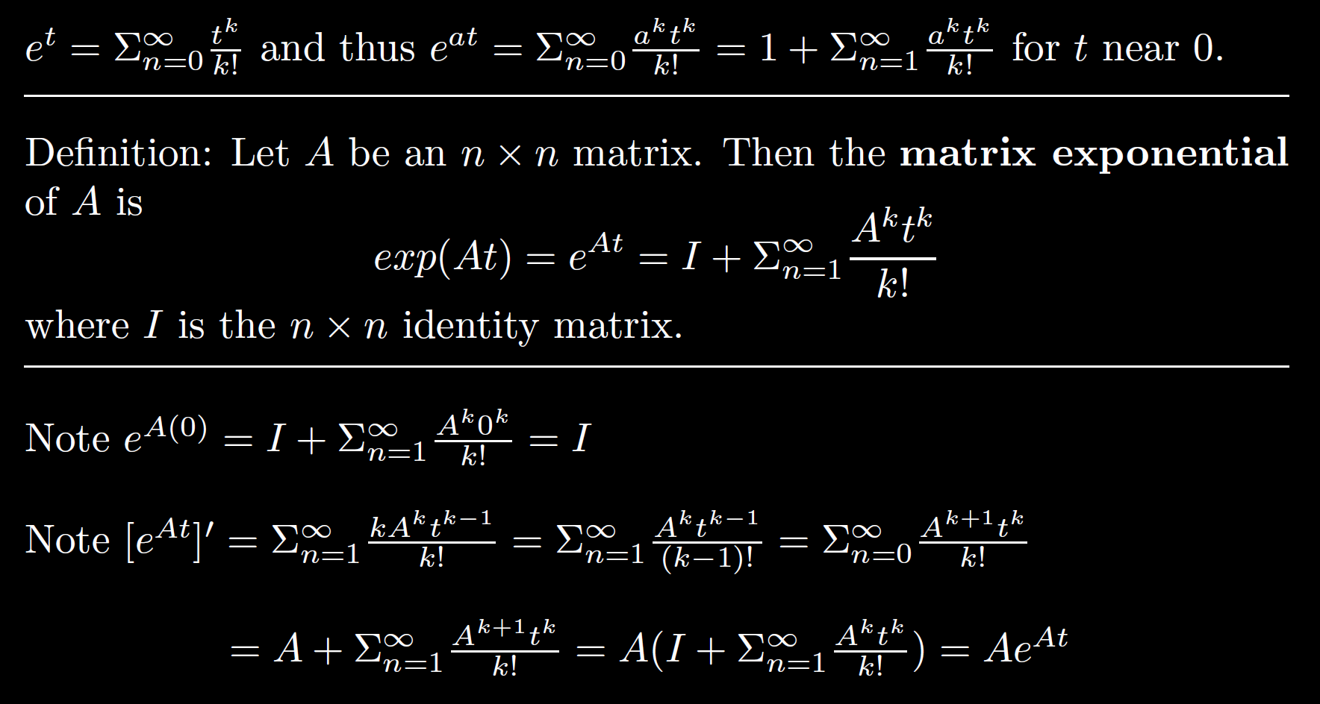

Slide 35
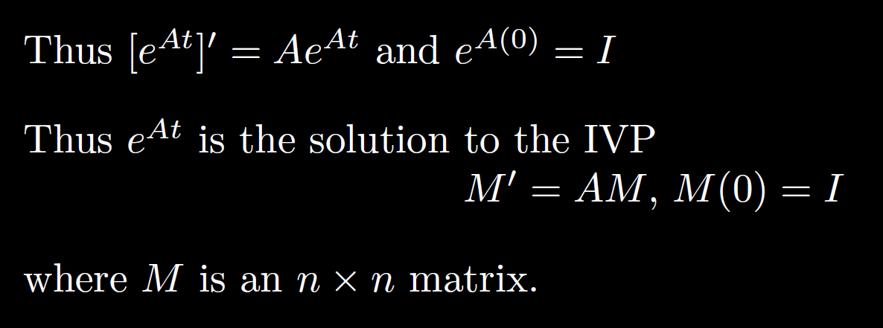

Slide 36
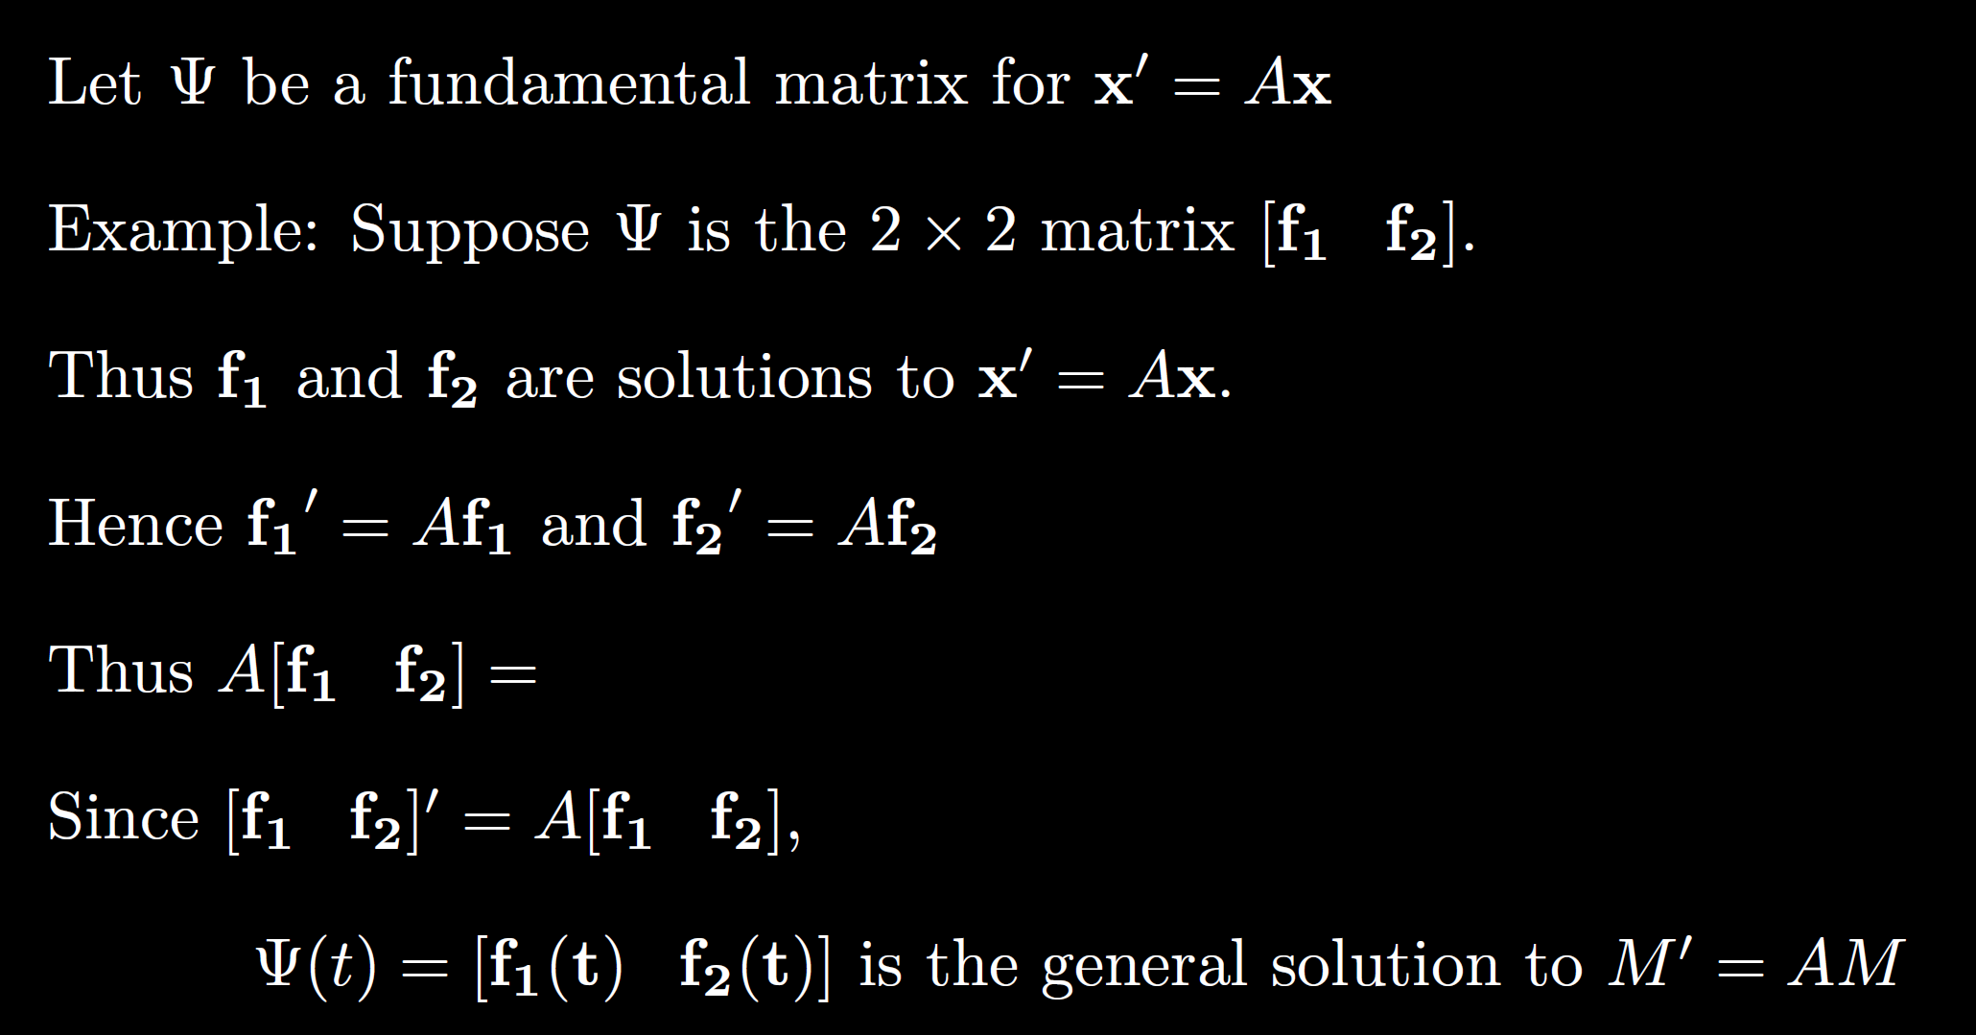

Slide 37
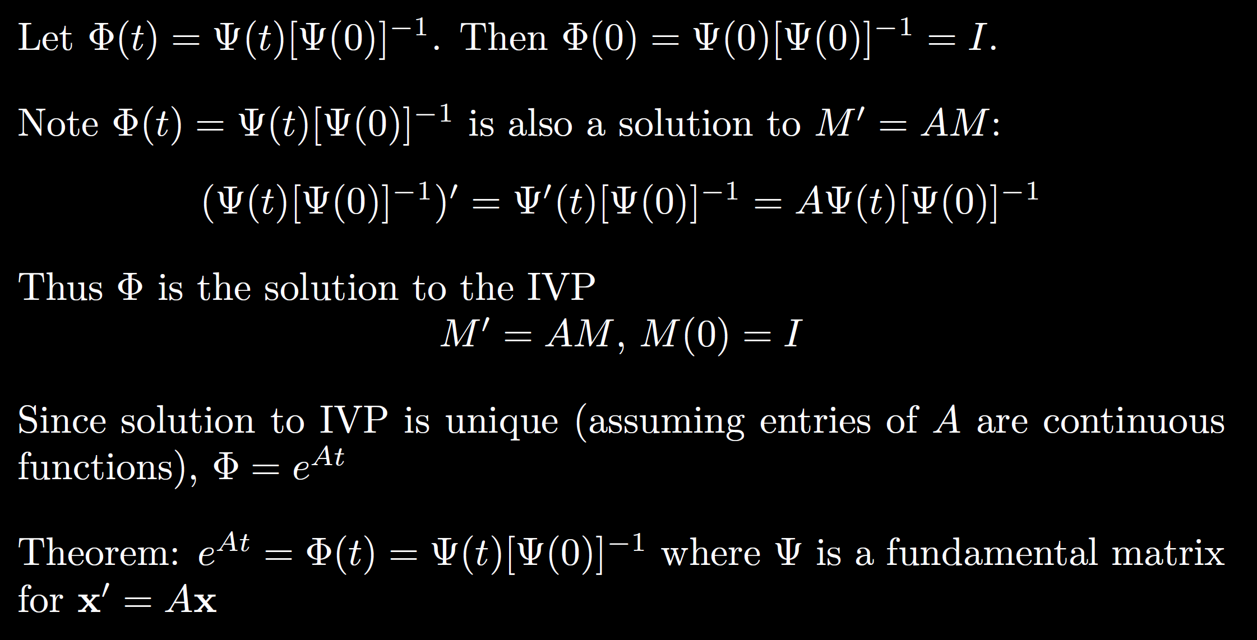

Slide 38
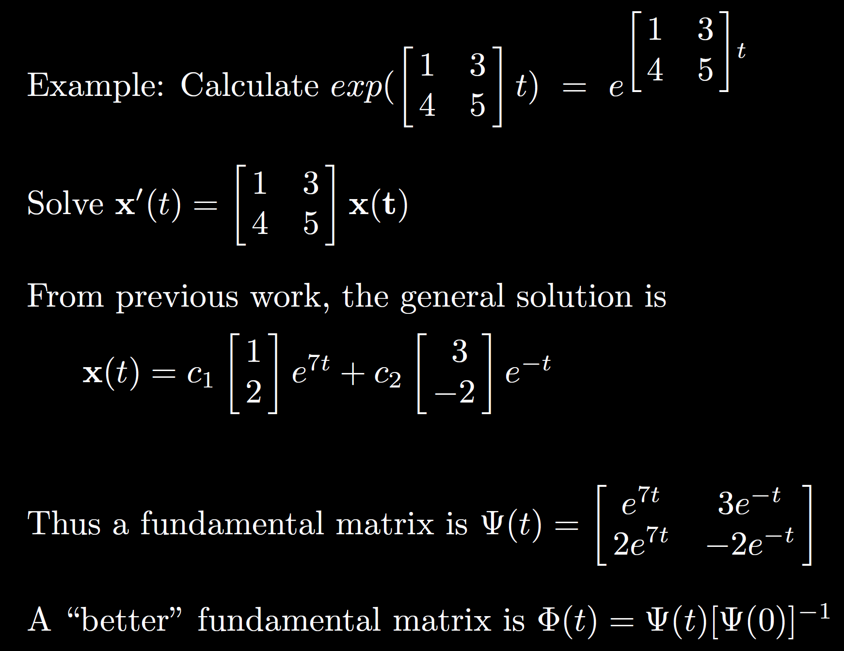

Slide 39
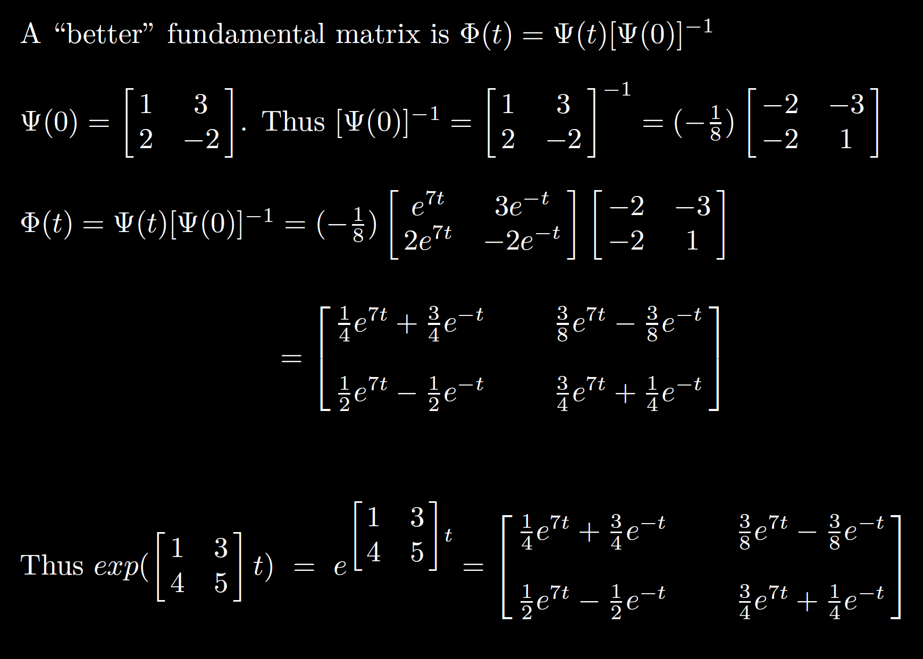

Slide 40
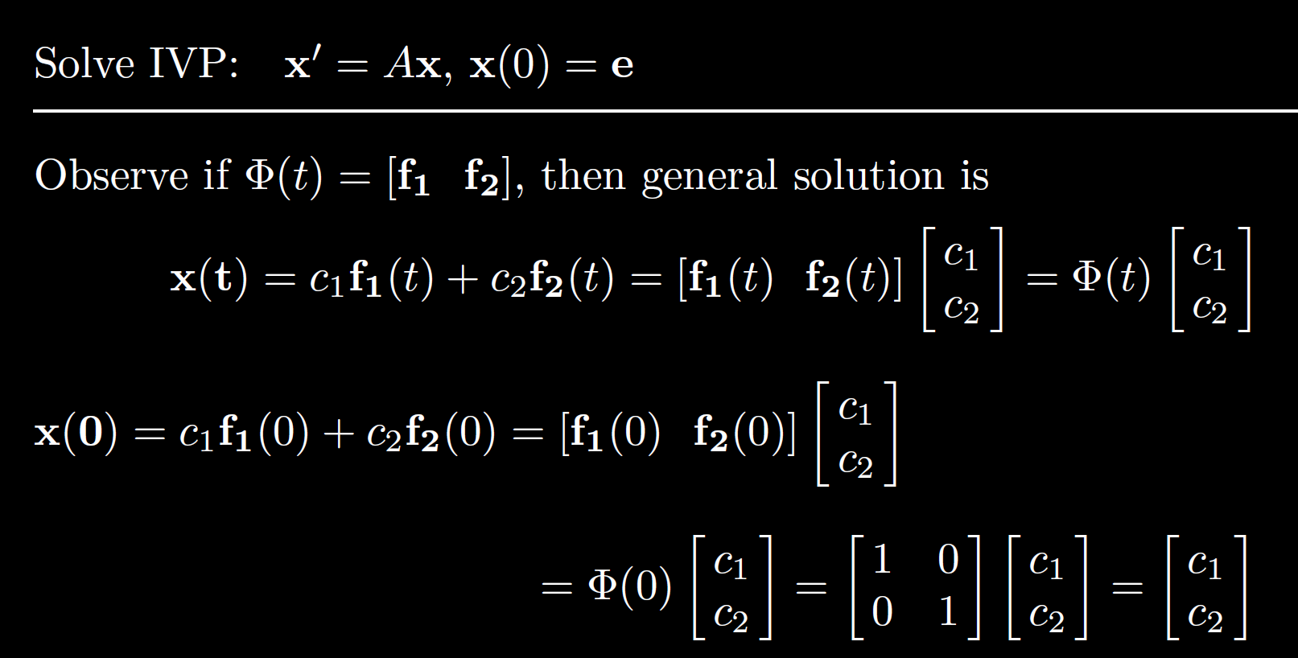

Slide 41
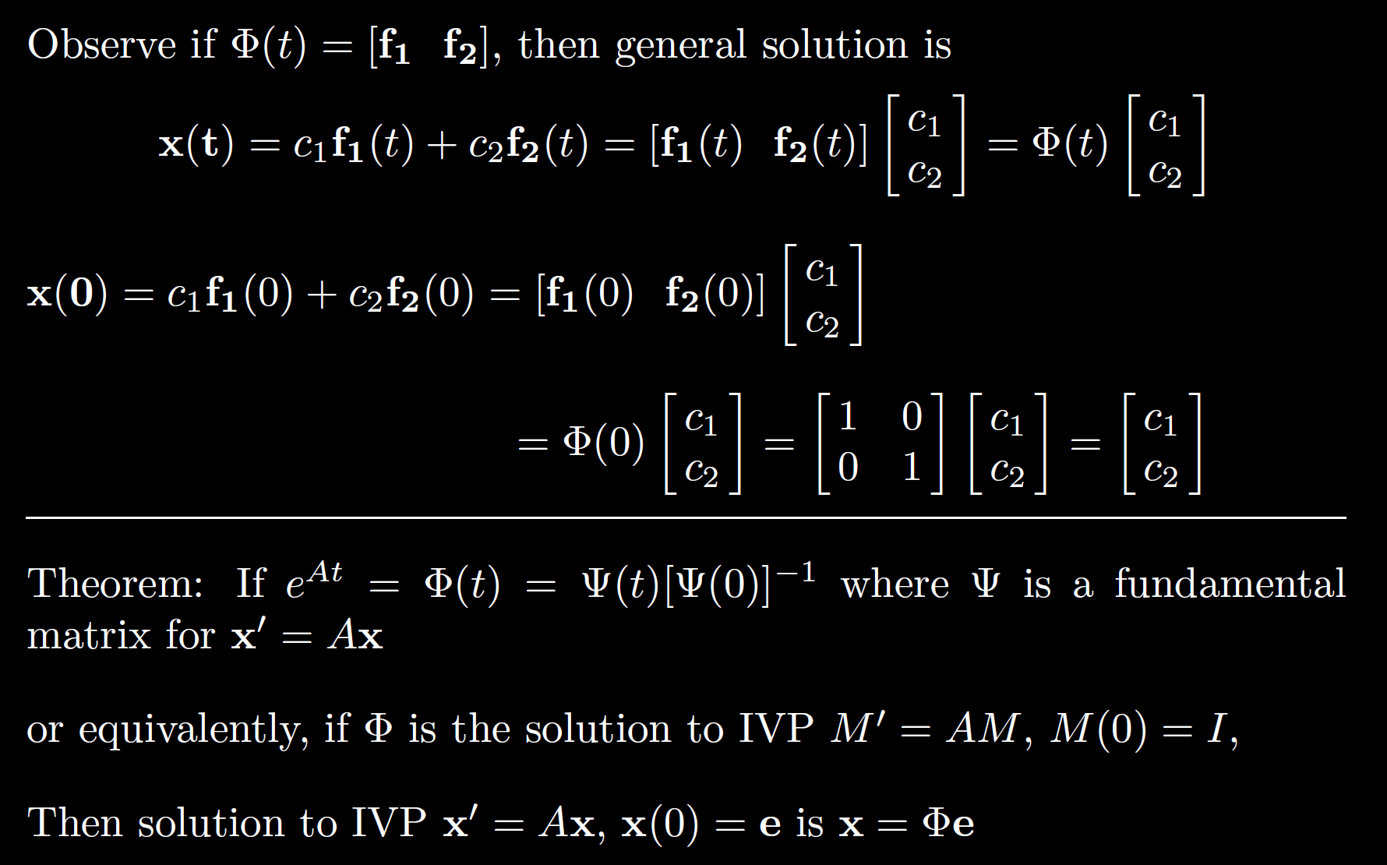

Slide 42
