Slide 1
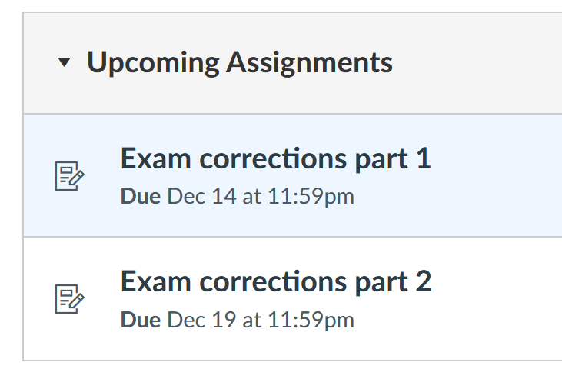
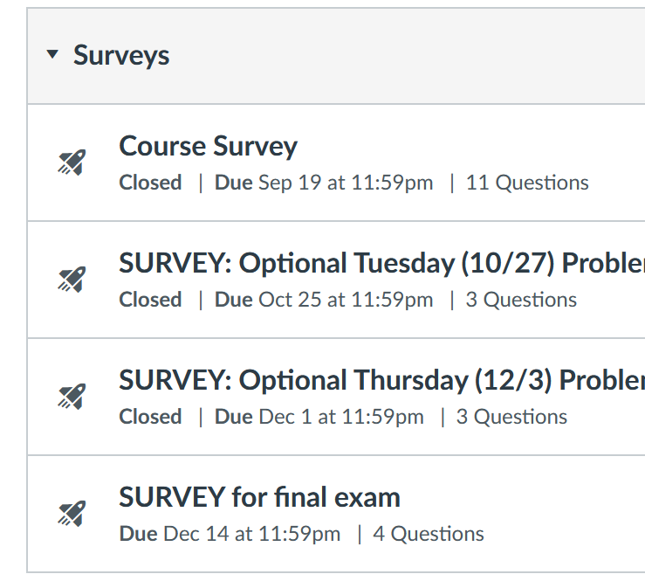

Slide 2
Exam corrections part 1
Per class Wednesday and Friday, there were issues with some of the uploads for the written part for exam 3. Thus for the final exam (similar to our other exams, but not everyone has done this):
Send me a chat after you upload the written part of your final exam so that I can check it before you sign out. Please wait to log out of zoom until I respond that your exam looks readable. I don't guarantee that I will catch all issues, but I have caught several problems.
If you have issues with zoom or anything else, please e-mail me (isabel-darcy@uiowa.edu or call 319-335-0770 and leave message -- I'll call back)
The above will be included in the Quiz Instructions. If you have any questions about exam 3 grading (or other questions), please let me know.

Slide 3
Exam corrections
Since I do not want upload issues to affect grades, I will consider replacing your 2nd lowest exam grade with your final exam grade if it results in a higher grade and if you do one or both of Exam corrections part 1 and part 2.
Part 1 is due this Monday Dec 14 while Part 2 is due Saturday Dec 19. Partial answers to exams will be provided on Tuesday.
Note: I will not grade your exam corrections. You should check the partial answers provided Tuesday.

Slide 4
If your final exam grade is higher than your 2nd lowest exam grade (lowest exam grade will be dropped), I will look to see if you submitted exam corrections. If you have corrected your exam with lowest grade (all parts including multiple choice/answer with brief explanations) or the written part of your 2 exams with lowest grades, I will likely do the final exam replacement.
IF your grade is borderline or if your grade jumps significantly, I may take a closer look at your exam corrections to determine if I should bump your grade up.
Optional exam corrections (but not optional if you want the exam replacement described above): Correct your lowest exam(s) and upload to this optional assignment. You may consult any resource including people for the exam redo (including me, tutors, classmates, etc).
Your corrections should include whatever detail that will help you study for the final exam. Reviewing old exams/quizzes will be extremely helpful for the final exam (in addition to studying section 5.2 and the practice problems reviewing earlier sections that will be provided).

Slide 5
Optional exam corrections (but not optional if you want the exam replacement described above):
Correct your lowest exam(s) and upload to this optional assignment. You may consult any resource including people for the exam redo (including me, tutors, classmates, etc).
Your corrections should include whatever detail that will help you study for the final exam. Reviewing old exams/quizzes will be extremely helpful for the final exam (in addition to studying section 5.2 and the practice problems reviewing earlier sections that will be provided).

Slide 6
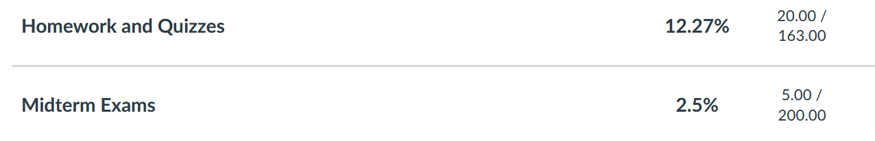

Slide 7
Final exam will be similar format as exams 1 – 3 ( breakdown between written part and ICON part TBD).
Send me a chat after you upload the written part of your final exam so that I can check it before you sign out.
PLEASE write on only 1 side.
If you do the optional exam redo HW, your grade will be
0.15 (HW and Quizzes) + 0.3(max(exam1, exam2, exam3)
0.25 (Final exam) + 0.3(max( Final exam, 2nd highest exam k)
k = 1, 2, 3

Slide 8
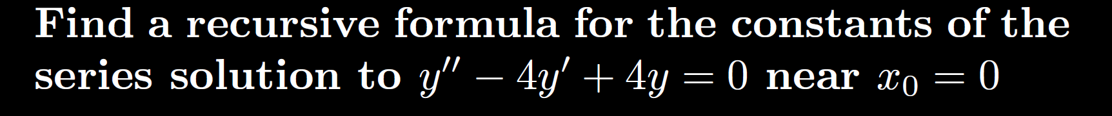
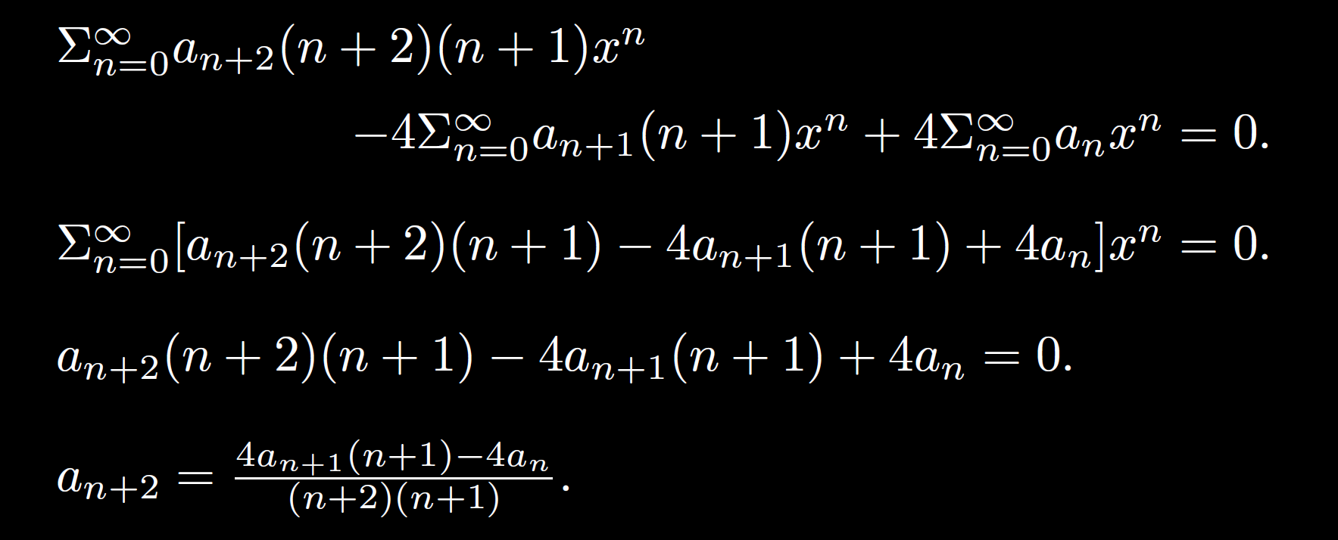
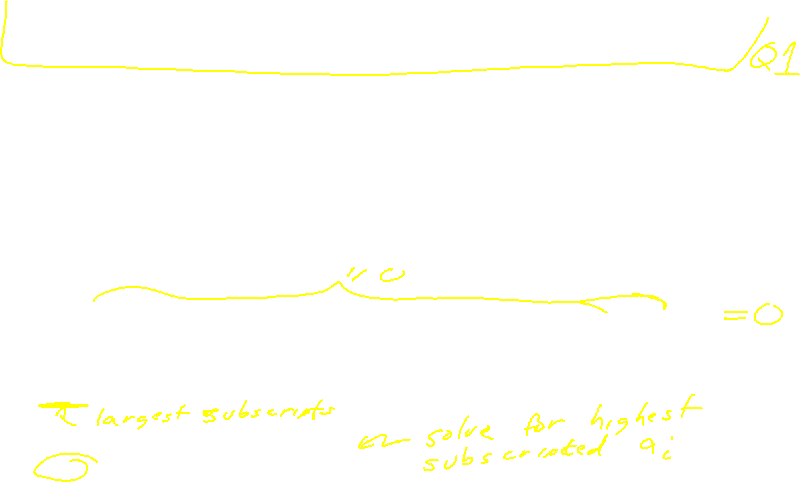

Slide 9
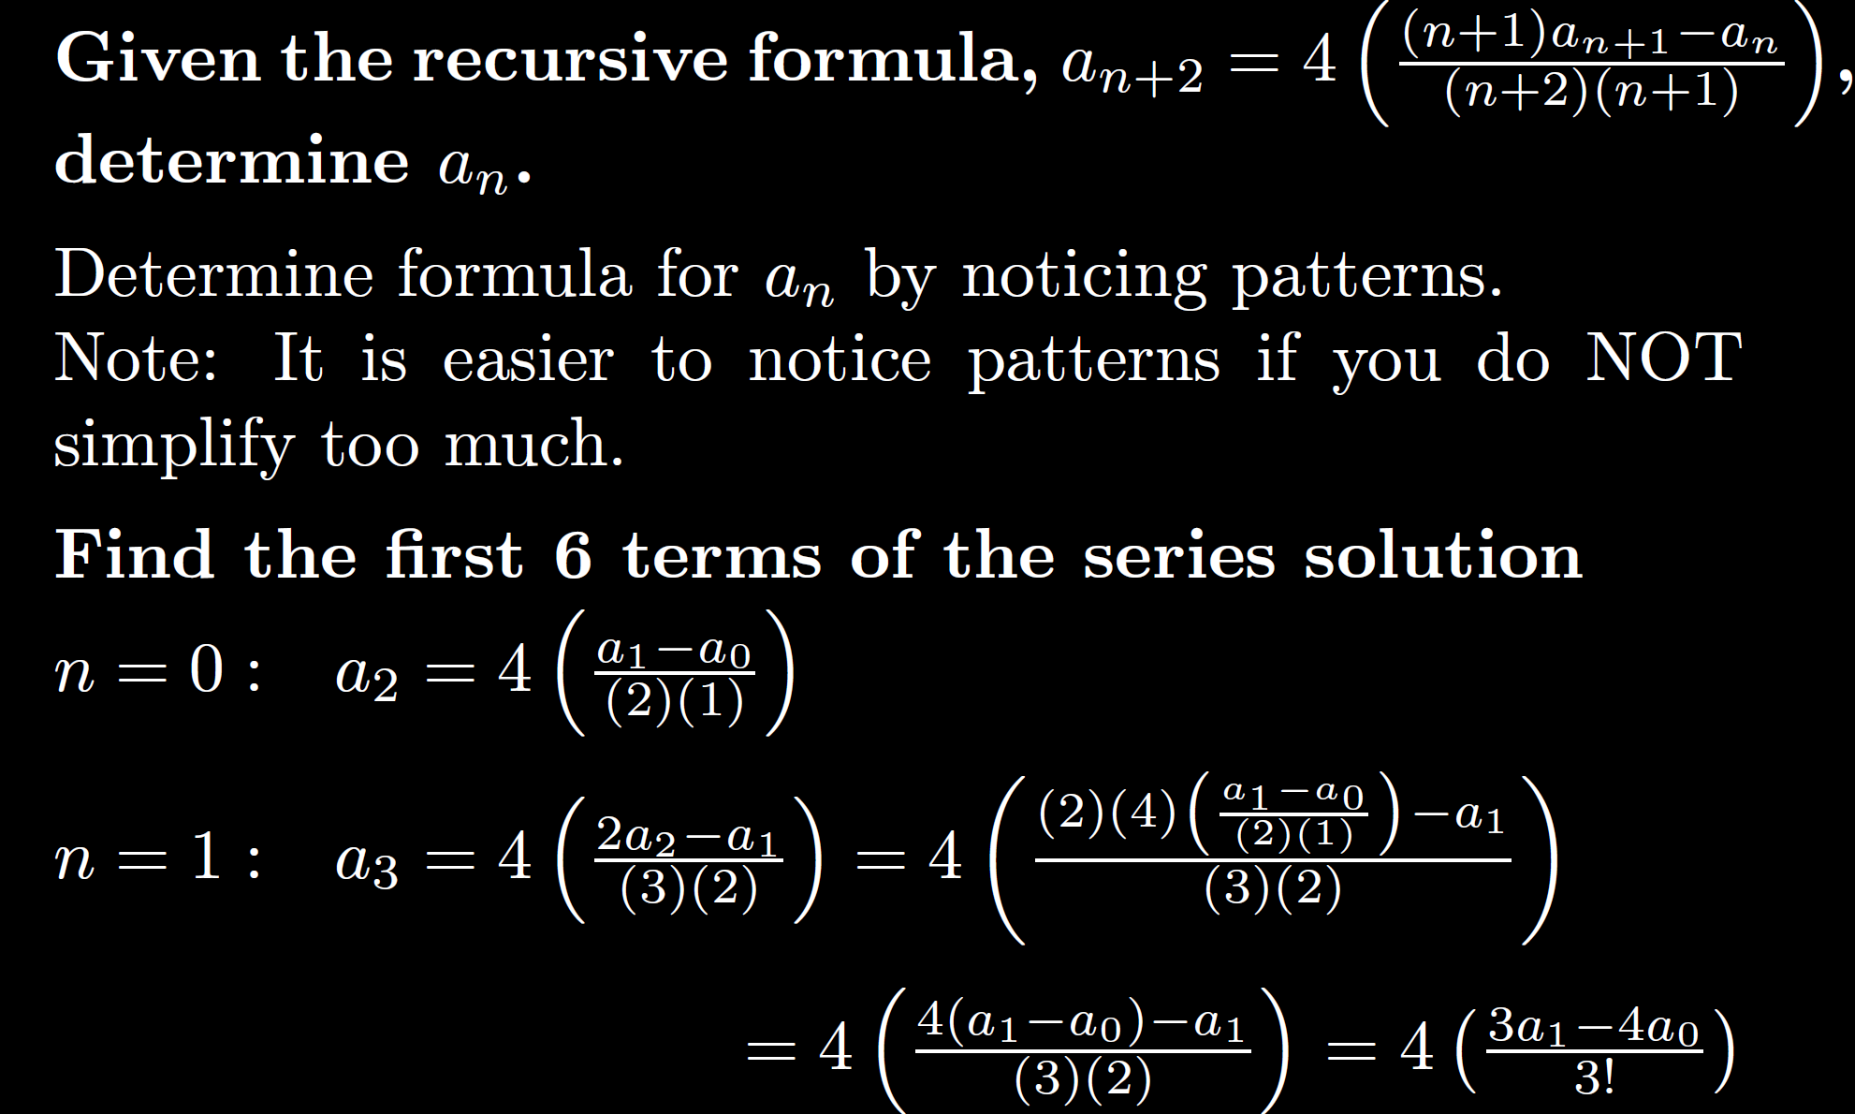
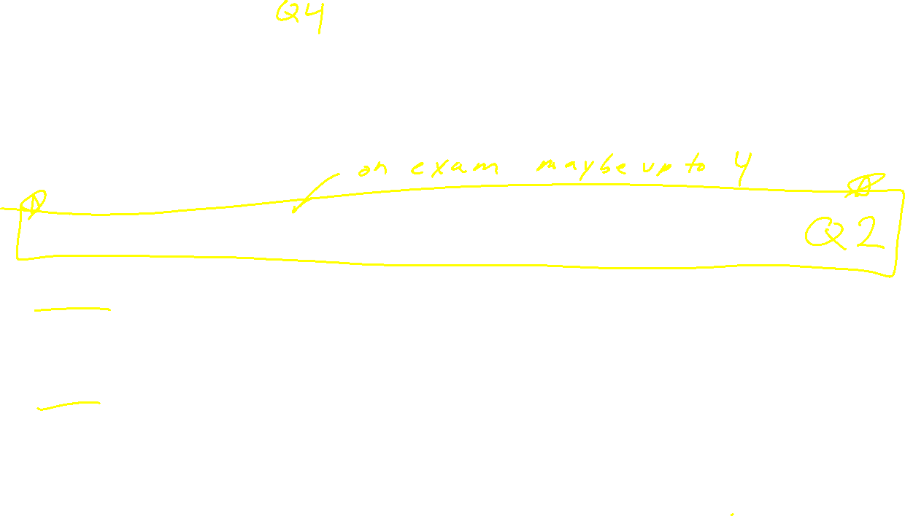

Slide 10
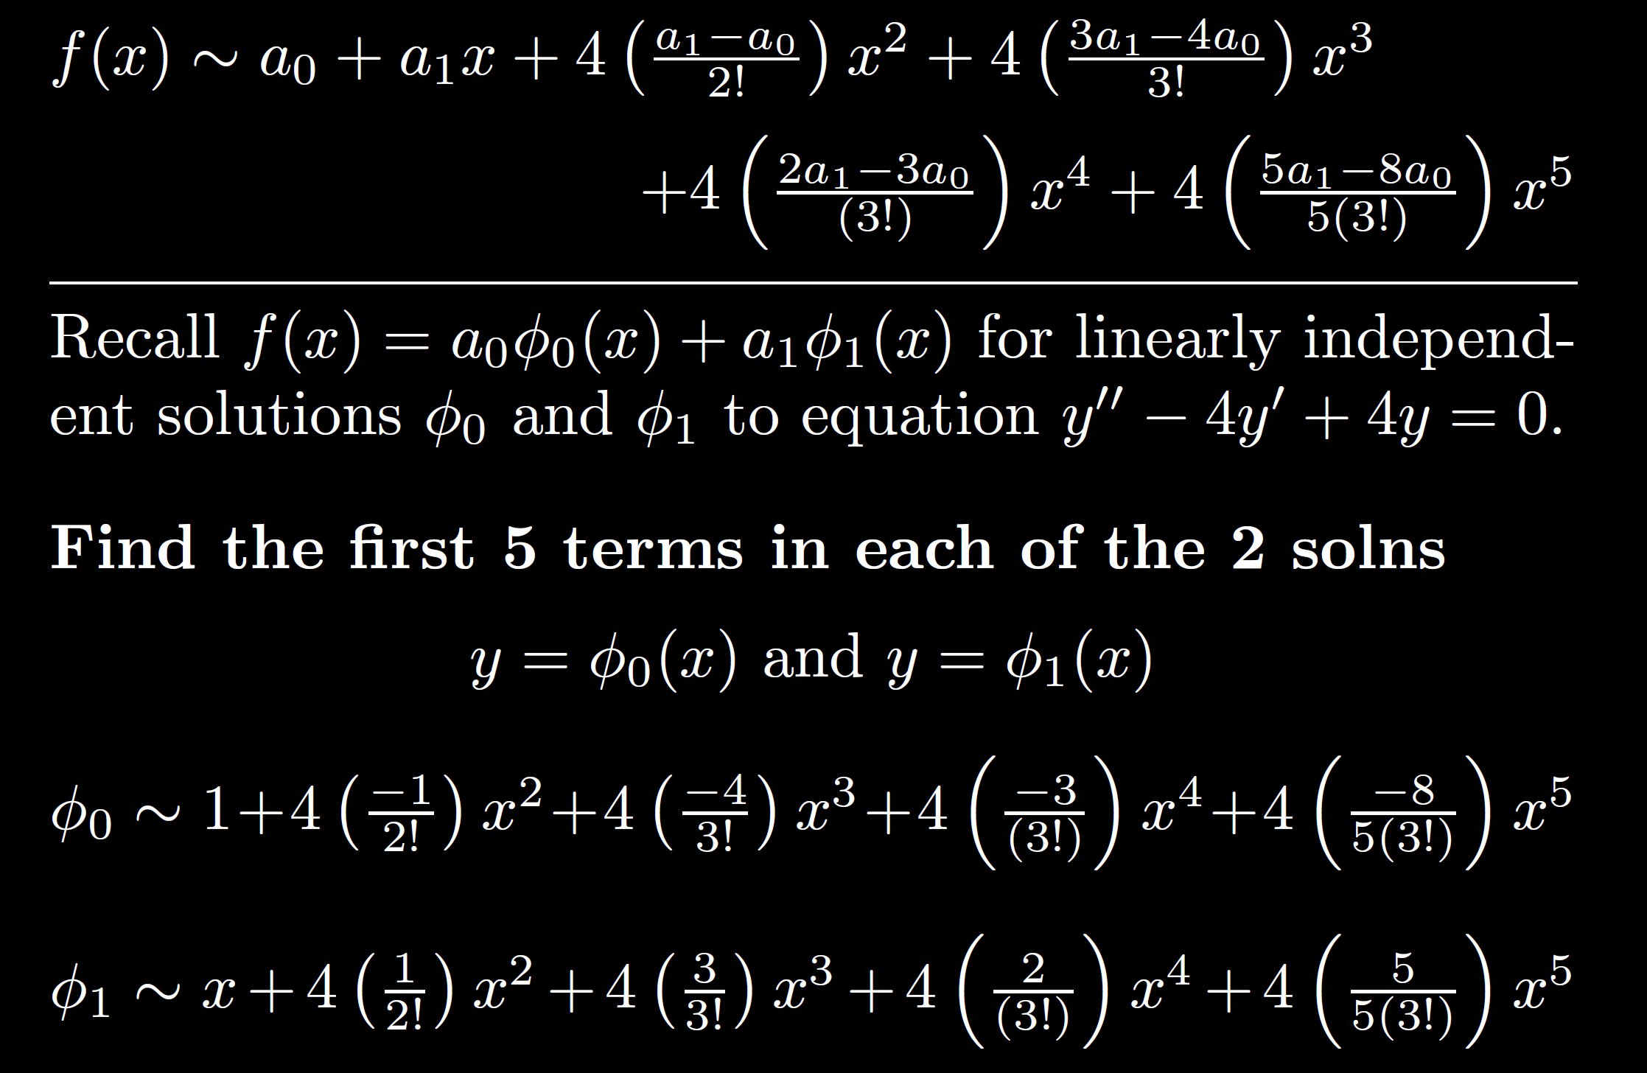
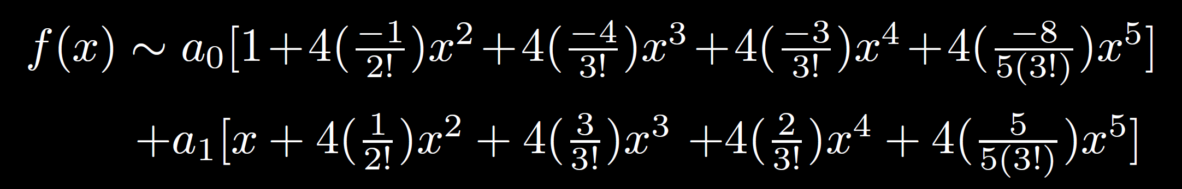
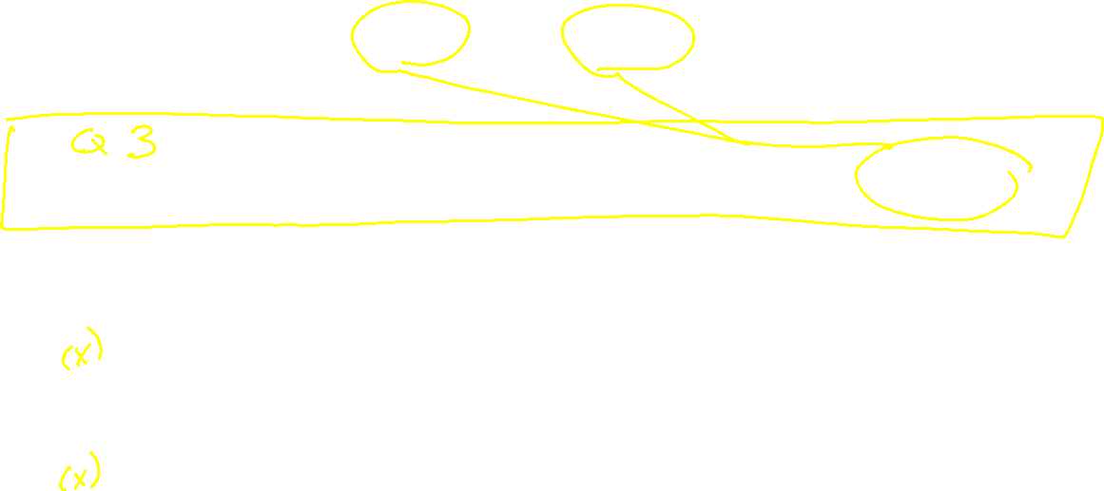

Slide 11
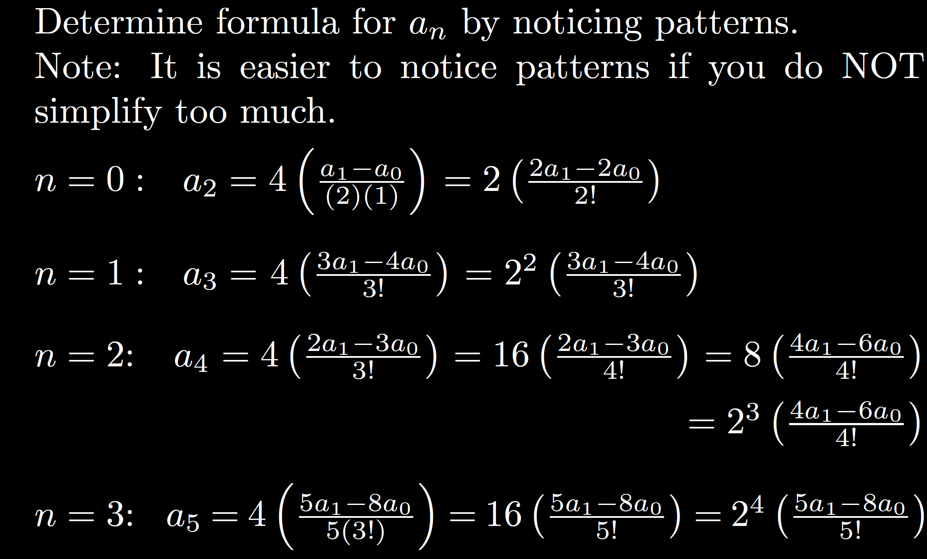
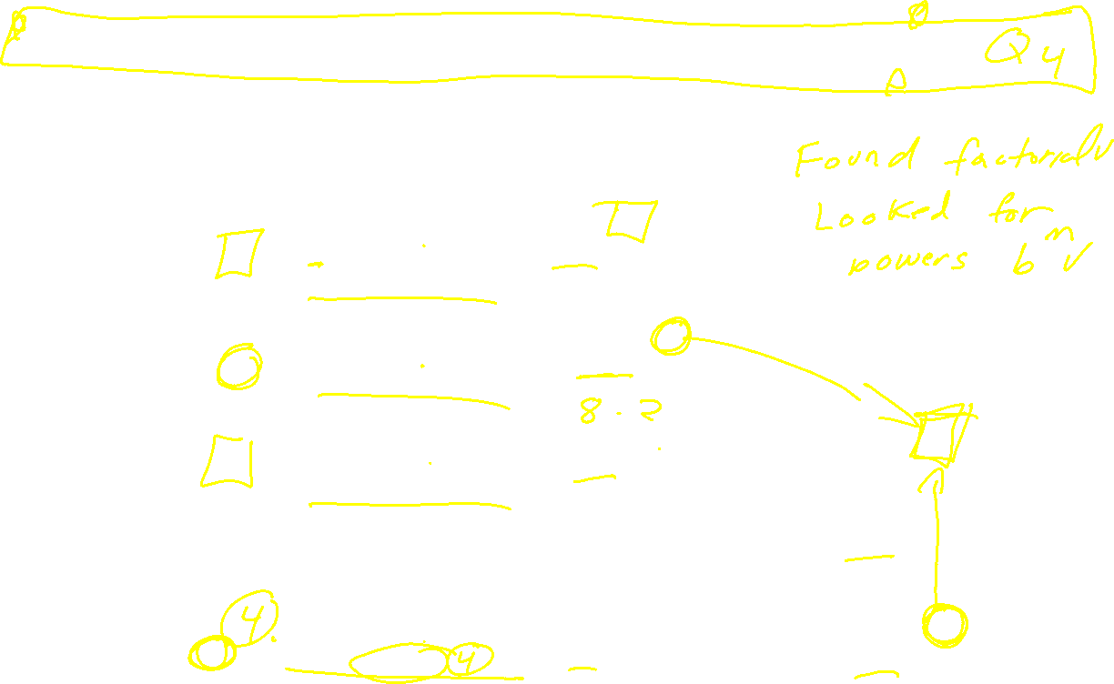

Slide 12
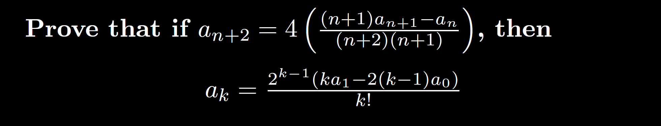
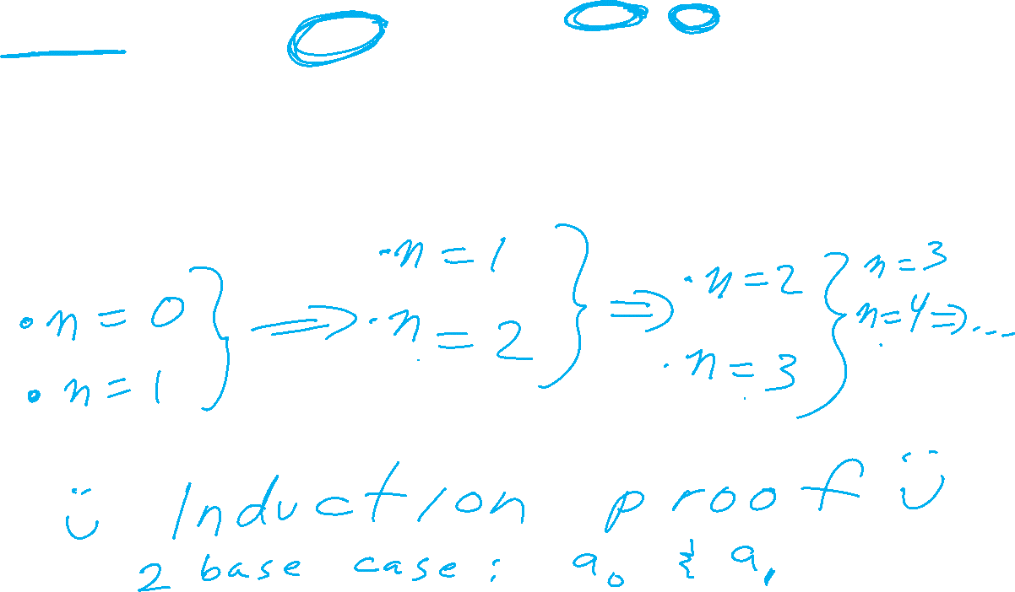
Scratch:

Slide 13









Scratch:

Slide 15
What day/times would you like the problem sessions to be?
Are there days/times that would not work for you for the optional problem sessions?

Slide 16
I will create multiple choice/answer part of exam by modifying questions from the following 2 sources (1) multiple choice practice pdf and (2) ICON "All quizzes".
Note: some questions may be repeated. This does not imply these questions are more important than others, but just the way quizzes were created.
I will create the written part of the exam, by taking 1 or 2 questions from the 5 types of questions from section 5.2 as well as modifying questions from the following 3 sources (1) multiple choice practice pdf, (2) ICON "All quizzes", (3) Written part of exams 1, 2, 3 (multiple choice/answer parts

Slide 17
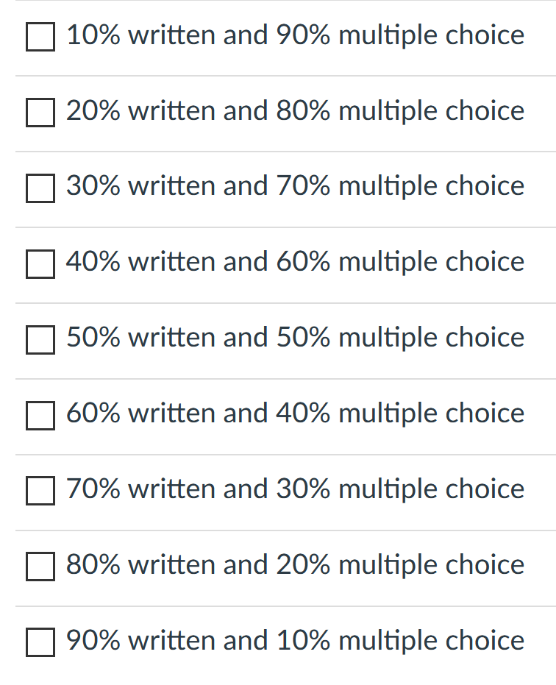
I will create multiple choice/answer part of exam by modifying questions from the following 2 sources (1) multiple choice practice pdf and (2) ICON "All quizzes".
Note: some questions may be repeated. This does not imply these questions are more important than others, but just the way quizzes were created.
I will create the written part of the exam, by taking 1 or 2 questions from the 5 types of questions from section 5.2 as well as modifying questions from the following 3 sources (1) multiple choice practice pdf, (2) ICON "All quizzes", (3) Written part of exams 1, 2, 3 (multiple choice/answer parts
Based on the above, what percent would you like for the written part vs multiple choice part (select as many as you like?

Slide 18
Any comments, questions, suggestions, etc?
In particular, are there any sections/problem types you would prefer NOT be on the final exam?
Any other comments, questions, suggestions regarding final exam, course, book, lectures, HW, etc?
Note: This anonymous survey does NOT replace the course evaluation. I would appreciate it if you also fill out the anonymous course evaluation. Thank you.

