Slide 9
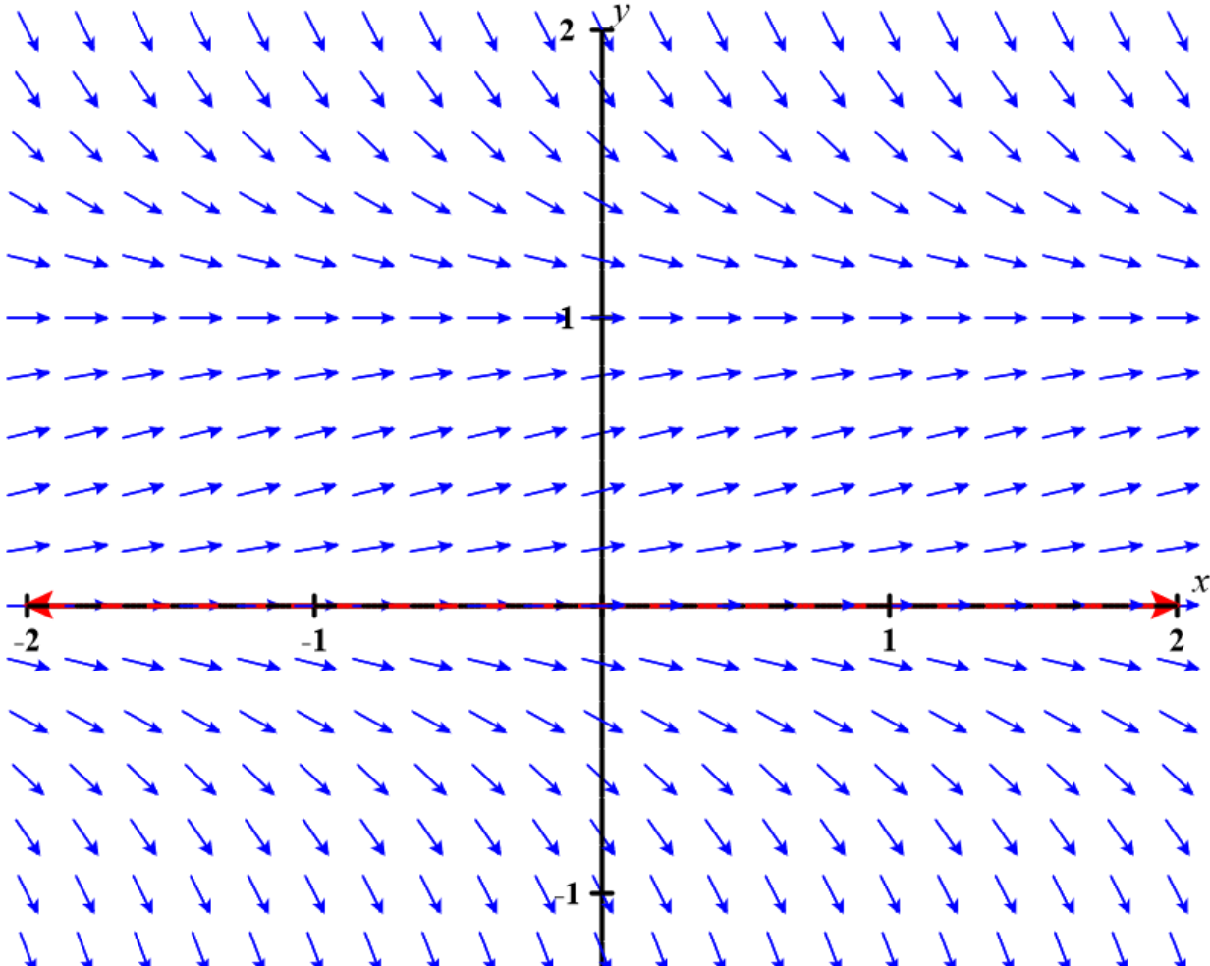
https://c3d.libretexts.org/DirectionField/index.html

Slide 10
