Slide 1
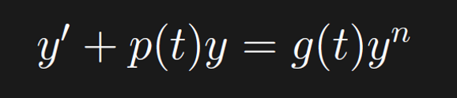
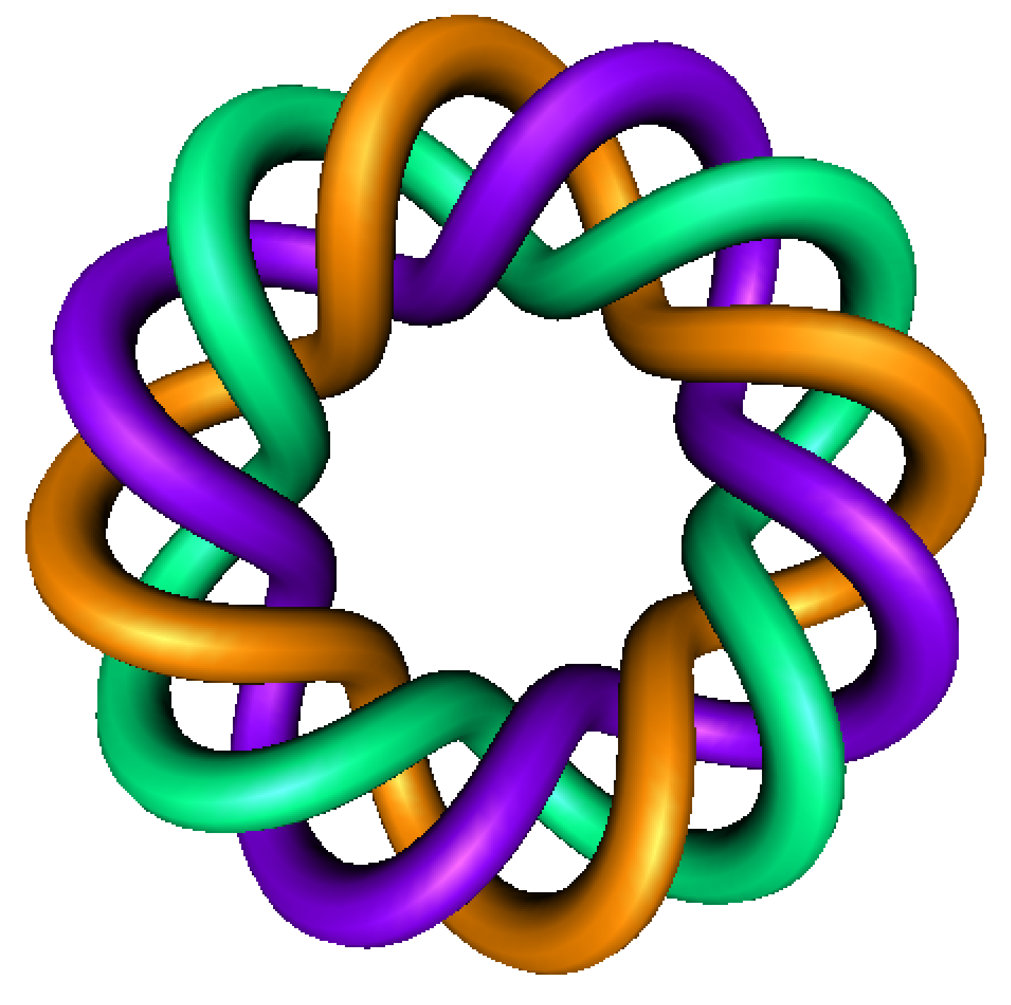
Solving Bernoulli's equation
By Dr. Isabel Darcy,
Dept of Mathematics and AMCS,
University of Iowa

Slide 2
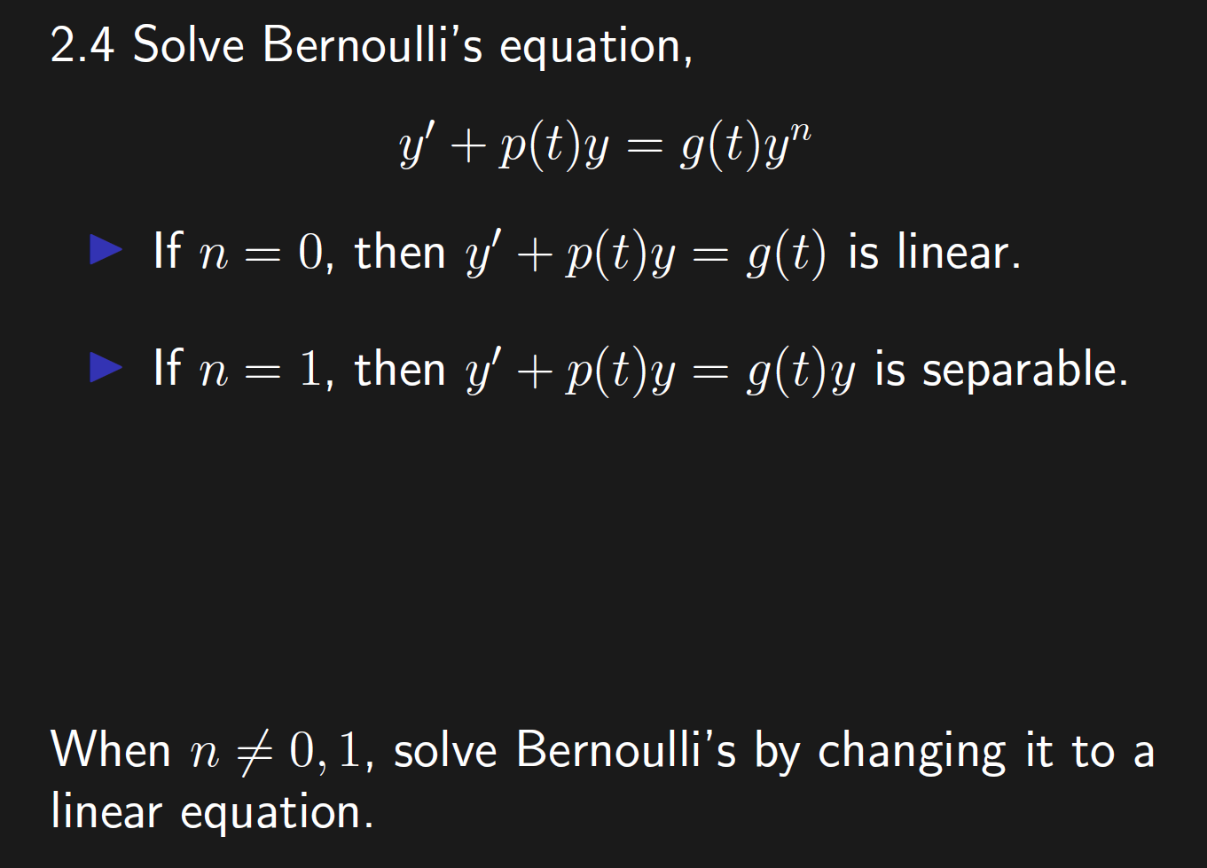

Slide 3
How do you change a problem that you do not know how to solve into a problem that you do know how to solve?

Slide 4
The algorithm is NOT as important as the idea behind the algorithm.

Slide 5
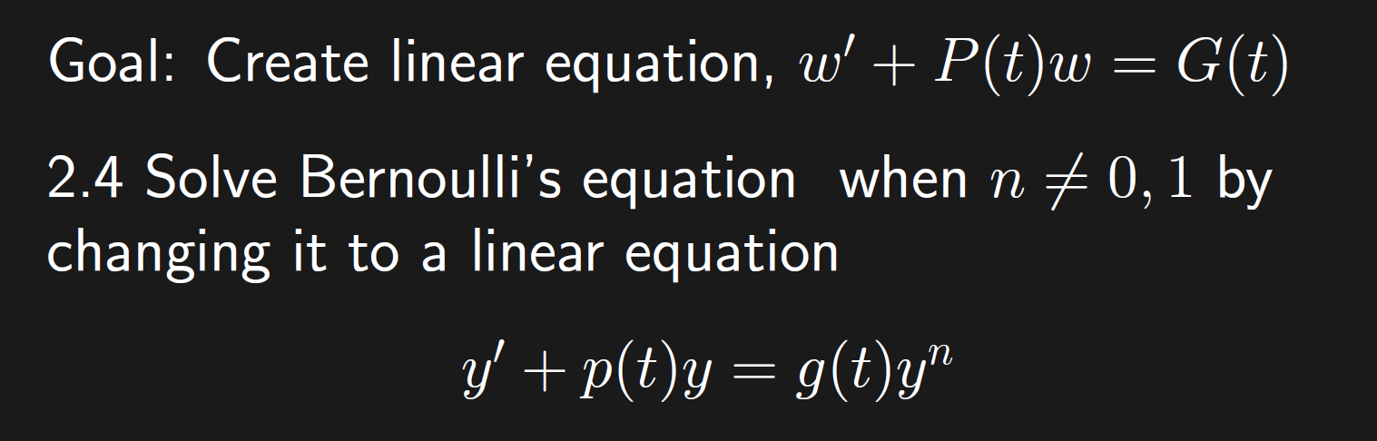

Slide 6
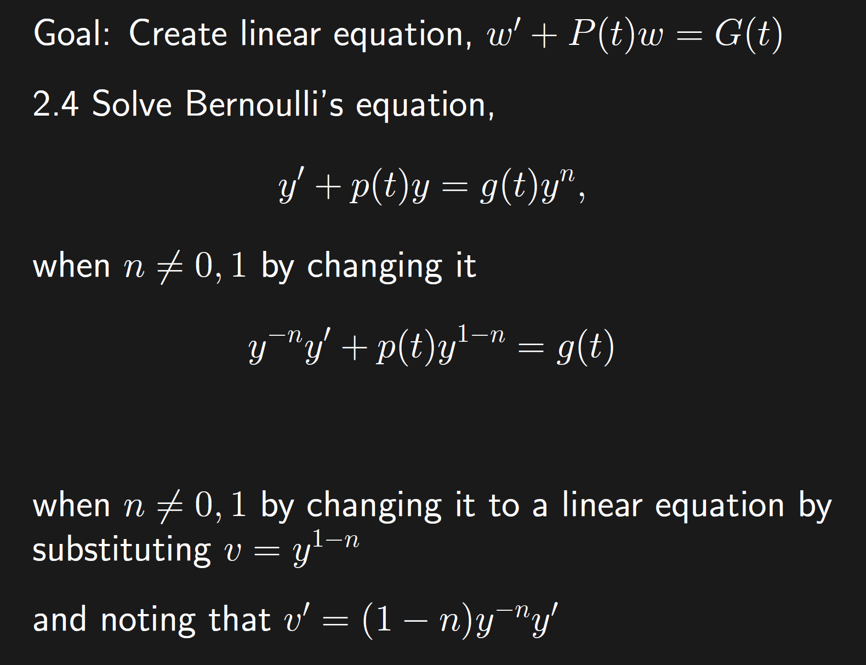

Slide 7
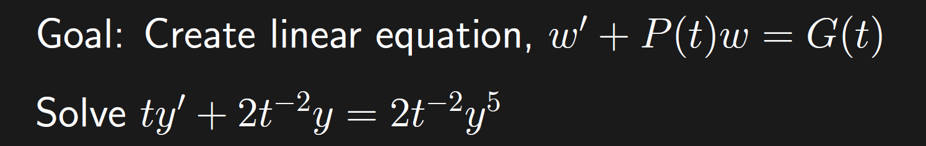

Slide 8
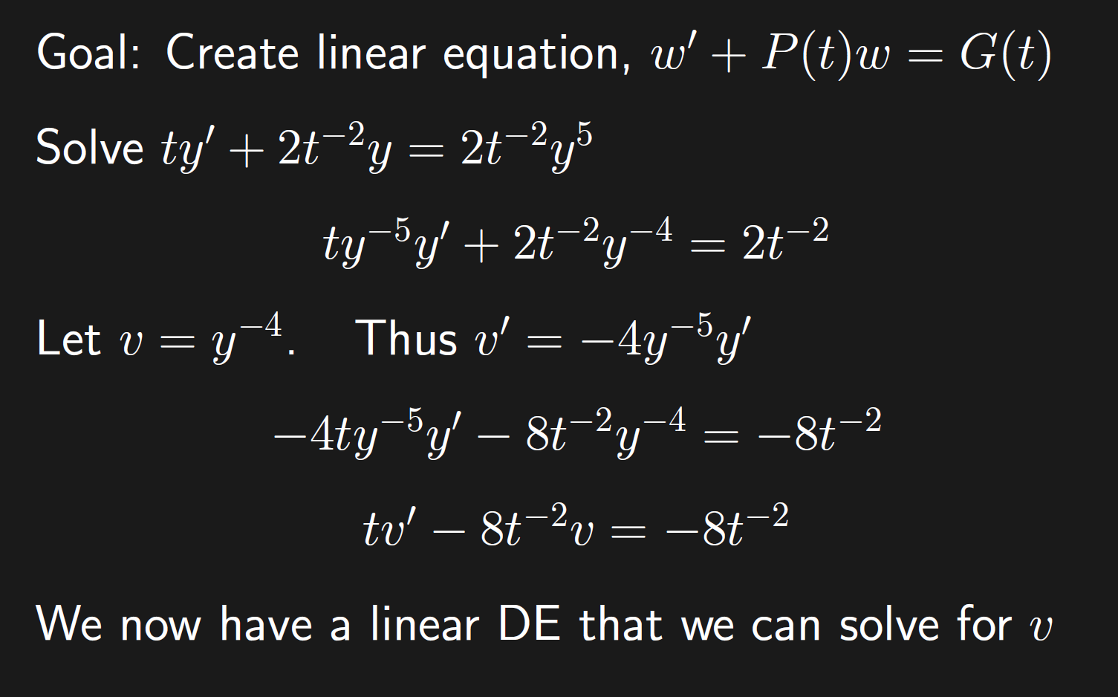

Slide 9
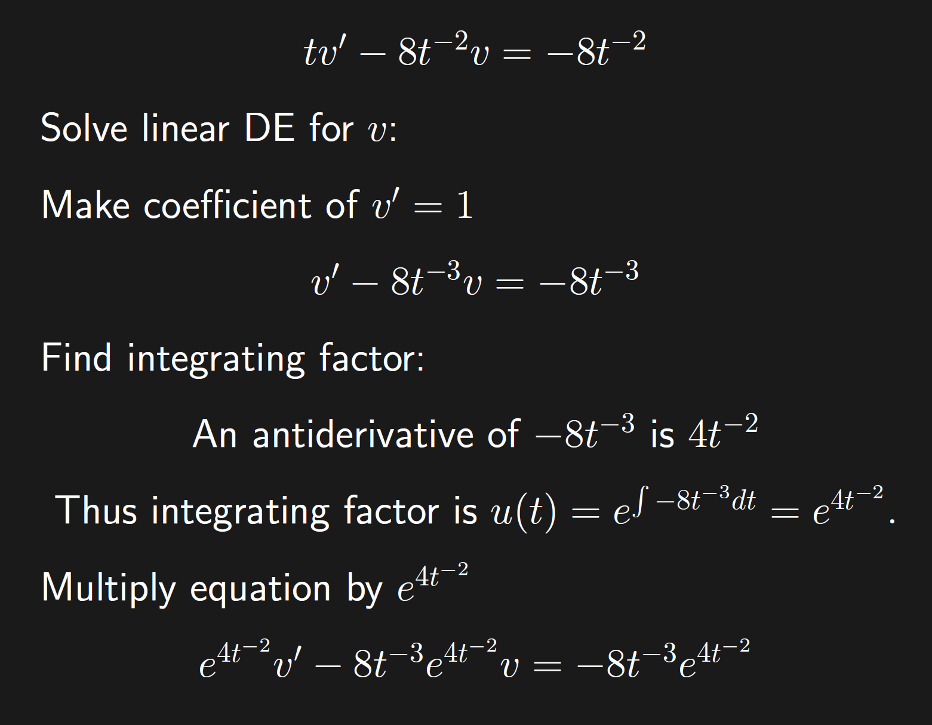

Slide 10
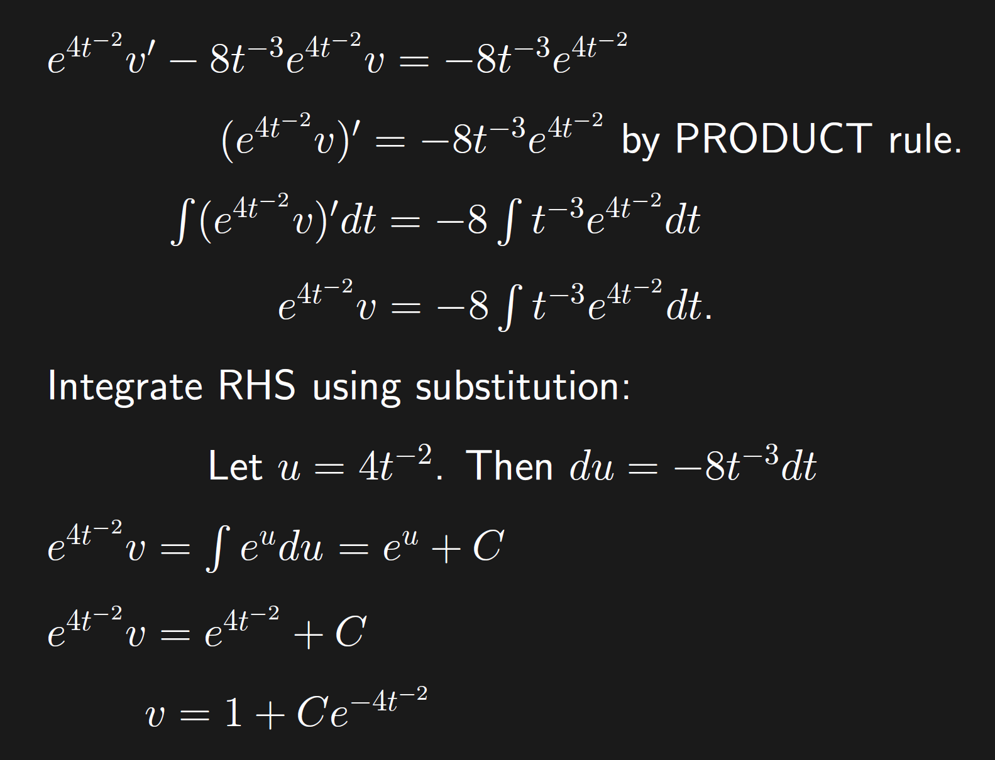

Slide 11
