Slide 1
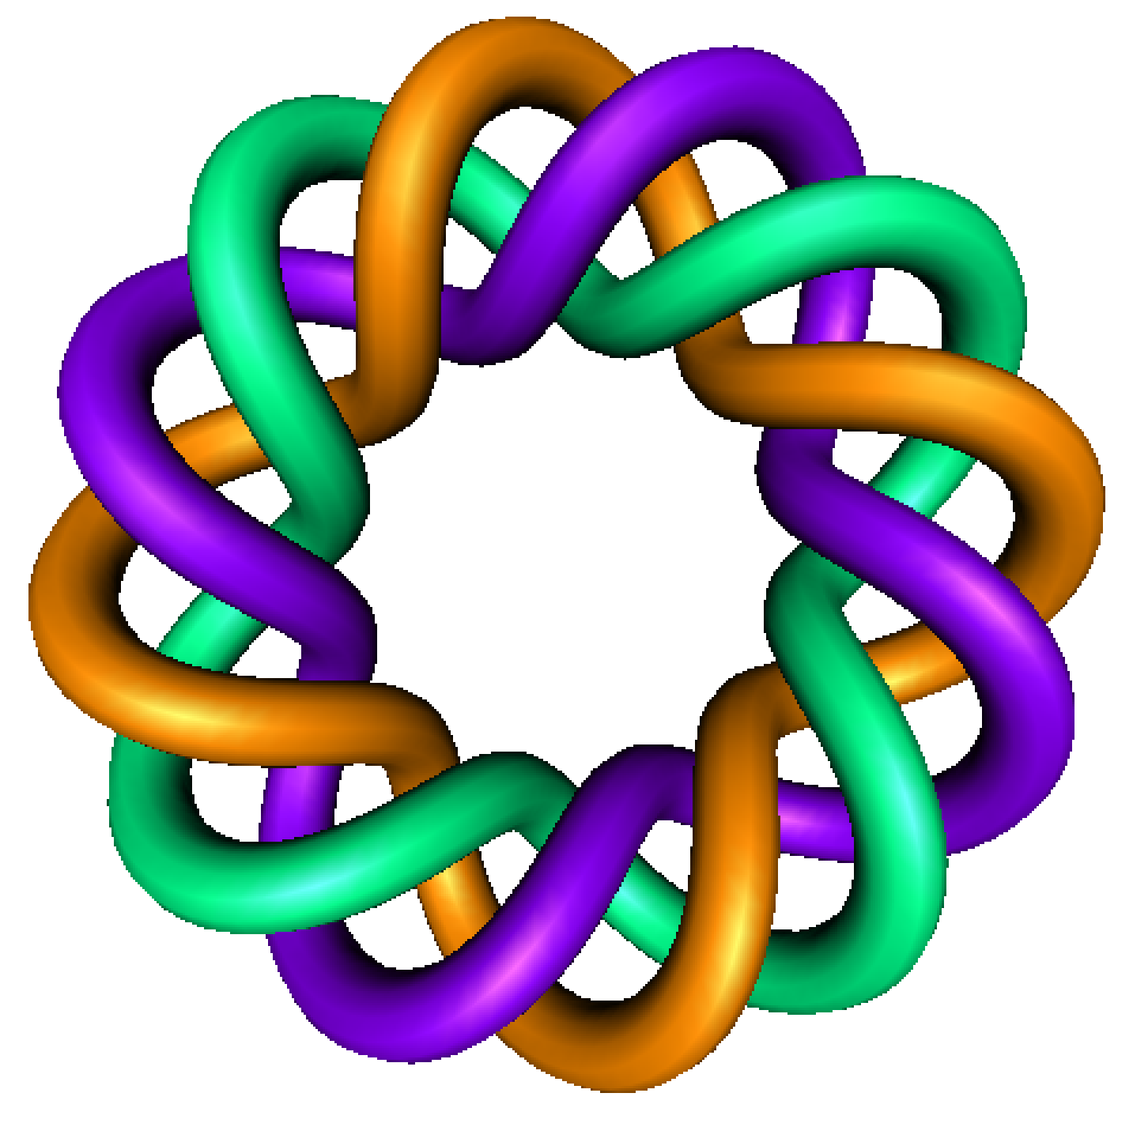
Review of solving first order LINEAR differential equation using an integrating factor
By Dr. Isabel Darcy,
Dept of Mathematics and AMCS,
University of Iowa

Slide 3
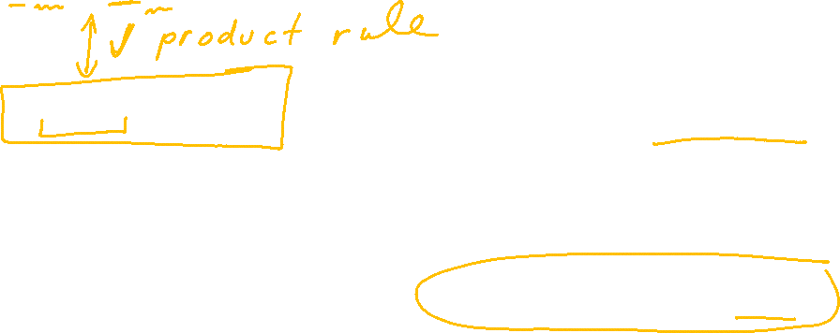

Slide 4
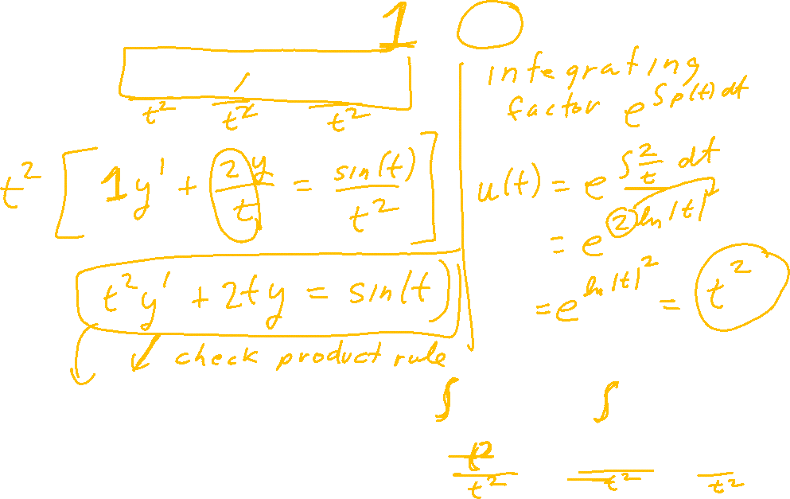

Slide 7
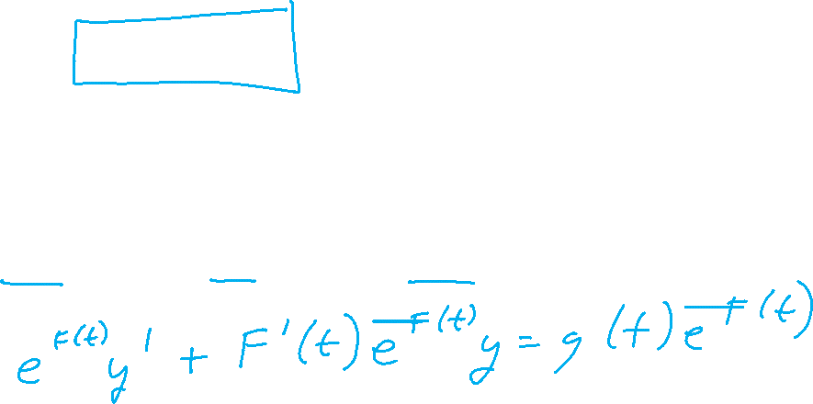

Slide 8
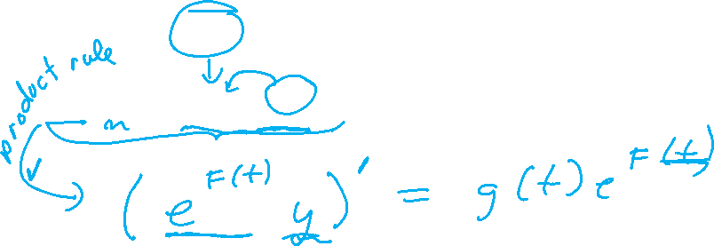

Slide 9
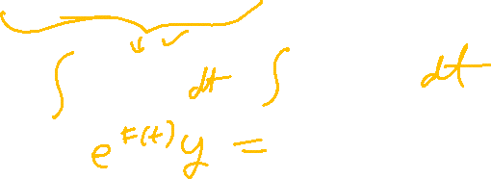

Slide 11
