Slide 1
Notation and Tabulation of 2-String Tangles
Zachary Bryhtan
Mathematics Department—University of Iowa

Slide 2
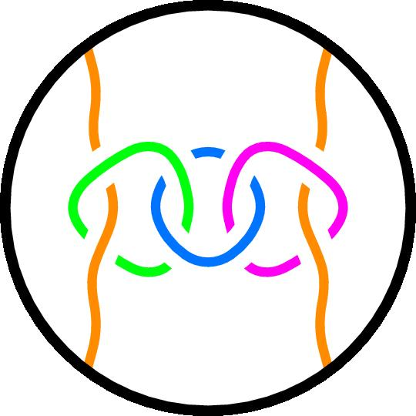
Definition
A knot is an embedding of the circle $S^{1}$ into $ℝ^{3}$
Focus of the talk
A link is a finite disjoint union of knots
An $n$-tangle is a ball containing $n$ disjoint properly embedded arcs and a possibly empty set of loops (but our focus will be on tangles of two strings)
Focus of the research

Slide 3
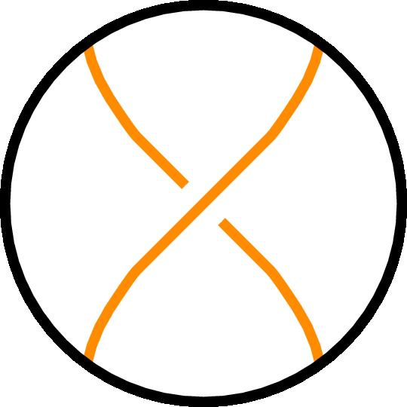
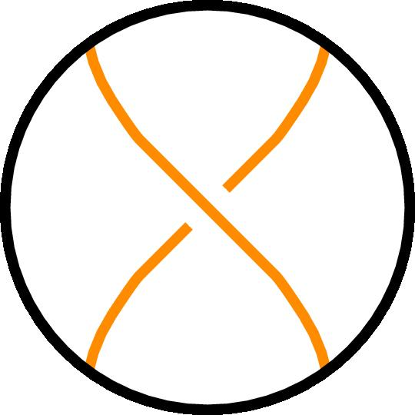
Definition
An integer tangle is a tangle consisting of horizontal twists only and denoted by the fraction $\frac{n}{1}$ where $n$ indicates the number of crossings and their orientation.
The mathematical convention assigns the orientation of crossings based on the slope of the overstrand.
$\frac{1}{1}$
$\frac{−1}{1}$
$\frac{3}{1}$
$\frac{−2}{1}$

Slide 4
Definition
$$\frac{1}{4}$$
A vertical tangle is a tangle consisting of vertical twists only (obtained through an integer tangle and rotating it 90 degrees) and denoted by the fraction $\frac{1}{n}$.
$$\frac{1}{−2}$$

Slide 5
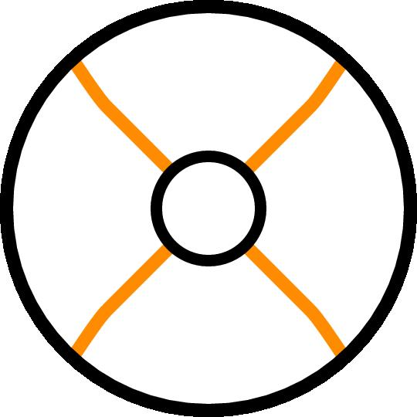
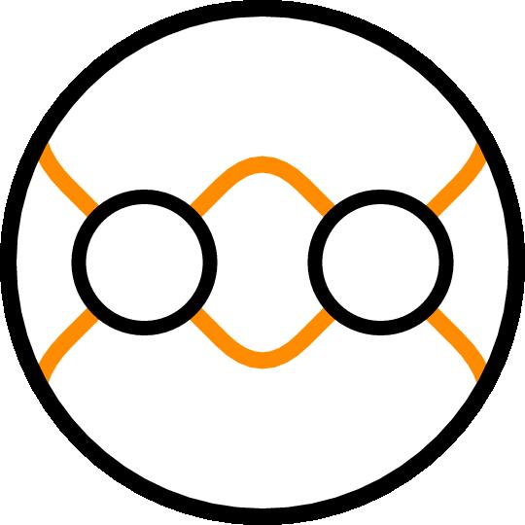
Tangle Operations
The sum of two tangles $A$ and $B$ is performed by laying them in a row ($A$ left of $B$) and connecting the for interior endpoints horizontally.
$$A$$
$$+$$
$$B$$
$$=$$
$$A$$
$$B$$

Slide 6
Tangle Operations
The product of two tangles $A$ and $B$ is performed by laying them in a column ($A$ over $B$) and connecting the four interior endpoints vertically.
$$A$$
$$A$$
$$∗$$
$$B$$
$$=$$
$$B$$

Slide 7
Definition
Two tangles/knots/links are equivalent if one can be continuously deformed into the other using Reidemeister moves
$$RI$$
$$RIII$$
$$⇔$$
$$⇔$$
$$RII$$
$$⇔$$

Slide 8
Definition
A flype may be recreated through a series of Reidemeister moves and may be used for convenience to determine equivalences
$$L$$
$$⇔$$
$$L$$
Notes:
Introduced by tait

Slide 9
Conway Notation
We can describe tangles through a sequence of integers.
Let $[a_{1}a_{2}⋯a_{n}]$ be such a sequence, the associated tangle is constructed by performing the indicated operations in order
$\left(⋯\left(\left(\frac{a_{1}}{1}∗\frac{1}{a_{2}}\right)+\frac{a_{3}}{1}\right)∗⋯\frac{1}{a_{n−1}}\right)+\frac{a_{n}}{1}$ (for $n$ odd)
$\left(⋯\left(\left(\left(\frac{1}{a_{1}}+\frac{a_{2}}{1}\right)∗\frac{1}{a_{3}}\right)+\frac{a_{4}}{1}\right)∗⋯\frac{1}{a_{n−1}}\right)+\frac{a_{n}}{1}$ (for $n$ even)

Slide 10
Conway Notation $\left[−3,−1,3\right]⇒\left(\frac{−3}{1}∗\frac{1}{−1}\right)+\frac{3}{1}$
$$\frac{−3}{1}=$$
$$\frac{1}{−1}=$$
$$\frac{3}{1}=$$
$$\left(\frac{−3}{1}∗\frac{1}{−1}\right)+\frac{3}{1} ⇒$$
$$($$
$$)$$
$$∗$$
$$+$$

Slide 11
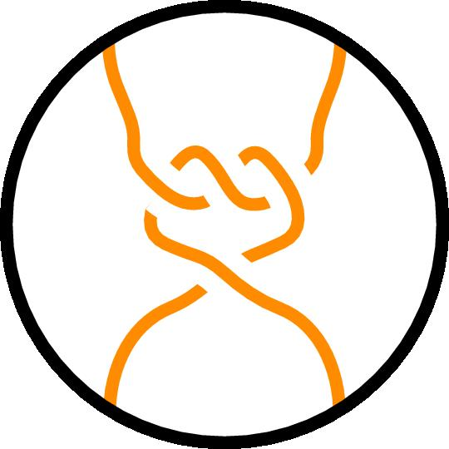
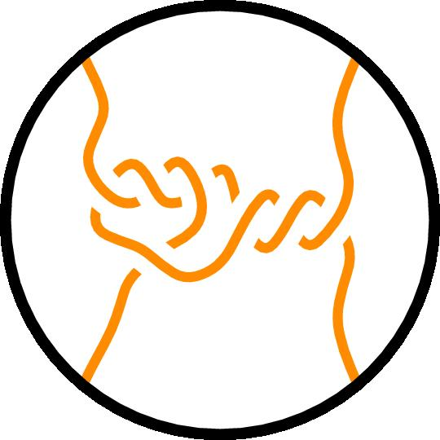
Conway Notation $\left[−3,−1,3\right]⇒\left(\frac{−3}{1}∗\frac{1}{−1}\right)+\frac{3}{1}$
$$($$
$$)$$
$$∗$$
$$+$$
$$=$$
$$+$$
$$=$$

Slide 12
Definition
A rational tangle can be expressed as an alternating sum and product of integer and vertical tangles:
$\left(\left(\frac{a_{1}}{1}∗\frac{1}{a_{2}}\right)+\frac{a_{3}}{1}\right)∗⋯$ or $\left(\left(\frac{1}{a_{1}}+\frac{a_{2}}{1}\right)∗\frac{1}{a_{3}}\right)+⋯$
A rational tangle may be denoted by a single fraction $\frac{a}{b}$, called the continued fraction.

Slide 13
Continued Fractions
We compute the continued fraction of a rational tangle using the Conway notation, and we may reverse the process to find the Conway notation.
For a rational tangle with Conway notation $[a_{1}⋯a_{n}]$, the continued fraction is computed:
$$a_{n}+\frac{1}{a_{n−1}+\frac{1}{a_{n−2}+\frac{1}{⋯a_{2}+\frac{1}{a_{1}}}}}$$

Slide 14
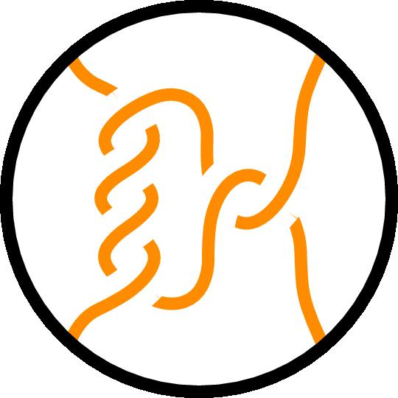
Conway to Continued Fraction
is a rational tangle with continued fraction:
Rational tangles with the same continued fraction are equivalent.
$$2+\frac{1}{4}=\frac{9}{4}$$
$$[4,2]$$
is a rational tangle with continued fraction:
$$3+\frac{1}{−1+\frac{1}{−3}}=3+\frac{1}{\frac{4}{−3}}=\frac{9}{4}$$
$$[−3,−1,3]$$

Slide 15
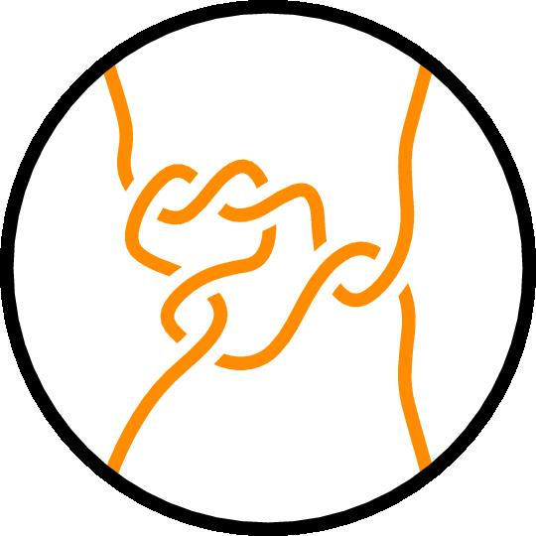
Continued Fraction to Conway
Find Conway Notation for a rational tangle with continued fraction $\frac{17}{7}$
$$\frac{17}{7}=2+\frac{3}{7}=2+\frac{1}{\frac{7}{3}}=2+\frac{1}{2+\frac{1}{3}}⟹[3,2,2]$$
$$\frac{17}{7}=3−\frac{4}{7}=3+\frac{1}{−\frac{7}{4}}=3+\frac{1}{−2+\frac{1}{4}}⟹\left[4,−2,3\right]$$

Slide 16
Conway Notation
Conway notation $[a_{1}⋯a_{n}]$ is in a canonical form if it is the shortest sequence of non-zero integers (except for possibly $a_{n}=0$) with the same sign, $2≤\left|a_{1}\right|$.
$$\frac{17}{7}=2+\frac{3}{7}=2+\frac{1}{\frac{7}{3}}=2+\frac{1}{2+\frac{1}{3}}⟹[3,2,2]$$
$$\frac{1}{−4}=0+\frac{1}{−4}⟹[−4,0]$$
Notes:
Could also describe 1/-4 by [-1,-3,0] or [1, -5, 0]
There are other canonical forms including odd-length and even-length which have different benefits.

Slide 17
Operations to Create Knots and Links
The numerator closure of a tangle $A$ is performed by connecting the top two endpoints and the bottom two endpoints, denoted by $N(A)$.
The denominator closure of a tangle $A$ is performed by connecting the left two endpoints and the right two endpoints, denoted by $D(A)$.
$$A$$
$$A$$
$$A$$
$$D(A)$$
$$N(A)$$

Slide 18
Application to Knots and Links
The knot or link produced in taking the numerator closure of a tangle shares the Conway notation and continued fraction of the tangle.
A rational knot/link is the numerator closure of a rational tangle.
$\left[2\right]$ tangle
$\left[2\right]$ link
$\left[4,2\right]$ tangle
$\left[4,2\right]$ knot
Notes:
Include rational = 2-bridge and 4-plat

Slide 19
Continued Fractions of Knots and Links
Slide borrowed from Tangle Analysis of Flp Recombination by Isabel Darcy

Slide 20
Example
The link $N\left(\frac{2}{7}\right)$must be equivalent to the link $N\left(\frac{2}{1}\right)$since they have the same numerator and satisfy
$$7≡1 mod 2$$
$$\frac{2}{7}=0+\frac{1}{3+\frac{1}{2}}⟹[2,3, 0]$$
$$\frac{2}{1}=2⟹[2]$$
Notes:
THESE ARE SPECIFICALLY WITHIN NUMERATOR CLOSURES< INDICATE THEM AS SUCH (21-24)

Slide 21
Example
The fraction equivalence reflects added vertical twists which can be undone using Reidemeister moves
$$N\left(\frac{2}{7}\right)$$
$$N\left(\frac{2}{1}\right)$$
Notes:
Include rational = 2-bridge and 4-plat

Slide 22
Example
The rational knot $N(\frac{15}{8})$ must be equivalent to the rational knot $N\left(\frac{15}{2}\right)$ by having the same numerator and satisfying
$$2∗8≡1 mod 15$$
$$\frac{15}{8}=1+\frac{1}{1+\frac{1}{7}}⟹[7 ,1 ,1]$$
$$\frac{15}{2}=7+\frac{1}{2}⟹[2, 7]$$
Notes:
Include rational = 2-bridge and 4-plat

Slide 23
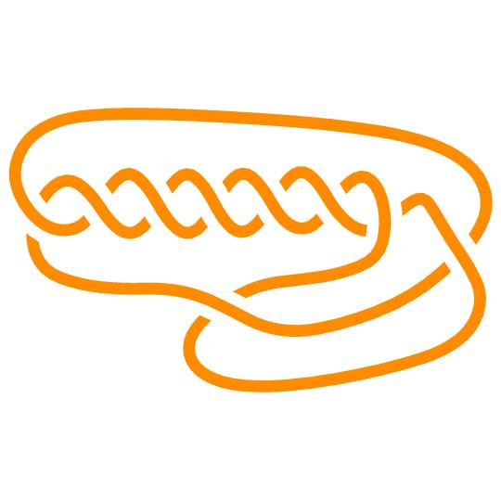
Example
The fraction equivalence reflects crossing rearrangement which can be undone using Reidemeister moves
$$N\left(\frac{15}{8}\right)⇒[7 1 1]$$
$$N\left(\frac{15}{2}\right)⇒[2 7]$$
Notes:
Get new figure for 7 1 1

Slide 24
Definition
A Montesinos knot is a knot which can be expressed as the numerator closure of a finite sum of rational tangles.
$$N\left(\frac{2}{3}+\frac{1}{2}+\frac{3}{5}\right)⟹$$
Notes:
Include a slide before defining Montesinos

Slide 25
Conway Notation
We use the semicolon to add two or more rational tangles to create a Montesinos knot. In this case, for sequences $A_{i},$ $\left[A_{1};⋯;A_{n}\right]=[A_{1},0;⋯;A_{n}, 0]$
Warning!
$$\left[3;3;2\right]≠$$
$$\left[3;3;2\right]=\left[3,0;3,0;2,0\right]⟹N\left(\frac{1}{3}+\frac{1}{3}+\frac{1}{2}\right)$$
$$N($$
$$+$$
$$+$$
$$)=$$
Notes:
Include a slide before defining Montesinos

Slide 26
Definition
A generalized Montesinos knot is a Montesinos knot with alternating vertical and horizontal twists added to the bottom and right before closing.
$$T=$$
$$[3;3;2]$$
$$"[T,1,2]"$$
Notes:
Draw a circle around T on the right

Slide 27
Conway Notation
We use a combination of periods and colons to abbreviate any groupings of the number 1 so that the number of dots gives the number of 1’s which occur.
$$\left[2:.2\right]=\left[2,1,1,1,2\right]⟹\left(\left(\left(\frac{2}{1}∗\frac{1}{1}\right)+\frac{1}{1}\right)∗\frac{1}{1}\right)+\frac{2}{1}$$
Notes:
Include rational = 2-bridge and 4-plat

Slide 28
Conway Notation
$$\left[2:.2\right]=\left[2,1,1,1,2\right]⟹\left(\left(\left(\frac{2}{1}∗\frac{1}{1}\right)+\frac{1}{1}\right)∗\frac{1}{1}\right)+\frac{2}{1}$$
$$\frac{2}{1}=$$
$$\frac{1}{1}=$$
$$\frac{2}{1}∗\frac{1}{1}⇒$$
$$∗$$
$$=$$

Slide 29
Conway Notation
$$\left[2:.2\right]=\left[2 1 1 1 2\right]⟹\left(\left(\left(\frac{2}{1}∗\frac{1}{1}\right)+\frac{1}{1}\right)∗\frac{1}{1}\right)+\frac{2}{1}$$
$$\left(\frac{2}{1}∗\frac{1}{1}\right)+\frac{1}{1}⇒$$
$$+$$
$$=$$
$$\left(\left(\frac{2}{1}∗\frac{1}{1}\right)+\frac{1}{1}\right)∗\frac{1}{1}⇒$$
$$∗$$
$$=$$

Slide 30
Conway Notation
$$\left[2:.2\right]=\left[2,1,1,1,2\right]⟹\left(\left(\left(\frac{2}{1}∗\frac{1}{1}\right)+\frac{1}{1}\right)∗\frac{1}{1}\right)+\frac{2}{1}$$
$$\left(\left(\left(\frac{2}{1}∗\frac{1}{1}\right)+\frac{1}{1}\right)∗\frac{1}{1}\right)+\frac{2}{1}⇒$$
$$+$$
$$=$$

Slide 31
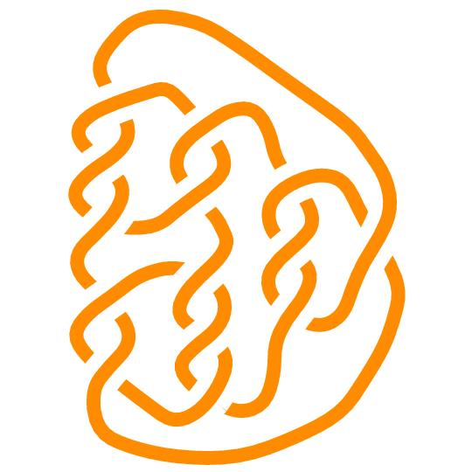
Definition
An algebraic knot is a knot which may be decomposed into the closure of integer or vertical tangles combined using any sequence of sums and products.
$$N\left(\left(\left(\left(\frac{1}{3}+\frac{1}{2}\right)∗\left(\frac{1}{2}+\frac{1}{3}\right)\right)+\frac{1}{3}\right)+\frac{1}{1}\right)⟹$$

Slide 32
Conway Notation
Polyhedral knots are not expressible by strict use of addition and multiplication (are non-algebraic) but may be described using these diagrams.
Notes:
Include rational = 2-bridge and 4-plat

Slide 33
Conway Notation
$[1^{∗}A] = [A]$ and is the base case.
The value 1 is often omitted if they occur at the end or if all vertices correspond to 1 crossing, otherwise the use of periods and colons are used to abbreviate large groupings.
Notes:
Include rational = 2-bridge and 4-plat

Slide 34
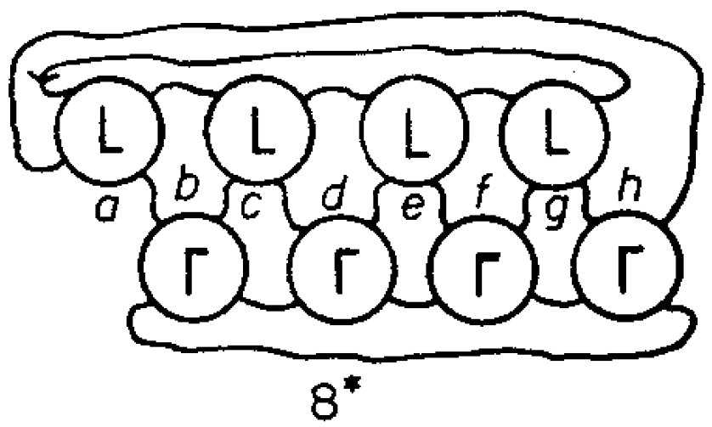
Conway Notation
$$\left[8^{∗}2:2\right]=[8^{∗}2, 1,1,2]=[8^{∗}2,1,1,2,1,1,1,1]$$
$$\frac{1}{1}=$$
$$\frac{2}{1}=$$

Slide 35
Conway Notation
$$\left[8^{∗}2:2\right]=[8^{∗}2 1 1 2]=[8^{∗}2,1,1,2,1,1,1,1]$$
$$\frac{1}{1}=$$
$$\frac{2}{1}=$$

Slide 36
Conway Notation
$$\left[8^{∗}2:2\right]=[8^{∗}2,1,1,2]=[8^{∗}2,1,1,2,1,1,1,1]$$
$$\frac{1}{1}=$$
$$\frac{2}{1}=$$

Slide 37
Conway Notation
$$\left[8^{∗}2:2\right]=[8^{∗}2,1,1,2]=[8^{∗}2,1,1,2,1,1,1,1]$$
$$\frac{1}{1}=$$
$$\frac{2}{1}=$$

Slide 38
Conway Notation
$$\left[8^{∗}2:2\right]=[8^{∗}2,1,1,2]=[8^{∗}2,1, 1,2,1,1,1,1]$$
$$\frac{1}{1}=$$
$$\frac{2}{1}=$$

Slide 39
Conway Notation
$$\left[8^{∗}2:2\right]=[8^{∗}2,1,1,2]=[8^{∗}2,1,1,2,1,1,1,1]$$
$$\frac{1}{1}=$$
$$\frac{2}{1}=$$

Slide 40
Conway Notation
$$\left[8^{∗}2:2\right]=[8^{∗}2,1,1,2]=[8^{∗}2,1,1,2,1,1,1,1]$$
$$\frac{1}{1}=$$
$$\frac{2}{1}=$$

Slide 41
Conway Notation
$$\left[8^{∗}2:2\right]=[8^{∗}2,1,1,2]=[8^{∗}2, 1,1,2,1,1,1,1]$$
$$\frac{1}{1}=$$
$$\frac{2}{1}=$$

Slide 42
Conway Notation
$$\left[8^{∗}2:2\right]=[8^{∗}2,1,1,2]=[8^{∗}2,1,1,2,1,1,1,1]$$
$$\frac{1}{1}=$$
$$\frac{2}{1}=$$
Notes:
Email Rob and ask about the 8* tholder

Slide 43
Conway Notation
$$\left[8^{∗}2:2\right]=[8^{∗}2,1,1,2]=[8^{∗}2,1,1,2,1,1,1,1]$$

Slide 44
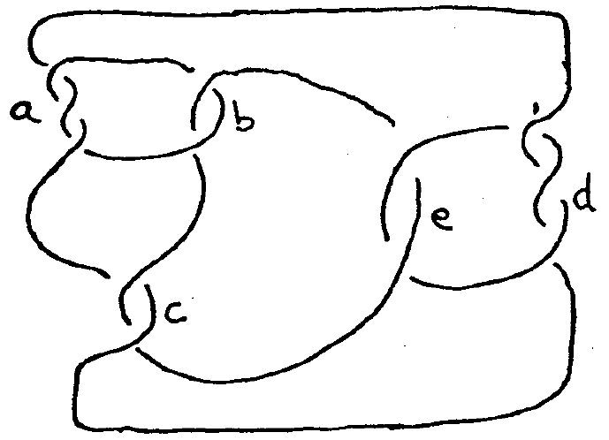
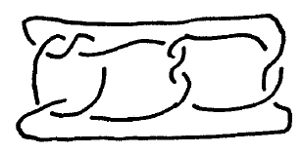
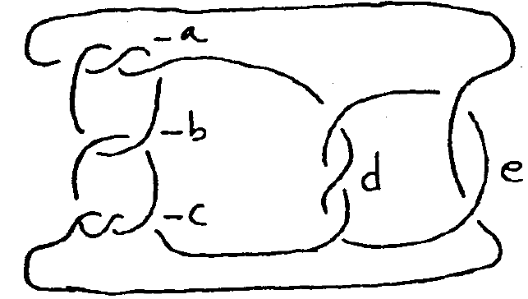
Conway Notation
Parentheses can be used to combine Montesinos knots alternating between sums of vertical tangles and products of integer tangles.
The last set of parentheses is almost always a sum of vertical tangles.
$$[\left(3;2\right),\left(3;2\right)]$$
$$[\left(3;2;3\right),\left(3;2\right)]$$
$$[\left(3;2\right),2,\left(2;3\right)]$$
Notes:
Adjusted from Caudron’s diagrams

Slide 45
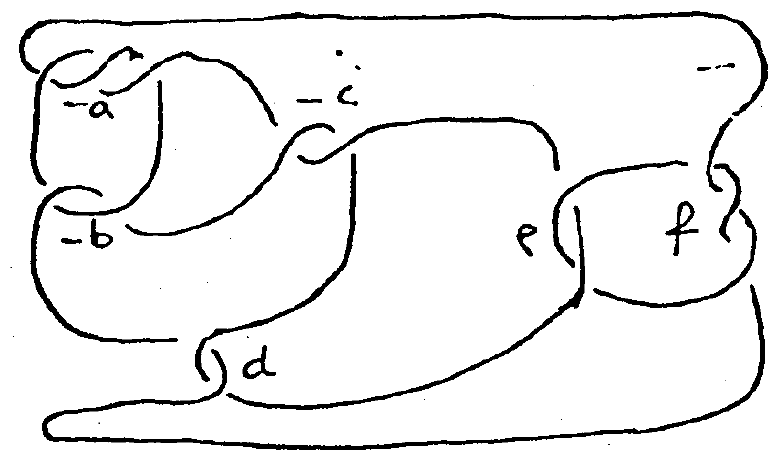
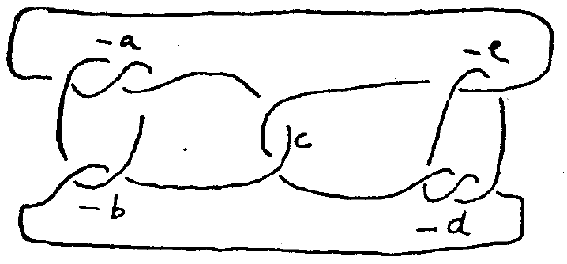
Conway Notation
$$[\left(3;2\right),2,2,\left(2;3\right)]$$
$$[\left(3;2\right);2;\left(2;3\right)]$$
Notes:
Diagrams adjusted from Caudron

Slide 46
Planar Diagram Notation
This notation describes knots by enumerating each edge connecting two crossings, then giving a sequence of 4 integers for each crossing which can be used to assemble the knot by matching up edge labels.
The PD notation of a knot with $n$ crossings has the form $[[a_{11}, a_{12}, a_{13}, a_{14}], [a_{21}, a_{22,} a_{23}, a_{24}], …,[a_{n1}, a_{n2}, a_{n3}, a_{n4}]]$.
For each crossing, the values $[a,b,c,d]$ are arranged around the crossing as $[SW, SE, NE, NW]$.
$$d$$
$$c$$
$$a$$
$$b$$

Slide 47
Planar Diagram Notation
$$[[4,2,5,1],[8,6,1,5],[6,3,7,4],[2,7,3,8]]$$
$$1$$
$$5$$
$$5$$
$$1$$
$$4$$
$$7$$
$$8$$
$$3$$
$$4$$
$$2$$
$$8$$
$$6$$
$$6$$
$$3$$
$$2$$
$$7$$

Slide 48
Planar Diagram Notation
$$[[4,2,5,1],[8,6,1,5],[6,3,7,4],[2,7,3,8]]$$
$$1$$
$$5$$
$$5$$
$$1$$
$$4$$
$$7$$
$$8$$
$$3$$
$$4$$
$$2$$
$$8$$
$$6$$
$$6$$
$$3$$
$$2$$
$$7$$
Notes:
This jump is jumpy

Slide 49
Planar Diagram Notation
$$[[4,2,5,1],[8,6,1,5],[6,3,7,4],[2,7,3,8]]$$
$$1$$
$$5$$
$$6$$
$$8$$
$$4$$
$$7$$
$$7$$
$$2$$
$$4$$
$$2$$
$$1$$
$$5$$
$$6$$
$$3$$
$$3$$
$$8$$
Notes:
This jump is jumpy

Slide 50
Planar Diagram Notation
$$[[4,2,5,1],[8,6,1,5],[6,3,7,4],[2,7,3,8]]$$
$$6$$
$$8$$
$$4$$
$$7$$
$$7$$
$$2$$
$$5$$
$$5$$
$$1$$
$$1$$
$$6$$
$$3$$
$$3$$
$$8$$
$$4$$
$$2$$
Notes:
This jump is jumpy

Slide 51
Planar Diagram Notation
$$[[4,2,5,1],[8,6,1,5],[6,3,7,4],[2,7,3,8]]$$
$$6$$
$$8$$
$$4$$
$$2$$
$$4$$
$$2$$
$$6$$
$$8$$

Slide 52
Planar Diagram Notation
$$[[4,2,5,1],[8,6,1,5],[6,3,7,4],[2,7,3,8]]$$
$$6$$
$$8$$
$$4$$
$$2$$
$$4$$
$$2$$
$$6$$
$$8$$

Slide 53
Planar Diagram Notation
$$[[4,2,5,1],[8,6,1,5],[6,3,7,4],[2,7,3,8]]$$
$$6$$
$$8$$
$$8$$
$$6$$
$$4$$
$$2$$
$$2$$
$$4$$

Slide 54
Planar Diagram Notation
$$[[4,2,5,1],[8,6,1,5],[6,3,7,4],[2,7,3,8]]$$
$$6$$
$$6$$
$$4$$
$$4$$

Slide 55
Planar Diagram Notation
$$[[4,2,5,1],[8,6,1,5],[6,3,7,4],[2,7,3,8]]$$
$$6$$
$$6$$
$$4$$
$$4$$

Slide 56
Planar Diagram Notation
$$[[4,2,5,1],[8,6,1,5],[6,3,7,4],[2,7,3,8]]$$

Slide 57
Planar Diagram Notation
The Planar Diagram notation for a knot is not unique due to the freedom in enumerating the edges and crossings.
Start by identifying all crossings and labeling the edges connecting them.
There are twice as many distinct edges as there are crossings.

Slide 58
Planar Diagram Notation
The Planar Diagram notation for a knot is not unique due to the freedom in enumerating the edges and crossings.
Start by identifying all crossings and labeling the edges connecting them.
There are twice as many distinct edges as there are crossings.

Slide 59
Planar Diagram Notation
The Planar Diagram notation for a knot is not unique due to the freedom in enumerating the edges and crossings.
Start by identifying all crossings and labeling the edges connecting them.
There are twice as many distinct edges as there are crossings.
$$1$$
Notes:
Fix outlines, they’re fuzzy. Make crisp

Slide 60
Planar Diagram Notation
The Planar Diagram notation for a knot is not unique due to the freedom in enumerating the edges and crossings.
Start by identifying all crossings and labeling the edges connecting them.
There are twice as many distinct edges as there are crossings.
$$1$$
$$2$$

Slide 61
Planar Diagram Notation
The Planar Diagram notation for a knot is not unique due to the freedom in enumerating the edges and crossings.
Start by identifying all crossings and labeling the edges connecting them.
There are twice as many distinct edges as there are crossings.
$$1$$
$$3$$
$$2$$

Slide 62
Planar Diagram Notation
The Planar Diagram notation for a knot is not unique due to the freedom in enumerating the edges and crossings.
Start by identifying all crossings and labeling the edges connecting them.
There are twice as many distinct edges as there are crossings.
$$1$$
$$4$$
$$3$$
$$2$$

Slide 63
Planar Diagram Notation
The Planar Diagram notation for a knot is not unique due to the freedom in enumerating the edges and crossings.
Start by identifying all crossings and labeling the edges connecting them.
There are twice as many distinct edges as there are crossings.
$$1$$
$$4$$
$$3$$
$$12$$
$$8$$
$$11$$
$$5$$
$$10$$
$$7$$
$$2$$
$$6$$
$$9$$

Slide 64
Planar Diagram Notation
$$[\left[4, 12, 3, 1\right],…]$$
$$1$$
$$4$$
$$3$$
$$1$$
$$3$$
$$12$$
$$8$$
$$11$$
$$5$$
$$2$$
$$4$$
$$12$$
$$10$$
$$7$$
$$6$$
$$[4, 12, 3, 1]$$
$$9$$

Slide 65
Planar Diagram Notation
$$[\left[4, 12, 3, 1\right],\left[11, 5, 12, 4\right],…]$$
$$1$$
$$4$$
$$3$$
$$4$$
$$12$$
$$12$$
$$8$$
$$11$$
$$5$$
$$2$$
$$11$$
$$5$$
$$10$$
$$7$$
$$6$$
$$[11, 5, 12, 4]$$
$$9$$

Slide 66
Planar Diagram Notation
$$[\left[4, 12, 3, 1\right],\left[11, 5, 12, 4\right],\left[6, 10, 5, 11\right],…]$$
$$1$$
$$4$$
$$3$$
$$11$$
$$5$$
$$12$$
$$8$$
$$11$$
$$5$$
$$2$$
$$6$$
$$10$$
$$10$$
$$7$$
$$6$$
$$[6, 10, 5, 11]$$
$$9$$

Slide 67
Planar Diagram Notation
$$[\left[4, 12, 3, 1\right],\left[11, 5, 12, 4\right],\left[6, 10, 5, 11\right],$$
$$\left[9, 7, 10, 6\right],…]$$
$$1$$
$$4$$
$$3$$
$$6$$
$$10$$
$$12$$
$$8$$
$$11$$
$$5$$
$$2$$
$$9$$
$$7$$
$$10$$
$$7$$
$$6$$
$$[9, 7, 10, 6]$$
$$9$$

Slide 68
Planar Diagram Notation
$$[\left[4, 12, 3, 1\right],\left[11, 5, 12, 4\right],\left[6, 10, 5, 11\right],$$
$$\left[9, 7, 10, 6\right],\left[7, 2, 8, 3\right],…]$$
$$1$$
$$4$$
$$3$$
$$3$$
$$8$$
$$12$$
$$8$$
$$11$$
$$5$$
$$2$$
$$7$$
$$2$$
$$10$$
$$7$$
$$6$$
$$[7, 2, 8, 3]$$
$$9$$

Slide 69
Planar Diagram Notation
$$[\left[4, 12, 3, 1\right],\left[11, 5, 12, 4\right],\left[6, 10, 5, 11\right],$$
$$\left[9, 7, 10, 6\right],\left[7, 2, 8, 3\right],[2, 9, 1, 8]]$$
$$1$$
$$4$$
$$3$$
$$8$$
$$1$$
$$12$$
$$8$$
$$11$$
$$5$$
$$2$$
$$2$$
$$9$$
$$10$$
$$7$$
$$6$$
$$[2, 9, 1, 8]$$
$$9$$

Slide 70
Planar Diagram Notation
$$1$$
$$4$$
So we have
$$[\left[4, 12, 3, 1\right],\left[11, 5, 12, 4\right],\left[6, 10, 5, 11\right],$$
$$\left[9, 7, 10, 6\right],\left[7, 2, 8, 3\right],[2, 9, 1, 8]]$$
as Planar Diagram notation for this knot.
$$3$$
$$12$$
$$8$$
$$11$$
$$5$$
$$2$$
$$10$$
$$7$$
$$6$$
$$9$$

Slide 71
Planar Diagram Notation
With Planar Diagram notation, we can choose to indicate an orientation.
In this case we take each crossing to be positioned with the overstrand pointing northeast.
The third label corresponds to the exit of the overstrand.
$$d$$
$$c$$
$$[a, b, c, d]$$
$$a$$
$$b$$
The first label corresponds to the entrance of the overstrand.

Slide 72
Planar Diagram Notation
To include this shown orientation, the Planar Diagram notation changes from
$$[\left[4, 12, 3, 1\right],\left[11, 5, 12, 4\right],\left[6, 10, 5, 11\right],$$
$$\left[9, 7, 10, 6\right],\left[7, 2, 8, 3\right],[2, 9, 1, 8]]$$
to
$$[\left[1, 8, 2, 9\right], \left[3, 1, 4, 12\right], \left[5, 11, 6, 10\right],$$
$$\left[7, 2, 8, 3\right],\left[9, 7, 10, 6\right],[11, 5, 12, 4]]$$
$$1$$
$$4$$
$$3$$
$$12$$
$$8$$
$$11$$
$$5$$
$$2$$
$$10$$
$$7$$
$$6$$
$$9$$
Notes:
Maybe add another slide to mention crossing order but definitely say something about it. Work with this figure to show re-indexing to accommodate C.

Slide 73
Planar Diagram Notation
$$1$$
$$[\left[1, 8, 2, 9\right], \left[3, 1, 4, 12\right], \left[5, 11, 6, 10\right],$$
$$\left[7, 2, 8, 3\right],\left[9, 7, 10, 6\right],[11, 5, 12, 4]]$$
We order the crossings so that edge $1$ flows into crossing $1$
Crossing $2$ is the next crossing where this strand is on top, following the chosen orientation
$$4$$
$$3$$
$$12$$
$$8$$
$$11$$
$$5$$
$$2$$
$$10$$
$$7$$
$$6$$
$$9$$
Notes:
Maybe add another slide to mention crossing order but definitely say something about it. Work with this figure to show re-indexing to accommodate C.

Slide 74
Planar Diagram Notation
$$1$$
$$[\left[1, 8, 2, 9\right], \left[3, 1, 4, 12\right], \left[5, 11, 6, 10\right],$$
$$\left[7, 2, 8, 3\right],\left[9, 7, 10, 6\right],[11, 5, 12, 4]]$$
We order the crossings so that edge $1$ flows into crossing $1$
Crossing $2$ is the next crossing where this strand is on top, following the chosen orientation
$$4$$
$$3$$
$$12$$
$$8$$
$$11$$
$$5$$
$$1$$
$$2$$
$$10$$
$$7$$
$$6$$
$$9$$
Notes:
Maybe add another slide to mention crossing order but definitely say something about it. Work with this figure to show re-indexing to accommodate C.

Slide 75
Planar Diagram Notation
$$1$$
$$[\left[1, 8, 2, 9\right], \left[3, 1, 4, 12\right], \left[5, 11, 6, 10\right],$$
$$\left[7, 2, 8, 3\right],\left[9, 7, 10, 6\right],[11, 5, 12, 4]]$$
We order the crossings so that edge $1$ flows into crossing $1$
Crossing $2$ is the next crossing where this strand is on top, following the chosen orientation
$$4$$
$$2$$
$$3$$
$$12$$
$$8$$
$$11$$
$$5$$
$$1$$
$$2$$
$$10$$
$$7$$
$$6$$
$$9$$
Notes:
Maybe add another slide to mention crossing order but definitely say something about it. Work with this figure to show re-indexing to accommodate C.

Slide 76
Planar Diagram Notation
$$1$$
$$[\left[1, 8, 2, 9\right], \left[3, 1, 4, 12\right], \left[5, 11, 6, 10\right],$$
$$\left[7, 2, 8, 3\right],\left[9, 7, 10, 6\right],[11, 5, 12, 4]]$$
We order the crossings so that edge $1$ flows into crossing $1$
Crossing $2$ is the next crossing where this strand is on top, following the chosen orientation
$$4$$
$$2$$
$$3$$
$$12$$
$$8$$
$$11$$
$$5$$
$$1$$
$$3$$
$$2$$
$$10$$
$$7$$
$$6$$
$$9$$
Notes:
Maybe add another slide to mention crossing order but definitely say something about it. Work with this figure to show re-indexing to accommodate C.

Slide 77
Planar Diagram Notation
$$1$$
$$[\left[1, 8, 2, 9\right], \left[3, 1, 4, 12\right], \left[5, 11, 6, 10\right],$$
$$\left[7, 2, 8, 3\right],\left[9, 7, 10, 6\right],[11, 5, 12, 4]]$$
We order the crossings so that edge $1$ flows into crossing $1$
Crossing $2$ is the next crossing where this strand is on top, following the chosen orientation
$$4$$
$$2$$
$$3$$
$$12$$
$$8$$
$$11$$
$$5$$
$$4$$
$$1$$
$$3$$
$$2$$
$$10$$
$$7$$
$$6$$
$$9$$
Notes:
Maybe add another slide to mention crossing order but definitely say something about it. Work with this figure to show re-indexing to accommodate C.

Slide 78
Planar Diagram Notation
$$1$$
$$[\left[1, 8, 2, 9\right], \left[3, 1, 4, 12\right], \left[5, 11, 6, 10\right],$$
$$\left[7, 2, 8, 3\right],\left[9, 7, 10, 6\right],[11, 5, 12, 4]]$$
We order the crossings so that edge $1$ flows into crossing $1$
Crossing $2$ is the next crossing where this strand is on top, following the chosen orientation
$$4$$
$$2$$
$$3$$
$$12$$
$$8$$
$$11$$
$$5$$
$$4$$
$$1$$
$$3$$
$$2$$
$$10$$
$$7$$
$$6$$
$$5$$
$$9$$
Notes:
Maybe add another slide to mention crossing order but definitely say something about it. Work with this figure to show re-indexing to accommodate C.

Slide 79
Planar Diagram Notation
$$1$$
$$[\left[1, 8, 2, 9\right], \left[3, 1, 4, 12\right], \left[5, 11, 6, 10\right],$$
$$\left[7, 2, 8, 3\right],\left[9, 7, 10, 6\right],[11, 5, 12, 4]]$$
We order the crossings so that edge $1$ flows into crossing $1$
Crossing $2$ is the next crossing where this strand is on top, following the chosen orientation
$$4$$
$$2$$
$$3$$
$$12$$
$$6$$
$$8$$
$$11$$
$$5$$
$$4$$
$$1$$
$$3$$
$$2$$
$$10$$
$$7$$
$$6$$
$$5$$
$$9$$
Notes:
Maybe add another slide to mention crossing order but definitely say something about it. Work with this figure to show re-indexing to accommodate C.

Slide 80
Converting Planar Diagram to Conway
Program Overview
Take PD notation and add additional information.
Combine crossings to make integer and vertical tangles.
Combine integer and vertical tangles into rational tangles.
Combine rational tangles into Montesinos tangles.
Identify twists for Generalized Montesinos tangles.
Combine Montesinos tangles into algebraic tangles.
If non-algebraic, identify polyhedrals.
Notes:
Include rational = 2-bridge and 4-plat

Slide 81
Converting Planar Diagram to Conway
PD Notation:
$$"[\left[1,11,2,10\right],\left[3,14,4,15\right],$$
$$\left[5,16,6,1\right],\left[7,12,8,13\right],$$
$$\left[9,3,10,2\right],\left[11,6,12,7\right],$$
$$\left[13,8,14,9\right],\left[15,4,16,5\right]]"$$
Conway Notation:
$$[3,0;3,0;2,0]$$
Notes:
PD Notation taken from KnotInfo

Slide 82
Converting Planar Diagram to Conway
Program Overview
Take PD notation and add additional information.
Combine crossings to make integer and vertical tangles.
Combine integer and vertical tangles into rational tangles.
Combine rational tangles into Montesinos tangles.
Identify twists for Generalized Montesinos tangles.
Combine Montesinos tangles into algebraic tangles.
If non-algebraic, identify polyhedrals.
Notes:
Include rational = 2-bridge and 4-plat

Slide 83
Planar Diagram Re-indexing Example
$$1$$
Re-indexing drops all values by $1$
$$[\left[1, 8, 2, 9\right], \left[3, 1, 4, 12\right], \left[5, 11, 6, 10\right],$$
$$\left[7, 2, 8, 3\right],\left[9, 7, 10, 6\right],[11, 5, 12, 4]]$$
becomes
$$[\left[0,7,2,9\right],\left[2,0,3,11\right],\left[4,10,5,9\right],$$
$$\left[6,1,7,2\right],\left[8,6,9,5\right],[10,4,11,3]]$$
$$4$$
$$2$$
$$3$$
$$12$$
$$6$$
$$8$$
$$11$$
$$5$$
$$4$$
$$1$$
$$3$$
$$2$$
$$10$$
$$7$$
$$6$$
$$5$$
$$9$$
Notes:
Maybe add another slide to mention crossing order but definitely say something about it. Work with this figure to show re-indexing to accommodate C.

Slide 84
Planar Diagram Re-indexing Example
$$0$$
Re-indexing drops all values by $1$
$$[\left[1, 8, 2, 9\right], \left[3, 1, 4, 12\right], \left[5, 11, 6, 10\right],$$
$$\left[7, 2, 8, 3\right],\left[9, 7, 10, 6\right],[11, 5, 12, 4]]$$
becomes
$$[\left[0,7,2,9\right],\left[2,0,3,11\right],\left[4,10,5,9\right],$$
$$\left[6,1,7,2\right],\left[8,6,9,5\right],[10,4,11,3]]$$
$$3$$
$$1$$
$$2$$
$$11$$
$$5$$
$$7$$
$$10$$
$$4$$
$$3$$
$$0$$
$$2$$
$$1$$
$$9$$
$$6$$
$$5$$
$$4$$
$$8$$
Notes:
Maybe add another slide to mention crossing order but definitely say something about it. Work with this figure to show re-indexing to accommodate C.

Slide 85
Converting Planar Diagram to Conway
$$[\left[1,11,2,10\right],\left[3,14,4,15\right],\left[5,16,6,1\right],\left[7,12,8,13\right],$$
$$\left[9,3,10,2\right],\left[11,6,12,7\right],\left[13,8,14,9\right],\left[15,4,16,5\right]]$$
Tangle 0
Tangle 1
Tangle 2
Tangle 3
Tangle 4
Tangle 5
Tangle 6
Tangle 7
$$\left[\begin{matrix}0 & 10 & 1 & 9 & 1 & 1 \\ 2 & 13 & 3 & 14 & 1 & 1 \\ 4 & 15 & 5 & 0 & 1 & 1 \\ 6 & 11 & 7 & 12 & 1 & 1 \\ 8 & 2 & 9 & 1 & 1 & 1 \\ 10 & 5 & 11 & 6 & 1 & 1 \\ 12 & 7 & 13 & 8 & 1 & 1 \\ 14 & 3 & 15 & 5 & 1 & 1\end{matrix}\right]$$
Notes:
Be aware of comments/questions about array setup

Slide 86
Converting Planar Diagram to Conway
For any $j<4$, the ${\left(i, j\right)}^{th}$ entry is an edge belonging to Tangle $i$ at position $j$
$$j$$
$$\left[\begin{matrix}0 & 10 & 1 & 9 & 1 & 1 \\ 2 & 13 & 3 & 14 & 1 & 1 \\ 4 & 15 & 5 & 0 & 1 & 1 \\ 6 & 11 & 7 & 12 & 1 & 1 \\ 8 & 2 & 9 & 1 & 1 & 1 \\ 10 & 5 & 11 & 6 & 1 & 1 \\ 12 & 7 & 13 & 8 & 1 & 1 \\ 14 & 3 & 15 & 5 & 1 & 1\end{matrix}\right]$$
$$d$$
$$c$$
$$3$$
$$2$$
$$i$$
$$a$$
$$b$$
$$0$$
$$1$$
Positions $[a,b,c,d]$ become
positions $[0,1,2,3]$
Notes:
Be aware of comments/questions about array setup

Slide 87
Converting Planar Diagram to Conway
Edge $n$ : $\left[p, q, r, s\right]$
Fill a $16×4$ array with edge information:
The $n^{th}$ row stores information for edge $n$
Edge $n$ : $\left[p, q, r, s\right]$
$$n$$
$$q$$
$$s$$
Tangle $p$
Tangle $r$
Notes:
Connect ‘n’ over the top (slide for cross over vs under)

Slide 88
Converting Planar Diagram to Conway
Position
$0$ $1$ $2$ $3$
$$9$$
$$1$$
$$0$$
$$5$$
Tangle 0
Tangle 1
Tangle 2
Tangle 3
Tangle 4
Tangle 5
Tangle 6
Tangle 7
$$\left[\begin{matrix}0 & 10 & 1 & 9 & 1 & 1 \\ 2 & 13 & 3 & 14 & 1 & 1 \\ 4 & 15 & 5 & 0 & 1 & 1 \\ 6 & 11 & 7 & 12 & 1 & 1 \\ 8 & 2 & 9 & 1 & 1 & 1 \\ 10 & 5 & 11 & 6 & 1 & 1 \\ 12 & 7 & 13 & 8 & 1 & 1 \\ 14 & 3 & 15 & 5 & 1 & 1\end{matrix}\right]$$
$$0$$
$$10$$
$$4$$
$$15$$
Tangle $0$
Tangle $2$
Edge $0$
Edge $1$
$$⋮$$
$$\left[\begin{matrix}0 & 0 & 2 & 3 \\ ∗ & ∗ & ∗ & ∗\end{matrix}\right]$$
$$⋮$$
Edge $0$ belongs to Tangle $0$ at position $0$
Edge $0$ belongs to Tangle $2$ at position $3$
Notes:
Include a line to separate PD from CF. Include [a,b,c,d] positions above pdarray. Split this slide into two, where second shows the change in position labels.
Definitely include slides with pictures to emphasize the edge array process. Borrow from PPT.

Slide 89
Converting Planar Diagram to Conway
$$[\left[0,10,1,9\right],\left[2,13,3,14\right],\left[4,15,5,0\right],\left[6,11,7,12\right],$$
$$\left[8,2,0,1\right],\left[10,5,11,6\right],\left[12,7,13,8\right],\left[14,3,15,4\right]]$$
Edge 0
Edge 1
Edge 2
Edge 3
Edge 4
Edge 5
Edge 6
Edge 7
$$\left[\begin{matrix}0 & 0 & 2 & 3 \\ 0 & 2 & 4 & 3 \\ 1 & 0 & 4 & 1 \\ 1 & 2 & 7 & 1 \\ 2 & 0 & 7 & 3 \\ 2 & 2 & 5 & 1 \\ 3 & 0 & 5 & 3 \\ 3 & 2 & 6 & 1\end{matrix}\right]$$
Edge 8
Edge 9
Edge 10
Edge 11
Edge 12
Edge 13
Edge 14
Edge 15
$$\left[\begin{matrix}4 & 0 & 6 & 3 \\ 4 & 2 & 0 & 3 \\ 5 & 0 & 0 & 1 \\ 5 & 2 & 3 & 1 \\ 6 & 0 & 3 & 3 \\ 6 & 2 & 1 & 1 \\ 7 & 0 & 1 & 3 \\ 7 & 2 & 2 & 1\end{matrix}\right]$$
Notes:
Connect with arrow maybe instead of dots

Slide 90
Converting Planar Diagram to Conway
Program Overview
Take PD notation and add additional information.
Combine crossings to make integer and vertical tangles.
Combine integer and vertical tangles into rational tangles.
Combine rational tangles into Montesinos tangles.
Identify twists for Generalized Montesinos tangles.
Combine Montesinos tangles into algebraic tangles.
If non-algebraic, identify polyhedrals.
Notes:
Include rational = 2-bridge and 4-plat

Slide 91
Converting Planar Diagram to Conway
When taking the sum of integer tangles or the product of vertical tangles, their continued fractions combine in a natural way
For integer tangles $A$, $B$ with continued fractions $\frac{a}{1}$, $\frac{b}{1}$ respectively, the sum $A+B$ has continued fraction $\frac{a+b}{1}$
For vertical tangles $A$, $B$ with continued fractions $\frac{1}{a}$, $\frac{1}{b}$ respectively, the product $A∗B$ has continued fraction $\frac{1}{a+b}$
Notes:
N(a/b + c/d) = N( ad + bc/ ad’ +c’b ) where c’d-cd’ = 1

Slide 92
Converting Planar Diagram to Conway
When taking the sum of integer tangles or the product of vertical tangles, their continued fractions combine in a natural way
$$+$$
$$∗$$
$$=$$
$$=$$

Slide 93
Converting Planar Diagram to Conway
Starting from the bottom of the PD array, add tangles along the right to create integer tangles. Do the same for addition along the left and products along the top and bottom.
Change continued fraction values in the last two entries to reflect the operations using:
$\frac{a+b}{1}$ for integer tangles and
$\frac{1}{a+b}$ for vertical tangles.
Notes:
Remove slide maybe?

Slide 94
Converting Planar Diagram to Conway
Tangle 0
Tangle 1
Tangle 2
Tangle 3
Tangle 4
Tangle 5
Tangle 6
Tangle 7
$$\left[\begin{matrix}0 & 10 & 1 & 9 & 1 & 1 \\ 2 & 13 & 3 & 14 & 1 & 1 \\ 4 & 15 & 5 & 0 & 1 & 1 \\ 6 & 11 & 7 & 12 & 1 & 1 \\ 8 & 2 & 9 & 1 & 1 & 1 \\ 10 & 5 & 11 & 6 & 1 & 1 \\ 12 & 7 & 13 & 8 & 1 & 1 \\ 14 & 3 & 15 & 5 & 1 & 1\end{matrix}\right]$$
$$\left[\begin{matrix}0 & 10 & 1 & 9 & 1 & 1 \\ 2 & 13 & 15 & 5 & 1 & 2 \\ 4 & 15 & 5 & 0 & 1 & 1 \\ 6 & 11 & 7 & 12 & 1 & 1 \\ 8 & 2 & 9 & 1 & 1 & 1 \\ 10 & 5 & 11 & 6 & 1 & 1 \\ 12 & 7 & 13 & 8 & 1 & 1 \\ 0 & 0 & 0 & 0 & 0 & 0\end{matrix}\right]$$
$$5$$
$$15$$
$$14$$
$$3$$
$$5$$
$$15$$
$$\left(\frac{1}{1}∗\frac{1}{1}=\frac{1}{1+1}=\frac{1}{2}\right)$$
$$∗$$
$$=$$
$$14$$
$$3$$
$$2$$
$$13$$
$$2$$
$$13$$
Tangle $7$
Tangle $1$
Tangle $1$
Notes:
Maybe box and highlight

Slide 95
Converting Planar Diagram to Conway
Tangle 0
Tangle 1
Tangle 2
Tangle 3
Tangle 4
Tangle 5
Tangle 6
Tangle 7
$$\left[\begin{matrix}0 & 10 & 1 & 9 & 1 & 1 \\ 2 & 3 & 13 & 4 & 1 & 2 \\ 4 & 15 & 5 & 0 & 1 & 1 \\ 6 & 11 & 7 & 12 & 1 & 1 \\ 8 & 2 & 9 & 1 & 1 & 1 \\ 10 & 5 & 11 & 6 & 1 & 1 \\ 12 & 7 & 13 & 8 & 1 & 1 \\ 0 & 0 & 0 & 0 & 0 & 0\end{matrix}\right]$$
$$\left[\begin{matrix}8 & 2 & 0 & 10 & 1 & 2 \\ 2 & 13 & 5 & 0 & 1 & 3 \\ 10 & 5 & 13 & 8 & 1 & 3 \\ 0 & 0 & 0 & 0 & 0 & 0 \\ 0 & 0 & 0 & 0 & 0 & 0 \\ 0 & 0 & 0 & 0 & 0 & 0 \\ 0 & 0 & 0 & 0 & 0 & 0 \\ 0 & 0 & 0 & 0 & 0 & 0\end{matrix}\right]$$
Notes:
Include rational = 2-bridge and 4-plat

Slide 96
Converting Planar Diagram to Conway
Tangle 0
Tangle 1
Tangle 2
$$\left[\begin{matrix}8 & 2 & 0 & 10 & 1 & 2 \\ 2 & 13 & 5 & 0 & 1 & 3 \\ 10 & 5 & 13 & 8 & 1 & 3\end{matrix}\right]$$
Edge 0
Edge 1
Edge 2
Edge 3
Edge 4
Edge 5
Edge 6
Edge 7
$$\left[\begin{matrix}0 & 2 & 1 & 3 \\ −1 & −1 & −1 & −1 \\ 1 & 0 & 0 & 1 \\ −1 & −1 & −1 & −1 \\ −1 & −1 & −1 & −1 \\ 2 & 1 & 1 & 2 \\ −1 & −1 & −1 & −1 \\ −1 & −1 & −1 & −1\end{matrix}\right]$$
Edge 8
Edge 9
Edge 10
Edge 11
Edge 12
Edge 13
Edge 14
Edge 15
$$\left[\begin{matrix}0 & 0 & 2 & 3 \\ −1 & −1 & −1 & −1 \\ 0 & 3 & 2 & 0 \\ −1 & −1 & −1 & −1 \\ −1 & −1 & −1 & −1 \\ 2 & 2 & 1 & 1 \\ −1 & −1 & −1 & −1 \\ −1 & −1 & −1 & −1\end{matrix}\right]$$
Notes:
Include rational = 2-bridge and 4-plat

Slide 97
Converting Planar Diagram to Conway
Program Overview
Take PD notation and add additional information.
Combine crossings to make integer and vertical tangles.
Combine integer and vertical tangles into rational tangles.
Combine rational tangles into Montesinos tangles.
Identify twists for Generalized Montesinos tangles.
Combine Montesinos tangles into algebraic tangles.
If non-algebraic, identify polyhedrals.
Notes:
Include rational = 2-bridge and 4-plat

Slide 98
Converting Planar Diagram to Conway
$$10$$
$$0$$
$$0$$
$$5$$
$$\left[\begin{matrix}8 & 2 & 0 & 10 & 1 & 2 \\ 2 & 13 & 5 & 0 & 1 & 3 \\ 10 & 5 & 13 & 8 & 1 & 3 \\ 0 & 0 & 0 & 0 & 0 & 0 \\ 0 & 0 & 0 & 0 & 0 & 0 \\ 0 & 0 & 0 & 0 & 0 & 0 \\ 0 & 0 & 0 & 0 & 0 & 0 \\ 0 & 0 & 0 & 0 & 0 & 0\end{matrix}\right]$$
$$2$$
$$13$$
$$8$$
$$2$$
$$8$$
$$13$$
$$10$$
$$5$$
Notes:
Include rational = 2-bridge and 4-plat

Slide 99
Converting Planar Diagram to Conway
$$10$$
$$0$$
$$0$$
$$5$$
$$\left[\begin{matrix}8 & 2 & 0 & 10 & 1 & 2 \\ 2 & 13 & 5 & 0 & 1 & 3 \\ 10 & 5 & 13 & 8 & 1 & 3 \\ 0 & 0 & 0 & 0 & 0 & 0 \\ 0 & 0 & 0 & 0 & 0 & 0 \\ 0 & 0 & 0 & 0 & 0 & 0 \\ 0 & 0 & 0 & 0 & 0 & 0 \\ 0 & 0 & 0 & 0 & 0 & 0\end{matrix}\right]$$
$$2$$
$$13$$
$$8$$
$$2$$
$$8$$
$$13$$
$$10$$
$$5$$
Notes:
Include rational = 2-bridge and 4-plat

Slide 100
Converting Planar Diagram to Conway
Program Overview
Take PD notation and add additional information.
Combine crossings to make integer and vertical tangles.
Combine integer and vertical tangles into rational tangles.
Combine rational tangles into Montesinos tangles.
Identify twists for Generalized Montesinos tangles.
Combine Montesinos tangles into algebraic tangles.
If non-algebraic, identify polyhedrals.
Notes:
Include rational = 2-bridge and 4-plat

Slide 101
Converting Planar Diagram to Conway
Rotate tangles as needed to identify an algebraic expression which combines all rows of the PD matrix.
Prioritizes sums as the expected operation for Montesinos knots and links.
Notes:
Remove slide maybe?

Slide 102
Converting Planar Diagram to Conway
$$\left[\begin{matrix}8 & 2 & 0 & 10 & 1 & 2 \\ 2 & 13 & 5 & 0 & 1 & 3 \\ 10 & 5 & 13 & 8 & 1 & 3 \\ 0 & 0 & 0 & 0 & 0 & 0 \\ 0 & 0 & 0 & 0 & 0 & 0 \\ 0 & 0 & 0 & 0 & 0 & 0 \\ 0 & 0 & 0 & 0 & 0 & 0 \\ 0 & 0 & 0 & 0 & 0 & 0\end{matrix}\right]$$
$$10$$
$$0$$
$$0$$
$$5$$
$$2$$
$$13$$
$$8$$
$$2$$
$$8$$
$$13$$
All appear to be sums, now reorder tangles and rotate as needed.
$$10$$
$$5$$
Notes:
Include rational = 2-bridge and 4-plat

Slide 103
Converting Planar Diagram to Conway
Operations $[? ?]$
$$\left[\begin{matrix}8 & 2 & 0 & 10 & 1 & 2 \\ 2 & 13 & 5 & 0 & 1 & 3 \\ 10 & 5 & 13 & 8 & 1 & 3 \\ 0 & 0 & 0 & 0 & 0 & 0 \\ 0 & 0 & 0 & 0 & 0 & 0 \\ 0 & 0 & 0 & 0 & 0 & 0 \\ 0 & 0 & 0 & 0 & 0 & 0 \\ 0 & 0 & 0 & 0 & 0 & 0\end{matrix}\right]$$
$$10$$
$$0$$
$$0$$
$$5$$
$$2$$
$$13$$
$$8$$
$$2$$
Tangle $0$ combines with Tangle $1$ as a sum
Notes:
Include rational = 2-bridge and 4-plat

Slide 104
Converting Planar Diagram to Conway
Operations $[+ ?]$
$$\left[\begin{matrix}8 & 2 & 0 & 10 & 1 & 2 \\ 2 & 13 & 5 & 0 & 1 & 3 \\ 10 & 5 & 13 & 8 & 1 & 3 \\ 0 & 0 & 0 & 0 & 0 & 0 \\ 0 & 0 & 0 & 0 & 0 & 0 \\ 0 & 0 & 0 & 0 & 0 & 0 \\ 0 & 0 & 0 & 0 & 0 & 0 \\ 0 & 0 & 0 & 0 & 0 & 0\end{matrix}\right]$$
$$10$$
$$0$$
$$0$$
$$5$$
$$+$$
$$2$$
$$13$$
$$8$$
$$2$$
Tangle $0$ combines with Tangle $1$ as a sum
Notes:
Include rational = 2-bridge and 4-plat

Slide 105
Converting Planar Diagram to Conway
Operations $[+ ?]$
$$\left[\begin{matrix}8 & 2 & 0 & 10 & 1 & 2 \\ 2 & 13 & 5 & 0 & 1 & 3 \\ 10 & 5 & 13 & 8 & 1 & 3 \\ 0 & 0 & 0 & 0 & 0 & 0 \\ 0 & 0 & 0 & 0 & 0 & 0 \\ 0 & 0 & 0 & 0 & 0 & 0 \\ 0 & 0 & 0 & 0 & 0 & 0 \\ 0 & 0 & 0 & 0 & 0 & 0\end{matrix}\right]$$
$$0$$
$$5$$
$$8$$
$$13$$
$$2$$
$$13$$
$$10$$
$$5$$
Tangle $1$ combines with Tangle $2$ as a sum if Tangle $2$ is rotated $180°$
Notes:
Include rational = 2-bridge and 4-plat

Slide 106
Converting Planar Diagram to Conway
Operations $[+ +]$
$$\left[\begin{matrix}8 & 2 & 0 & 10 & 1 & 2 \\ 2 & 13 & 5 & 0 & 1 & 3 \\ 13 & 8 & 10 & 5 & 1 & 3 \\ 0 & 0 & 0 & 0 & 0 & 0 \\ 0 & 0 & 0 & 0 & 0 & 0 \\ 0 & 0 & 0 & 0 & 0 & 0 \\ 0 & 0 & 0 & 0 & 0 & 0 \\ 0 & 0 & 0 & 0 & 0 & 0\end{matrix}\right]$$
$$0$$
$$5$$
$$5$$
$$10$$
$$+$$
$$2$$
$$13$$
$$13$$
$$8$$
Tangle $1$ combines with Tangle $2$ as a sum if Tangle $2$ is rotated $180°$
Notes:
Include rational = 2-bridge and 4-plat

Slide 107
Converting Planar Diagram to Conway
Operations $[+ +]$
$$+$$
$$+$$
$$\left[\begin{matrix}8 & 2 & 0 & 10 & 1 & 2 \\ 2 & 13 & 5 & 0 & 1 & 3 \\ 13 & 8 & 10 & 5 & 1 & 3 \\ 0 & 0 & 0 & 0 & 0 & 0 \\ 0 & 0 & 0 & 0 & 0 & 0 \\ 0 & 0 & 0 & 0 & 0 & 0 \\ 0 & 0 & 0 & 0 & 0 & 0 \\ 0 & 0 & 0 & 0 & 0 & 0\end{matrix}\right]$$
$$10$$
$$10$$
$$8$$
$$8$$
Notes:
Include rational = 2-bridge and 4-plat

Slide 108
Converting Planar Diagram to Conway
Operations $[+ +]$
$$10$$
$$10$$
$$\left[\begin{matrix}8 & 2 & 0 & 10 & 1 & 2 \\ 2 & 13 & 5 & 0 & 1 & 3 \\ 13 & 8 & 10 & 5 & 1 & 3 \\ 0 & 0 & 0 & 0 & 0 & 0 \\ 0 & 0 & 0 & 0 & 0 & 0 \\ 0 & 0 & 0 & 0 & 0 & 0 \\ 0 & 0 & 0 & 0 & 0 & 0 \\ 0 & 0 & 0 & 0 & 0 & 0\end{matrix}\right]$$
$$8$$
$$8$$
Expected closure type and operations to form a Montesinos knot
Notes:
Include rational = 2-bridge and 4-plat

Slide 109
Converting Planar Diagram to Conway
Operations $[+ +]$
$$\left[\begin{matrix}8 & 2 & 0 & 10 & 1 & 2 \\ 2 & 13 & 5 & 0 & 1 & 3 \\ 13 & 8 & 10 & 5 & 1 & 3 \\ 0 & 0 & 0 & 0 & 0 & 0 \\ 0 & 0 & 0 & 0 & 0 & 0 \\ 0 & 0 & 0 & 0 & 0 & 0 \\ 0 & 0 & 0 & 0 & 0 & 0 \\ 0 & 0 & 0 & 0 & 0 & 0\end{matrix}\right]$$
$$N\left(\frac{1}{2}+\frac{1}{3}+\frac{1}{3}\right)$$
Notes:
Include rational = 2-bridge and 4-plat

Slide 110
Converting Planar Diagram to Conway
$$\frac{1}{2}=0+\frac{1}{2}⇒\left[2 0\right]$$
$$\frac{1}{3}=0+\frac{1}{3}⇒[3 0]$$
A semicolon is used to indicate a sum of rational tangles
$$N\left(\frac{1}{2}+\frac{1}{3}+\frac{1}{3}\right) ⟹ [2 0;3 0;3 0]$$
Notes:
Include rational = 2-bridge and 4-plat

Slide 111
Converting Planar Diagram to Conway
Expected
Found
$$N\left(\frac{1}{3}+\frac{1}{3}+\frac{1}{2}\right),[3 0;3 0;2 0]$$
Notes:
Include rational = 2-bridge and 4-plat

Slide 112
Future Work
Program Overview
Take PD notation and add additional information.
Combine crossings to make integer and vertical tangles.
Combine integer and vertical tangles into rational tangles.
Combine rational tangles into Montesinos tangles.
Identify twists for Generalized Montesinos tangles.
Combine Montesinos tangles into algebraic tangles.
If non-algebraic, identify polyhedrals.
Complete the pdToConway program,achieving accurate results for knots and links
Notes:
Steal some figurage from slide 2

Slide 113
Future Work: Apply to Tangles
Program Overview
Take PD notation and add additional information.
Combine crossings to make integer and vertical tangles.
Combine integer and vertical tangles into rational tangles.
Combine rational tangles into Montesinos tangles.
Identify twists for Generalized Montesinos tangles.
Combine Montesinos tangles into algebraic tangles.
If non-algebraic, identify polyhedrals.
Apply these results to 2-string tangles, and add to the database The Tanglenomicon implemented by Nick Connolly
http://www.nick-connolly.com/tangles/tangles.php
Notes:
Emphasize

Slide 114
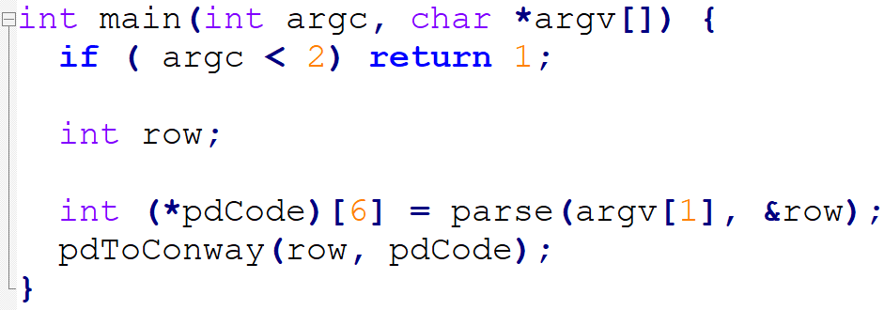
Converting Planar Diagram to Conway
Calling the program with the desired PD notation which is then converted into an $8×6$ array with all entries in the last two columns of value $1.$
All numbered labels are decreased by one for convenience.
Tangle 1 $=$ $\left[1,11,2,10\right]$
$⇒$ Tangle 0 $= [0,10,1,9]$

Slide 115
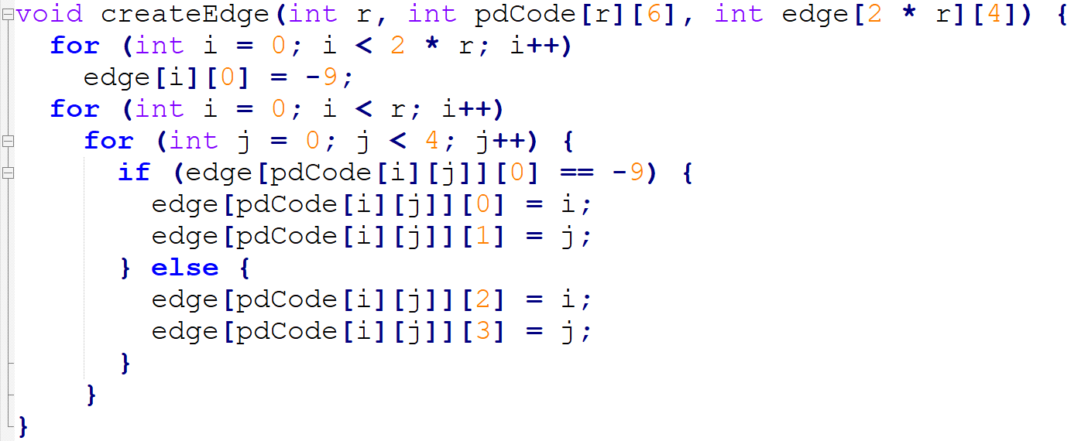
Converting Planar Diagram to Conway
Fill a $16×4$ array with edge information:
The $n^{th}$ row stores information for edge $n$
Edge $n$ : $\left[p, q, r, s\right]$
$$n=pdCode\left[i\right][j]$$
Notes:
Consider pointing to n = pdCode with brackets or a little more text, maybe both. Maybe even add a figure to keep track of values

Slide 116
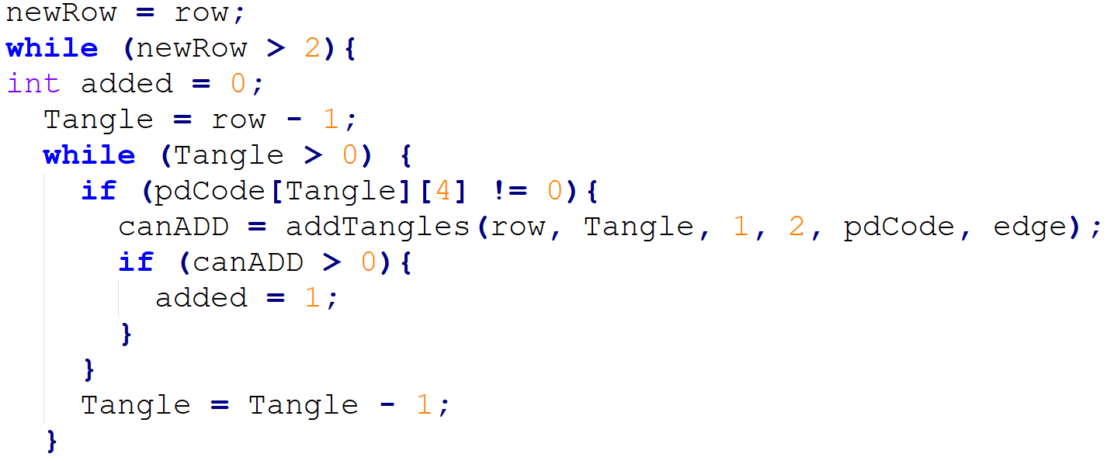
Converting Planar Diagram to Conway
Starting from the bottom of the PD array, add tangles along the right to create integer tangles. Do the same for addition along the left and products along the top and bottom.
Change continued fraction values in the last two entries to reflect the operations using $\frac{a+b}{1}$ for integer tangles
and $\frac{1}{a+b}$ for vertical tangles.
Notes:
Remove slide maybe?

Slide 117
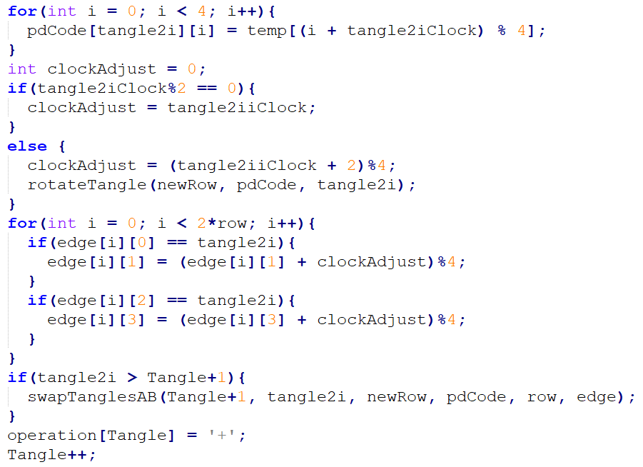
Converting Planar Diagram to Conway
Rotate tangles as needed to identify an algebraic expression which combines all rows of the PD matrix.
Prioritizes sums as the expected operation for Montesinos knots and links.
Notes:
Remove slide maybe?

Slide 118
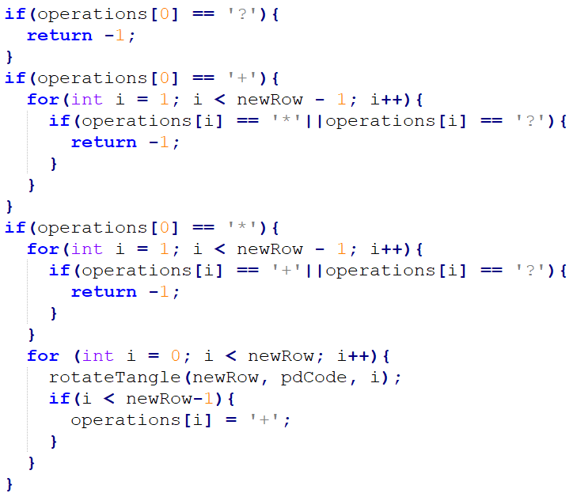
Converting Planar Diagram to Conway
If the operations are not all the same, the structure cannot be Montesinos but may be algebraic or a polyhedral type.
Notes:
Remove slide maybe?

Slide 119
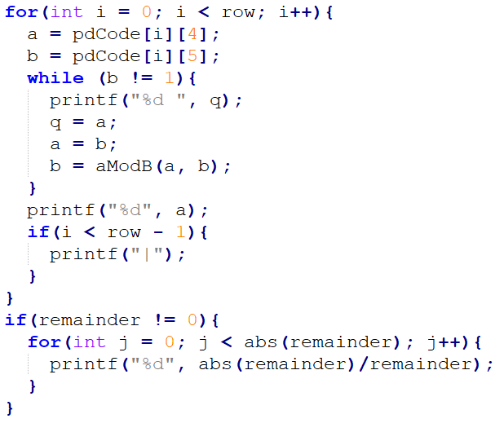
Converting Planar Diagram to Conway
With PD matrix finalized, convert continued fraction expression into Conway notation
Notes:
Include rational = 2-bridge and 4-plat

