Slide 1
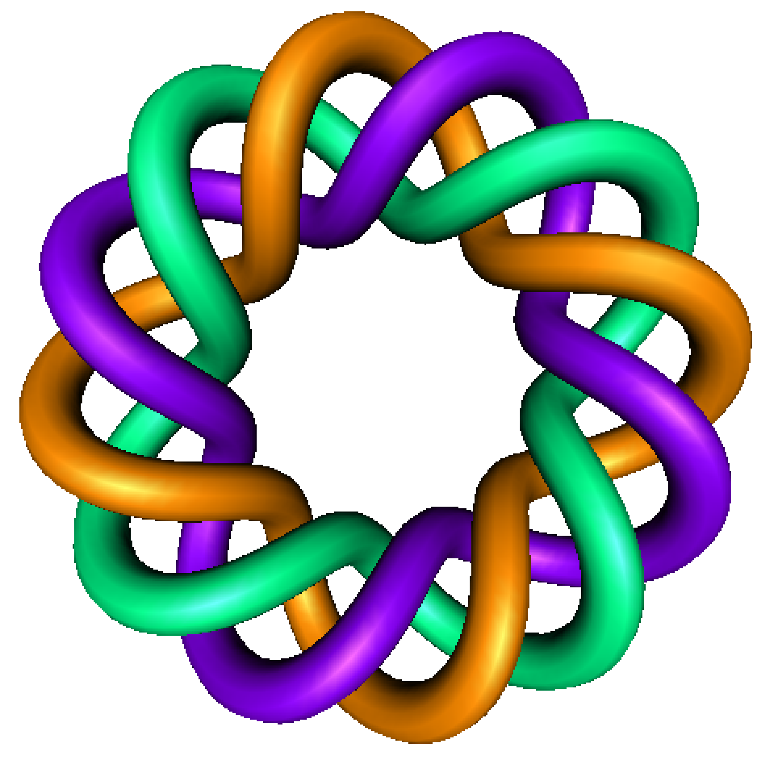
Existence and Uniqueness
By Dr. Isabel Darcy,
Dept of Mathematics and AMCS,
University of Iowa

Slide 6
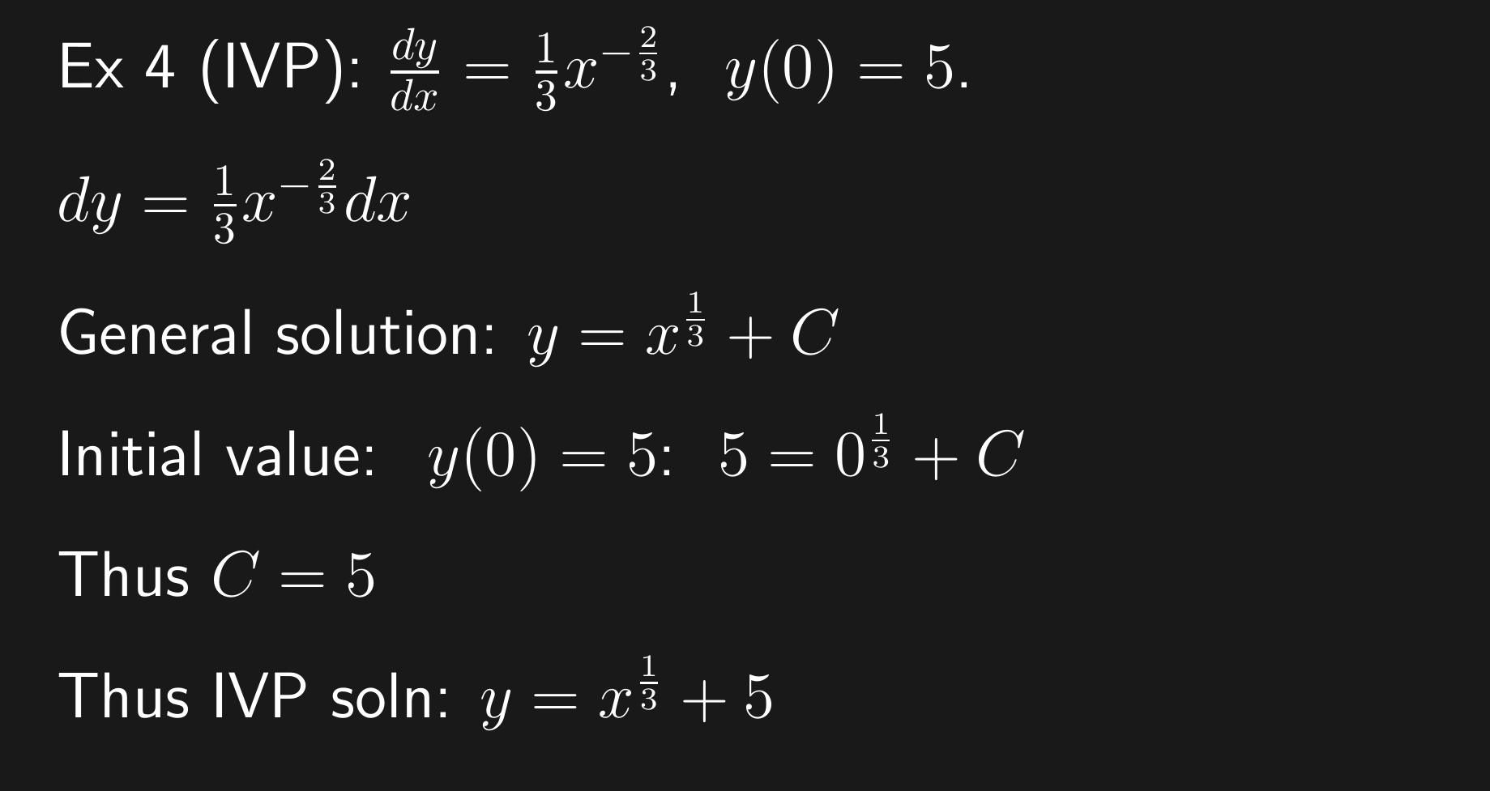

Slide 19
Special cases:
When do we know a unique solution exists?

Slide 20
Breakout groups: work on problem 2.3:18a. Use short-cut:

