Slide 1
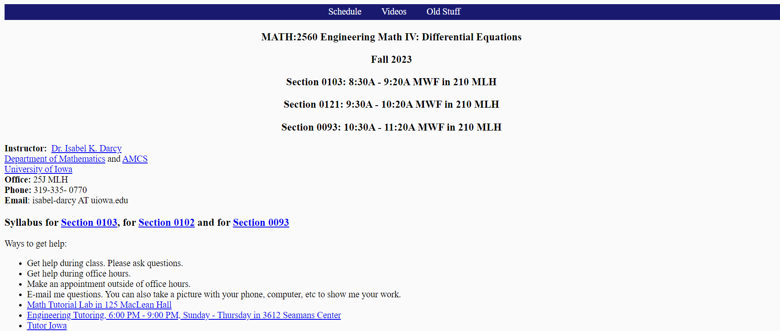
“The goal of this course is to offer a meaningful, rigorous, and rewarding experience to every student; you will build that rich experience by devoting your strongest available effort to the class. You will be challenged and supported. Please be prepared to take an active, patient, and generous role in your learning and that of your classmates.”
Federico Ardila https://www.ams.org/journals/notices/202308/noti2752/noti2752.html
http://homepage.divms.uiowa.edu/~idarcy/COURSES/100/FALL23/2560.html

Slide 2
When e-mailing me, please include Math 2560 in your subject line.

Slide 3
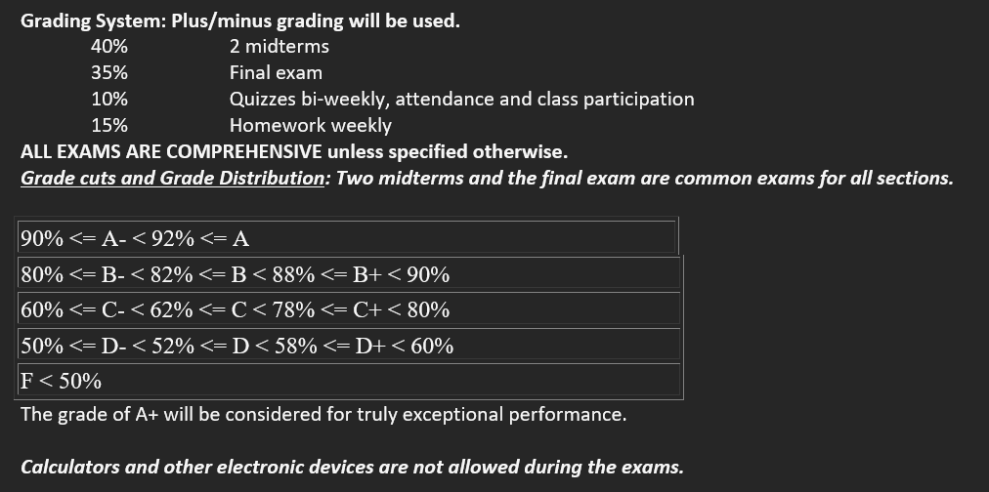

Slide 4
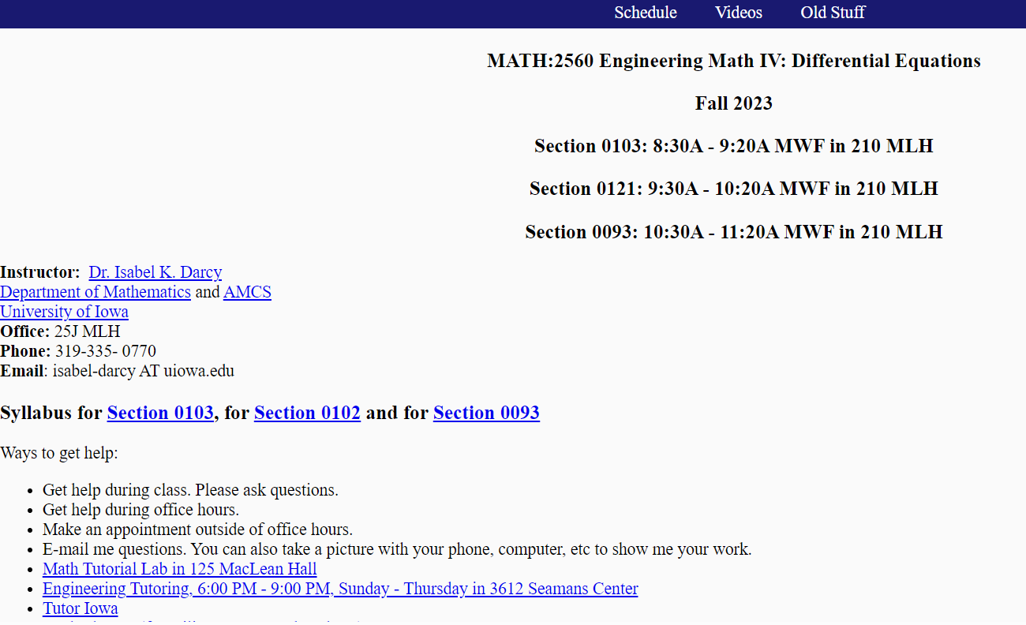
http://homepage.divms.uiowa.edu/~idarcy/COURSES/100/FALL23/2560.html

Slide 5
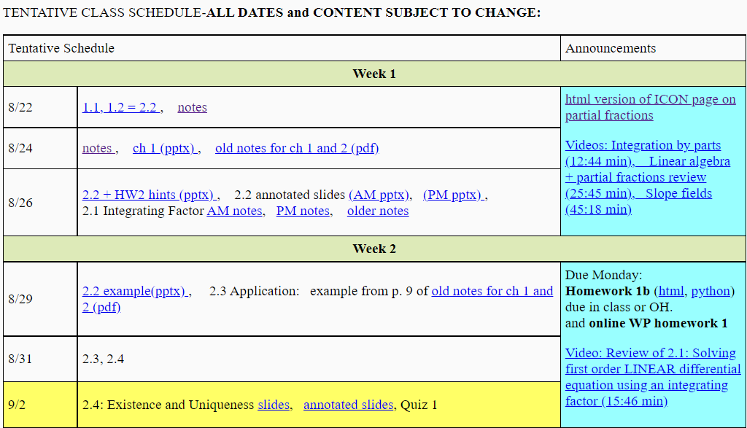
https://homepage.divms.uiowa.edu/~idarcy/COURSES/100/FALL23/2560.html

Slide 7
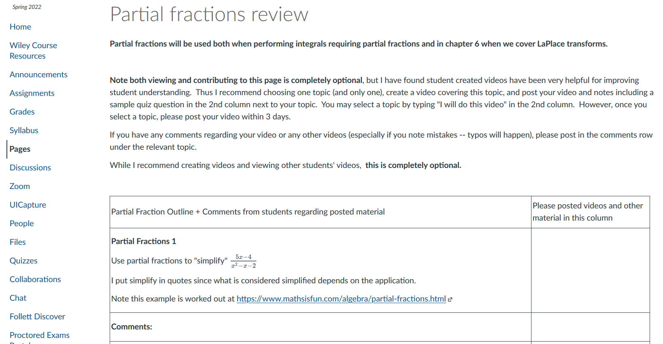

Slide 8
https://homepage.divms.uiowa.edu/~idarcy/COURSES/100/FALL22/2560.html

Slide 9
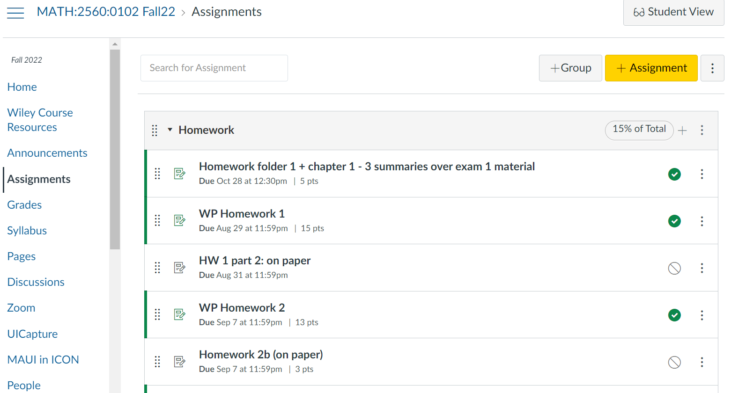

Slide 10
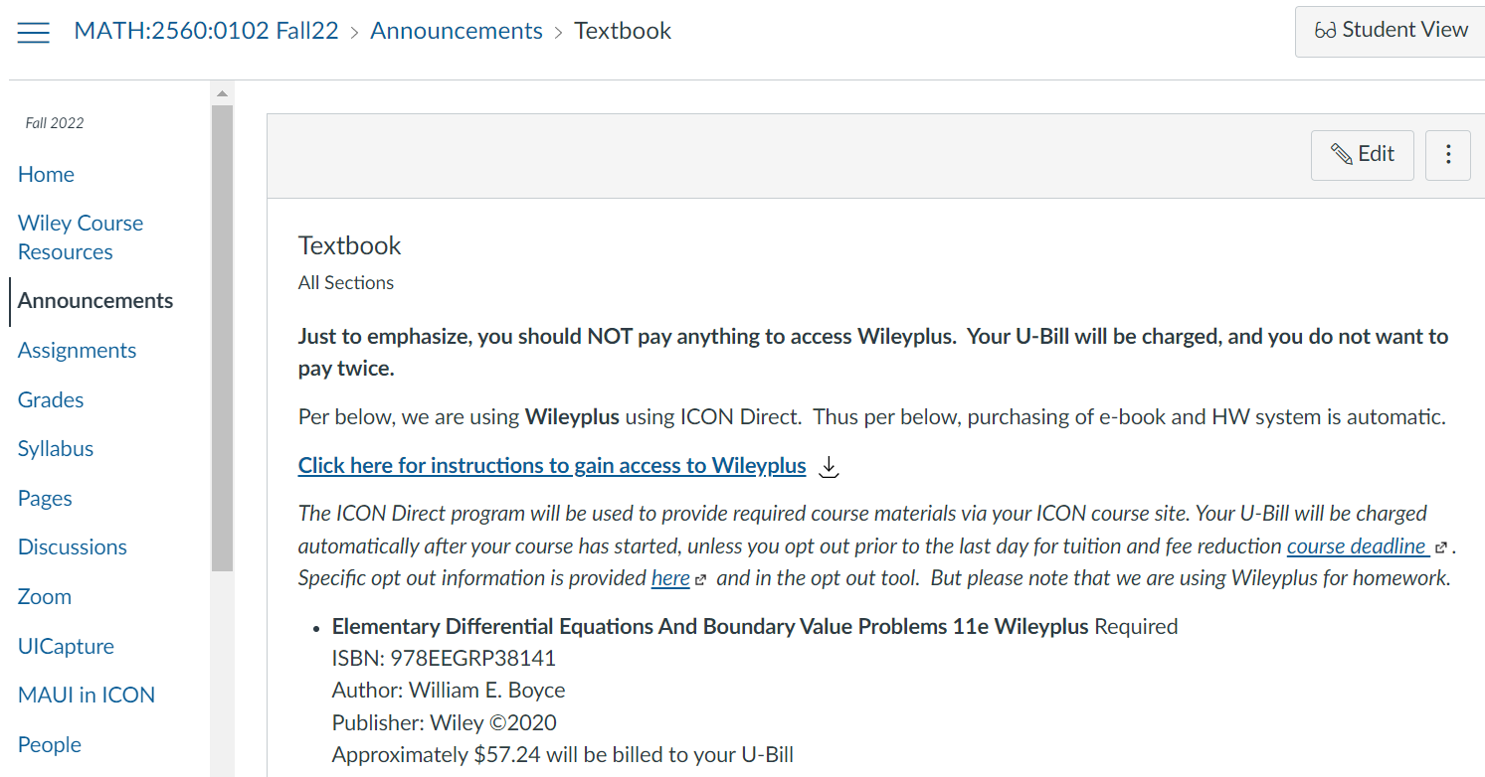

Slide 11
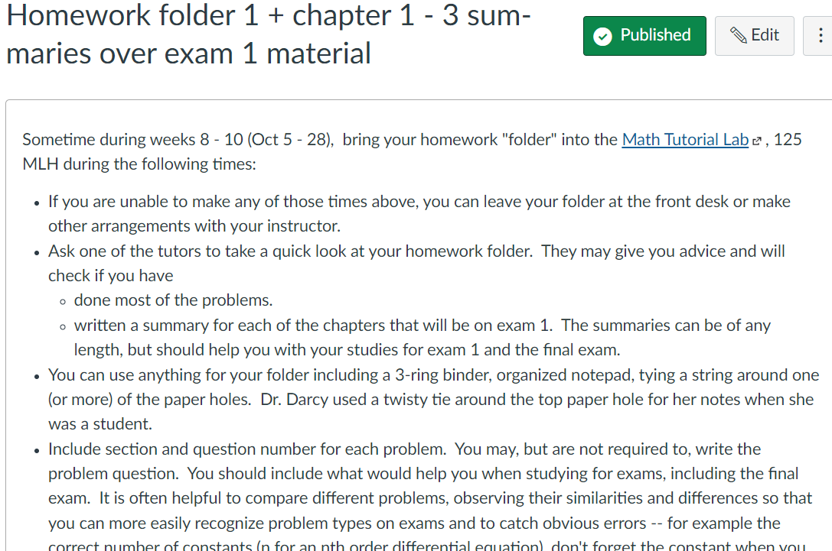

Slide 12
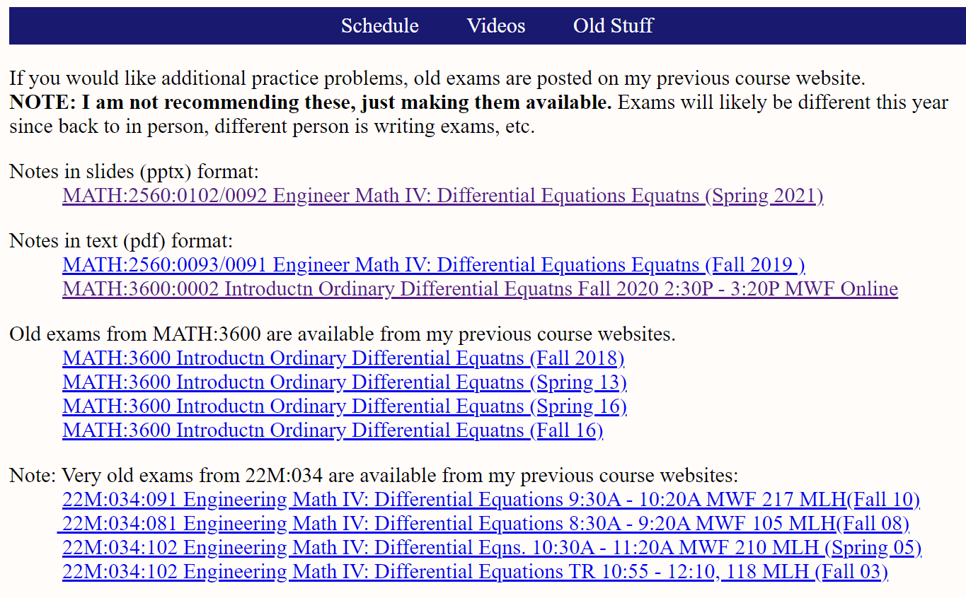

Slide 13
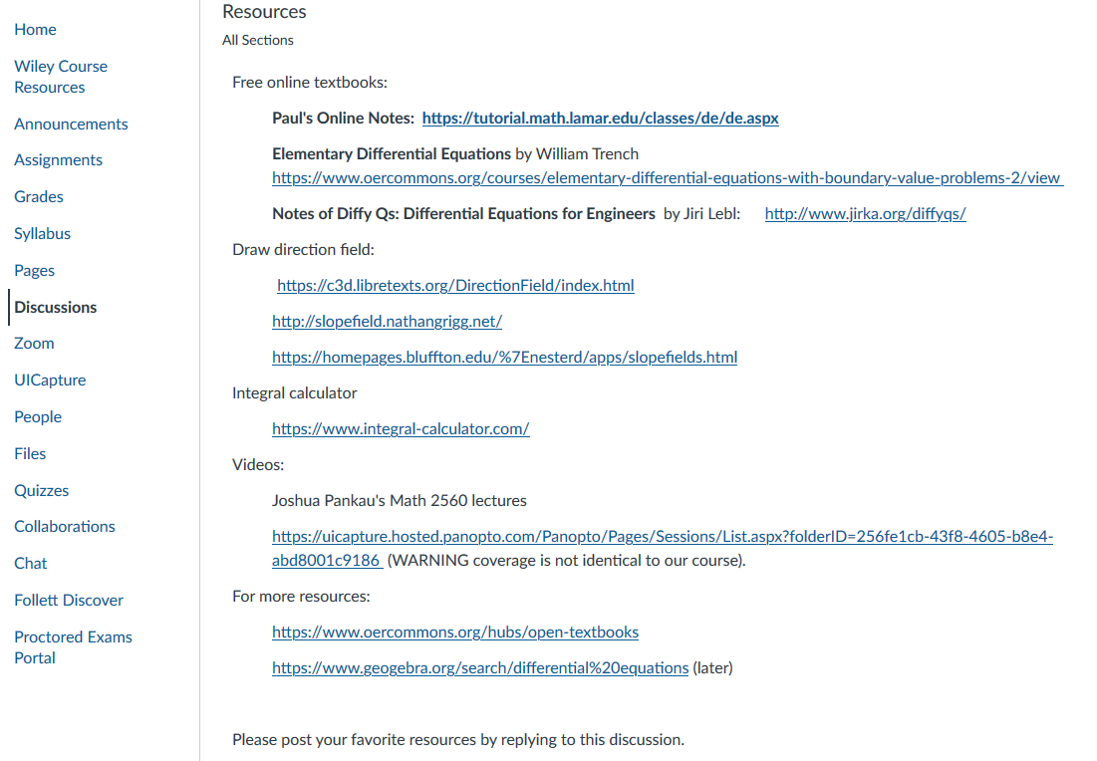

Slide 14
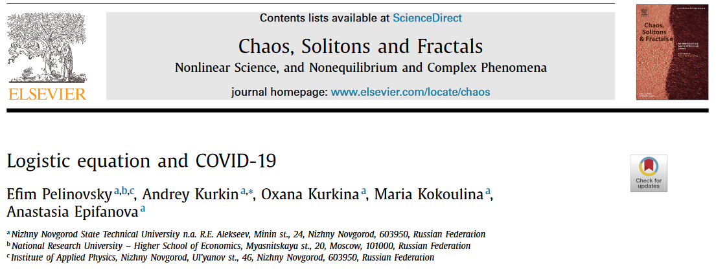
Differential equations and Covid:
Section 2.5: https://www.ncbi.nlm.nih.gov/pmc/articles/PMC7444956/

Slide 15
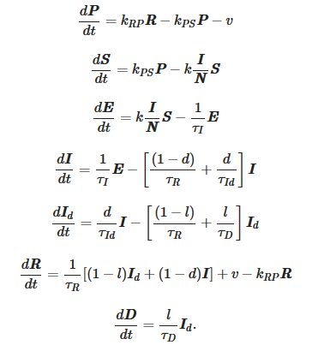
Differential equations and Covid:
Ch 7 and 9: https://www.nature.com/articles/s41598-021-95494-6
Systems of differential equations:

Slide 16
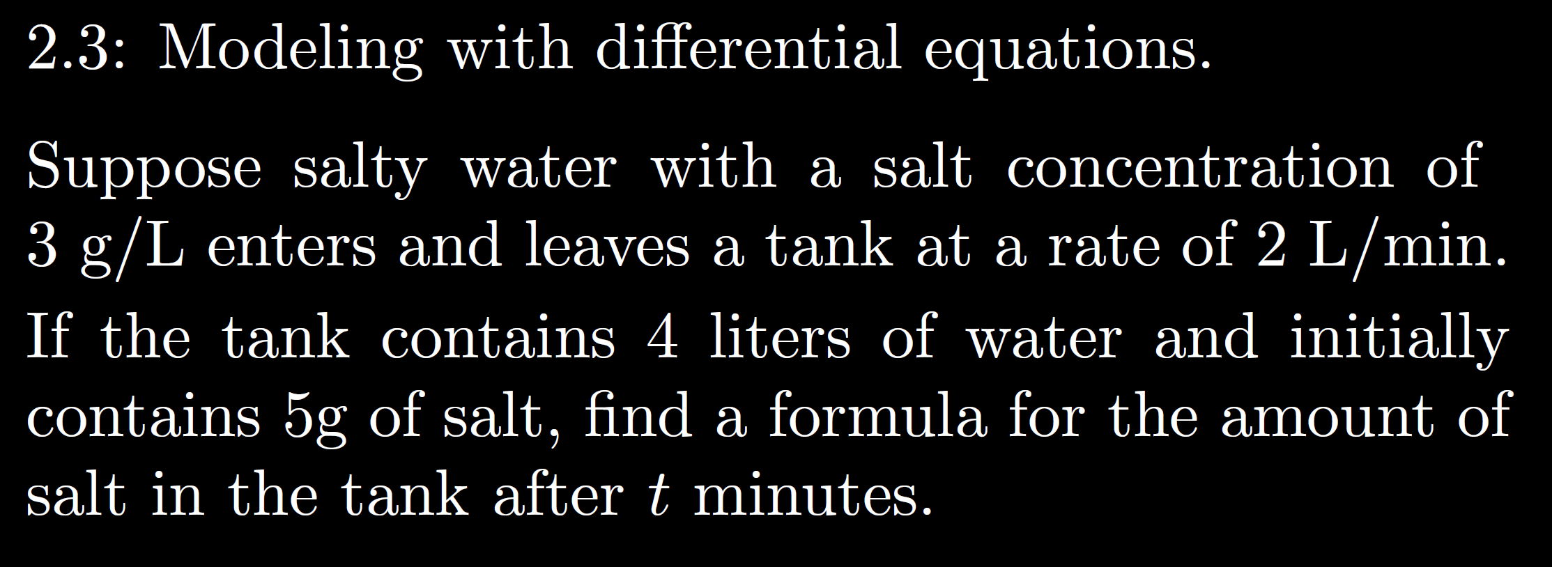

Slide 22
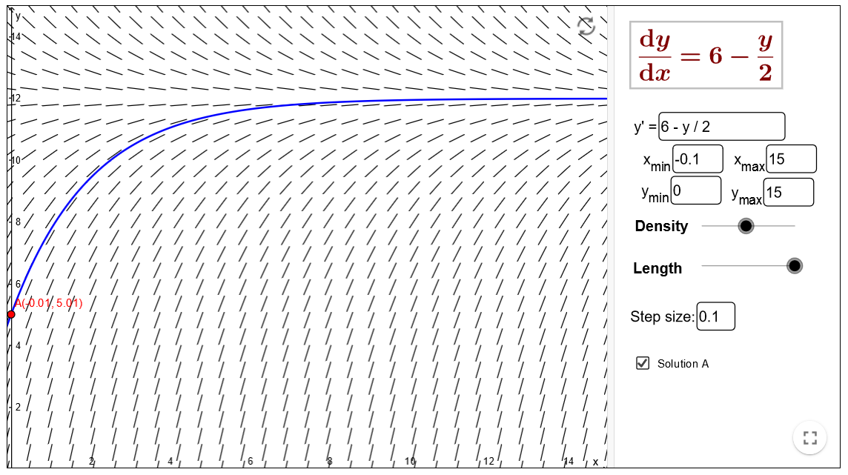
https://www.geogebra.org/m/Pd4Hn4BR

Slide 35
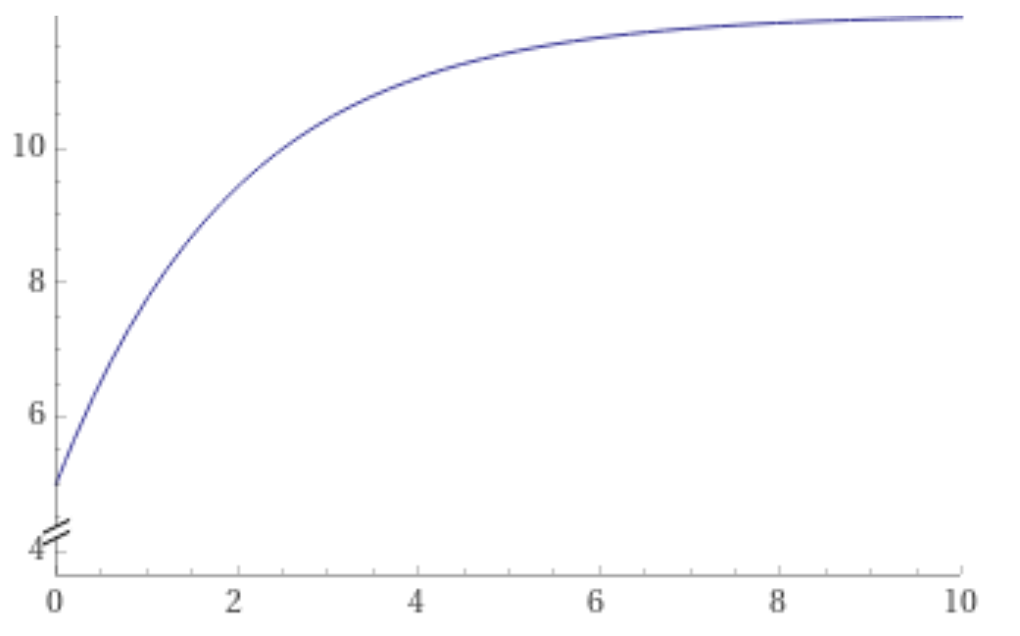
https://www.wolframalpha.com/input/?i=plot+-7+e%5E%7B-x%2F2%7D+%2B+12+from+x%3D0+to+10

Slide 39
