Slide 1
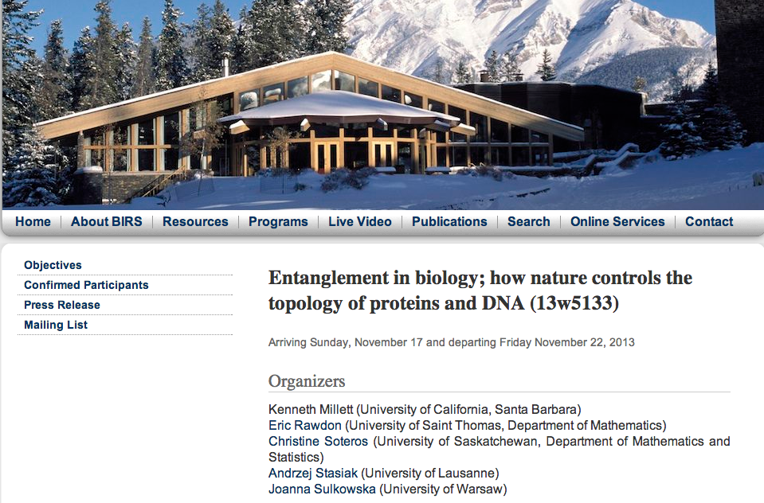
You can join live lecture Wednesday and Friday either by going to
or joining via regular classroom.
NOTE: to ask questions, you need to joing via regular classroom.

