Slide 1
MATH:7450 (22M:305) Topics in Topology: Scientific and Engineering Applications of Algebraic Topology
Sept 27, 2013: Phom
Fall 2013 course offered through the
University of Iowa Division of Continuing Education
Isabel K. Darcy, Department of Mathematics
Applied Mathematical and Computational Sciences, University of Iowa
http://www.math.uiowa.edu/~idarcy/AppliedTopology.html

Slide 2



Slide 3


Keller Hall 3-180

Slide 4

http://ima.umn.edu/publications/Resources.html

Slide 5


Slide 6
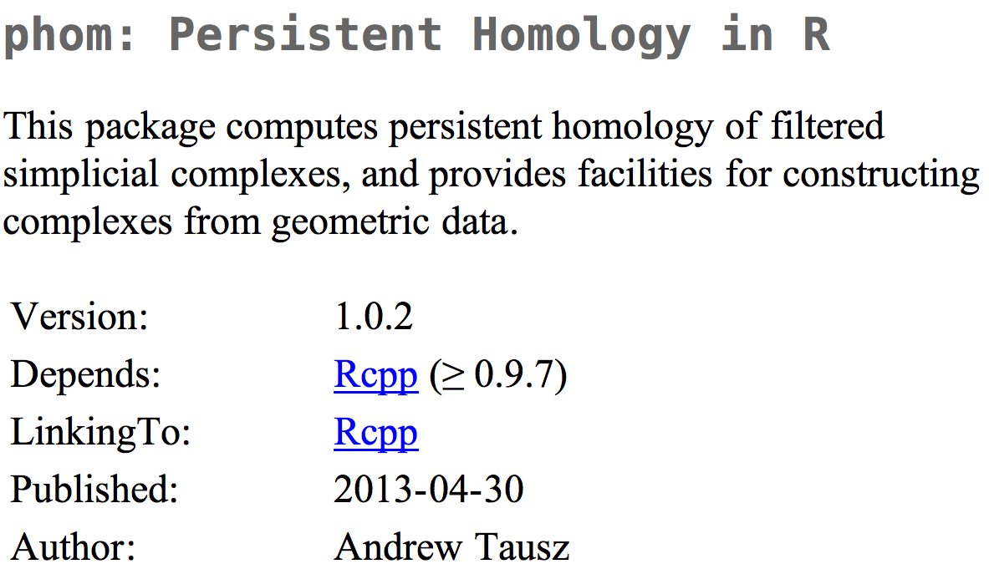
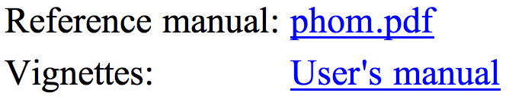
http://cran.r-project.org/web/packages/phom/

Slide 7

http://www.r-project.org/

Slide 8

http://cran.r-project.org/mirrors.html

Slide 9


Slide 10


Slide 11

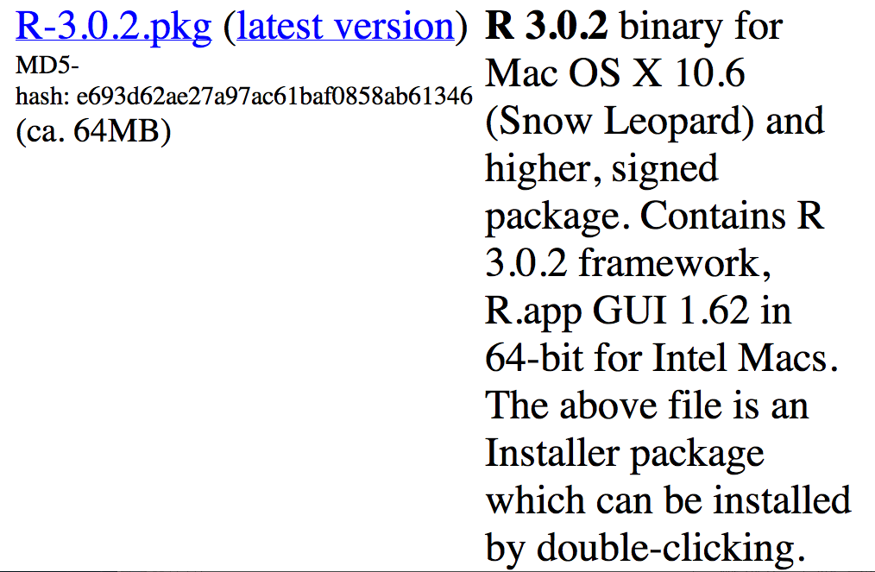

Slide 12


Slide 13
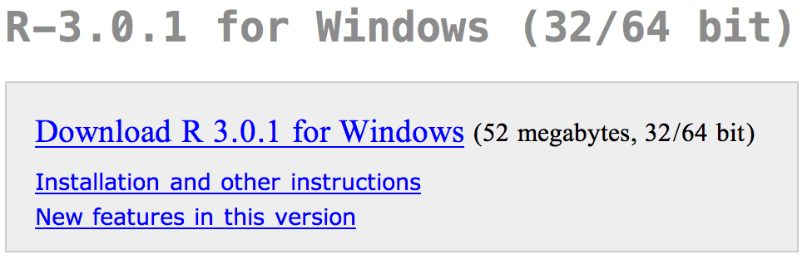

Slide 14
getwd()
setwd("Documents/CompTOP/Data")
list.files()
points <- read.table("5yrMs.csv",sep=",")
points = read.table("5yrMs.csv",sep=",")
points[1,2]
help()
help(matrix)
install.packages(“phom”)

Slide 15
http://cran.r-project.org/web/packages/phom/

Slide 16
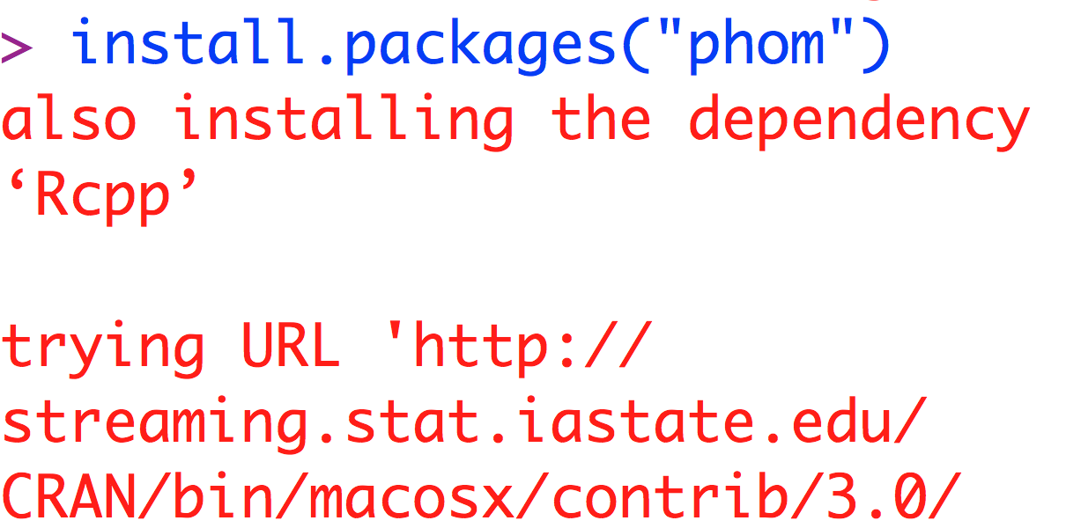
Start R and type:

Slide 17
Create points on a circle:
t <- 2 * pi * runif(100)
x <- cos(t); y <- sin(t)
X <- t(as.matrix(rbind(x, y)))
plot(X)
library(phom)
max_dim <- 1
max_f <- 0.6
intervals <- pHom(X, max_dim, max_f)
plotPersistenceDiagram(intervals, max_dim, max_f,
title="Random Points on S^1 with Euclidean Norm")
plotBarcodeDiagram(intervals, max_dim, max_f, title="")

Slide 18
pHom(X,
dimension,
max filtration value,
mode = “vr”,
metric = “euclidean”,
p = 2,
landmark set size = 2* ceiling(sqrt(length(X))), maxmin samples = min(1000, length(X)))

Slide 19
pHom(X,
dimension,
max filtration value,
mode = “vr”,
metric = “euclidean”,
p = 2,
landmark set size = 2* ceiling(sqrt(length(X))), maxmin samples = min(1000, length(X)))
metric
This indicates the type of metric that will be used.

Slide 20
metric
This indicates the type of metric that will be used.
Valid choices include the following: "distance_matrix”, "euclidean", "maximum", "manhattan", "canberra", "binary", "minkowski".
When "distance_matrix” is specified, the parameter "X" is interpreted as a distance matrix.
Otherwise, "X" is regarded as a set of points, where each row is one point.

Slide 21
pHom(X,
dimension,
max filtration value,
mode = “vr”,
metric = “euclidean”,
p = 2,
landmark set size = 2* ceiling(sqrt(length(X))), maxmin samples = min(1000, length(X)))
p
This is the value of the power to use in the minkowski metric.

Slide 22
pHom(X,
dimension,
max filtration value,
mode = “vr”,
metric = “euclidean”,
p = 2,
landmark set size = 2* ceiling(sqrt(length(X))), maxmin samples = min(1000, length(X)))
X
Data matrix consisting of either data points OR distances between data points.

Slide 23
X
A matrix with 1 of the 2 following interpretations.
If metric = "distance_matrix", then
X is required to be a square matrix whose entries indicate the distance between two points. The number of rows (and columns) equals the number of points in the dataset.
If metric is NOT "distance_matrix", then
X is required to be a matrix in which the rows are points in Euclidean space.
The number of columns is the dimensionality of the dataset.

Slide 24
pHom(X,
dimension,
max filtration value,
mode = “vr”,
metric = “euclidean”,
p = 2,
landmark set size = 2* ceiling(sqrt(length(X))), maxmin samples = min(1000, length(X)))
dimension
The maximum dimension to compute persistent homology to.

Slide 25
pHom(X,
dimension,
max filtration value,
mode = “vr”,
metric = “euclidean”,
p = 2,
landmark set size = 2* ceiling(sqrt(length(X))), maxmin samples = min(1000, length(X)))
max filtration value
The maximum filtration value to use in constructing the filtered complex.

Slide 26
pHom(X,
dimension,
max filtration value,
mode = “vr”,
metric = “euclidean”,
p = 2,
landmark set size = 2* ceiling(sqrt(length(X))), maxmin samples = min(1000, length(X)))
mode
"vr" (default) = Vietoris-Rips
"lw" =lazy-witness

Slide 27
Phom lazy witness complex LW(D, ε, k):
Let D = set of point cloud data points.
Choose L D, L = set of landmark points.
Let m_{k}(v) = dist (v, d) where d is the k^{th} closest point in D to v.
U
{l₁, l₂} is a 1-simplex
iff
max{d(v, l₁), d(v, l₁)} ≤ m_{k}(v)+ ε
v is the witness

Slide 28
mode
This indicates the type of filtration to use.
2 possible choices are
"vr" (default) indicates that the Vietoris-Rips filtration will be used,
"lw" indicates that the lazy-witness construction will be used.
For Vietoris-Rips filtrations, the parameters landmark_set_size and maxmin_samples are ignored.

Slide 29
pHom(X,
dimension,
max filtration value,
mode = “vr”,
metric = “euclidean”,
p = 2,
landmark set size = 2* ceiling(sqrt(length(X))), maxmin samples = min(1000, length(X)))
The number of points to include in the landmark set. A sensible value for this is in between 20 and 100. The default value is taken to be 2p|X| . This parameter is only relevant for the lazy-witness filtration.

Slide 30
pHom(X,
dimension,
max filtration value,
mode = “vr”,
metric = “euclidean”,
p = 2,
landmark set size = 2* ceiling(sqrt(length(X))), maxmin samples = min(1000, length(X)))
intervals <- pHom(X, max_dim, max_f, mode="lw", metric="euclidean", 30, 40)
The number of samples to use when performing the maxmin selection. The default value is taken to be min(|X|, 1000) . This parameter is only relevant for the lazy-witness filtration.

Slide 31
plotBarcodeDiagram(intervals, dimension, max f, title=”Persistence Diagram”)
intervals
A matrix with three columns that specifies the persistence intervals. Entries in the first column indicate the dimension of an interval. The entries in the second and third columns indicate the start and end points of the intervals, respectively. The function pHom produces outputs that are in this form.

Slide 32
plotBarcodeDiagram(intervals, dimension, max f, title=”Persistence Diagram”)
dimension
The dimension to plot intervals for. Unlike plotPersistenceDiagram, this function only plots intervals for one dimension, and not all of them.
max f
The maximum filtration value to use in the diagram.
title
The title on the barcode diagram.

Slide 33
plotPersistenceDiagram(intervals, max dim, max f, title=”Persistence Diagram”)
intervals
A matrix with three columns that specifies the persistence intervals. Entries in the first column indicate the dimension of an interval. The entries in the second and third columns indicate the start and end points of the intervals, respectively. The function pHom produces outputs that are in this form.
max dim
The maximum dimension to plot.
max f
The maximum filtration value to use in the persistence diagram.
title
The title on the persistence diagram.

Slide 34
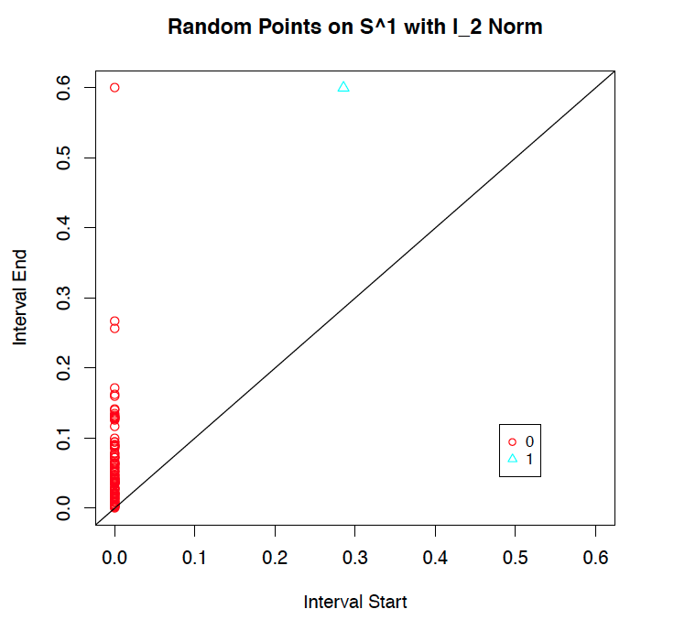
persistence diagram = set of points in the plane
where
x-coordinate = the start of interval,
y-coordinate = the ending point.

Slide 35
plotPersistenceDiagram(intervals, max dim, max f, title=”Persistence Diagram”)
intervals
A matrix with three columns that specifies the persistence intervals. Entries in the first column indicate the dimension of an interval. The entries in the second and third columns indicate the start and end points of the intervals, respectively. The function pHom produces outputs that are in this form.
max dim
The maximum dimension to plot.
max f
The maximum filtration value to use in the persistence diagram.
title
The title on the persistence diagram.

Slide 36
Choosing Landmark points:
A.) Random
B.) Maxmin
1.) choose point l₁ randomly
2.) If {l₁, …, l_{k-1}} have been chosen, choose l_{k} such that {l₁, …, l_{k-1}} is in D - {l₁, …, l_{k-1}} and
min {d(l_{k}, l₁), …, d(l_{k}, l_{k-1})} ≥ min {d(v, l₁), …, d(v, l_{k-1})}

Slide 37

num_landmark_points = 100;
random_selector = api.Plex4.createRandomSelector(point_cloud, num_landmark_points);
maxmin_selector = api.Plex4.createMaxMinSelector(point_cloud, num_landmark_points);

Slide 38
Javaplex Witness complex W(D, L, ε):
Let D = set of point cloud data points.
Choose L D, L = set of landmark points.
Let m_{k} (v) = dist (v, l) where l is the k+1 closest point in L to v.
U
{l₁, …, l_{k+1}} is a k-simplex
iff
d(v, l_{i}) ≤ m_{k} (v)+ ε for all i
v is the witness

Slide 39
>> num_landmark_points = 50;
>> max_dimension = 3;
>> num_divisions = 100;
>> landmark_selector = api.Plex4.createMaxMinSelector(point_cloud, num_landmark_points);
>> random_selector = api.Plex4.createRandomSelector(point_cloud, num_landmark_points);

Slide 40
The next command returns the landmark covering measure R from Section 5.2. Often the value for tmax is chosen in proportion to R.
>> R = landmark_selector.getMaxDistanceFromPointsToLandmarks()
R = 0.7033 % Generally close to 0.7
>> max_filtration_value = R / 8;

Slide 41
We create the witness stream.
>> stream = api.Plex4.createWitnessStream(
landmark_selector, max_dimension,
max_filtration_value, num_divisions);
>> num_simplices = stream.getSize()
num_simplices = 1164 % Generally close to 1200

Slide 42


Slide 43

The primary visual cortex (V1)
1.) V1 is a component in the visual pathway, which begins with
the retinal cells in the eye,
proceeds through the lateral geniculate locus,
then to the primary visual cortex,
and then through a number of higher level processing units, such as V2, V3, V4, middle temporal area (MT), and others
2.) V1 performs low level tasks, such as edge and line detection, and its output is then processed for higher level and larger scale properties further along the visual pathway. However, the mechanism by which it carries out these tasks is not understood.

Slide 44
Studied via method 2: embedded electrode arrays
Record voltages at points in time at each electrode.
Spike train: lists of firing times for a neuron
  obtained via spike sorting –i.e. signal processing.
Data = an array of N spike trains.
Compared spontaneous (eyes occluded) to evoked (via movie clips).
10 second segments broken into 50 ms bins
The 5 neurons with the highest firing rate in each ten second window were chosen
For each bin, create a vector in R⁵ corresponding to the number of firings of each of the 5 neurons.
200 bins = 200 data points in R⁵
Many 10 second segments = many data sets

Slide 45
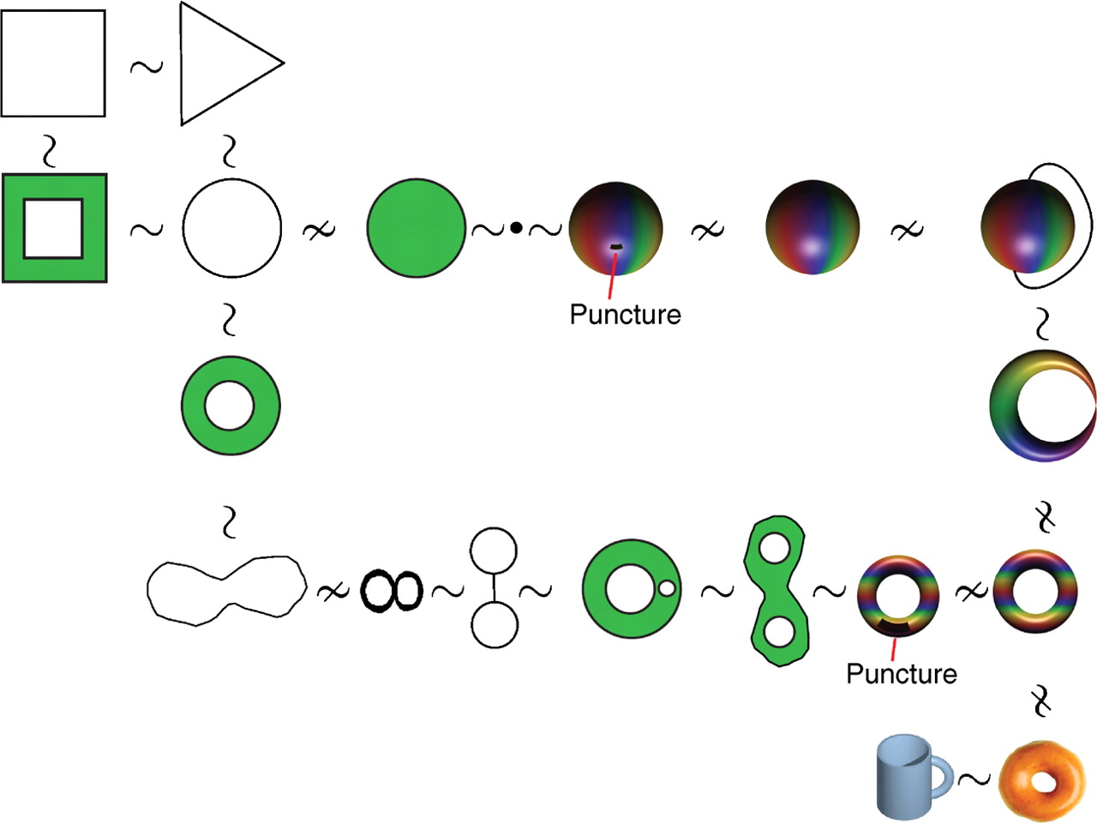

Topological equivalence in rubber-world.
Singh G et al. J Vis 2008;8:11
©2008 by Association for Research in Vision and Ophthalmology
Notes:
Topological equivalence in rubber-world. The figure illustrates the notion of equivalence by showing several objects (topological spaces) connected by the symbols ∼ when they are equivalent or by ≁ when they are not. The reader should think that all the objects shown are made of an elastic material and visualize the equivalence of two spaces by imagining a deformation between to objects.

Slide 46
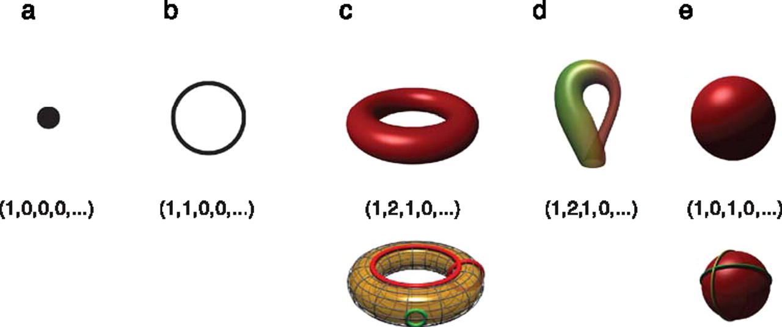
Betti numbers provide a signature of the underlying topology.
Singh G et al. J Vis 2008;8:11
©2008 by Association for Research in Vision and Ophthalmology
Notes:
Betti numbers provide a signature of the underlying topology. Illustrated in the figure are five simple objects (topological spaces) together with their Betti number signatures: (a) a point, (b) a circle, (c) a hollow torus, (d) a Klein bottle, and (e) a hollow sphere. For the case of the torus (c), the figure shows three loops on its surface. The red loops are “essential” in that they cannot be shrunk to a point, nor can they be deformed one into the other without tearing the loop. The green loop, on the other hand, can be deformed to a point without any obstruction. For the torus, therefore, we have b 1 = 2. For the case of the sphere, the loops shown (and actually all loops on the sphere) can be contracted to points, which is reflected by the fact that b 1 = 0. Both the sphere and the torus have b 2 = 1, this is due to the fact both surfaces enclose a part of space (a void).

Slide 47
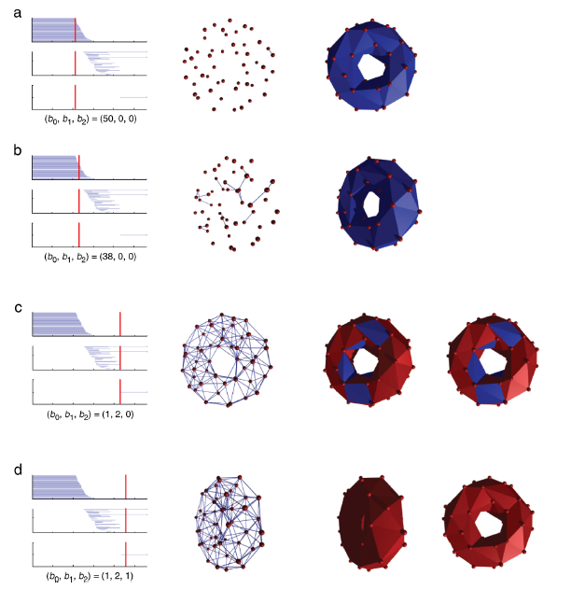
http://www.journalofvision.org/
content/8/8/11.full
Figure 4 animation

Slide 48
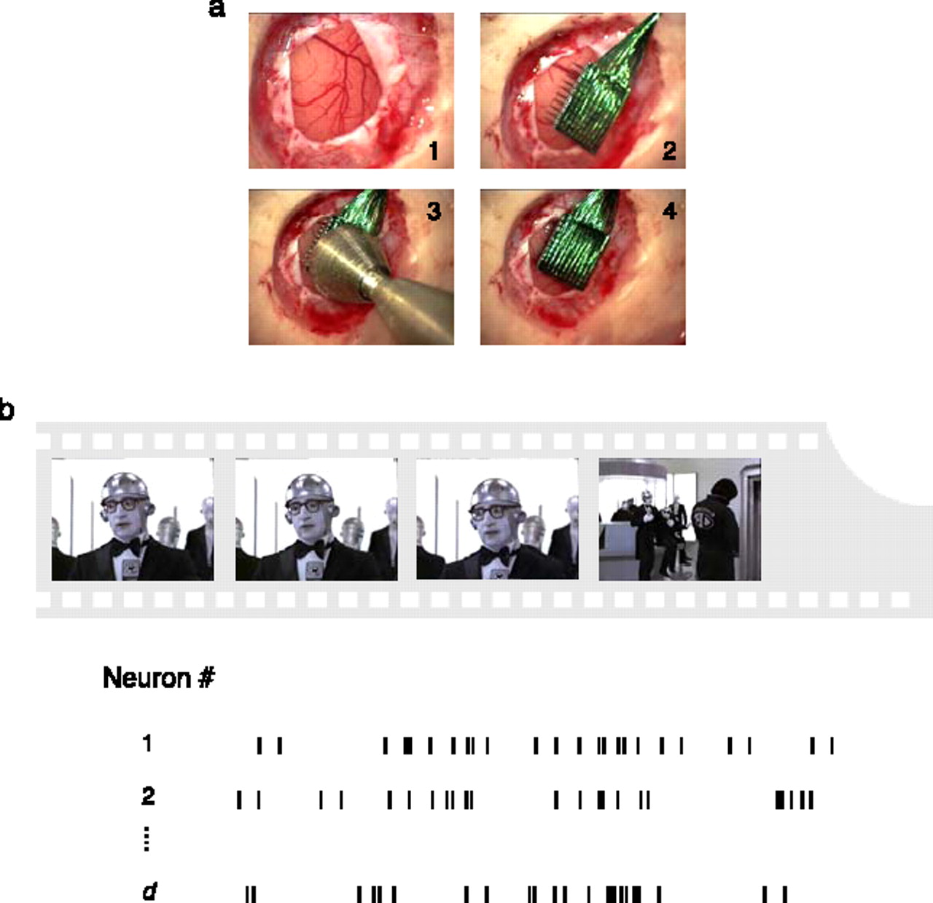
Experimental recordings in primary visual cortex.
Singh G et al. J Vis 2008;8:11
©2008 by Association for Research in Vision and Ophthalmology
Notes:
Experimental recordings in primary visual cortex. (a) Insertion sequence of a multi-electrode array into primary visual cortex (Nauhaus & Ringach, 2007). (b) Natural image sequences, sampled from commercial movies, were used to stimulate all receptive fields of neurons isolated by the array. In the spontaneous condition, activity was recorded while both eyes were occluded.

Slide 49
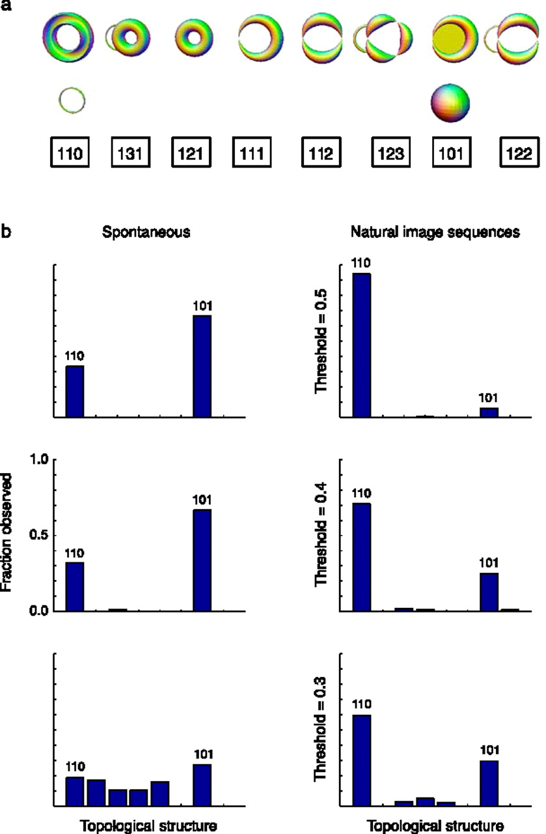
Estimation of topological structure in driven and spontaneous conditions.
Record voltages at points in time at each electrode.
Spike train: lists of firing times for a neuron
  obtained via spike sorting –i.e. signal processing.
Data = an array of N spike trains.
Compared spontaneous (eyes occluded) to evoked (via movie clips).
10 second segments broken into 50 ms bins
  Transistion between states about 80ms
The 5 neurons with the highest firing rate in each ten second window were chosen
For each bin, create a vector in R⁵ corresponding to the number of firings of each of the 5 neurons.
200 bins = 200 data points in R⁵.
  Used 35 landmark points.
20-30minutes of data = many data sets
Control: shuffled data 52700 times.
Singh G et al. J Vis 2008;8:11
©2008 by Association for Research in Vision and Ophthalmology
Notes:
Estimation of topological structure in driven and spontaneous conditions. (a) Ordering of topological signatures observed in our experiments. Each triplet ( b 0, b 1, b 2) is shown along an illustration of objects consistent with these signature. (b) Distribution of topological signatures in the spontaneous and natural image stimulation conditions pooled across the three experiments performed. Each row correspond to signatures with a minimum interval length (denoted as the threshold) expressed as a fraction of the covering radius of the data cloud (see Appendix A for the definition of the covering radius).

Slide 50
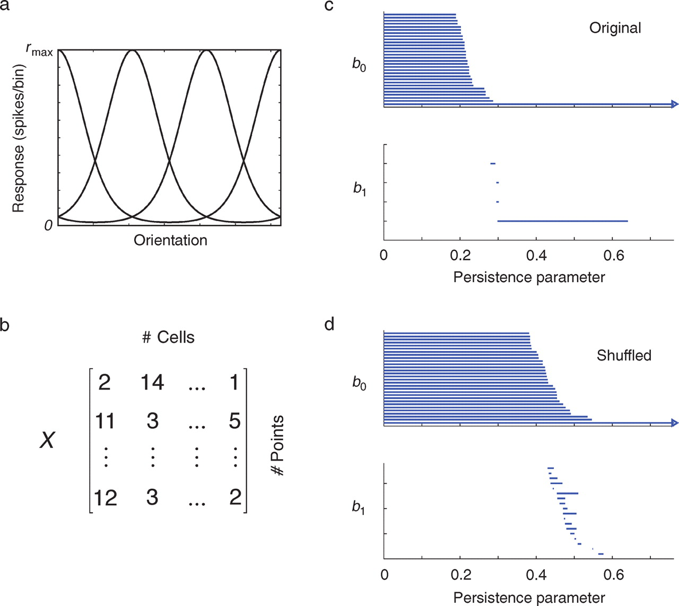
Testing the statistical significance of barcodes.
Singh G et al. J Vis 2008;8:11
©2008 by Association for Research in Vision and Ophthalmology
Notes:
Testing the statistical significance of barcodes. (a) We assume an initial population of Poisson-spiking neurons tuned for orientation. (b) The simulated response of this population to the presentation of different orientations is collected into a data matrix (or point cloud). (c) Analysis of the simulated data shows a long interval with a signature (b0, b1) = (1, 1), which correctly identifies the underlying object as a circle. (d) We also compute the barcodes by shifting the relative positions of the columns (data shuffling). In this case, the statistical distributions of spike counts for each axis remain unchanged, but their relationship is destroyed. By computing the distribution of maximal b1 lengths under this null hypothesis, we can evaluate the likelihood that our data was generated by the null hypothesis that there the coordinates of the points are independent.

