Slide 1
MATH:7450 (22M:305) Topics in Topology: Scientific and Engineering Applications of Algebraic Topology
Sept 23, 2013: Image data Application.
Fall 2013 course offered through the
University of Iowa Division of Continuing Education
Isabel K. Darcy, Department of Mathematics
Applied Mathematical and Computational Sciences, University of Iowa
http://www.math.uiowa.edu/~idarcy/AppliedTopology.html

Slide 2
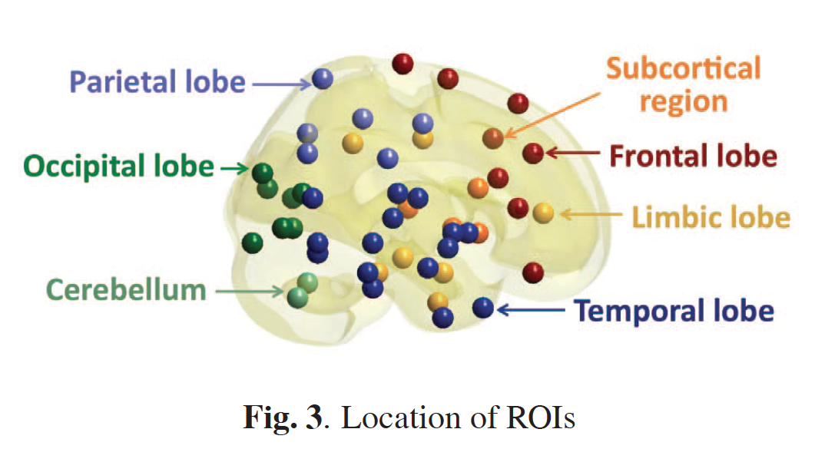
Discriminative persistent homology of brain networks, 2011 Hyekyoung Lee Chung, M.K.; Hyejin Kang; Bung-Nyun Kim;Dong Soo Lee
Constructing functional brain networks with 97 regions of interest (ROIs) extracted from FDG-PET data for
24 attention-deficit hyperactivity disorder (ADHD),
26 autism spectrum disorder (ASD) and
11 pediatric control (PedCon).
Data = measurement f_{j}
taken at region j
Graph: 97 vertices representing 97 regions of interest
edge exists between two vertices i,j if correlation
between f_{j} and f_{j} ≥ threshold
How to choose the threshold? Don’t, instead use persistent homology

Slide 3
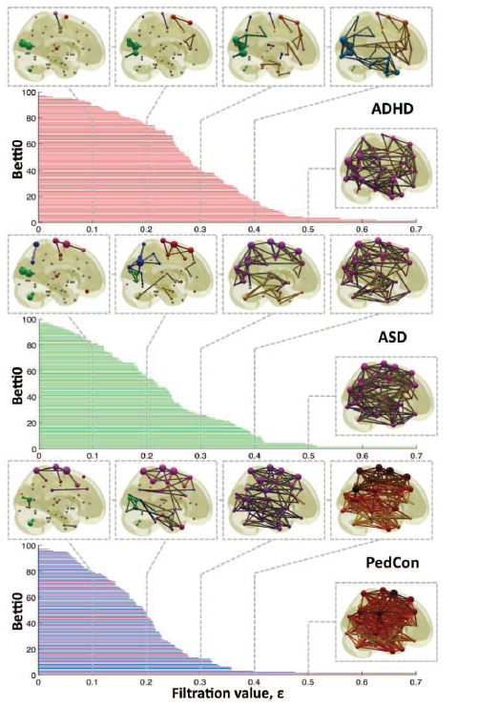

Vertices = Regions of Interest
Create Rips complex by growing epsilon balls (i.e. decreasing threshold) where distance between two vertices is given by
where f_{i} =
measurement at location i

Slide 4


http://www.ima.umn.edu/videos/?id=856
http://ima.umn.edu/2008-2009/ND6.15-26.09/activities/Carlsson-Gunnar/imafive-handout4up.pdf

Slide 5

Application to Natural Image Statistics
With V. de Silva, T. Ishkanov, A. Zomorodian
http://www.ima.umn.edu/videos/?id=1846
http://www.ima.umn.edu/2011-2012/W3.26-30.12/activities/Carlsson-Gunnar/imamachinefinal.pdf

Slide 6
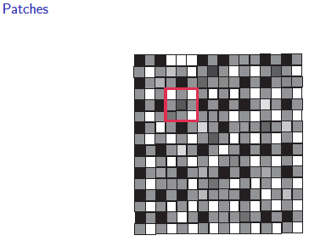
An image taken by black and white digital camera can be viewed as a vector, with one coordinate for each pixel
Each pixel has a “gray scale” value, can be thought of as a real number (in reality, takes one of 255 values)
Typical camera uses tens of thousands of pixels, so images lie in a very high dimensional space, call it pixel space, P

Slide 7
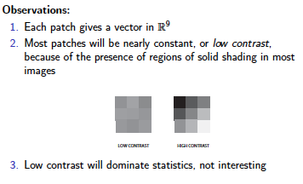
Lee-Mumford-Pedersen [LMP] study only high contrast patches.
Collection: 4.5 x 10⁶ high contrast patches from a
collection of images obtained by van Hateren and van der Schaaf

Slide 8
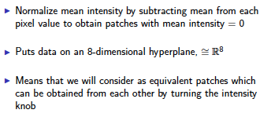
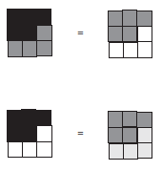


Slide 9
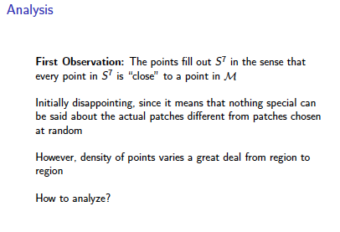

Slide 10
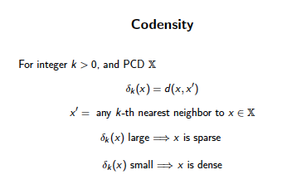
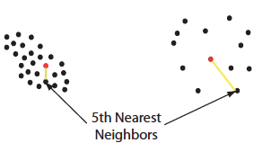


Slide 11
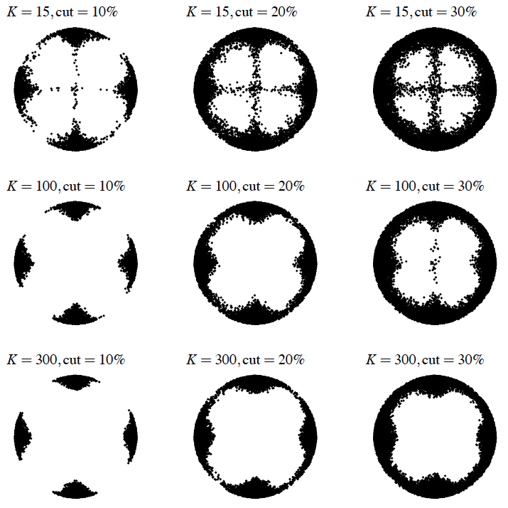
Eurographics Symposium on Point-Based Graphics (2004)
Topological estimation using witness complexes
Vin de Silva and Gunnar Carlsson

Slide 12
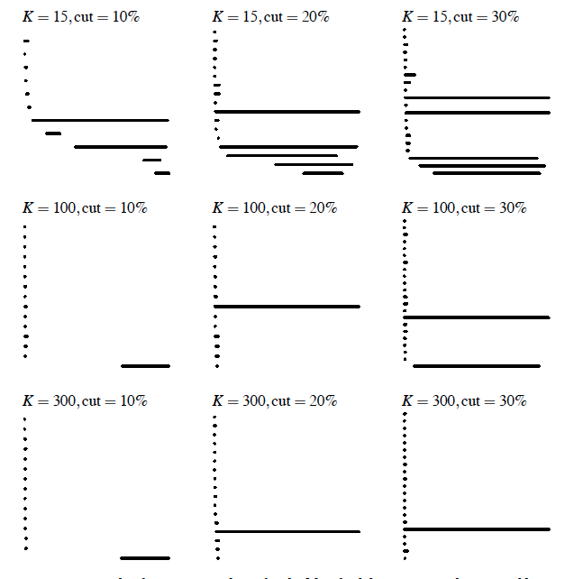
Eurographics Symposium on Point-Based Graphics (2004)
Topological estimation using witness complexes
Vin de Silva and Gunnar Carlsson

Slide 13
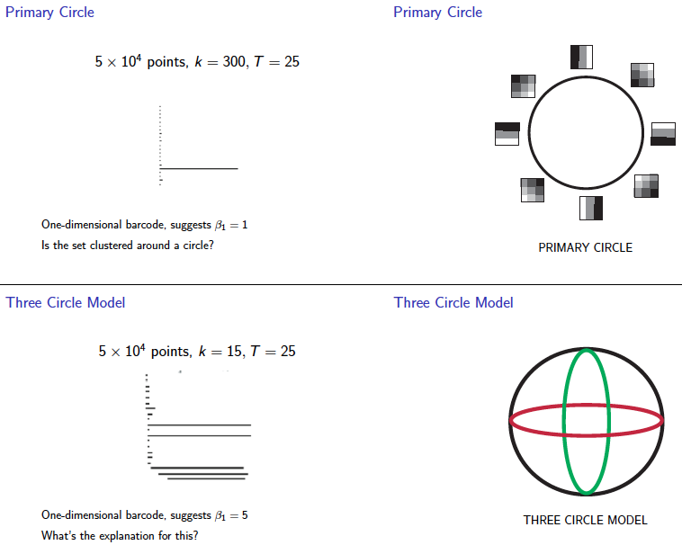
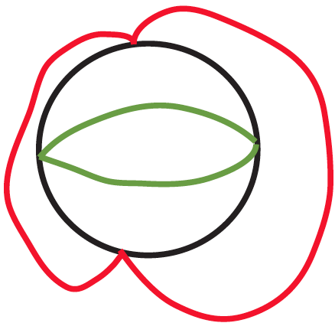

Slide 14
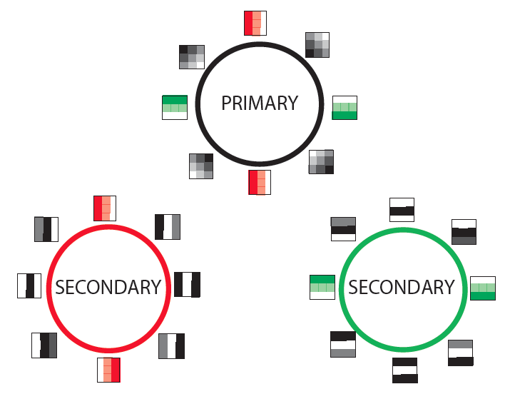

Slide 15
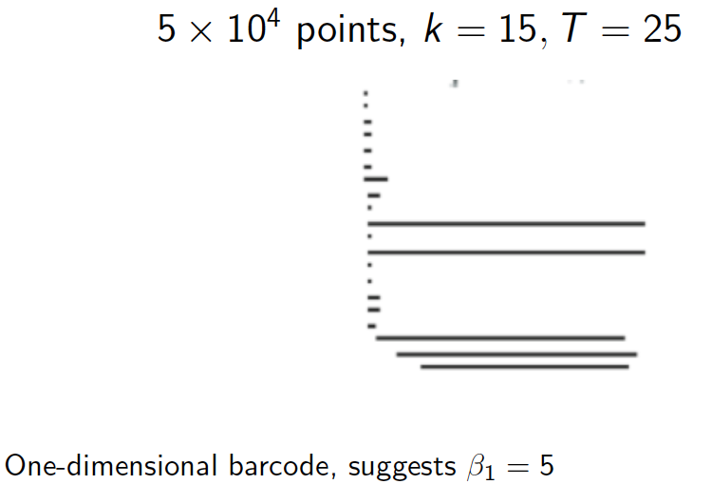

Slide 16
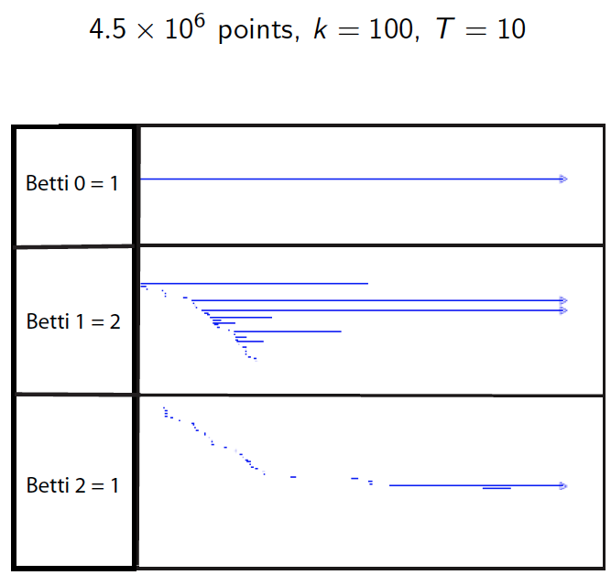

Slide 17
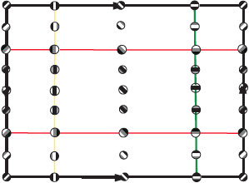

Slide 18
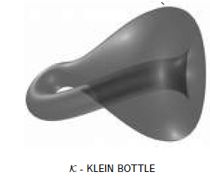

Slide 19
Creating a simplicial complex
Step 0.) Start by adding data points
= 0-dimensional vertices (0-simplices)
Notes:
data points.
In this very simplified case my data points lie in a two-dimensional plane. Normally data points are high dimensional.
For example, I may be comparing the expression or thousands of genes in tumor cells to healthy cells using microarray data. OR I might be comparing politicians voting records. Or I might be comparing the stats of basketball players. These three applications were all, by the way, published by Lum et al this past February in Nature’s Scientific Reports. I have included a link to their paper on my youtube site.
http://www.nature.com/srep/2013/130207/srep01236/full/srep01236.html

Slide 20

Creating a simplicial complex
1.) Adding 1-dimensional edges (1-simplices)
Let T = Threshold =
Connect vertices v and w with an edge iff
the distance between v and w is less than T
Notes:
So we will connect every pair of vertices if their distance is less than 1.8 cm. If the center of these points represent the 0-dimensional vertices, then this distance is less than our threshold, so we add an edge. Similarly this pair of points satisfy our definition of close, so we add an edge
The distance between this pair of vertices is greater than 1.8, so we won’t connect them with an edge. Continuing to add edges between vertices whenever their distance is less than our threshold of 1.8cm, we now have

Slide 21
Creating a simplicial complex
1.) Adding 1-dimensional edges (1-simplices)
Let T = Threshold =
Connect vertices v and w with an edge iff
the distance between v and w is less than T
Notes:
So we will connect every pair of vertices if their distance is less than 1.8 cm. If the center of these points represent the 0-dimensional vertices, then this distance is less than our threshold, so we add an edge. Similarly this pair of points satisfy our definition of close, so we add an edge
The distance between this pair of vertices is greater than 1.8, so we won’t connect them with an edge. Continuing to add edges between vertices whenever their distance is less than our threshold of 1.8cm, we now have

Slide 22
Creating a simplicial complex
1.) Adding 1-dimensional edges (1-simplices)
Let T = Threshold =
Connect vertices v and w with an edge iff
the distance between v and w is less than T
Notes:
So we will connect every pair of vertices if their distance is less than 1.8 cm. If the center of these points represent the 0-dimensional vertices, then this distance is less than our threshold, so we add an edge. Similarly this pair of points satisfy our definition of close, so we add an edge
The distance between this pair of vertices is greater than 1.8, so we won’t connect them with an edge. Continuing to add edges between vertices whenever their distance is less than our threshold of 1.8cm, we now have

Slide 23
Creating a simplicial complex
1.) Adding 1-dimensional edges (1-simplices)
Add an edge between data points that are “close”
Notes:
a one dimensional simplicial complex. Note that we have clustered our data into five disjoint connected sets. So this is one way to cluster our data – that is grouping our data points into disjoint sets based on some definition of similarity. In this case, we have 5 clusters.
We can now add higher dimensional simplices.

Slide 24
Creating a simplicial complex
1.) Adding 1-dimensional edges (1-simplices)
Add an edge between data points that are “close”
Notes:
a one dimensional simplicial complex. Note that we have clustered our data into five disjoint connected sets. So this is one way to cluster our data – that is grouping our data points into disjoint sets based on some definition of similarity. In this case, we have 5 clusters.
We can now add higher dimensional simplices.

Slide 25
Vietoris Rips complex = flag complex = clique complex
2.) Add all possible simplices of dimensional > 1.
Notes:
Thus we now have the Vietoris Rips simplicial complex. Note we get the same simplex by adding one dimension at a time

Slide 26
Creating the Čech simplicial complex
1.) Adding 1-dimensional edges (1-simplices)
Add an edge between data points that are “close”
Notes:
a one dimensional simplicial complex. Note that we have clustered our data into five disjoint connected sets. So this is one way to cluster our data – that is grouping our data points into disjoint sets based on some definition of similarity. In this case, we have 5 clusters.
We can now add higher dimensional simplices.

Slide 27
Creating the Čech simplicial complex
1.) B₁ … B_{k+1} ≠ ⁄ , create k-simplex {v₁, ... , v_{k+1}}.
U
U
0
Notes:
Thus we now have the Vietoris Rips simplicial complex. Note we get the same simplex by adding one dimension at a time

Slide 28
Creating the Čech simplicial complex
1.) B₁ … B_{k+1} ≠ ⁄ , create k-simplex {v₁, ... , v_{k+1}}.
U
U
0
Notes:
Thus we now have the Vietoris Rips simplicial complex. Note we get the same simplex by adding one dimension at a time

Slide 29
Creating Delaunay triangulation via Voronoi diagrams
Notes:
data points.
In this very simplified case my data points lie in a two-dimensional plane. Normally data points are high dimensional.
For example, I may be comparing the expression or thousands of genes in tumor cells to healthy cells using microarray data. OR I might be comparing politicians voting records. Or I might be comparing the stats of basketball players. These three applications were all, by the way, published by Lum et al this past February in Nature’s Scientific Reports. I have included a link to their paper on my youtube site.
http://www.nature.com/srep/2013/130207/srep01236/full/srep01236.html

Slide 30
Voronoi diagram:
Suppose your data points live in R^{n}.
Choose data point v.
The Voronoi cell
associated with v is
H(v,w)
U
w ≠ v
H(v,w) = { x in R^{n} : d(x, v) ≤ d(x, w) }
Notes:
data points.
In this very simplified case my data points lie in a two-dimensional plane. Normally data points are high dimensional.
For example, I may be comparing the expression or thousands of genes in tumor cells to healthy cells using microarray data. OR I might be comparing politicians voting records. Or I might be comparing the stats of basketball players. These three applications were all, by the way, published by Lum et al this past February in Nature’s Scientific Reports. I have included a link to their paper on my youtube site.
http://www.nature.com/srep/2013/130207/srep01236/full/srep01236.html

Slide 31
Voronoi diagram:
Suppose your data points live in R^{n}.
Choose data point v.
The Voronoi cell associated with v is
H(v,w)
U
w ≠ v
H(v,w) = { x in R^{n} : d(x, v) ≤ d(x, w) }
Notes:
data points.
In this very simplified case my data points lie in a two-dimensional plane. Normally data points are high dimensional.
For example, I may be comparing the expression or thousands of genes in tumor cells to healthy cells using microarray data. OR I might be comparing politicians voting records. Or I might be comparing the stats of basketball players. These three applications were all, by the way, published by Lum et al this past February in Nature’s Scientific Reports. I have included a link to their paper on my youtube site.
http://www.nature.com/srep/2013/130207/srep01236/full/srep01236.html

Slide 32
Choose data point v.
The Voronoi cell associated with v is
H(v,w)
U
w ≠ v
Notes:
data points.
In this very simplified case my data points lie in a two-dimensional plane. Normally data points are high dimensional.
For example, I may be comparing the expression or thousands of genes in tumor cells to healthy cells using microarray data. OR I might be comparing politicians voting records. Or I might be comparing the stats of basketball players. These three applications were all, by the way, published by Lum et al this past February in Nature’s Scientific Reports. I have included a link to their paper on my youtube site.
http://www.nature.com/srep/2013/130207/srep01236/full/srep01236.html

Slide 33
Choose data point v.
The Voronoi cell associated with v is
H(v,w)
U
w ≠ v
Notes:
data points.
In this very simplified case my data points lie in a two-dimensional plane. Normally data points are high dimensional.
For example, I may be comparing the expression or thousands of genes in tumor cells to healthy cells using microarray data. OR I might be comparing politicians voting records. Or I might be comparing the stats of basketball players. These three applications were all, by the way, published by Lum et al this past February in Nature’s Scientific Reports. I have included a link to their paper on my youtube site.
http://www.nature.com/srep/2013/130207/srep01236/full/srep01236.html

Slide 34
Choose data point v.
The Voronoi cell associated with v is
H(v,w)
U
w ≠ v
Notes:
data points.
In this very simplified case my data points lie in a two-dimensional plane. Normally data points are high dimensional.
For example, I may be comparing the expression or thousands of genes in tumor cells to healthy cells using microarray data. OR I might be comparing politicians voting records. Or I might be comparing the stats of basketball players. These three applications were all, by the way, published by Lum et al this past February in Nature’s Scientific Reports. I have included a link to their paper on my youtube site.
http://www.nature.com/srep/2013/130207/srep01236/full/srep01236.html

Slide 35
Choose data point v.
The Voronoi cell associated with v is
H(v,w)
U
w ≠ v
Notes:
data points.
In this very simplified case my data points lie in a two-dimensional plane. Normally data points are high dimensional.
For example, I may be comparing the expression or thousands of genes in tumor cells to healthy cells using microarray data. OR I might be comparing politicians voting records. Or I might be comparing the stats of basketball players. These three applications were all, by the way, published by Lum et al this past February in Nature’s Scientific Reports. I have included a link to their paper on my youtube site.
http://www.nature.com/srep/2013/130207/srep01236/full/srep01236.html

Slide 36
Voronoi diagram:
Suppose your data points live in R^{n}.
Choose data point v.
The Voronoi cell associated with v is
H(v,w)
U
w ≠ v
H(v,w) = { x in R^{n} : d(x, v) ≤ d(x, w) }
Notes:
data points.
In this very simplified case my data points lie in a two-dimensional plane. Normally data points are high dimensional.
For example, I may be comparing the expression or thousands of genes in tumor cells to healthy cells using microarray data. OR I might be comparing politicians voting records. Or I might be comparing the stats of basketball players. These three applications were all, by the way, published by Lum et al this past February in Nature’s Scientific Reports. I have included a link to their paper on my youtube site.
http://www.nature.com/srep/2013/130207/srep01236/full/srep01236.html

Slide 37
Voronoi diagram Suppose your data points live in R^{n}.
Choose data point v.
The Voronoi cell associated with v is
H(v,w)
U
w ≠ v
The Voronoi cell associated with v is
C_{v}= { x in R^{n} : d(x, v) ≤ d(x, w) for all w ≠ v }
Notes:
data points.
In this very simplified case my data points lie in a two-dimensional plane. Normally data points are high dimensional.
For example, I may be comparing the expression or thousands of genes in tumor cells to healthy cells using microarray data. OR I might be comparing politicians voting records. Or I might be comparing the stats of basketball players. These three applications were all, by the way, published by Lum et al this past February in Nature’s Scientific Reports. I have included a link to their paper on my youtube site.
http://www.nature.com/srep/2013/130207/srep01236/full/srep01236.html

Slide 38
The delaunay triangulation is the dual to the voronoi diagram
If C_{v} ≠ 0, then
σ is a simplex in the
delaunay triangulation.
U
⁄
w in σ
The Voronoi cell associated with v is
C_{v}= { x in R^{n} : d(x, v) ≤ d(x, w) for all w ≠ v }
Notes:
data points.
In this very simplified case my data points lie in a two-dimensional plane. Normally data points are high dimensional.
For example, I may be comparing the expression or thousands of genes in tumor cells to healthy cells using microarray data. OR I might be comparing politicians voting records. Or I might be comparing the stats of basketball players. These three applications were all, by the way, published by Lum et al this past February in Nature’s Scientific Reports. I have included a link to their paper on my youtube site.
http://www.nature.com/srep/2013/130207/srep01236/full/srep01236.html

Slide 39
The delaunay triangulation is the dual to the voronoi diagram
If C_{v} ≠ 0, then
σ is a simplex in the
delaunay triangulation.
U
⁄
w in σ
The Voronoi cell associated with v is
C_{v}= { x in R^{n} : d(x, v) ≤ d(x, w) for all w ≠ v }
Notes:
data points.
In this very simplified case my data points lie in a two-dimensional plane. Normally data points are high dimensional.
For example, I may be comparing the expression or thousands of genes in tumor cells to healthy cells using microarray data. OR I might be comparing politicians voting records. Or I might be comparing the stats of basketball players. These three applications were all, by the way, published by Lum et al this past February in Nature’s Scientific Reports. I have included a link to their paper on my youtube site.
http://www.nature.com/srep/2013/130207/srep01236/full/srep01236.html

Slide 40
The delaunay triangulation is the dual to the voronoi diagram
If C_{v} ≠ 0, then
σ is a simplex in the
delaunay triangulation.
U
⁄
w in σ
The Voronoi cell associated with v is
C_{v}= { x in R^{n} : d(x, v) ≤ d(x, w) for all w ≠ v }
Notes:
data points.
In this very simplified case my data points lie in a two-dimensional plane. Normally data points are high dimensional.
For example, I may be comparing the expression or thousands of genes in tumor cells to healthy cells using microarray data. OR I might be comparing politicians voting records. Or I might be comparing the stats of basketball players. These three applications were all, by the way, published by Lum et al this past February in Nature’s Scientific Reports. I have included a link to their paper on my youtube site.
http://www.nature.com/srep/2013/130207/srep01236/full/srep01236.html

Slide 41
The delaunay triangulation is the dual to the voronoi diagram
If C_{v} ≠ 0, then
σ is a simplex in the
delaunay triangulation.
U
⁄
w in σ
The Voronoi cell associated with v is
C_{v}= { x in R^{n} : d(x, v) ≤ d(x, w) for all w ≠ v }
Notes:
data points.
In this very simplified case my data points lie in a two-dimensional plane. Normally data points are high dimensional.
For example, I may be comparing the expression or thousands of genes in tumor cells to healthy cells using microarray data. OR I might be comparing politicians voting records. Or I might be comparing the stats of basketball players. These three applications were all, by the way, published by Lum et al this past February in Nature’s Scientific Reports. I have included a link to their paper on my youtube site.
http://www.nature.com/srep/2013/130207/srep01236/full/srep01236.html

Slide 42
Notes:
data points.
In this very simplified case my data points lie in a two-dimensional plane. Normally data points are high dimensional.
For example, I may be comparing the expression or thousands of genes in tumor cells to healthy cells using microarray data. OR I might be comparing politicians voting records. Or I might be comparing the stats of basketball players. These three applications were all, by the way, published by Lum et al this past February in Nature’s Scientific Reports. I have included a link to their paper on my youtube site.
http://www.nature.com/srep/2013/130207/srep01236/full/srep01236.html

Slide 43
Notes:
data points.
In this very simplified case my data points lie in a two-dimensional plane. Normally data points are high dimensional.
For example, I may be comparing the expression or thousands of genes in tumor cells to healthy cells using microarray data. OR I might be comparing politicians voting records. Or I might be comparing the stats of basketball players. These three applications were all, by the way, published by Lum et al this past February in Nature’s Scientific Reports. I have included a link to their paper on my youtube site.
http://www.nature.com/srep/2013/130207/srep01236/full/srep01236.html

