Slide 1
MATH:7450 (22M:305) Topics in Topology: Scientific and Engineering Applications of Algebraic Topology
Sept 20, 2013: Persistent homology.
Fall 2013 course offered through the
University of Iowa Division of Continuing Education
Isabel K. Darcy, Department of Mathematics
Applied Mathematical and Computational Sciences, University of Iowa
http://www.math.uiowa.edu/~idarcy/AppliedTopology.html

Slide 2
H₀ = < a, b, c, d : tc + td, tb + c, ta + tb>
H₁ = <z₁, z₂ : t z₂, t³z₁ + t²z₂ >
[ )
[ )
[ )
[ )
[
z₁ = ad + cd + t(bc) + t(ab), z₂ = ac + t²bc + t²ab

Slide 3
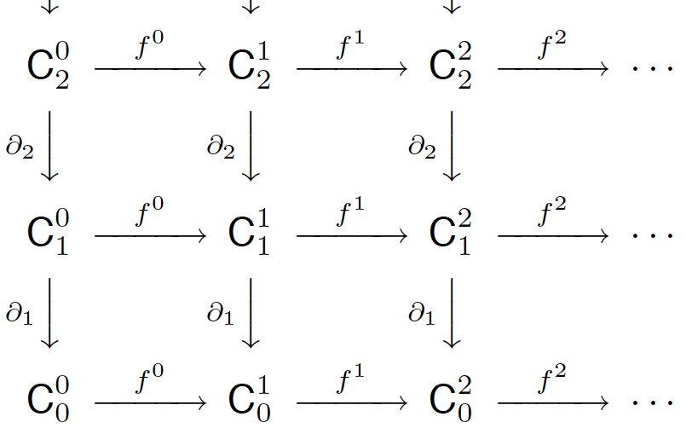
p-persistent k^{th} homology group:
_{i, p}
_{i}
_{i+p}
_{i}
H_{k} = Z_{k} / ( B_{k} Z_{k} )
U
http://link.springer.com/article/10.1007%2Fs00454-004-1146-y

Slide 4
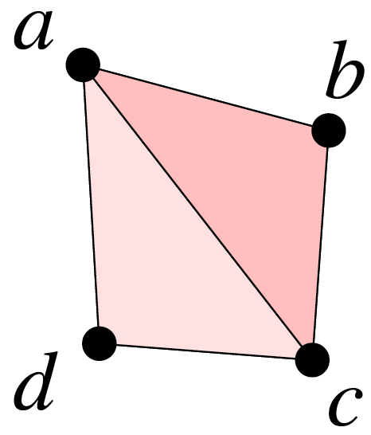
₃
→
C₂ = Z₂[abc, acd]
C₁ = Z₂[ab, bc, ac, ad, cd]
C₀ = Z₂[a, b, c, d]
₂
→
₁
→
→
₀
0

Slide 5
₃
→
C₂ = Z₂[abc, acd]
C₁ = Z₂[ab, bc, ac, ad, cd]
C₀ = Z₂[a, b, c, d]
₂
→
₁
→
+
+
+
+
+
C_{k} = C₀ C₁ C₂ C₃ …
→
₀
0

Slide 6
₃
→
C₂ = Z₂[abc, acd]
C₁ = Z₂[ab, bc, ac, ad, cd]
C₀ = Z₂[a, b, c, d]
₂
→
₁
+
+
+
→
C_{k} = C₀ C₁ C₂
→
₀
0

Slide 7
₃
→
C₂ = Z₂[abc, acd]
C₁ = Z₂[ab, bc, ac, ad, cd]
C₀ = Z₂[a, b, c, d]
₂
→
₁
+
+
+
→
C_{k} = C₀ C₁ C₂
→
a + b + bc + abc + acd
₀
0

Slide 8
₃
→
C₂ = Z₂[abc, acd]
C₁ = Z₂[ab, bc, ac, ad, cd]
C₀ = Z₂[a, b, c, d]
₂
→
₁
+
+
+
→
C_{k} = C₀ C₁ C₂
a + b bc abc + acd
(a + b, bc, abc + acd)
→
+
+
₀
0

Slide 9
₃
→
C₂ = Z₂[abc, acd]
C₁ = Z₂[ab, bc, ac, ad, cd]
C₀ = Z₂[a, b, c, d]
₂
→
₁
→
+
+
+
+
+
C_{k} = C₀ C₁ C₂ C₃ …
: C_{k} → C_{k}
+
+
→
₀
0
(0, ab, 0) = (a + b, 0, 0)
² = 0

Slide 10
₃
→
C₂ = Z₂[abc, acd]
C₁ = Z₂[ab, bc, ac, ad, cd]
C₀ = Z₂[a, b, c, d]
₂
→
₁
→
+
+
+
+
+
C_{k} = C₀ C₁ C₂ C₃ …
: C_{k} → C_{k}
+
+
→
₀
(0, ab, 0) = (a + b, 0, 0)
0
+
+
+
+
(0 ab 0) = a+b 0 0

Slide 11
₃
→
C₂ = Z₂[abc, acd]
C₁ = Z₂[ab, bc, ac, ad, cd]
C₀ = Z₂[a, b, c, d]
₂
→
₁
→
+
+
+
+
+
C_{k} = C₀ C₁ C₂ C₃ …
: C_{k} → C_{k}
+
+
→
₀
0

Slide 12
p-persistent k^{th} homology group:
_{i, p}
_{i}
_{i+p}
_{i}
H_{k} = Z_{k} / ( B_{k} Z_{k} )
U
http://link.springer.com/article/10.1007%2Fs00454-004-1146-y

Slide 13
⁰ ¹ ² ³ ⁴ ⁵
C_{j} → C_{j} → C_{j} → C_{j} → C_{j} → C_{j}

Slide 14
⁰ ¹ ² ³ ⁴ ⁵
C₀ → C₀ → C₀ → C₀ → C₀ → C₀

Slide 15
⁰ ¹ ² ³ ⁴ ⁵
C₀ → C₀ → C₀ → C₀ → C₀ → C₀ →…
+
<a, b> <c, d, ta, tb> <tc, td, t²a, t²b> …
C₀ =
+
+
+
^{i}
(a, c + ta, tc + t²b, t²c, t⁴b, t⁵b, t⁶b, … )

Slide 16
⁰ ¹ ² ³ ⁴ ⁵
C₀ → C₀ → C₀ → C₀ → C₀ → C₀ →…
+
<a, b> <c, d, ta, tb> <tc, td, t²a, t²b> …
C₀ =
+
+
+
^{i}
(a, c + ta, tc + t²b, t²c, t⁴b, t⁵b, t⁶b, … )
t • (a, c + ta, tc + t²b, t²c, t⁴b, t⁵b, t⁶b, … )
= (0, ta, tc + t²a, t²c + t³b, t³c, t⁵b, t⁶b, t⁷b, … )

Slide 17
H₀ = < a, b, c, d : tc + td, tb + c, ta + tb>
[ )
[ )
[

Slide 18
⁰ ¹ ² ³ ⁴ ⁵
C₀ → C₀ → C₀ → C₀ → C₀ → C₀ →…
+
<a, b> <c, d, ta, tb> <tc, td, t²a, t²b> …
C₀ =
+
+
+
^{i}
a: Z₂[t] b: Z₂[t] c: Σ¹ Z₂[t] d: Σ¹ Z₂[t]

Slide 19
⁰ ¹ ² ³ ⁴ ⁵
C₀ → C₀ → C₀ → C₀ → C₀ → C₀ →…
+
<a, b> <c, d, ta, tb> <tc, td, t²a, t²b> …
C₀ =
+
+
+
^{i}
a: Z₂[t] b: Z₂[t] c: Σ¹ Z₂[t] d: Σ¹ Z₂[t]
acd: Σ⁵ Z₂[t]

Slide 20
⁰ ¹ ² ³ ⁴ ⁵
C₀ → C₀ → C₀ → C₀ → C₀ → C₀ →…
+
<a, b> <c, d, ta, tb> <tc, td, t²a, t²b> …
C₀ =
+
+
+
^{i}
a: Z₂[t] = {n₀ + n₁t + n₂t² + … + n_{k}t^{k} : n_{i} in Z₂, k in Z₊}
= { (n₀, n₁, n₂, …, n_{k}, 0, 0, … ) : n_{i} in Z₂, k in Z₊}

Slide 21
⁰ ¹ ² ³ ⁴ ⁵
C₀ → C₀ → C₀ → C₀ → C₀ → C₀ →…
+
<a, b> <c, d, ta, tb> <tc, td, t²a, t²b> …
C₀ =
+
+
+
^{i}
b: Z₂[t] = {n₀ + n₁t + n₂t² + … + n_{k}t^{k} : n_{i} in Z₂, k in Z₊}
= { (n₀, n₁, n₂, …, n_{k}, 0, 0, … ) : n_{i} in Z₂, k in Z₊}

Slide 22
⁰ ¹ ² ³ ⁴ ⁵
C₀ → C₀ → C₀ → C₀ → C₀ → C₀ →…
+
<a, b> <c, d, ta, tb> <tc, td, t²a, t²b> …
C₀ =
+
+
+
^{i}
c: Σ¹Z₂[t] = {n₀t + n₁t² + … : n_{i} in Z₂}
= { (0, n₀, n₁, … ) : n_{i} in Z₂}

Slide 23
⁰ ¹ ² ³ ⁴ ⁵
C₀ → C₀ → C₀ → C₀ → C₀ → C₀ →…
+
<a, b> <c, d, ta, tb> <tc, td, t²a, t²b> …
C₀ =
+
+
+
^{i}
d: Σ¹Z₂[t] = {n₀t + n₁t² + … : n_{i} in Z₂}
= { (0, n₀, n₁, … ) : n_{i} in Z₂}

Slide 24
H₀ = < a, b, c, d : tc + td, tb + c, ta + tb>
[ )
[ )
[

Slide 25
[ )
[ )
[
H₀ = < a, b, c, d : tc + td, tb + c, ta + tb>
a: Z₂[t] = {n₀ + n₁t + n₂t² + … + n_{k}t^{k} : n_{i} in Z₂, k in Z₊}
= { (n₀, n₁, n₂, …, n_{k}, 0, 0, … ) : n_{i} in Z₂, k in Z₊}

Slide 26
[ )
[ )
[
H₀ = < a, b, c, d : tc + td, tb + c, ta + tb>
Z₂[t] = {n₀ + n₁t + n₂t² + … : n_{i} in Z₂}
b: Z₂[t]/t = {n₀ : n₀ in Z₂} = Z₂
= { (n₀, 0, 0, 0,… ) : n_{i} in Z₂}

Slide 27
[ )
[ )
[
H₀ = < a, b, c, d : tc + td, tb + c, ta + tb>
Z₂[t] = {n₀ + n₁t + n₂t² + … : n_{i} in Z₂}
d: Σ¹ Z₂[t]/t = Σ¹ {n₀ : n₀ in Z₂}
= { (0, n₀, 0, 0, 0, …) : n₀ in Z₂}

Slide 28
[ )
[ )
[
H₀ = < a, b, c, d : tc + td, tb + c, ta + tb>
Z₂[t] = {n₀ + n₁t + n₂t² + … : n_{i} in Z₂}
c: Σ¹ Z₂[t]/1 = { (0, 0, 0, … ) }

Slide 29
⁰ ¹ ² ³ ⁴ ⁵
C₀ → C₀ → C₀ → C₀ → C₀ → C₀ →…
H₀ = < a, b, c, d : tc + td, tb + c, ta + tb>
a: Z₂[t] = {n₀ + n₁t + n₂t² + … n_{j}t^{j} : n_{i} in Z₂}
b: Z₂[t]/t = {n₀ : n₀ in Z₂} = Z₂
c: Σ¹ Z₂[t]/1 = empty set
d: Σ¹ Z₂[t]/t = {n₀ : n₀ in Z₂} = {(0, n₀, 0, 0, 0, …)}

Slide 30
H₀ = < a, b, c, d : tc + td, tb + c, ta + tb>
= Z₂[t] Z₂[t]/t (Σ¹ Z₂[t])/t
[ )
[ )
[
+
+

Slide 31
H₀ = < a, b, c, d : tc + td, tb + c, ta + tb>
H₁ = <z₁, z₂ : t z₂, t³z₁ + t²z₂ >
[ )
[ )
[ )
[ )
[
z₁ = ad + cd + t(bc) + t(ab), z₂ = ac + t²bc + t²ab

Slide 32
H₀ = < a, b, c, d : tc + td, tb + c, ta + tb>
H₁ = < z₁, z₂ : t z₂, t³z₁ + t²z₂ >
[ )
[ )
[ ) (Σ² Z₂[t])/t³ (Σ³ Z₂[t])/t
[ )
[
+
z₁ = ad + cd + t(bc) + t(ab), z₂ = ac + t²bc + t²ab

Slide 33
[ )
[ )
H₁ = < z₁, z₂ : t z₂, t³z₁ + t²z₂ >
Z₂[t] = {n₀ + n₁t + n₂t² + n₂t³ + n₂t⁴ + … : n_{i} in Z₂}
z₁: (Σ² Z₂[t])/t³
= { (0, 0, n₀, n₁, n₂, 0, 0, 0,… ) : n_{i} in Z₂}

Slide 34
[ )
[ )
H₁ = < z₁, z₂ : t z₂, t³z₁ + t²z₂ >
Z₂[t] = {n₀ + n₁t + n₂t² + n₂t³ + n₂t⁴ + … : n_{i} in Z₂}
z₂: (Σ³ Z₂[t])/t
= { (0, 0, 0, n₀, 0, 0, 0, … ) : n_{i} in Z₂}

Slide 35
In general when calculating homology over the field F
H_{k} = ( Σ ^{i} F[t] ) ( Σ ^{j} F[t]/(t ^{j}) )
n
n
+
α
+
+
γ
k
i = 1
i = 1

Slide 36
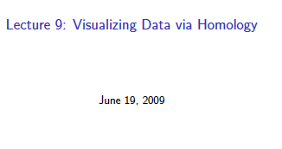
http://www.ima.umn.edu/videos/?id=856
http://ima.umn.edu/2008-2009/ND6.15-26.09/activities/Carlsson-Gunnar/imafive-handout4up.pdf

Slide 37
Application to Natural Image Statistics
With V. de Silva, T. Ishkanov, A. Zomorodian
http://www.ima.umn.edu/videos/?id=1846
http://www.ima.umn.edu/2011-2012/W3.26-30.12/activities/Carlsson-Gunnar/imamachinefinal.pdf

Slide 38
An image taken by black and white digital camera can be viewed as a vector, with one coordinate for each pixel
Each pixel has a “gray scale” value, can be thought of as a real number (in reality, takes one of 255 values)
Typical camera uses tens of thousands of pixels, so images lie in a very high dimensional space, call it pixel space, P

