Slide 1
MATH:7450 (22M:305) Topics in Topology: Scientific and Engineering Applications of Algebraic Topology
Sept 23, 2013: Imag e dataApplication.
Fall 2013 course offered through the
University of Iowa Division of Continuing Education
Isabel K. Darcy, Department of Mathematics
Applied Mathematical and Computational Sciences, University of Iowa
http://www.math.uiowa.edu/~idarcy/AppliedTopology.html

Slide 2
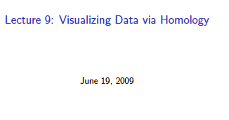
http://www.ima.umn.edu/videos/?id=856
http://ima.umn.edu/2008-2009/ND6.15-26.09/activities/Carlsson-Gunnar/imafive-handout4up.pdf

Slide 3
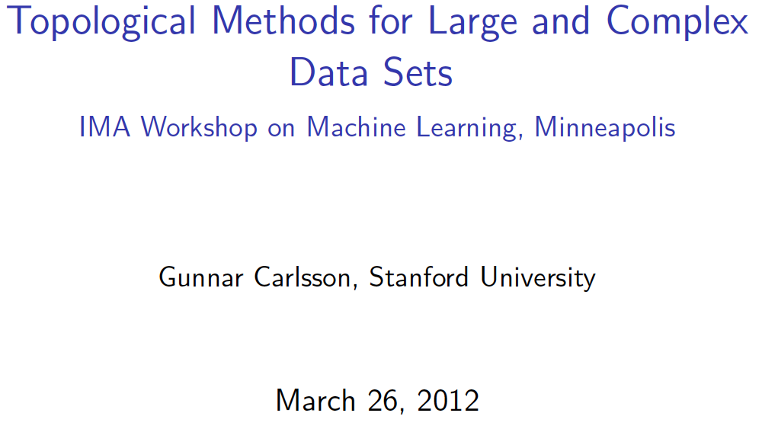
Application to Natural Image Statistics
With V. de Silva, T. Ishkanov, A. Zomorodian
http://www.ima.umn.edu/videos/?id=1846
http://www.ima.umn.edu/2011-2012/W3.26-30.12/activities/Carlsson-Gunnar/imamachinefinal.pdf

Slide 4
An image taken by black and white digital camera can be viewed as a vector, with one coordinate for each pixel
Each pixel has a “gray scale” value, can be thought of as a real number (in reality, takes one of 255 values)
Typical camera uses tens of thousands of pixels, so images lie in a very high dimensional space, call it pixel space, P

Slide 5
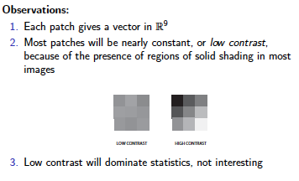
Lee-Mumford-Pedersen [LMP] study only high contrast patches.
Collection: 4.5 x 10⁶ high contrast patches from a
collection of images obtained by van Hateren and van der Schaaf

Slide 6
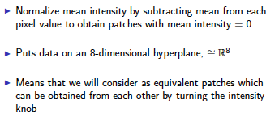
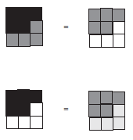

Slide 8
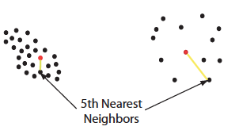

Slide 10
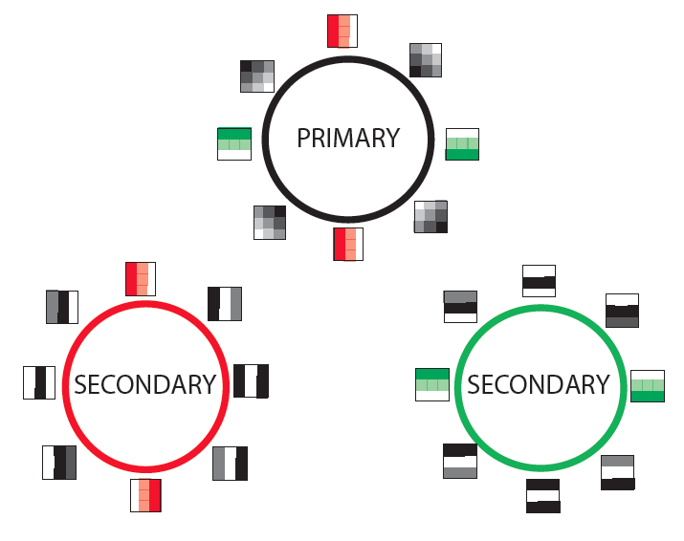

Slide 11
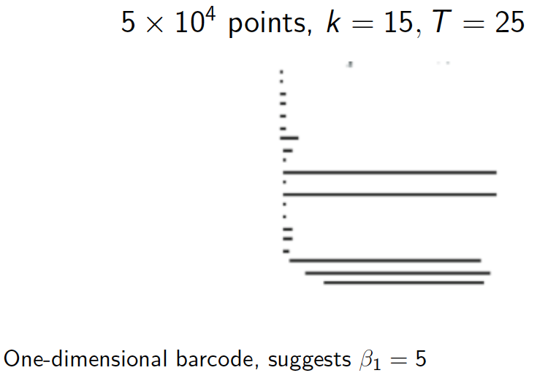
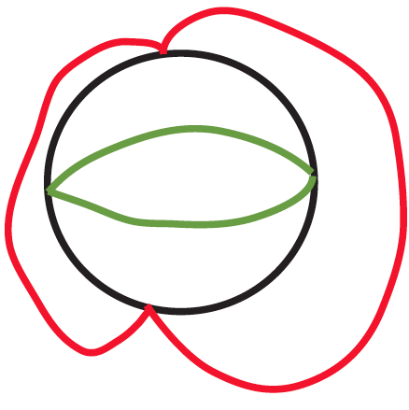

Slide 12
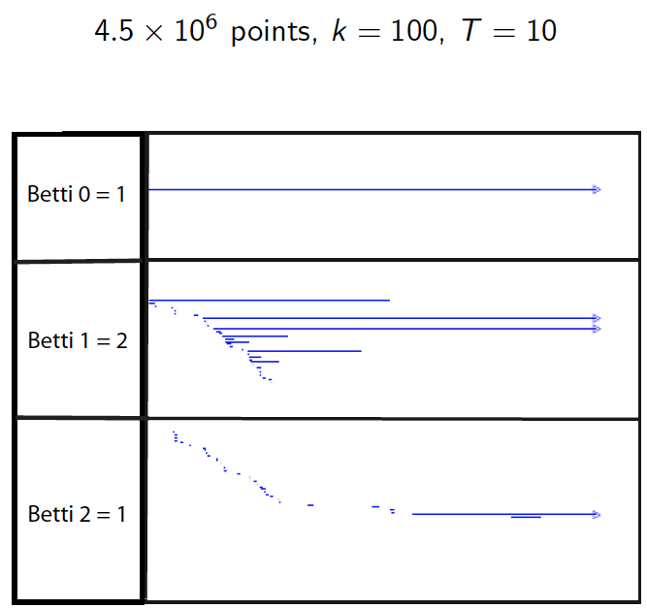

Slide 13
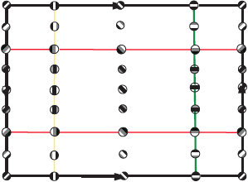

Slide 14
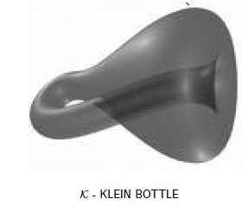

Slide 15
Creating a simplicial complex
Step 0.) Start by adding data points
= 0-dimensional vertices (0-simplices)
Notes:
data points.
In this very simplified case my data points lie in a two-dimensional plane. Normally data points are high dimensional.
For example, I may be comparing the expression or thousands of genes in tumor cells to healthy cells using microarray data. OR I might be comparing politicians voting records. Or I might be comparing the stats of basketball players. These three applications were all, by the way, published by Lum et al this past February in Nature’s Scientific Reports. I have included a link to their paper on my youtube site.
http://www.nature.com/srep/2013/130207/srep01236/full/srep01236.html

Slide 16
Creating a simplicial complex
1.) Adding 1-dimensional edges (1-simplices)
Let T = Threshold =
Connect vertices v and w with an edge iff
the distance between v and w is less than T
Notes:
So we will connect every pair of vertices if their distance is less than 1.8 cm. If the center of these points represent the 0-dimensional vertices, then this distance is less than our threshold, so we add an edge. Similarly this pair of points satisfy our definition of close, so we add an edge
The distance between this pair of vertices is greater than 1.8, so we won’t connect them with an edge. Continuing to add edges between vertices whenever their distance is less than our threshold of 1.8cm, we now have

Slide 17
Creating a simplicial complex
1.) Adding 1-dimensional edges (1-simplices)
Let T = Threshold =
Connect vertices v and w with an edge iff
the distance between v and w is less than T
Notes:
So we will connect every pair of vertices if their distance is less than 1.8 cm. If the center of these points represent the 0-dimensional vertices, then this distance is less than our threshold, so we add an edge. Similarly this pair of points satisfy our definition of close, so we add an edge
The distance between this pair of vertices is greater than 1.8, so we won’t connect them with an edge. Continuing to add edges between vertices whenever their distance is less than our threshold of 1.8cm, we now have

Slide 18
Creating a simplicial complex
1.) Adding 1-dimensional edges (1-simplices)
Let T = Threshold =
Connect vertices v and w with an edge iff
the distance between v and w is less than T
Notes:
So we will connect every pair of vertices if their distance is less than 1.8 cm. If the center of these points represent the 0-dimensional vertices, then this distance is less than our threshold, so we add an edge. Similarly this pair of points satisfy our definition of close, so we add an edge
The distance between this pair of vertices is greater than 1.8, so we won’t connect them with an edge. Continuing to add edges between vertices whenever their distance is less than our threshold of 1.8cm, we now have

Slide 19
Creating a simplicial complex
1.) Adding 1-dimensional edges (1-simplices)
Add an edge between data points that are “close”
Notes:
a one dimensional simplicial complex. Note that we have clustered our data into five disjoint connected sets. So this is one way to cluster our data – that is grouping our data points into disjoint sets based on some definition of similarity. In this case, we have 5 clusters.
We can now add higher dimensional simplices.

Slide 20
Creating a simplicial complex
1.) Adding 1-dimensional edges (1-simplices)
Add an edge between data points that are “close”
Notes:
a one dimensional simplicial complex. Note that we have clustered our data into five disjoint connected sets. So this is one way to cluster our data – that is grouping our data points into disjoint sets based on some definition of similarity. In this case, we have 5 clusters.
We can now add higher dimensional simplices.

Slide 21
Creating the Vietoris Rips simplicial complex
2.) Add all possible simplices of dimensional > 1.
Notes:
Thus we now have the Vietoris Rips simplicial complex. Note we get the same simplex by adding one dimension at a time

Slide 22
Creating a simplicial complex
1.) Adding 1-dimensional edges (1-simplices)
Let T = Threshold =
Connect vertices v and w with an edge iff
the distance between v and w is less than T
Notes:
So we will connect every pair of vertices if their distance is less than 1.8 cm. If the center of these points represent the 0-dimensional vertices, then this distance is less than our threshold, so we add an edge. Similarly this pair of points satisfy our definition of close, so we add an edge
The distance between this pair of vertices is greater than 1.8, so we won’t connect them with an edge. Continuing to add edges between vertices whenever their distance is less than our threshold of 1.8cm, we now have

