Slide 1
MATH:7450 (22M:305) Topics in Topology: Scientific and Engineering Applications of Algebraic Topology
Sept 18, 2013: javaPlex
Fall 2013 course offered through the
University of Iowa Division of Continuing Education
Isabel K. Darcy, Department of Mathematics
Applied Mathematical and Computational Sciences, University of Iowa
http://www.math.uiowa.edu/~idarcy/AppliedTopology.html

Slide 2
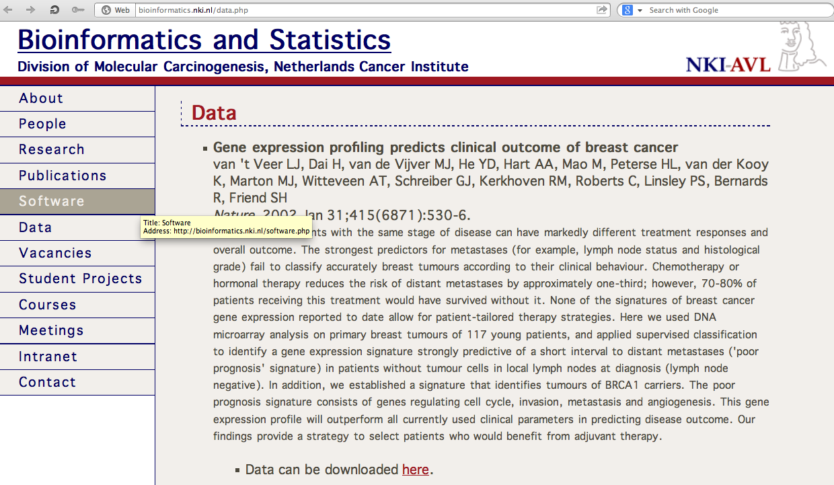
http://bioinformatics.nki.nl/data.php

Slide 3
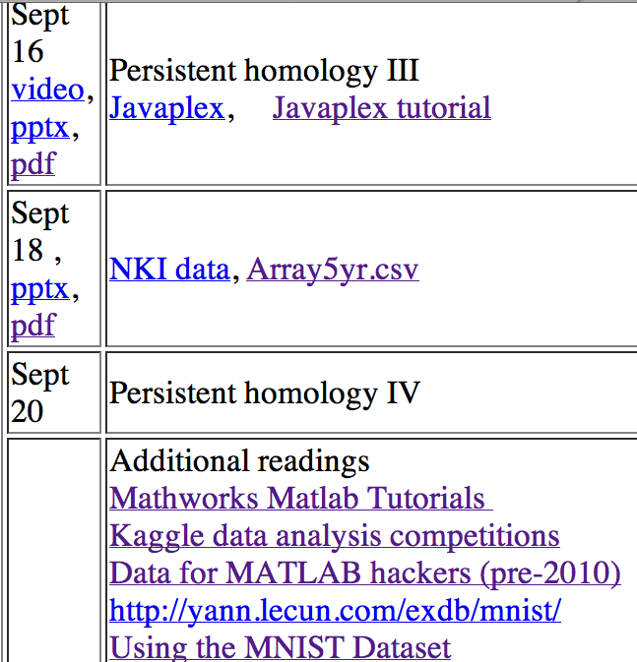
Michael Yoshizawa

Slide 4
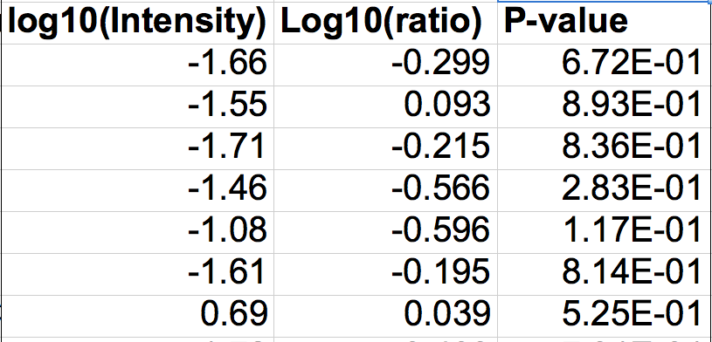
3 columns = patient
middle column (ratio) = data point
rows = genes

Slide 5
Create Data Matrix
load_javaplex
C = csvread('Array5yr.csv',2,1,[2,1,3,21])
C(1, 2)
for i = 1:7 D(:,i) = C(:,3*i-1); end
R = transpose(D)
size(R)

Slide 6
Use standard Euclidean Metric:
m_space = metric.impl.EuclideanMetricSpace(R);
m_space.getPoint(0)
m_space.distance(m_space.getPoint(0), m_space.getPoint(1))
sqrt([R(1,1) - R(2, 1)]^2 + [R(1,2) - R(2,2)]^2)

Slide 7
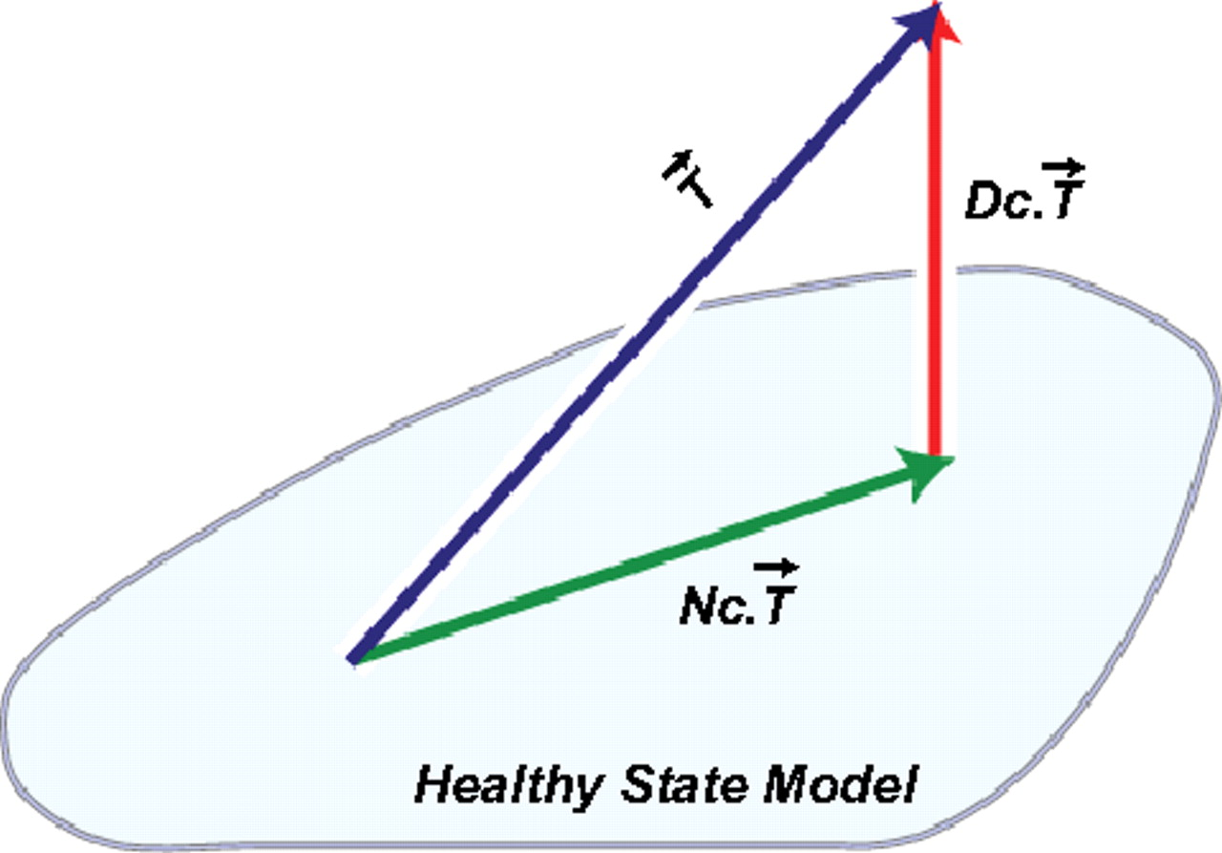
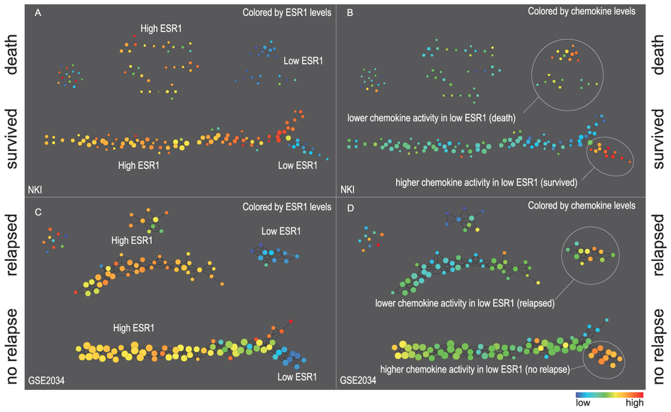
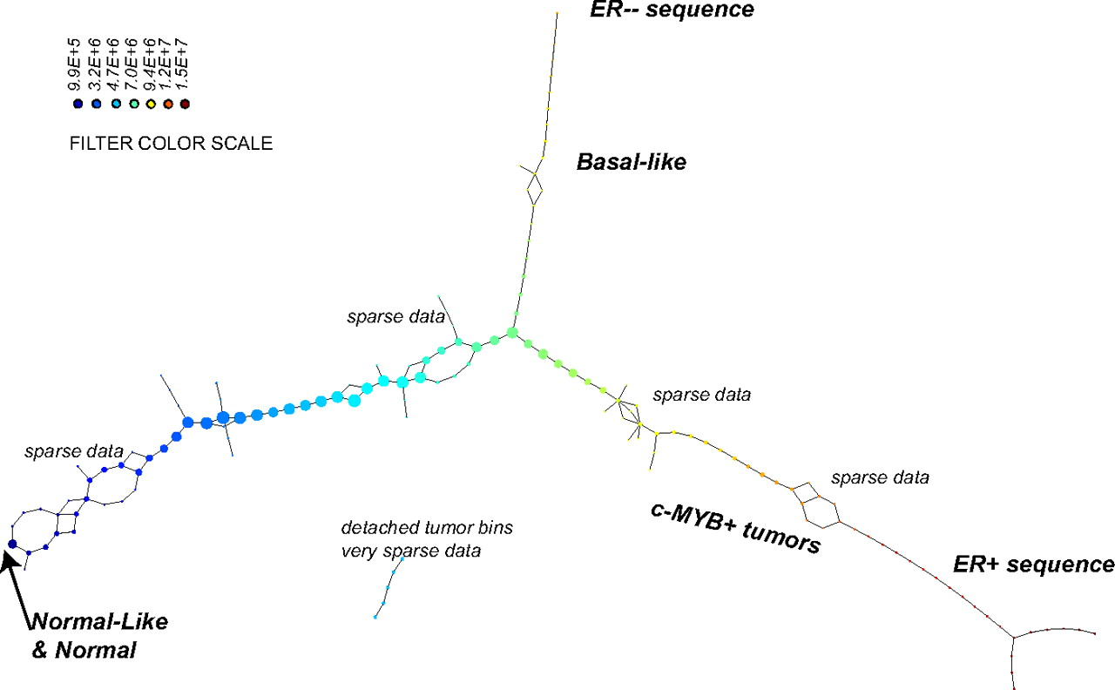
[Σ |x_{i}|^{p}]^{k/p}
k = 1…10
p = 1…5
Pearson correlation
Extracting insights from the shape of complex data using topology P. Y. Lum, G. Singh, A. Lehman, T. Ishkanov, M. Vejdemo-Johansson, M. Alagappan, J. Carlsson, G. Carlsson (2013)
p = 2, k=4
Topology based data analysis identifies a subgroup of breast cancers with a unique mutational profile and excellent survival
Monica Nicolau, Arnold J. Levineb,1, and Gunnar Carlsson, PNAS 2011

Slide 8
Choose your own distance matrix:
dist = ones(7) - eye(7)
dist_space = metric.impl.ExplicitMetricSpace(dist);
dist_space.distance(0,1)

Slide 9
Calculate Vietoris Rips Complex
max_dimension = 6;
max_filtration_value = 2;
num_divisions = 100;
stream = api.Plex4.createVietorisRipsStream(R, max_dimension,max_filtration_value, num_divisions);

Slide 10
Calculate Persistence
persistence =api.Plex4.getModularSimplicialAlgorithm(max_dimension, 2);
intervals = persistence.computeIntervals(stream)
intervals = persistence.computeAnnotatedIntervals(stream)
betti_numbers_array = infinite_barcodes.getBettiSequence()
betti_numbers_string = infinite_barcodes.getBettiNumbers()

Slide 11
options.filename = ’small_data’
options.max_filtration_value = max_filtration_value
options.max_dimension = max_dimension – 1
plot_barcodes(intervals, options)

Slide 12
Run on entire set:
load_javaplex;
clear C; clear D; clear R;
C = csvread('Array5yr.csv',2,1);
for i = 1:35 D(:,i) = C(:,3*i-1); end
R = transpose(D);
stream = api.Plex4.createVietorisRipsStream(R, max_dimension,max_filtration_value, num_divisions);
persistence =api.Plex4.getModularSimplicialAlgorithm(max_dimension, 2);
intervals = persistence.computeIntervals(stream)
options.filename = ’data’;
options.max_filtration_value = max_filtration_value;
options.max_dimension = max_dimension - 1;
plot_barcodes(intervals, options)

