Slide 1
MATH:7450 (22M:305) Topics in Topology: Scientific and Engineering Applications of Algebraic Topology
Sept 11, 2013: Persistent homology.
Fall 2013 course offered through the
University of Iowa Division of Continuing Education
Isabel K. Darcy, Department of Mathematics
Applied Mathematical and Computational Sciences, University of Iowa
http://www.math.uiowa.edu/~idarcy/AppliedTopology.html

Slide 2
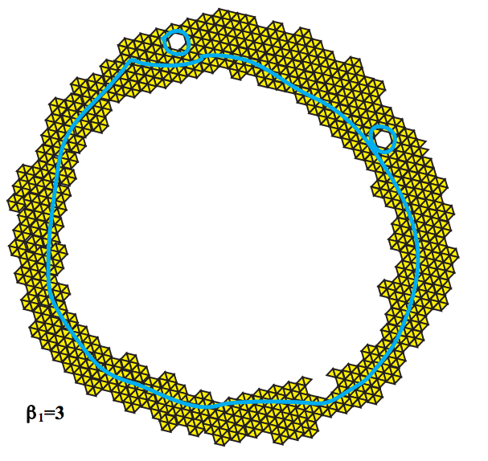
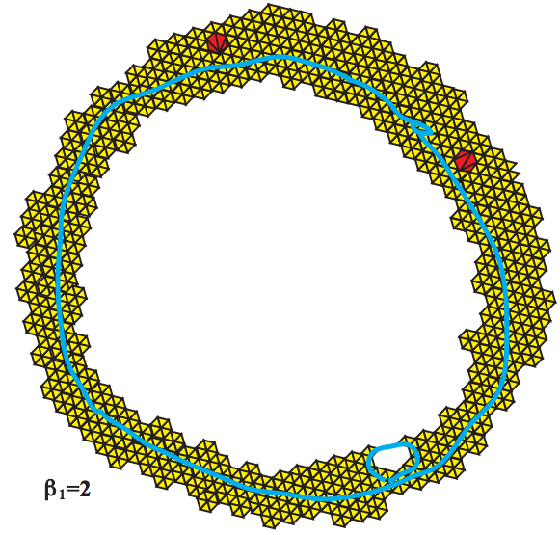
Topology and Data. Gunnar Carlsson
www.ams.org/journals/bull/2009-46-02/S0273-0979-09-01249-X

Slide 3
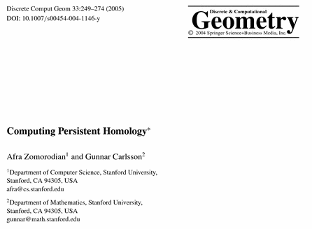
http://link.springer.com/article/10.1007%2Fs00454-004-1146-y

Slide 4
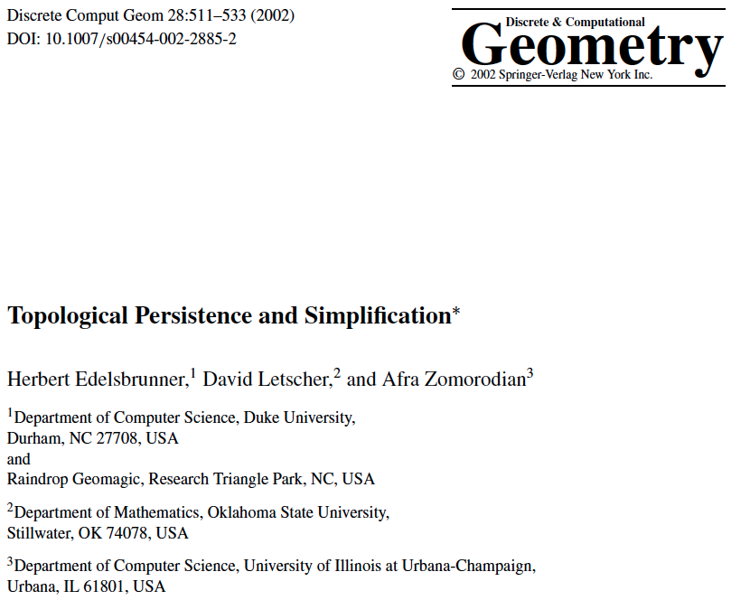
http://link.springer.com/article/10.1007/s00454-002-2885-2

Slide 5
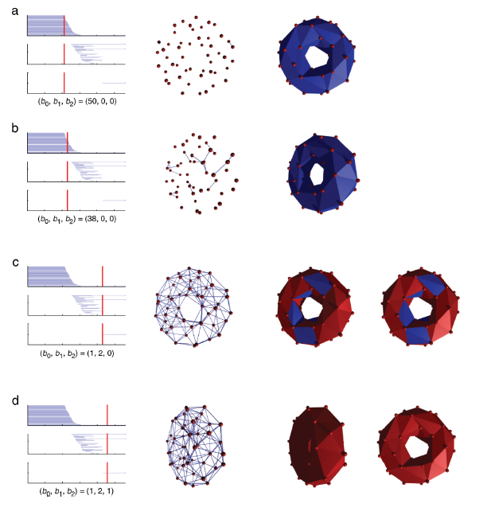
http://www.journalofvision.org/
content/8/8/11.full
Figure 3 from
Topological analysis of population activity in visual cortex
Gurjeet Singh, Facundo Memoli, Tigran Ishkhanov, Guillermo Sapiro, Gunnar Carlsson, and Dario L. Ringach
J Vis June 30, 2008 8(8): 11
See also Figure 4 animation

Slide 6
A filtered complex is an increasing sequence of simplicial complexes: C⁰ C¹ C² …
U
U
U
http://link.springer.com/article/10.1007%2Fs00454-004-1146-y
Notes:
Superscript = time, subscript = dimension

Slide 7
A filtered complex is an increasing sequence of simplicial complexes: C⁰ C¹ C² …
U
U
U
a, b is in C⁰ C¹ C² … C⁵
{a, b, c} is in C⁴ C⁵
₀
U
₀
U
₀
U
U
₀
₂
U
₂
http://link.springer.com/article/10.1007%2Fs00454-004-1146-y

Slide 8
₃
₂
₁
₀
→ C₂ → C₁ → C₀ → 0
H₀ = Z₀/B₀ = (kernel of ₀)/ (image of ₁)
null space of M₀
column space of M₁
Rank H₀ = Rank Z₀ – Rank B₀
=

Slide 9
₃
→
C₂
C₁
C₀
H₀ = Z₀/B₀ = (kernel of ₀)/ (image of ₁)
null space of M₀
column space of M₁
Rank H₀ = Rank Z₀ – Rank B₀
₂
→
=
₁
→
₀
0

Slide 10
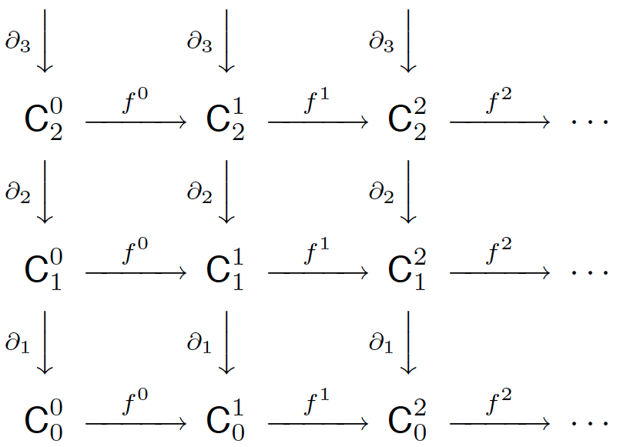
₀
₀
₀
0
0
0
http://link.springer.com/article/10.1007%2Fs00454-004-1146-y

Slide 11
₀
₀
₀
0
0
0
http://link.springer.com/article/10.1007%2Fs00454-004-1146-y

Slide 12
₀
₀
₀
0
0
0
H₀ = Z₀/B₀ = (kernel of ₀)/ (image of ₁)
http://link.springer.com/article/10.1007%2Fs00454-004-1146-y

Slide 13
₀
₀
₀
0
0
0
_{i, 0}
_{i}
_{i}
H₀ = Z₀ / B₀ = (kernel of ₀)/ (image of ₁)
http://link.springer.com/article/10.1007%2Fs00454-004-1146-y

Slide 14
₀
₀
₀
0
0
0
_{0, 1}
₀
₀₊₁
₀
H₀ = Z₀ / ( B₀ Z₀ )
U
http://link.springer.com/article/10.1007%2Fs00454-004-1146-y

Slide 15
₀
₀
₀
0
0
0
_{0, 2}
₀
₀₊₂
₀
H₀ = Z₀ / ( B₀ Z₀ )
U
http://link.springer.com/article/10.1007%2Fs00454-004-1146-y

Slide 16
₀
₀
₀
0
0
0
_{i, 1}
_{i}
_{i+1}
_{i}
H₀ = Z₀ / ( B₀ Z₀ )
U
http://link.springer.com/article/10.1007%2Fs00454-004-1146-y

Slide 17
_{i, 2}
_{i}
_{i+2}
_{i}
H₀ = Z₀ / ( B₀ Z₀ )
U
http://link.springer.com/article/10.1007%2Fs00454-004-1146-y

Slide 18
p-persistent k^{th} homology group:
_{i, p}
_{i}
_{i+p}
_{i}
H_{k} = Z_{k} / ( B_{k} Z_{k} )
U
http://link.springer.com/article/10.1007%2Fs00454-004-1146-y

Slide 19
o₂
o₁
C₂ → C₁ → C₀
H₁ = Z₁/B₁ = (kernel of )/ (image of )
null space of M₁
column space of M₂
<e₁ + e₂ + e₃, e₄ + e₅ + e₆>
<e₄ + e₅ + e₆>
Rank H₁ = Rank Z₁ – Rank B₁ = 2 – 1 = 1
o₁
o₂
=
=

Slide 20
_{k+1}
_{k}
C_{k+1} → C_{k} → C_{k-1 .} Let σ be a k-simplex
is a cycle if σ is in Z_{k} = kernel of _{k}
= null space of M_{k}
I.e., σ is a cycle if (σ) = 0
is a boundary if σ is in B_{k} = image of _{k+1}
= column space of M_{k+1}
I.e., σ is a boundary if there exits τ in C_{k+1}
such that (τ) = σ

Slide 21
Topological Persistence and Simplification, 2002
Figure from: Computing Persistent Homology, 2005
Let σ be a k-simplex
is a positive simplex if it creates a cycle when it enters.
is a negative simplex if it destroys a cycle when it enters.
http://link.springer.com/article/10.1007%2Fs00454-004-1146-y

Slide 22
Computing Persistent Homology by Afra Zomorodian, Gunnar Carlsson
0 | 0 | 1 | 1 | 1 | 1 | 2 | 2 | 3 | 4 | 5
a | b | c | d | ab | bc | cd | ad | ac | abc | acd
0 | 1 | 2 | 3 | 4 | 5 | 6 | 7 | 8 | 9 | 10
http://link.springer.com/article/10.1007%2Fs00454-004-1146-y

Slide 23
Computing Persistent Homology by Afra Zomorodian, Gunnar Carlsson
0 | 0 | 1 | 1 | 1 | 1 | 2 | 2 | 3 | 4 | 5
+ | + | + | + | - | - | - | + | + | - | -
a | b | c | d | ab | bc | cd | ad | ac | abc | acd
0 | 1 | 2 | 3 | 4 | 5 | 6 | 7 | 8 | 9 | 10
 | 4 | 5 | 6 |  |  |  | 10 | 9
 | a,b | b,c | c,d |  |  |  | ad | ac
http://link.springer.com/article/10.1007%2Fs00454-004-1146-y

Slide 24
0 | 0 | 1 | 1 | 1 | 1 | 2 | 2 | 3 | 4 | 5
+ | + | + | + | - | - | - | + | + | - | -
a | b | c | d | ab | bc | cd | ad | ac | abc | acd
0 | 1 | 2 | 3 | 4 | 5 | 6 | 7 | 8 | 9 | 10
 | 4 | 5 | 6 |  |  |  | 10 | 9
 | a,b | b,c | c,d |  |  |  | ad | ac
a⁰
b⁰
c¹
d¹
ab¹
bc¹
cd²
ad²
ac³
abc⁴
acd⁵
1
3

Slide 25
[
)
[
)
[
)
[
)
[
)
a⁰
b⁰
c¹
d¹
ab¹
bc¹
cd²
ad²
ac³
abc⁴
acd⁵
1
3

Slide 26
a⁰
b⁰
c¹
d¹
ab¹
bc¹
cd²
ad²
ac³
abc⁴
acd⁵
1
3
[
)
[
)
[
)
[
)
t⁰
t¹
t²
t³
t⁴
t⁵
1
3

Slide 27
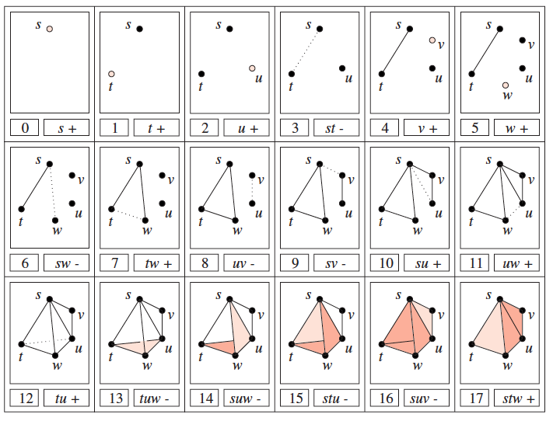
Topological Persistence and Simplification:link.springer.com/article/10.1007/s00454-002-2885-2

Slide 28
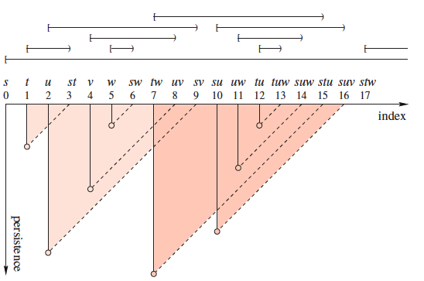
Topological Persistence and Simplification:link.springer.com/article/10.1007/s00454-002-2885-2

Slide 29
Topological Persistence and Simplification:link.springer.com/article/10.1007/s00454-002-2885-2

