Slide 1
MATH:7450 (22M:305) Topics in Topology: Scientific and Engineering Applications of Algebraic Topology
Oct 23, 2013: Cohomology III
Oct 23, 2013: Stability
Fall 2013 course offered through the
University of Iowa Division of Continuing Education
Isabel K. Darcy, Department of Mathematics
Applied Mathematical and Computational Sciences, University of Iowa
http://www.math.uiowa.edu/~idarcy/AppliedTopology.html

Slide 2

http://ima.umn.edu/2013-2014/W10.28-11.1.13/#Schedule

Slide 3

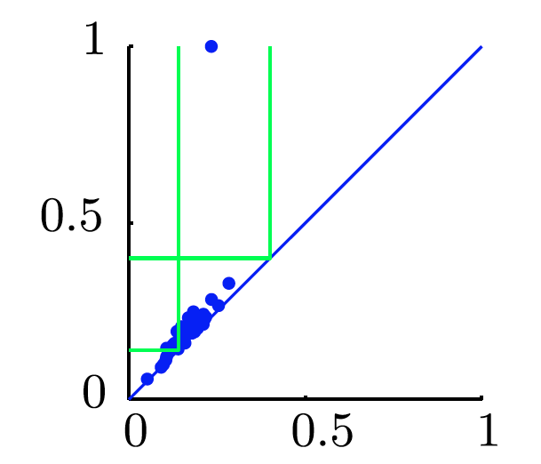
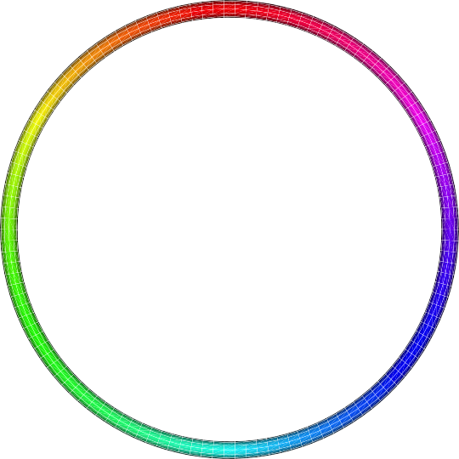
Goal
f: D → S¹ which “preserves” the structure of the data.
circle courtesy of knotplot.com

Slide 4
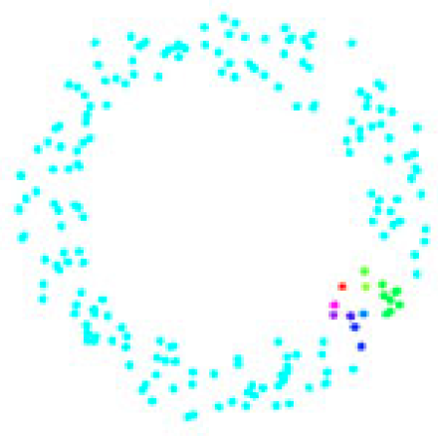
circle courtesy of knotplot.com

Slide 5

Let α ∈ C^{i} ,
d_{i} : C^{i} = { f : X^{i} → R } → C^{i+1} = { f : X^{i+1} → R }
α is a cocycle if d_{i}α = 0. I.e., α is in Ker(d₁)
α is a coboundary if there exists f in C^{i-1} s.t. d_{i-1}f = α
I.e., α is in Im(d_{i-1})
Note d_{i} d_{i-1} f = 0 for any f ∈ C^{i-1}.
d_{i} d_{i-1} f = 0 implies Im (d_{i-1} ) ⊆ Ker (d_{i} ).
H^{i} (X;A ) = Ker(d_{i} )/ Im(d_{i-1} ).
See ch 5

Slide 6
Persistent Cohomology
ε₁ < ε₂ < … < ε_{m}
X(ε₁) < X(ε₂) < … < X(ε_{m})
C^{i}(X(ε_{j}), R) = { f : X^{i}(ε_{j}) → R }
← ← … ←
C^{i}(X(ε₁), R) ← C^{i}(X(ε₂, R)) ← … ← C^{i}(X(ε_{m}, R))
H^{i}(X(ε₁), R) ← H^{i}(X(ε₂, R)) ← … ← H^{i}(X(ε_{m}, R))
Dualities in persistent (co)homology, _{de Silva, Morozov,} Vejdemo-Johansson, Inverse Problems 2011, http://iopscience.iop.org/0266-5611/27/12/124003
R
R
R

Slide 7
Proposition 1: Let α ∈ C¹(X;Z) be a cocycle.
Then there exists a continuous function
θ : X → S¹
which maps each vertex to 0, and
each edge ab around the entire
circle with winding number α(ab).
v₂
→
e₁
e₂
v₁
v₃
e₃

Slide 8
Proposition 2: 2 Let α ∈ C¹(X;R) be a cocycle. Suppose there exists α ∈ C¹(X;Z) and f ∈ C⁰(X;R) such that α = α + d₀f . Then there exists a continuous function
θ : X → S¹
which maps each edge ab linearly to an interval of length α(ab), measured with sign.
v₂
→
e₁
e₂
v₁
v₃
e₃

Slide 9
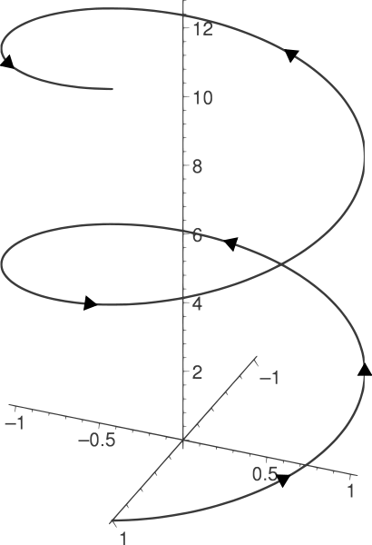
θ : X → R/Z = S¹

Slide 10
Given: α ∈ C¹(X;R) is a cocycle, α ∈ C¹(X;Z)
f ∈ C⁰(X;R), α = α + d₀f
Create: θ : X → R/Z = S¹ s.t. v_{i}v_{k} goes to interval
of length α(v_{i}v_{k})
→ R/Z
v₂
e₁
e₂
v₁
e₃
v₃

Slide 11
Given: α ∈ C¹(X;R) be a cocycle, α ∈ C¹(X;Z)
f ∈ C⁰(X;R), α = α + d₀f
Create: θ : X → R/Z = S¹ s.t. v_{i}v_{k} goes to interval
of length α(v_{i}v_{k})
→ R/Z
Let θ(v_{i}) = f(v_{i}) mod Z
θ(v_{i}) - θ(v_{k}) =
v₂
e₁
e₂
v₁
e₃
v₃

Slide 12
Given: α ∈ C¹(X;R) be a cocycle, α ∈ C¹(X;Z)
f ∈ C⁰(X;R), α = α + d₀f
Create: θ : X → R/Z = S¹ s.t. v_{i}v_{k} goes to interval
of length α(v_{i}v_{k})
→ R/Z
Let θ(v_{i}) = f(v_{i}) mod Z
θ(v_{i}) - θ(v_{k}) = f(v_{i}) - f(v_{k})
= d₀f(v_{i}v_{k}) = α(v_{i}v_{k}) - α(v_{i}v_{k})
= α(v_{i}v_{k}) mod Z
v₂
e₁
e₂
v₁
e₃
v₃

Slide 13
circle courtesy of knotplot.com

Slide 14
circle courtesy of knotplot.com

Slide 15
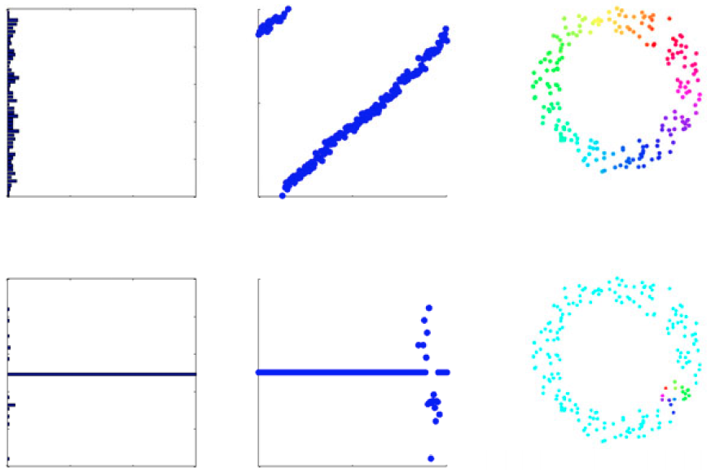
circle courtesy of knotplot.com

Slide 16
circle courtesy of knotplot.com

Slide 18
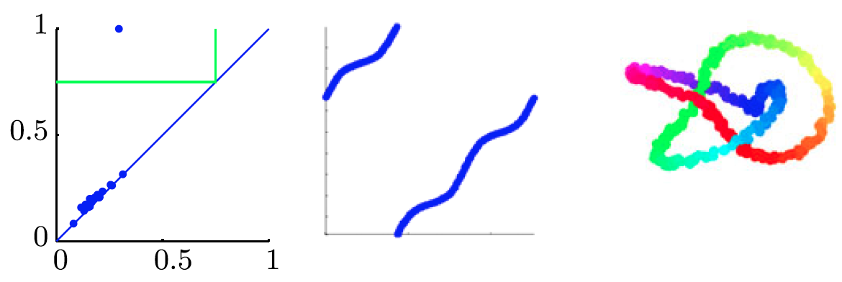

Slide 19
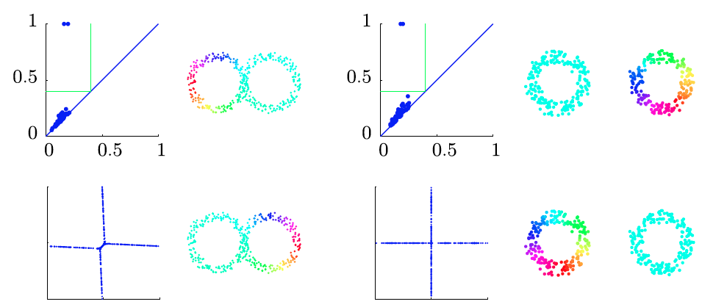

Slide 20
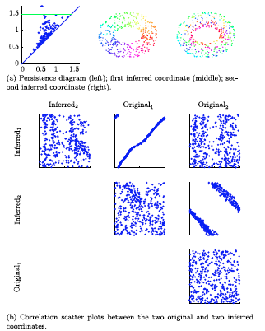

Slide 21
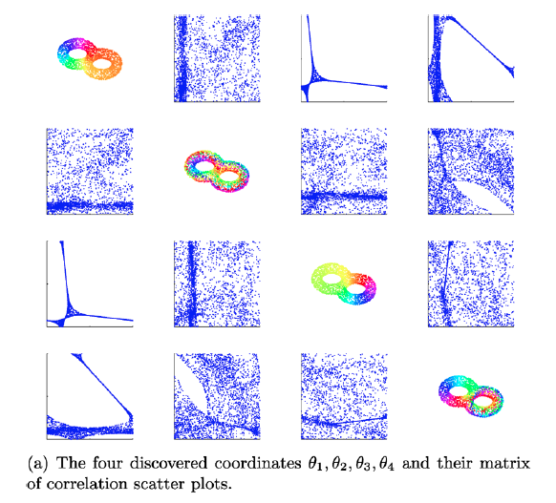

Slide 22
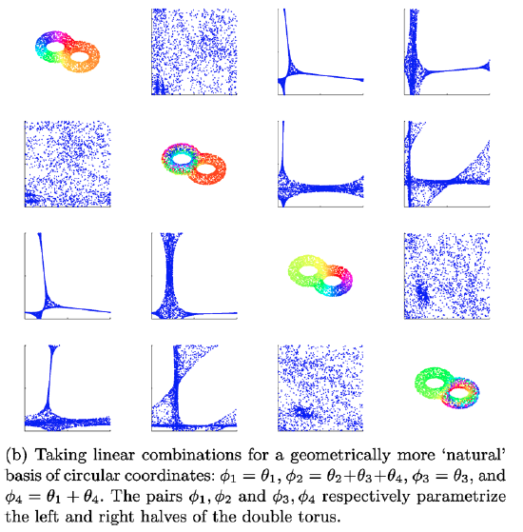

Slide 23
Given: α ∈ C¹(X;R) be a cocycle, α ∈ C¹(X;Z)
f ∈ C⁰(X;R), α = α + d₀f
Create: θ : X → R/Z = S¹ s.t. v_{i}v_{k} goes to interval
of length α(v_{i}v_{k})
→ R/Z
Let θ(v_{i}) = f(v_{i}) mod Z
θ(v_{i}) - θ(v_{k}) = f(v_{i}) - f(v_{k})
= d₀f(v_{i}v_{k}) = α(v_{i}v_{k}) - α(v_{i}v_{k})
= α(v_{i}v_{k}) mod Z
v₂
e₁
e₂
v₁
e₃
v₃

Slide 24
Given: α ∈ C¹(X;R) be a cocycle, f ∈ C⁰(X;R)
Let α = α + d₀f, a cocycle of C¹(X;Z)
Create: θ : X → R/Z = S¹ s.t. v_{i}v_{k} goes to interval
of length α(v_{i}v_{k})
→ R/Z
Let θ(v_{i}) = f(v_{i}) mod Z
θ(v_{i}) - θ(v_{k}) = f(v_{i}) - f(v_{k})
= d₀f(v_{i}v_{k}) = α(v_{i}v_{k}) - α(v_{i}v_{k})
= α(v_{i}v_{k}) mod Z
v₂
e₁
e₂
v₁
e₃
v₃

Slide 25
Let α ∈ C¹(X;R). There is a unique solution α to the least-squares minimization problem:
min { ||α||² | there exists f ∈ C⁰(X;R)
such that α = α + d₀f }
α

Slide 26
The (simplified) algorithm:
1a.) Calculate H¹(X(ε), Z_{p}), for some prime p.
1b.) Determine persistent cohomology.
1c.) Lift persistent 1-cocycles in H¹(X(ε), Z_{p}) to
1-cocycles in H¹(X(ε), Z).
2.) Simplify the cocyle via least squares minimization.
3.) Use cocyle to create map θ : X → R/Z = S¹ s.t.
v_{i}v_{k} goes to interval of length α(v_{i}v_{k}).

Slide 27
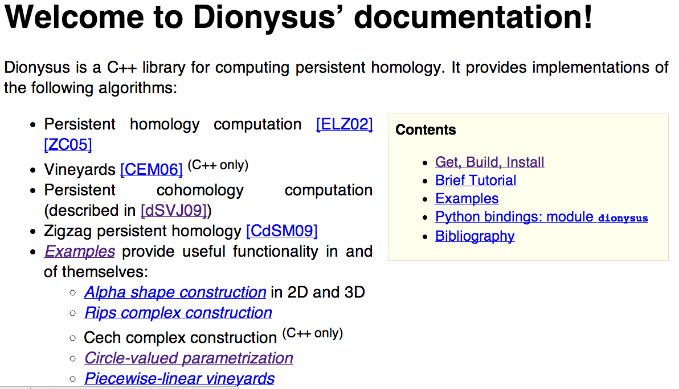

Slide 28
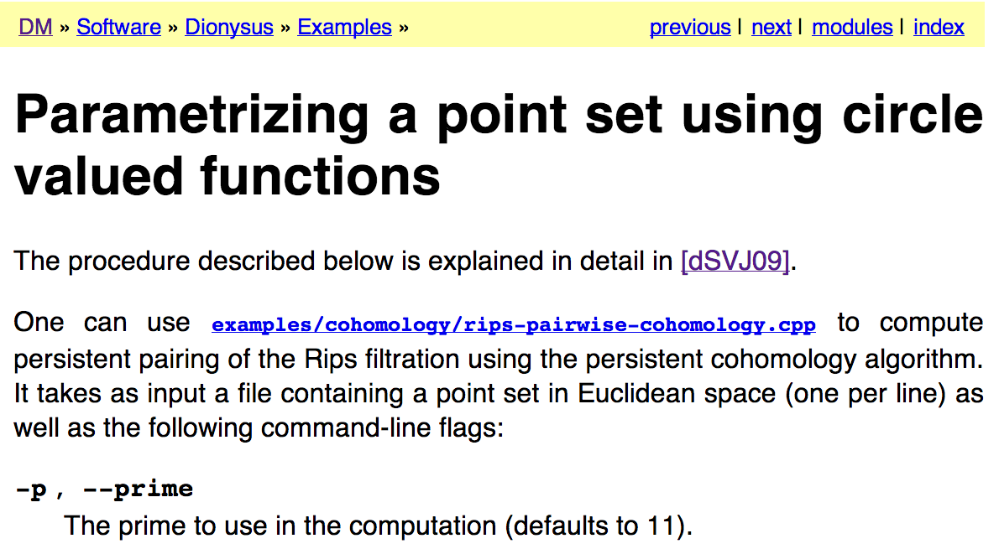

Slide 30
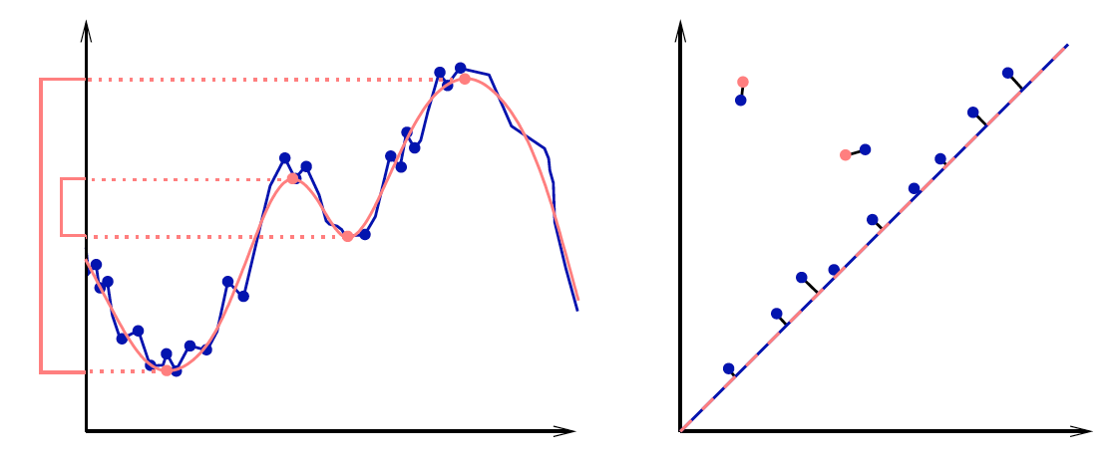
Discrete & Computational Geometry
January 2007, Volume 37, Issue 1, pp 103-120
Stability of Persistence Diagrams
David Cohen-Steiner, Herbert Edelsbrunner, John Harer
http://www.cs.duke.edu/~edels/Papers/2007-J-01-StabilityPersistenceDiagrams.pdf

Slide 31
|| (x₁,…,x_{n}) – (y₁,…,y_{n}) ||∞ = max{|x₁ – y₁|,…,|x_{n} - y_{n}|}
Given sets X, Y and bijection g: X → Y,
Bottleneck Distance: d_{B}(X, Y) = inf sup || x – g(x) ||∞
g x

Slide 32
Stability theorem:
Let X be a triangulable space with continuous
tame functions f, g : X → R. Then the persistence diagrams satisfy
d_{B}(D(f), D(g)) ≤ || f − g ||∞

Slide 33
|| (x₁,…,x_{n}) – (y₁,…,y_{n}) ||∞ = max{|x₁ – y₁|,…,|x_{n} - y_{n}|}
Given sets X, Y and bijection g: X → Y,
Wasserstein distance:
W_{q}(X, Y) = [inf Σ || x – g(x) ||∞]^{1/q}
^{q}
g x in X

Slide 34
Stability theorem:
Let X be a triangulable space whose traingulations grow polynomially with constant exponent j.
Let f, g : X → R be tame Lipschitz functions .
Then there are constants C and k > j no smaller than 1 such that persistence diagrams satisfy
W_{q}(D(f), D(g)) ≤ C|| f − g ||∞
for every q ≥ k.
1 – k/q

