Slide 1
MATH:7450 (22M:305) Topics in Topology: Scientific and Engineering Applications of Algebraic Topology
Nov 8, 2013: DNA Topology
Fall 2013 course offered through the
University of Iowa Division of Continuing Education
Isabel K. Darcy, Department of Mathematics
Applied Mathematical and Computational Sciences, University of Iowa
http://www.math.uiowa.edu/~idarcy/AppliedTopology.html

Slide 2
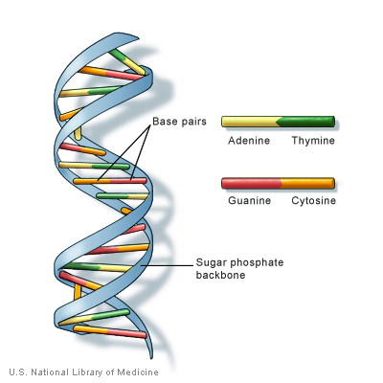
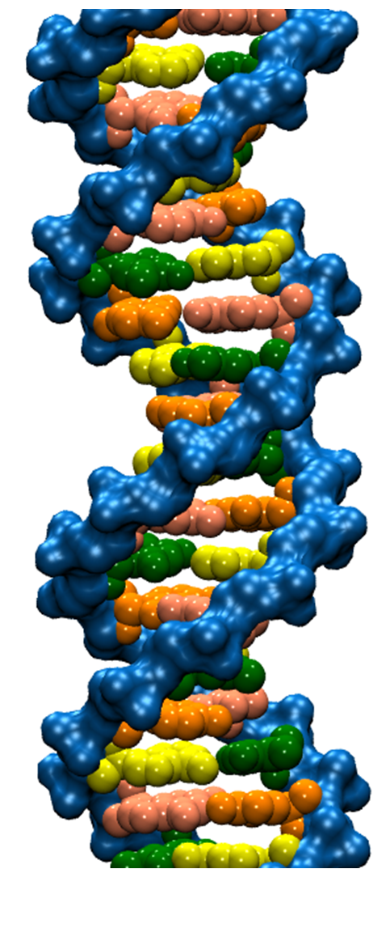

Slide 4
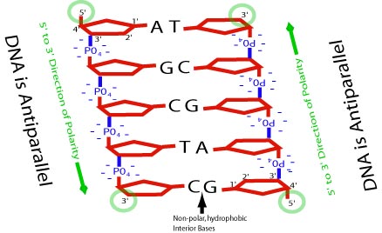

Slide 5
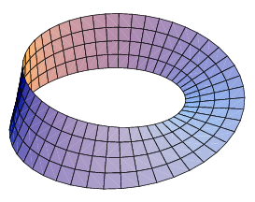
Antiparallel implied no Mobius bands

Slide 7
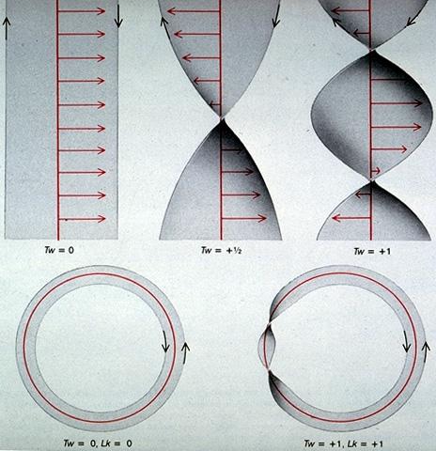
Twist
http://cmgm.stanford.edu/biochem201/Handouts/DNAtopo.html

Slide 8
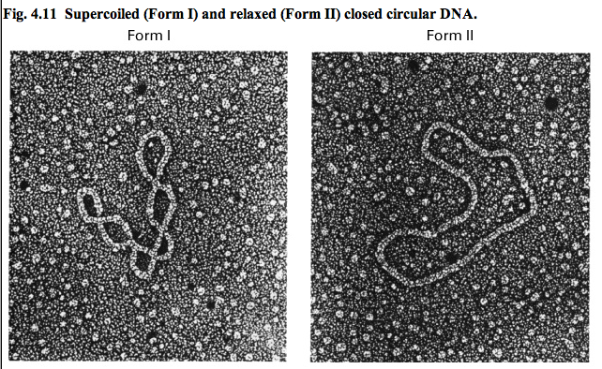
Writhe
http://bioweb.wku.edu/courses/biol22000/6StructureNA/

Slide 9
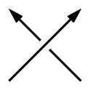
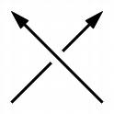
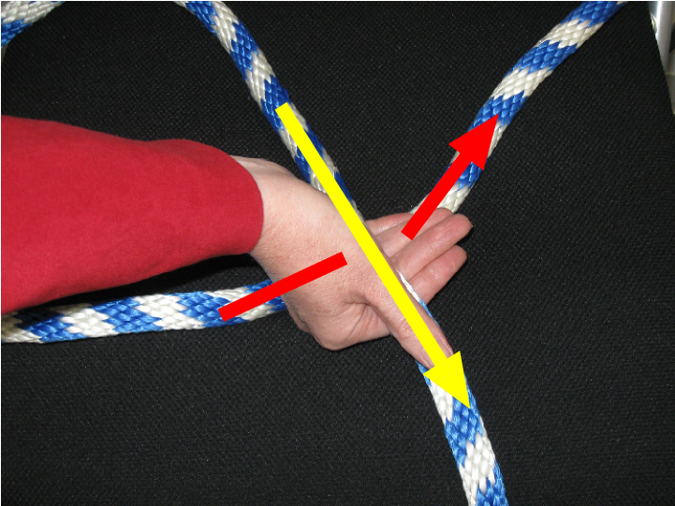
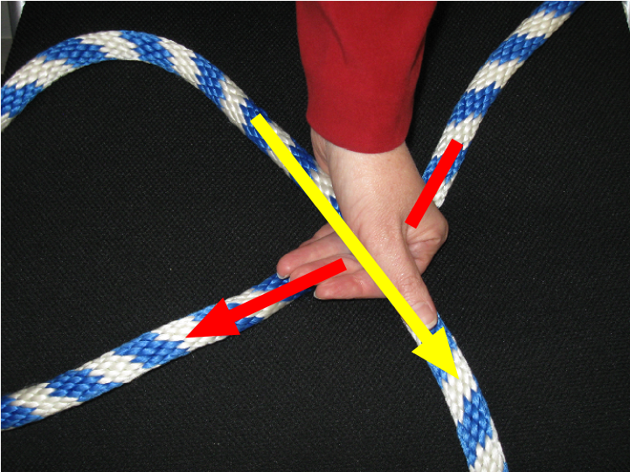
Crossing Sign Determination
Right-hand Rule
Right-handed Crossing
+1
Left-handed Crossing
-1

Slide 10
Writhe
http://bioweb.wku.edu/courses/biol22000/6StructureNA/

Slide 11
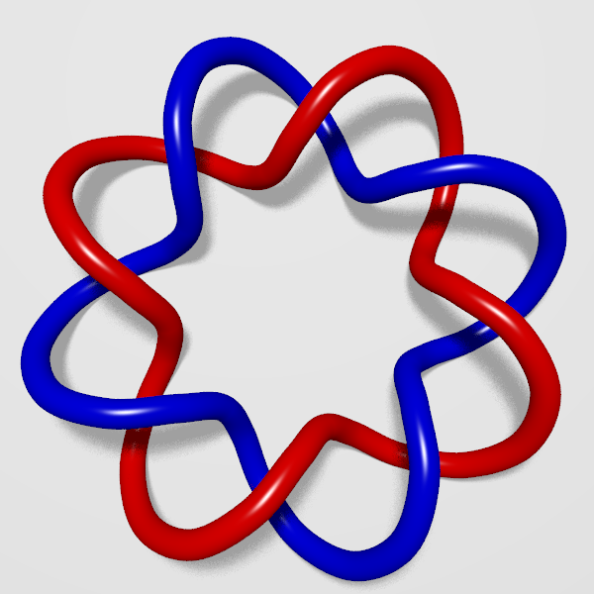
Linking number

Slide 12
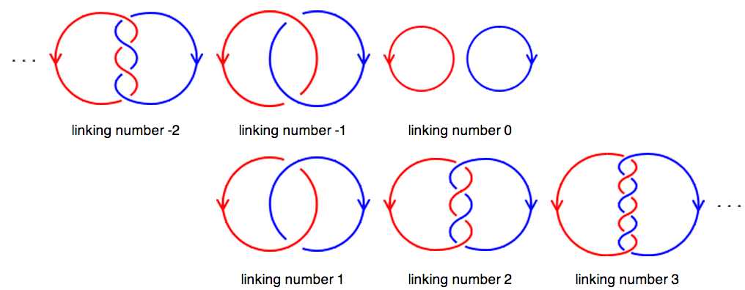
Linking number
http://en.wikipedia.org/wiki/Linking_number

Slide 13
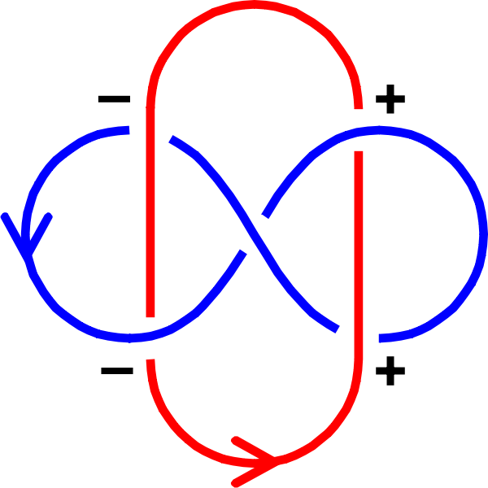
Linking number
http://en.wikipedia.org/wiki/File:Labeled_Whitehead_Link.svg

Slide 14
Linking number
http://en.wikipedia.org/wiki/Linking_number

Slide 15
http://bioweb.wku.edu/courses/biol22000/6StructureNA/

Slide 16
Linking Number = Twist + Writhe
http://sites.fas.harvard.edu/~biotext/animations/topology2.html

Slide 17
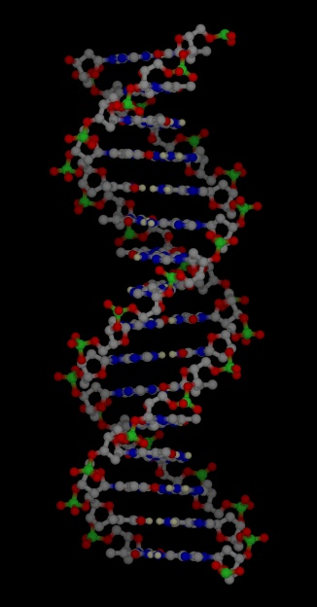
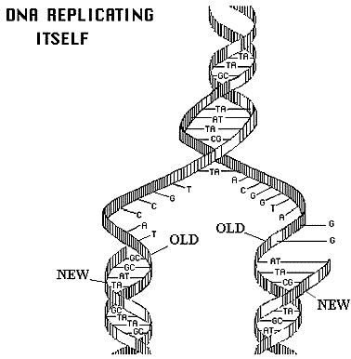
http://www.accessexcellence.org/RC/VL/GG/images/dna_replicating.gif
http://www.ch.cam.ac.uk/magnus/molecules/nucleic/dna1.jpg

Slide 18
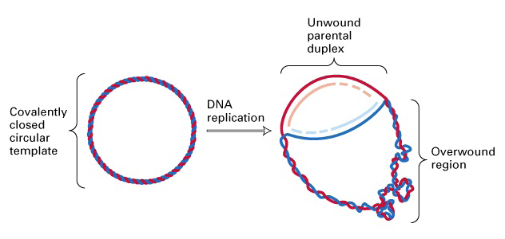
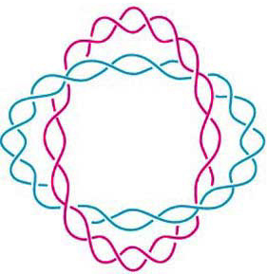
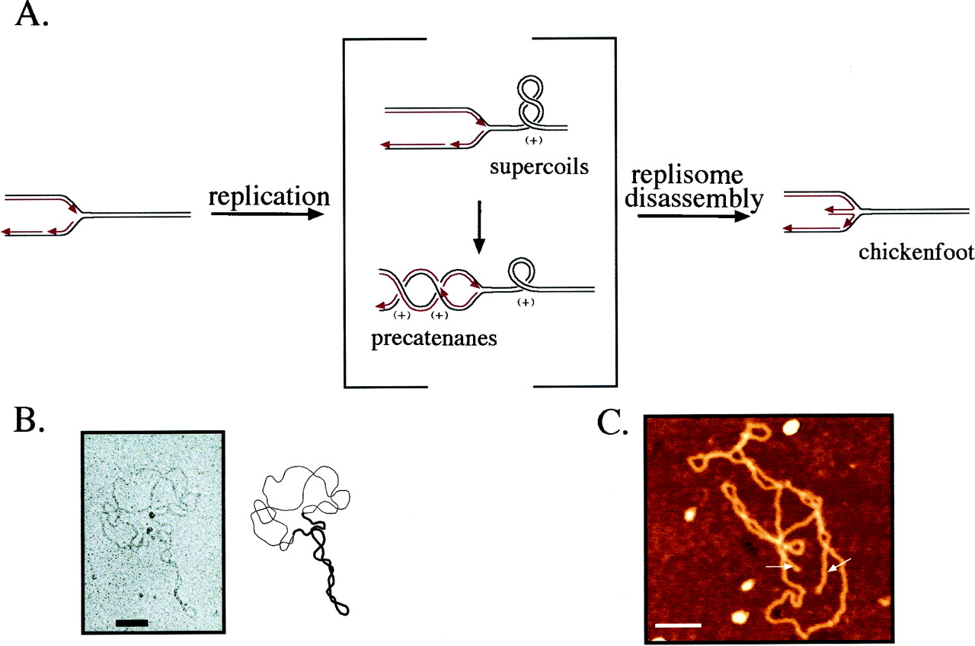
(J. Mann) http://www.sbs.utexas.edu/herrin/bio344/
Postow L. et.al. PNAS;2001;98:8219-8226

Slide 19
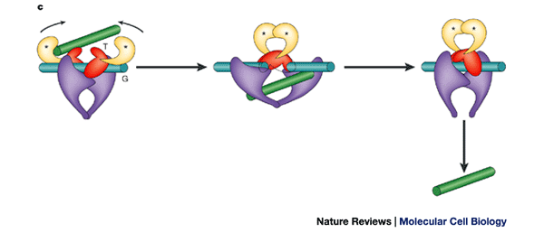
Topoisomerase II performing a crossing change on DNA:
Cellular roles of DNA topoisomerases: a molecular perspective, James C. Wang, Nature Reviews Molecular Cell Biology 3, 430-440 (June 2002)

Slide 20
Topoisomerases are involved in
  Replication
  Transcription
  Unknotting, unlinking, supercoiling.
  Targets of many anti-cancer drugs.

Slide 21
Topoisomerases are proteins which cut one segment of DNA allowing a second DNA segment to pass through before resealing the break.

