Slide 1
MATH:7450 (22M:305) Topics in Topology: Scientific and Engineering Applications of Algebraic Topology
Nov 18, 2013: Viral Evolution II and
Crickets via cubical homology.
Fall 2013 course offered through the
University of Iowa Division of Continuing Education
Isabel K. Darcy, Department of Mathematics
Applied Mathematical and Computational Sciences, University of Iowa
http://www.math.uiowa.edu/~idarcy/AppliedTopology.html

Slide 2
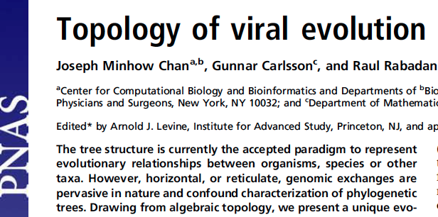
Monday December 09, 2013
10:15am-11:05am The Topology of Evolution Raul Rabadan (Columbia University)
vol. 110 no. 46, 18566–18571, 2013
http://www.pnas.org/content/110/46/18566.full

Slide 3
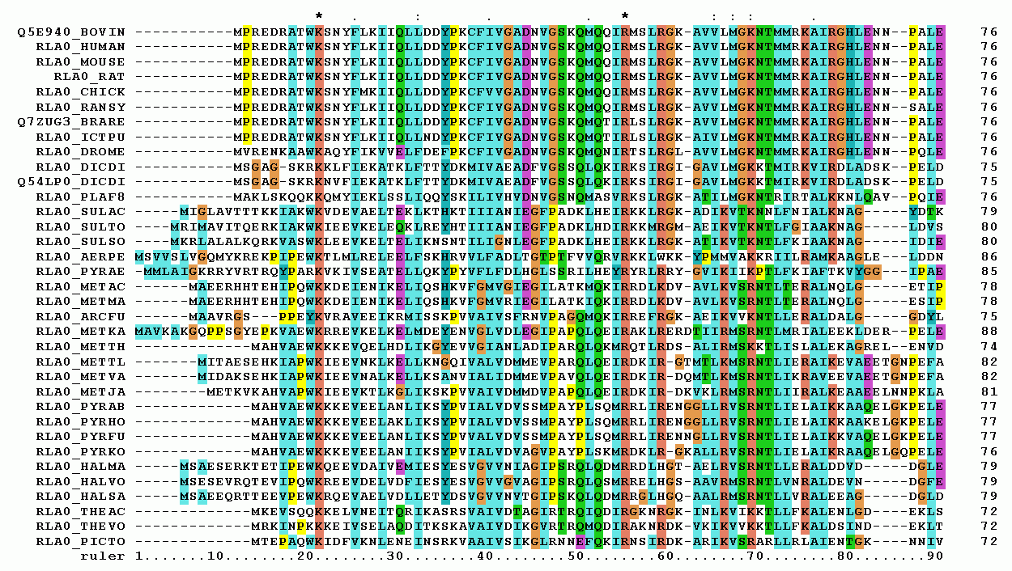
Multiple sequence alignment
http://upload.wikimedia.org/wikipedia/commons/7/79/RPLP0_90_ClustalW_aln.gif

Slide 4
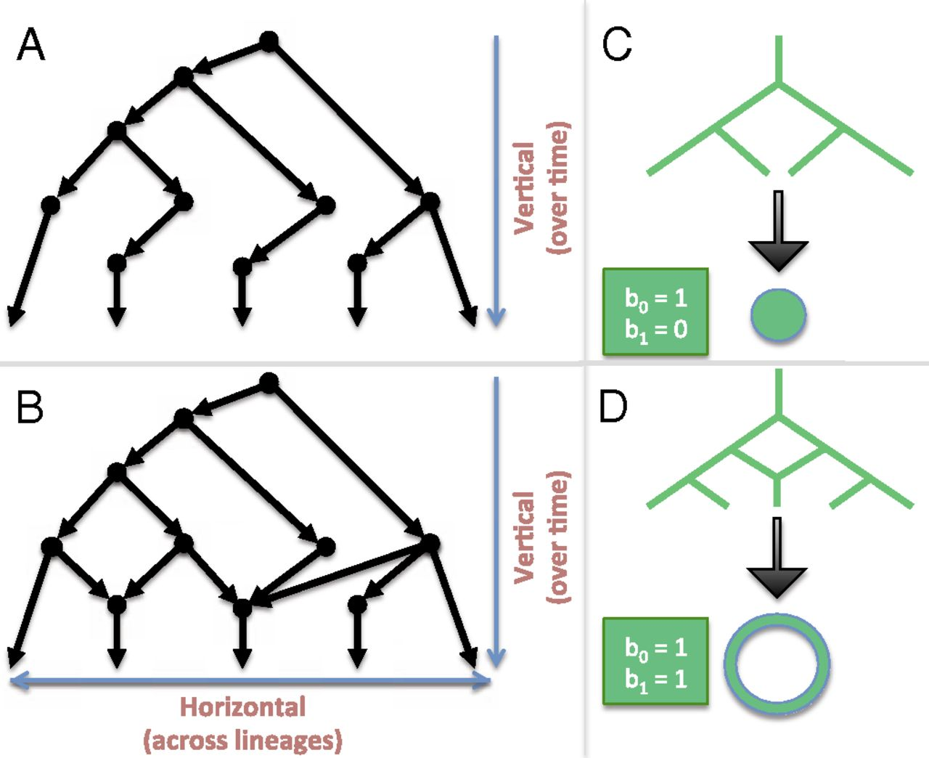
Linking algebraic topology to evolution.
Reticulation
Chan J M et al. PNAS 2013;110:18566-18571
©2013 by National Academy of Sciences
Notes:
Linking algebraic topology to evolution. (A) A tree depicting vertical evolution. (B) A reticulate structure capturing horizontal evolution, as well. (C) A tree can be compressed into a point. (D) The same cannot be done for a reticulate structure without destroying the hole at the center.

Slide 5
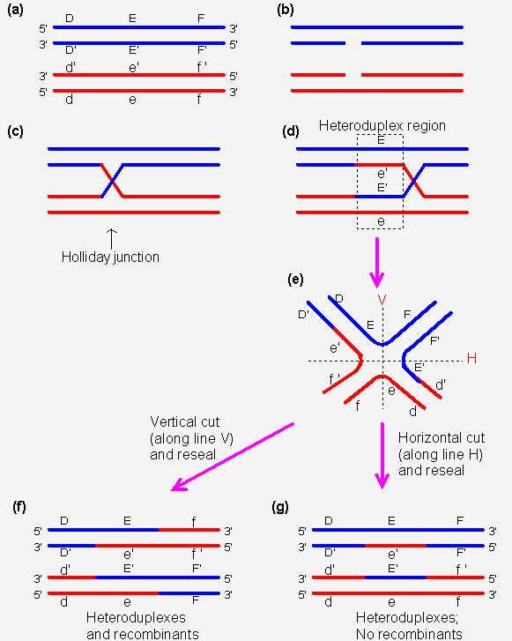
Homologous recombination
http://www.web-books.com/MoBio/Free/Ch8D2.htm

Slide 6
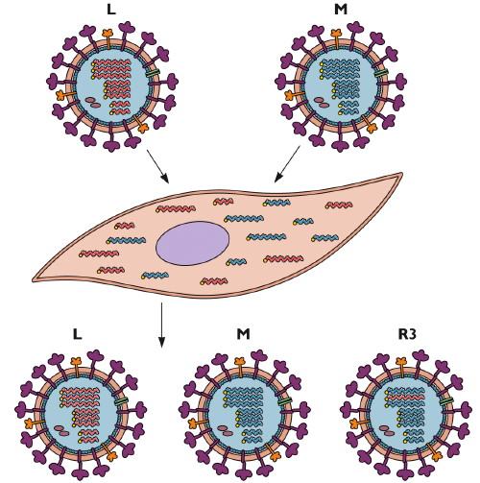
Reassortment
http://www.virology.ws/2009/06/29/reassortment-of-the-influenza-virus-genome/

Slide 7
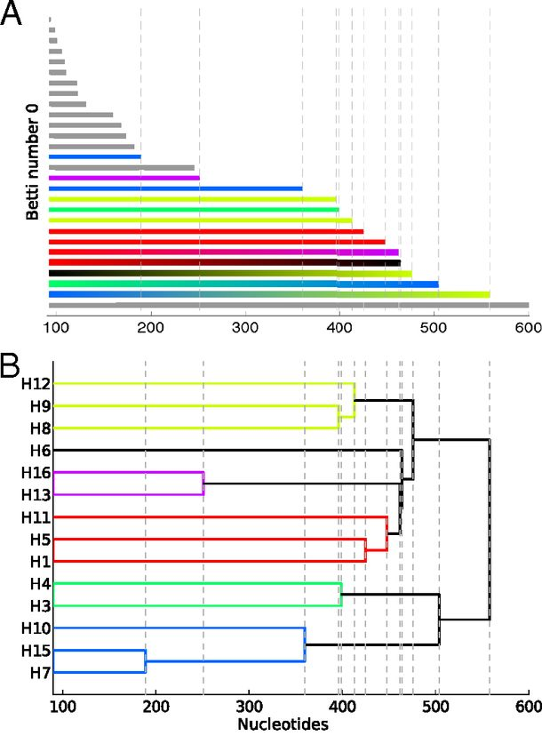
Reconstructing phylogeny from persistent homology of avian influenza HA. (A) Barcode plot in dimension 0 of all avian HA subtypes.
Influenza:
For a single segment,
no H_{k} for k > 0
no horizontal transfer
(i.e., no homologous recombination)
©2013 by National Academy of Sciences
Chan J M et al. PNAS 2013;110:18566-18571
Notes:
Reconstructing phylogeny from persistent homology of avian influenza HA. (A) Barcode plot in dimension 0 of all avian HA subtypes. Each bar represents a connected simplex of sequences given a Hamming distance of ε. When a bar ends at a given ε, it merges with another simplex. Gray bars indicate that two simplices of the same HA subtype merge together at a given ε. Solid color bars indicate that two simplices of different HA subtypes but same major clade merge together. Interpolated color bars indicate that two simplices of different major clades merge together. Colors correspond to known major clades of HA. For specific parameters, see SI Appendix, Supplementary Text. (B) Phylogeny of avian HA reconstructed from the barcode plot in A. Major clades are color-coded. (C) Neighbor-joining tree of avian HA (SI Appendix, Supplementary Text).

Slide 8
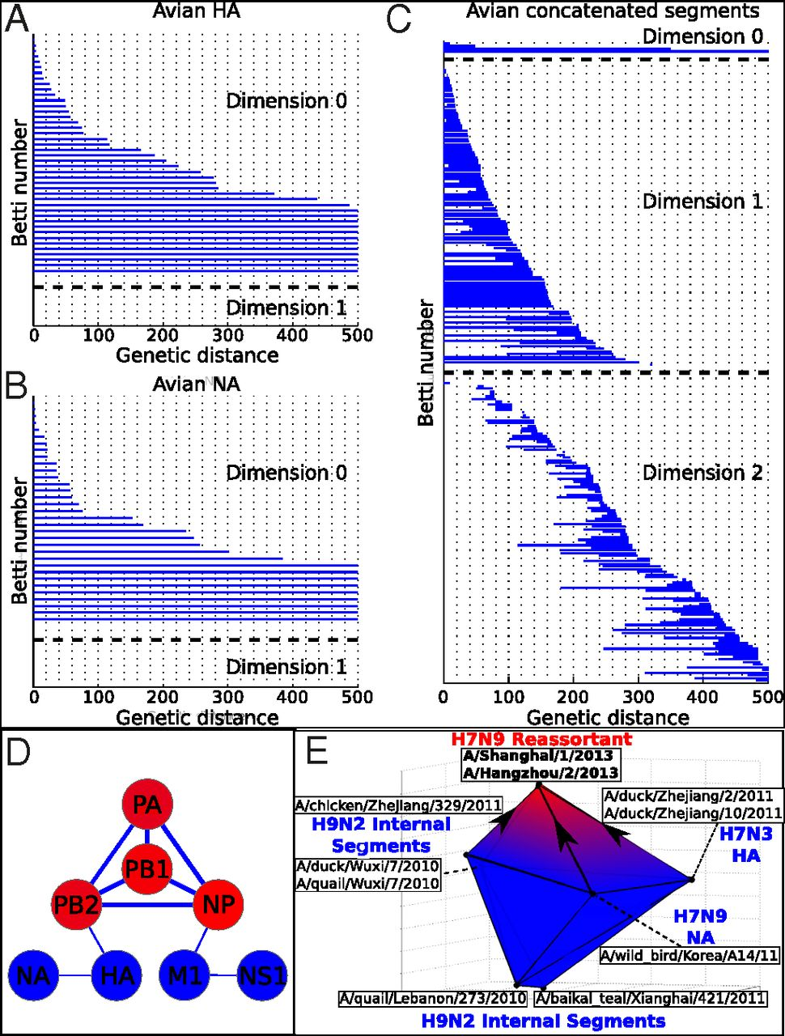
Persistent homology of reassortment in avian influenza.
For multiple segments,
non-trivial H_{k}
k = 1, 2.
Thus
horizontal transfer via reassortment
but not homologous recombination
www.virology.ws/2009/06/29/reassortment-of-the-influenza-virus-genome/
Chan J M et al. PNAS 2013;110:18566-18571
©2013 by National Academy of Sciences
Notes:
Persistent homology of reassortment in avian influenza. Analysis of (A) HA and (B) NA reveal no significant one-dimensional topological structure. (C) Concatenated segments reveal rich 1D and 2D topology, indicating reassortment. For specific parameters, see SI Appendix, Supplementary Text. (D) Network representing the reassortment pattern of avian influenza deduced from high-dimensional topology. Line width is determined by the probability that two segments reassort together. Node color ranges from blue to red, correlating with the sum of connected line weights for a given node. For specific parameters, see SI Appendix, Supplementary Text. (E) b₂ polytope representing the triple reassortment of H7N9 avian influenza. Concatenated genomic sequences forming the polytope were transformed into 3D space using PCoA (SI Appendix, Supplementary Text). Two-dimensional barcoding was performed using Vietoris–Rips complex and a maximum scale ε of 4,000 nucleotides.

Slide 9
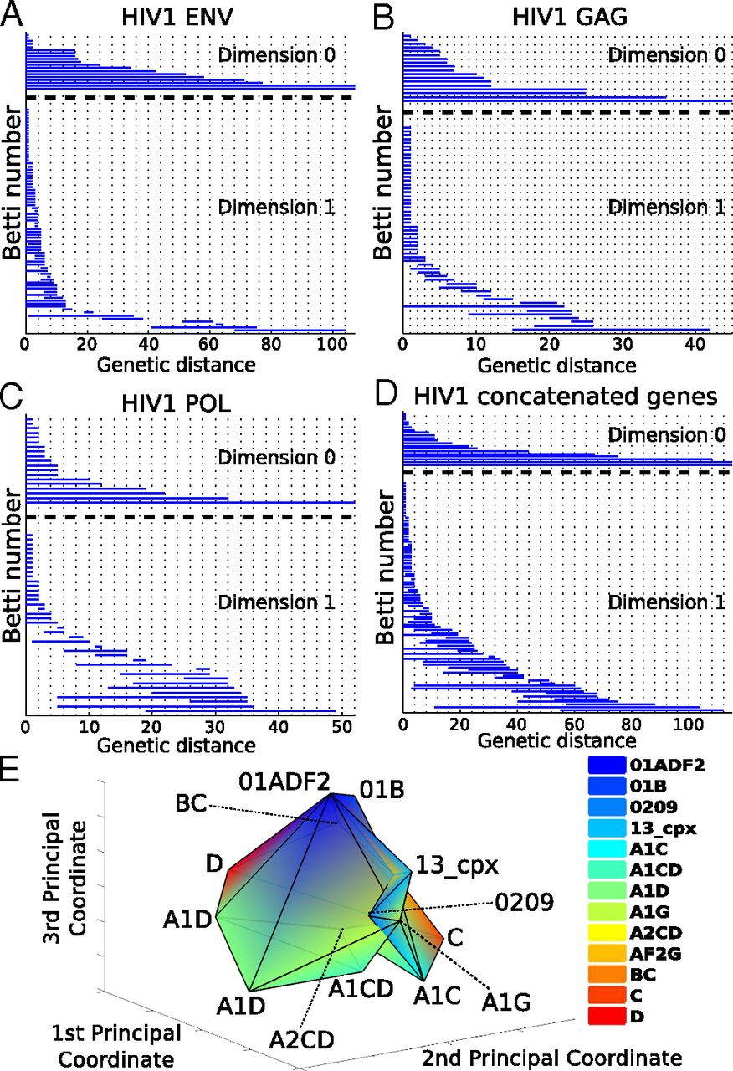
Barcoding plots of HIV-1 reveal evidence of recombination in (A) env, (B), gag, (C) pol, and (D) the concatenated sequences of all three genes.
HIV –
single segment
(so no reassortment)
Non-trivial H_{k}
k = 1, 2.
Thus horizontal transfer via homologous recombination.
©2013 by National Academy of Sciences
Chan J M et al. PNAS 2013;110:18566-18571
Notes:
Barcoding plots of HIV-1 reveal evidence of recombination in (A) env, (B), gag, (C) pol, and (D) the concatenated sequences of all three genes. One-dimensional topology present for alignments of individual genes as well as the concatenated sequences suggests recombination. (E) b₂ polytope representing a complex recombination event with multiple parental strains. Sequences of the [G4] generator of concatenated HIV-1 gag, pol, and env were transformed into 3D space using PCoA (SI Appendix, Supplementary Text) of the Nei–Tamura pairwise genetic distances. Two-simplices from the [G4] generator defined a polytope whose cavity represents a complex recombination. Each vertex of the polytope corresponds to a sequence that is color-coded by HIV-1 subtype. For specific parameters, see SI Appendix, Supplementary Text.

Slide 10
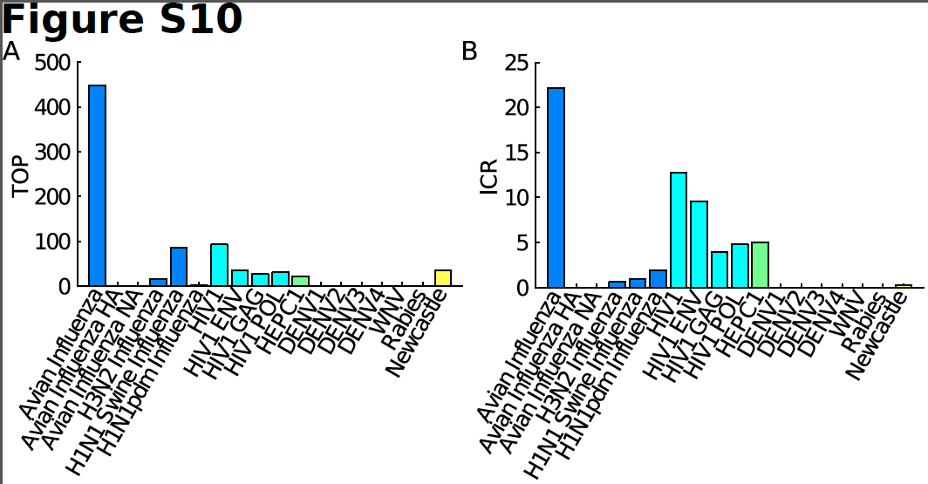
TOP = Topological obstruction
= maximum barcode length in non-zero dimensions
TOP ≠ 0 ➔ no additive distance tree
TOP is stable

Slide 11
ICR = irreducible cycle rate
= average number of the one-dimensional
irreducible cycles per unit of time
Simulations show that ICR is proportional to and provides a lower bound for recombination/reassortment rate

Slide 12
Persistent homology Viral evolution
Filtration value ε Genetic distance
(evolutionary scale)
β₀ at filtration value ε Number of clusters at scale ε
Generators of H₀ A representative element of
the cluster
Hierarchical Hierarchical clustering
relationship among
H₀ generators
β₁ Number of reticulate events
(recombination and
reassortment)

Slide 13
Persistent homology Viral evolution
Generators of H₁ Reticulate events
Generators of H₂ Complex horizontal
genomic exchange
H_{k} ≠ 0 for some k > 0 No phylogenetic tree
representation
No. of Lower bound on rate of
higher-dimensional reticulate events
generators over time
(irreducible cycle rate)

Slide 14
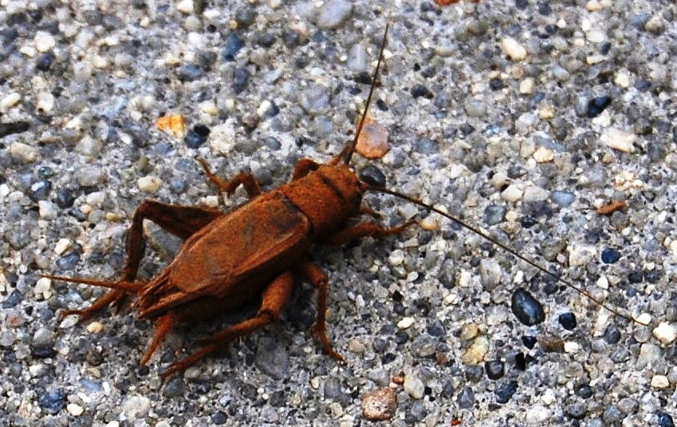
Cricket
http://upload.wikimedia.org/wikipedia/commons/8/8d/Cricket900ppx_crop.jpg

Slide 15
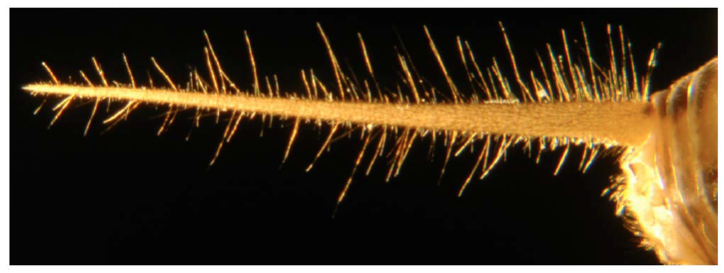
2012
Thursday December 12, 2013
9:00am-9:50am Structure of the Afferent Terminals in Terminal Ganglion of a Cricket and Persistent Homology Tomas Gedeon (Montana State University)

Slide 16
Nerve endings
2012
dense nerve center

Slide 17
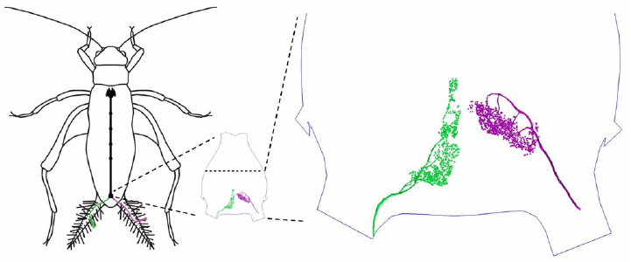

Slide 18
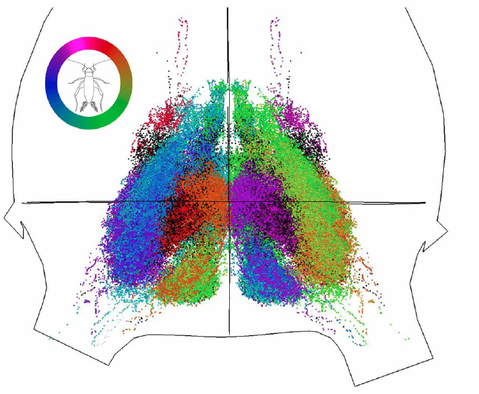
Terminal Ganglion

Slide 20
distal data: long
sparse since harder to obtain (6194).
proximal data:
long, medium, short 42428, 27442, 29297
distal vs proximal
furthest 30%
closest 15%

Slide 21
Proximal data was filtered:
1.) remove outliers (noise)
experimental error
using data obtained from many
different crickets
2.) remove (redundant) points in densest regions to improve computational speed
Performed comparison using data sampled from a
Gaussian Mixture Model.

Slide 22
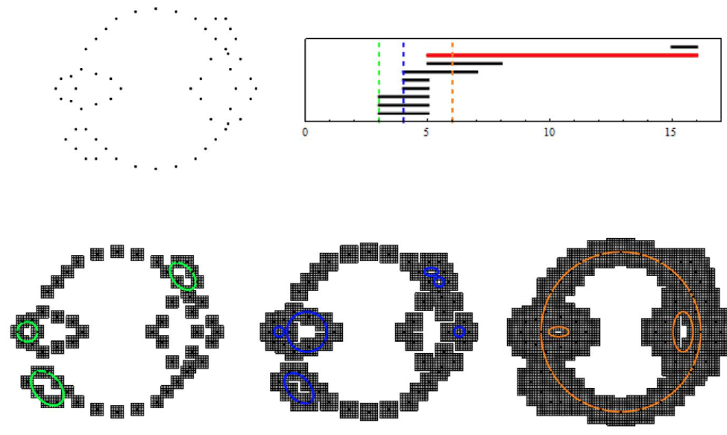
cubical homology: for reducing memory requirements (bitmap).
To calculate persistent homology:
Mrozek, Batko and Wanner’s
cubPersistenceMD.
To find cycles:
Homcubes in CHomP.

Slide 23
cubical homology
To calculate persistent homology:
Mrozek, Batko and Wanner’s cubPersistenceMD.
www.ii.uj.edu.pl/~mrozek/software/homology.html
Kaczynski T, Mischaikow K, Mrozek M (2004) Computational Homology.
Applied Mathematical Sciences. Springer.
http://chomp.rutgers.edu
http://www.sagemath.org/doc/reference/homology/sage/interfaces/chomp.html
To find cycles: Homcubes in CHomP.

Slide 24
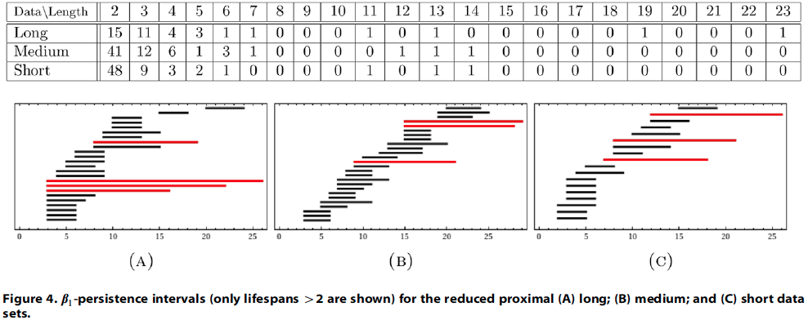

Slide 26
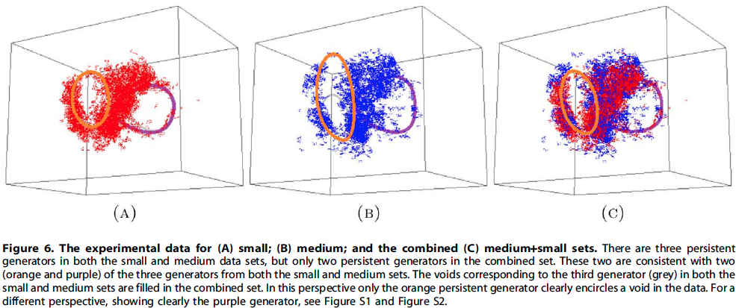

Slide 27
medium+small

Slide 28
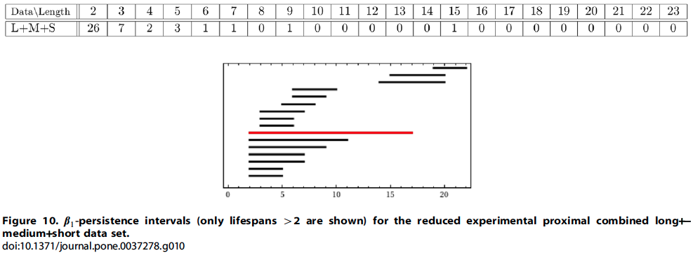

Slide 29
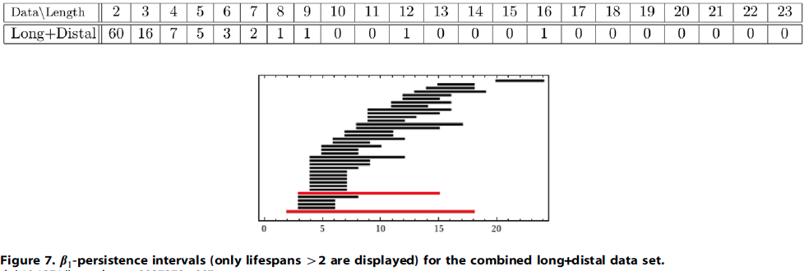

Slide 30
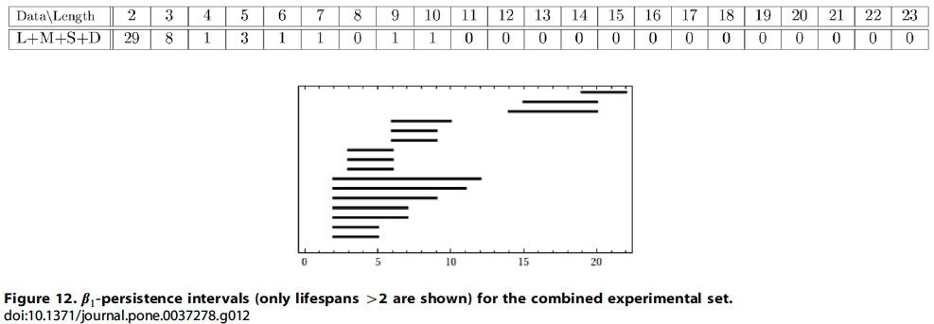

Slide 31
