Slide 1
MATH:7450 (22M:305) Topics in Topology: Scientific and Engineering Applications of Algebraic Topology
Nov 15, 2013: Brief intro to tangles & Phylogeny and Persistent Homology
Fall 2013 course offered through the
University of Iowa Division of Continuing Education
Isabel K. Darcy, Department of Mathematics
Applied Mathematical and Computational Sciences, University of Iowa
http://www.math.uiowa.edu/~idarcy/AppliedTopology.html

Slide 2
Recombination:

Slide 3
Different recombinases have different topological mechanisms:
Ex: Cre recombinase can act on both directly and inversely repeated sites.
Xer recombinase on psi.
Unique product
Uses topological filter to only perform deletions, not inversions

Slide 4

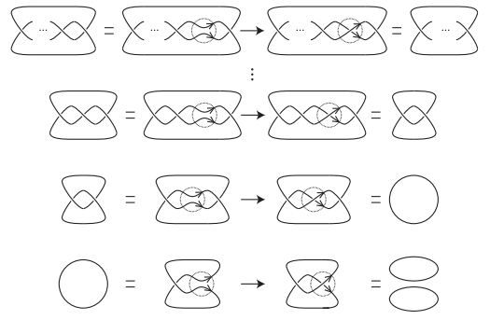
PNAS 2013

Slide 5
Tangle Analysis of Protein-DNA complexes

Slide 6
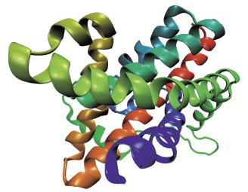
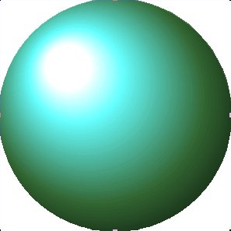
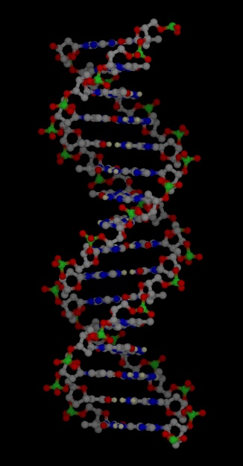
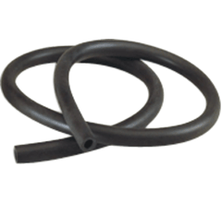
Mathematical Model
Protein =
=
=
=
DNA =

Slide 7
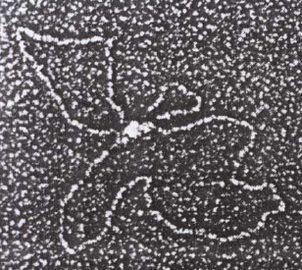
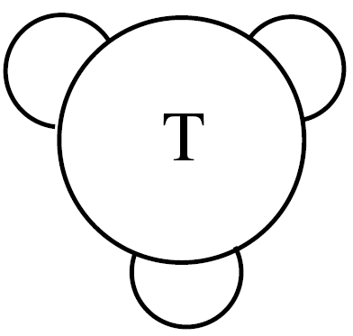
C. Ernst, D. W. Sumners, A calculus for rational tangles: applications to DNA recombination, Math. Proc. Camb. Phil. Soc. 108 (1990), 489-515.
protein = three dimensional ball
protein-bound DNA = strings.
Protein-DNA complex
Heichman and Johnson
Slide (modified) from Soojeong Kim

Slide 8
Solving tangle equations
Tangle equation from: Path of DNA within the Mu transpososome. Transposase interactions bridging two Mu ends and the enhancer trap five DNA supercoils. Pathania S, Jayaram M, Harshey RM.
Cell. 2002 May 17;109(4):425-36.

Slide 9
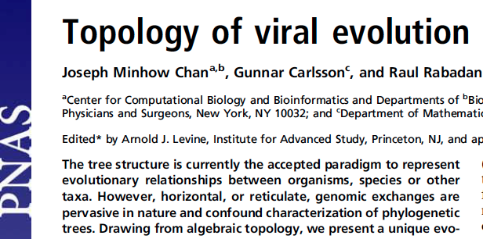
vol. 110 no. 46, 18566–18571, 2013
http://www.pnas.org/content/110/46/18566.full

Slide 10
Background

Slide 11
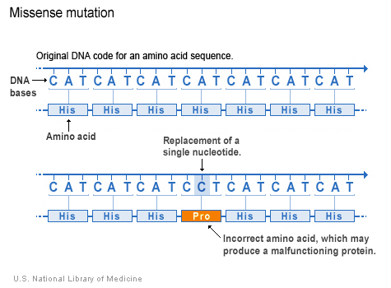
http://ghr.nlm.nih.gov/handbook/mutationsanddisorders/possiblemutations

Slide 12
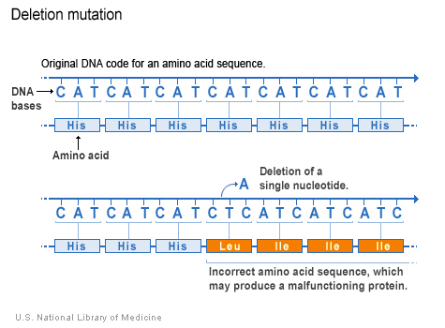
http://ghr.nlm.nih.gov/handbook/mutationsanddisorders/possiblemutations

Slide 13
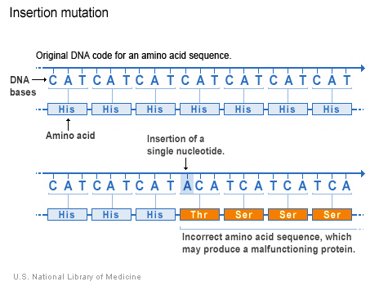
http://ghr.nlm.nih.gov/handbook/mutationsanddisorders/possiblemutations

Slide 14
Recombination:

Slide 15
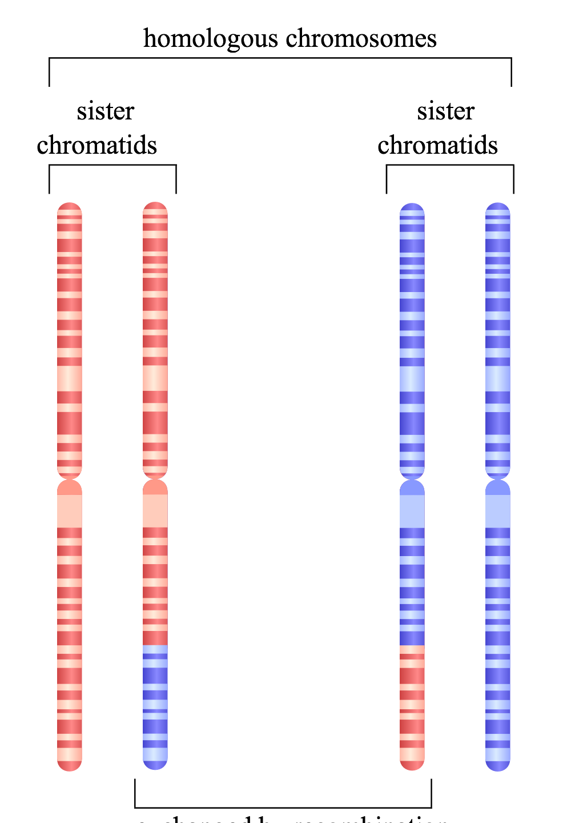
Homologous recombination
http://en.wikipedia.org/wiki/File:HR_in_meiosis.svg

Slide 16
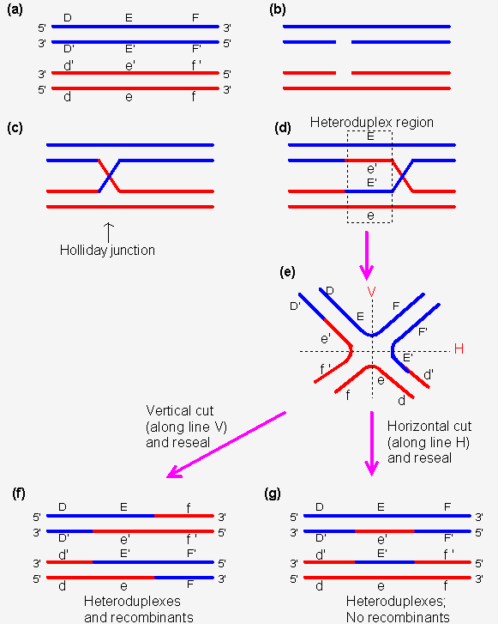
http://www.web-books.com/MoBio/Free/Ch8D2.htm

Slide 17
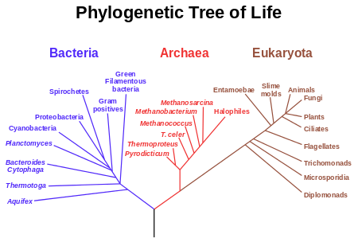

Slide 18
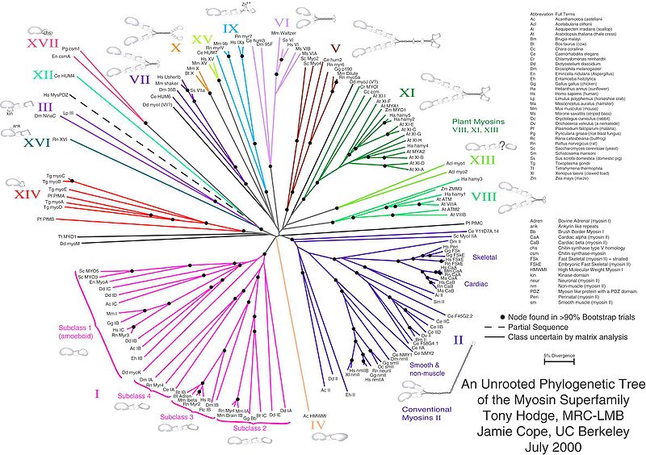

Slide 19
Where do we get distances from?
Distances can be derived from Multiple Sequence Alignments (MSAs).
The most basic distance is just a count of the number of sites which differ between two sequences divided by the sequence length. These are sometimes known as p-distances.
 | Cat | Dog | Rat | Cow
Cat | 0 | 0.2 | 0.4 | 0.7
Dog | 0.2 | 0 | 0.5 | 0.6
Rat | 0.4 | 0.5 | 0 | 0.3
Cow | 0.7 | 0.6 | 0.3 | 0
Cat | ATTTGCGGTA
Dog | ATCTGCGATA
Rat | ATTGCCGTTT
Cow | TTCGCTGTTT
http://www.allanwilsoncentre.ac.nz/massey/fms/AWC/download/SK_DistanceBasedMethods.ppt

Slide 20
Perfectly “tree-like” distances
 | Cat | Dog | Rat
Dog | 3
Rat | 4 | 5
Cow | 6 | 7 | 6
Cat
Rat
1
2
1
2
4
Dog
Cow
http://www.allanwilsoncentre.ac.nz/massey/fms/AWC/download/SK_DistanceBasedMethods.ppt

Slide 21
Perfectly “tree-like” distances
 | Cat | Dog | Rat
Dog | 3
Rat | 4 | 5
Cow | 6 | 7 | 6
Cat
Rat
1
2
1
2
4
Dog
Cow
http://www.allanwilsoncentre.ac.nz/massey/fms/AWC/download/SK_DistanceBasedMethods.ppt

Slide 22
Perfectly “tree-like” distances
 | Cat | Dog | Rat
Dog | 3
Rat | 4 | 5
Cow | 6 | 7 | 6
Cat
Rat
1
2
1
2
4
Dog
Cow
http://www.allanwilsoncentre.ac.nz/massey/fms/AWC/download/SK_DistanceBasedMethods.ppt

Slide 23
Perfectly “tree-like” distances
 | Cat | Dog | Rat
Dog | 3
Rat | 4 | 5
Cow | 6 | 7 | 6
Cat
Rat
1
2
1
2
4
Dog
Cow
http://www.allanwilsoncentre.ac.nz/massey/fms/AWC/download/SK_DistanceBasedMethods.ppt

Slide 24
Perfectly “tree-like” distances
 | Cat | Dog | Rat
Dog | 3
Rat | 4 | 5
Cow | 6 | 7 | 6
Cat
Rat
1
2
1
2
4
Dog
Cow
http://www.allanwilsoncentre.ac.nz/massey/fms/AWC/download/SK_DistanceBasedMethods.ppt

Slide 25
Perfectly “tree-like” distances
 | Cat | Dog | Rat
Dog | 3
Rat | 4 | 5
Cow | 6 | 7 | 6
Cat
Rat
1
2
1
2
4
Dog
Cow
http://www.allanwilsoncentre.ac.nz/massey/fms/AWC/download/SK_DistanceBasedMethods.ppt

Slide 26
 | Cat | Dog | Rat
Dog | 3
Rat | 4 | 5
Cow | 6 | 7 | 6
Cat
Rat
1
2
1
2
4
Dog
Cow
 | Rat | Dog | Cat
Dog | 3
Cat | 4 | 5
Cow | 6 | 7 | 6
Rat
Cat
1
2
1
2
4
Dog
Cow

Slide 27
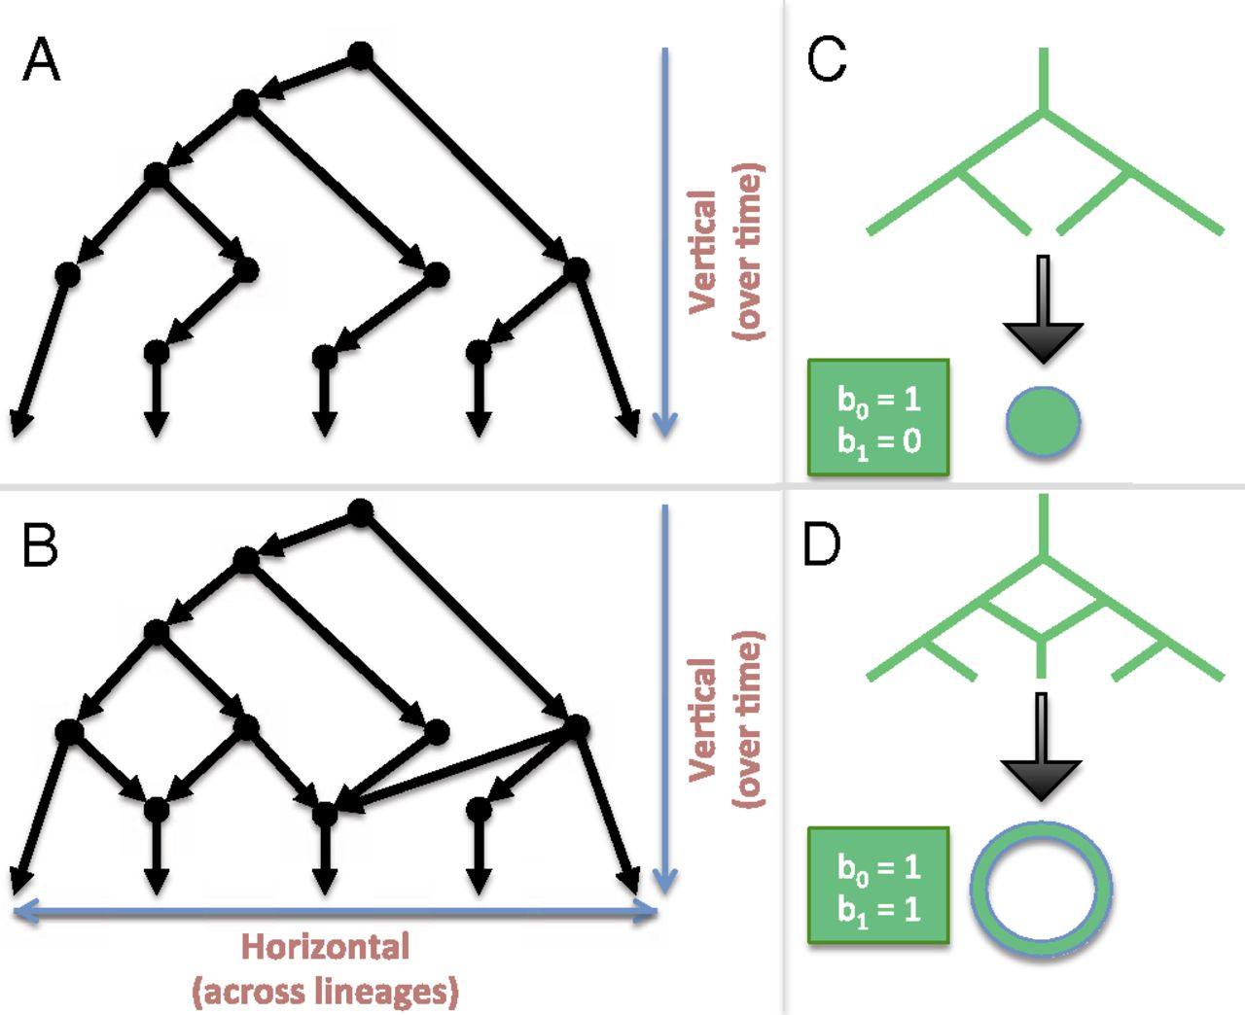
Linking algebraic topology to evolution.
Chan J M et al. PNAS 2013;110:18566-18571
©2013 by National Academy of Sciences
Notes:
Linking algebraic topology to evolution. (A) A tree depicting vertical evolution. (B) A reticulate structure capturing horizontal evolution, as well. (C) A tree can be compressed into a point. (D) The same cannot be done for a reticulate structure without destroying the hole at the center.

Slide 28
Linking algebraic topology to evolution.
Reticulation
Chan J M et al. PNAS 2013;110:18566-18571
©2013 by National Academy of Sciences
Notes:
Linking algebraic topology to evolution. (A) A tree depicting vertical evolution. (B) A reticulate structure capturing horizontal evolution, as well. (C) A tree can be compressed into a point. (D) The same cannot be done for a reticulate structure without destroying the hole at the center.

Slide 29
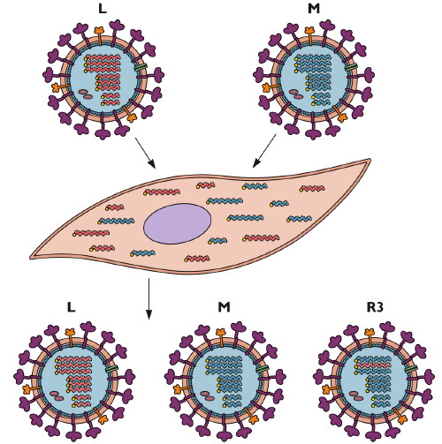
Reassortment
http://www.virology.ws/2009/06/29/reassortment-of-the-influenza-virus-genome/

Slide 30
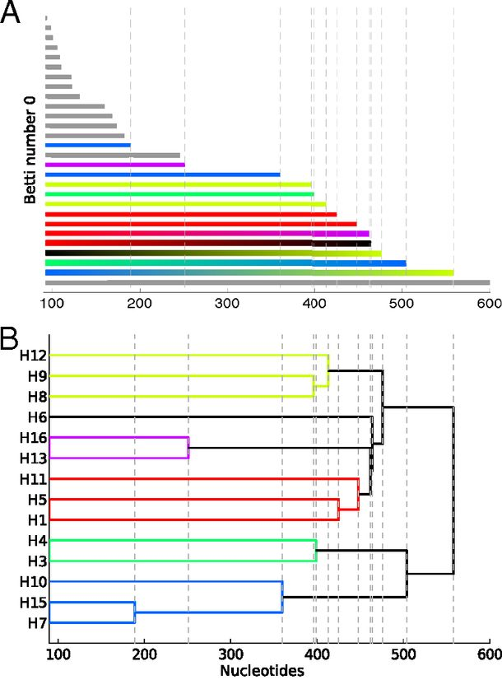
Reconstructing phylogeny from persistent homology of avian influenza HA. (A) Barcode plot in dimension 0 of all avian HA subtypes.
©2013 by National Academy of Sciences
Chan J M et al. PNAS 2013;110:18566-18571
Notes:
Reconstructing phylogeny from persistent homology of avian influenza HA. (A) Barcode plot in dimension 0 of all avian HA subtypes. Each bar represents a connected simplex of sequences given a Hamming distance of ε. When a bar ends at a given ε, it merges with another simplex. Gray bars indicate that two simplices of the same HA subtype merge together at a given ε. Solid color bars indicate that two simplices of different HA subtypes but same major clade merge together. Interpolated color bars indicate that two simplices of different major clades merge together. Colors correspond to known major clades of HA. For specific parameters, see SI Appendix, Supplementary Text. (B) Phylogeny of avian HA reconstructed from the barcode plot in A. Major clades are color-coded. (C) Neighbor-joining tree of avian HA (SI Appendix, Supplementary Text).

Slide 31
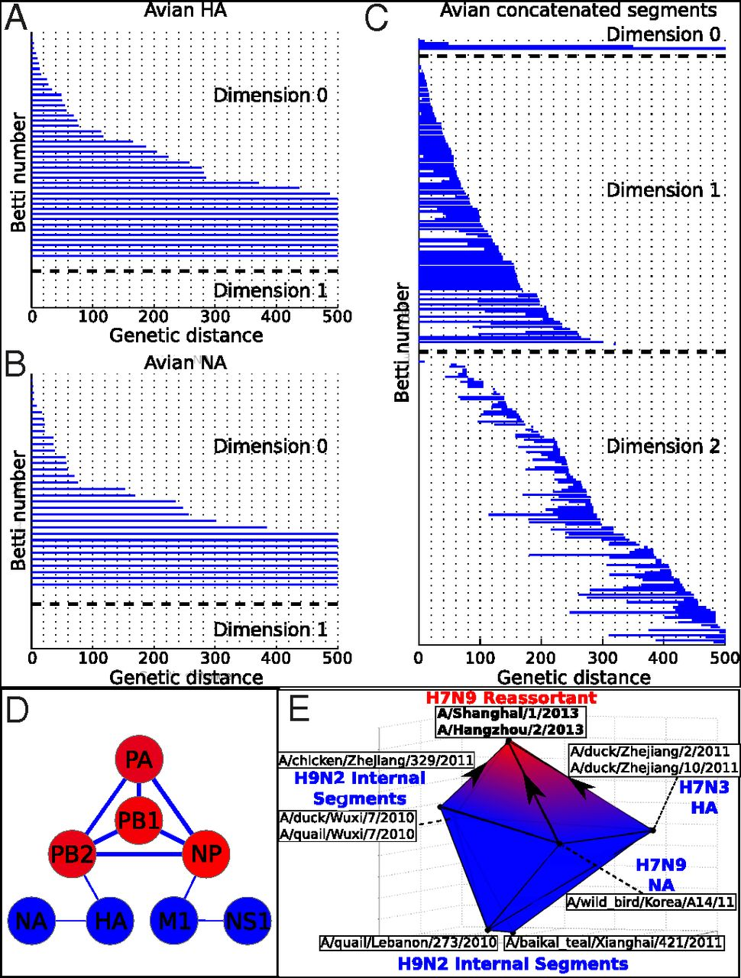
Persistent homology of reassortment in avian influenza.
Chan J M et al. PNAS 2013;110:18566-18571
©2013 by National Academy of Sciences
Notes:
Persistent homology of reassortment in avian influenza. Analysis of (A) HA and (B) NA reveal no significant one-dimensional topological structure. (C) Concatenated segments reveal rich 1D and 2D topology, indicating reassortment. For specific parameters, see SI Appendix, Supplementary Text. (D) Network representing the reassortment pattern of avian influenza deduced from high-dimensional topology. Line width is determined by the probability that two segments reassort together. Node color ranges from blue to red, correlating with the sum of connected line weights for a given node. For specific parameters, see SI Appendix, Supplementary Text. (E) b₂ polytope representing the triple reassortment of H7N9 avian influenza. Concatenated genomic sequences forming the polytope were transformed into 3D space using PCoA (SI Appendix, Supplementary Text). Two-dimensional barcoding was performed using Vietoris–Rips complex and a maximum scale ε of 4,000 nucleotides.

Slide 32
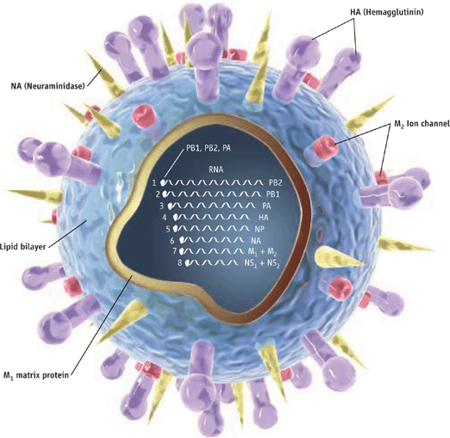
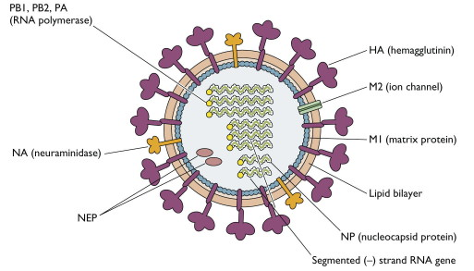
http://www.pnas.org/content/110/46/18566.full
http://www.sciencemag.org/content/312/5772/380.full
http://www.virology.ws/2009/04/30/structure-of-influenza-virus/
Notes:
Persistent homology of reassortment in avian influenza. Analysis of (A) HA and (B) NA reveal no significant one-dimensional topological structure. (C) Concatenated segments reveal rich 1D and 2D topology, indicating reassortment. For specific parameters, see SI Appendix, Supplementary Text. (D) Network representing the reassortment pattern of avian influenza deduced from high-dimensional topology. Line width is determined by the probability that two segments reassort together. Node color ranges from blue to red, correlating with the sum of connected line weights for a given node. For specific parameters, see SI Appendix, Supplementary Text. (E) b₂ polytope representing the triple reassortment of H7N9 avian influenza. Concatenated genomic sequences forming the polytope were transformed into 3D space using PCoA (SI Appendix, Supplementary Text). Two-dimensional barcoding was performed using Vietoris–Rips complex and a maximum scale ε of 4,000 nucleotides.

Slide 33
Reassortment
http://www.virology.ws/2009/06/29/reassortment-of-the-influenza-virus-genome/

Slide 34
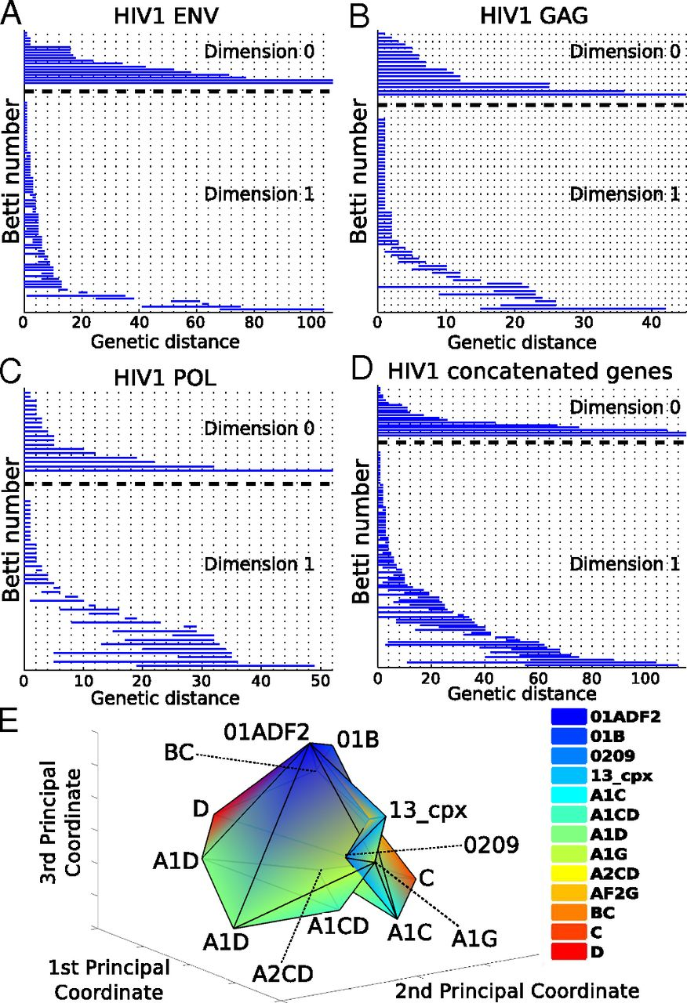
Barcoding plots of HIV-1 reveal evidence of recombination in (A) env, (B), gag, (C) pol, and (D) the concatenated sequences of all three genes.
©2013 by National Academy of Sciences
Chan J M et al. PNAS 2013;110:18566-18571
Notes:
Barcoding plots of HIV-1 reveal evidence of recombination in (A) env, (B), gag, (C) pol, and (D) the concatenated sequences of all three genes. One-dimensional topology present for alignments of individual genes as well as the concatenated sequences suggests recombination. (E) b₂ polytope representing a complex recombination event with multiple parental strains. Sequences of the [G4] generator of concatenated HIV-1 gag, pol, and env were transformed into 3D space using PCoA (SI Appendix, Supplementary Text) of the Nei–Tamura pairwise genetic distances. Two-simplices from the [G4] generator defined a polytope whose cavity represents a complex recombination. Each vertex of the polytope corresponds to a sequence that is color-coded by HIV-1 subtype. For specific parameters, see SI Appendix, Supplementary Text.

Slide 35
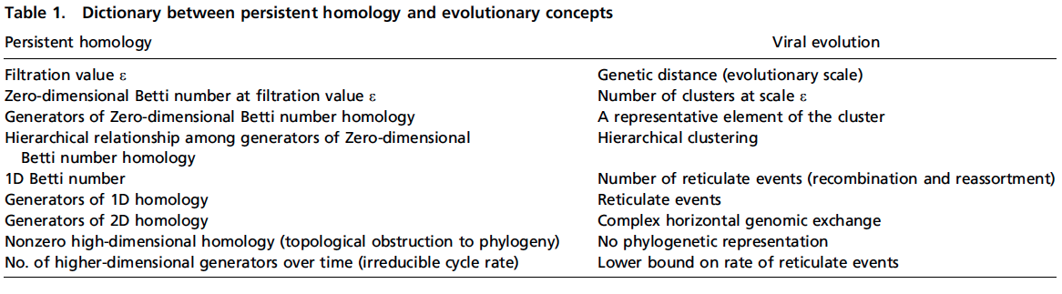

Slide 40
Left-over slides

Slide 41
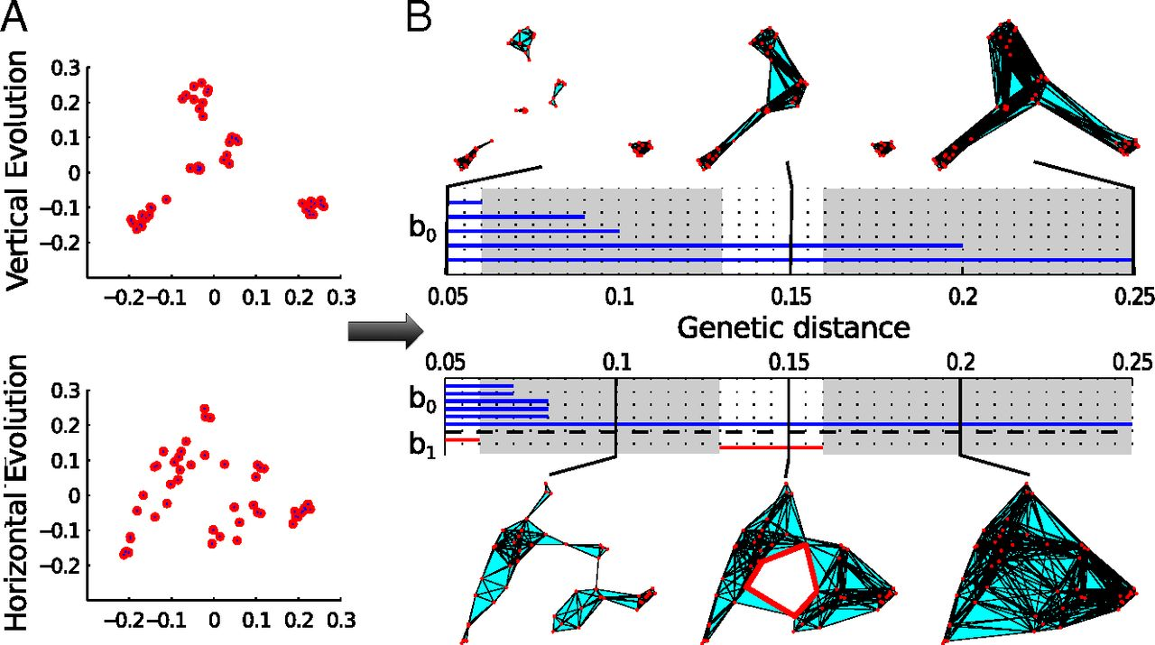
Persistent homology characterizes topological features of vertical and horizontal evolution.
Chan J M et al. PNAS 2013;110:18566-18571
©2013 by National Academy of Sciences
Notes:
Persistent homology characterizes topological features of vertical and horizontal evolution. Evolution was simulated with and without reassortment (SI Appendix, Supplementary Text). (A) A metric space of pairwise genetic distances d(i,j) can be calculated for a given population of genomic sequences g₁,…, g_{n}. We visualize these data points using principal coordinate analysis (PCoA) (SI Appendix, Supplementary Text). (B) In the construction of simplicial complexes, two genomes are considered related (joined by a line) if their genetic distance is smaller than ε. Three genomes within ε of each other form a triangle, and so on (SI Appendix, Supplementary Text). From there, we calculate the homology groups at different genetic scales. In the barcode, each bar in different dimensions represents a topological feature of a filtration of simplicial complexes persisting over an interval of ε. A one-dimensional cycle (red highlight) exists at ε = [0.13, 0.16 Hamming distance] and corresponds to a reticulate event. The evolutionary scales I where b₁ = 0 are highlighted in gray.

Slide 42
The tangle equations corresponding to the electron micrograph:

Slide 43
Different recombinases have different topological mechanisms:

Slide 44
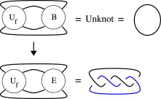


There are an infinite number of solutions to
Can solve by using
TopoICE in Rob Scharein’s KnotPlot.com

Slide 46
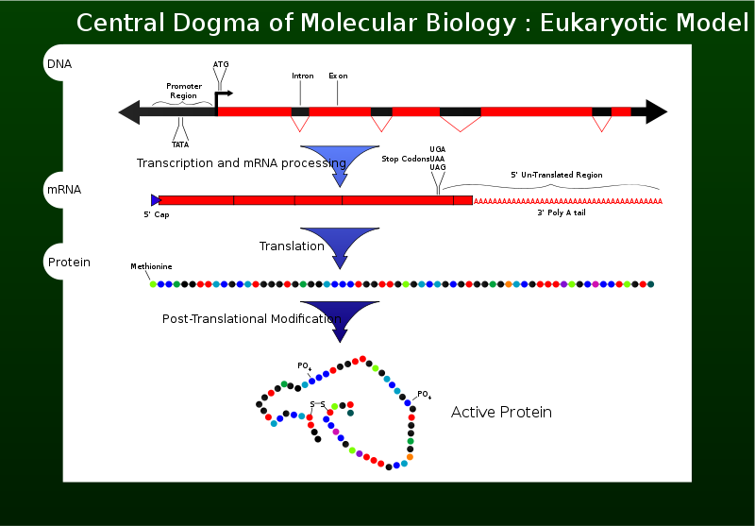
http://en.wikipedia.org/wiki/File:Cdmb.svg

Slide 47
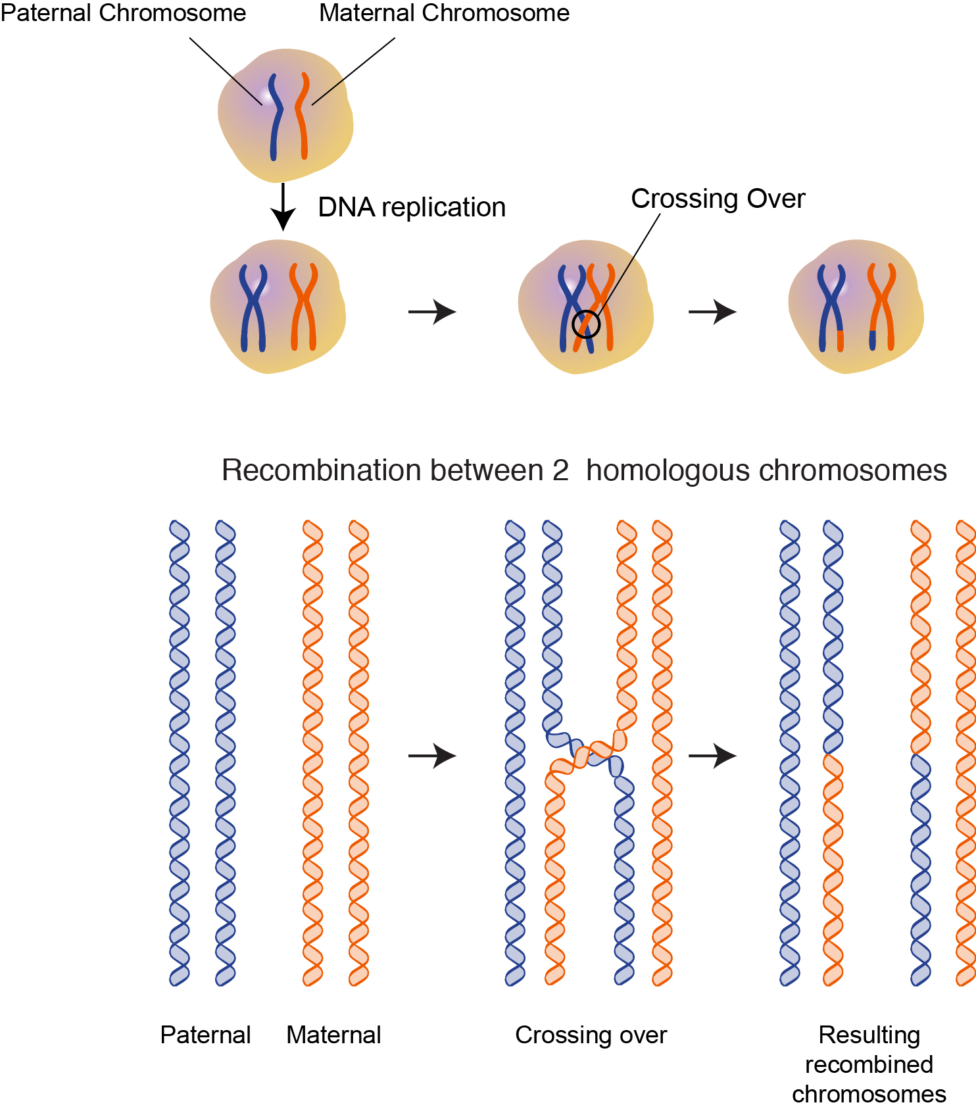

Slide 48
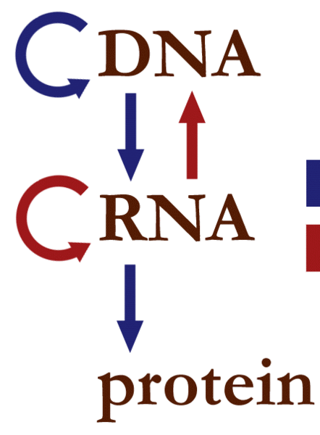
http://en.wikipedia.org/wiki/File:Centraldogma_nodetails.GIF
http://ghr.nlm.nih.gov/handbook/mutationsanddisorders/possiblemutations

Slide 49
http://ghr.nlm.nih.gov/handbook/mutationsanddisorders/possiblemutations

Slide 50
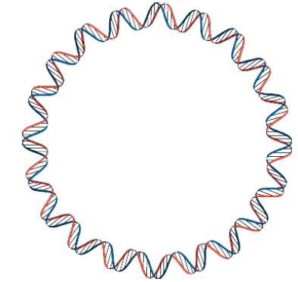
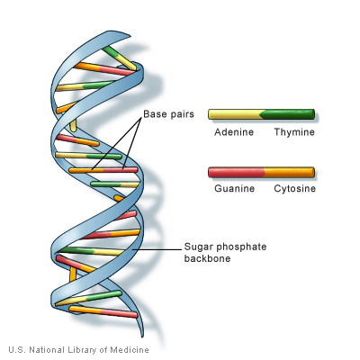

Slide 51
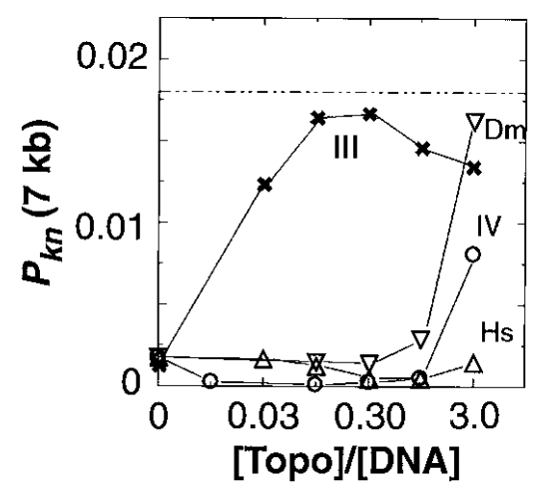
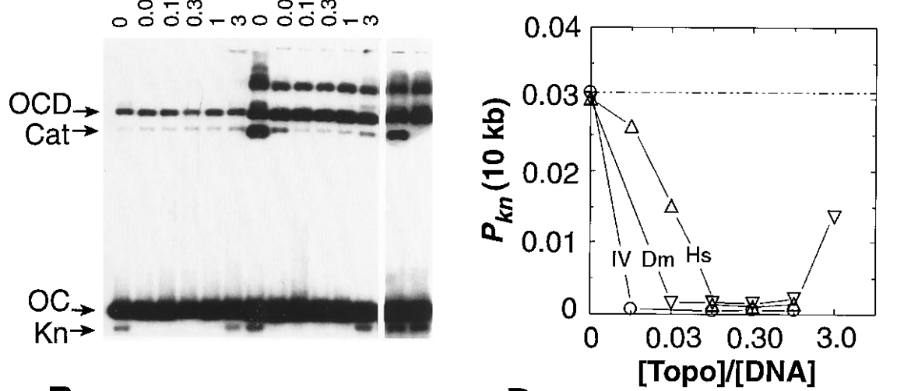
http://www.sciencemag.org/content/277/5326/690.full.pdf, Science. 1997;277(5326):690-3.

Slide 52
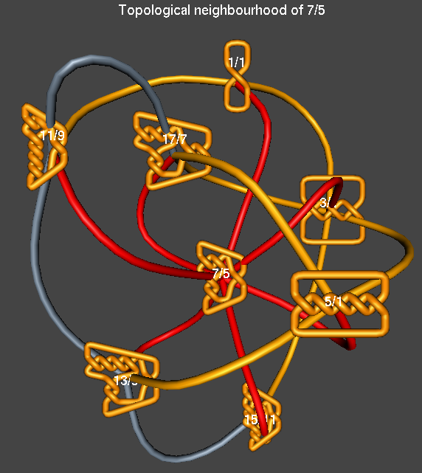

Slide 53


Slide 54
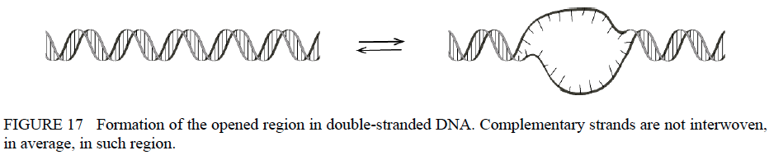
www.biophysics.org/Portals/1/PDFs/Education/Vologodskii.pdf

Slide 55
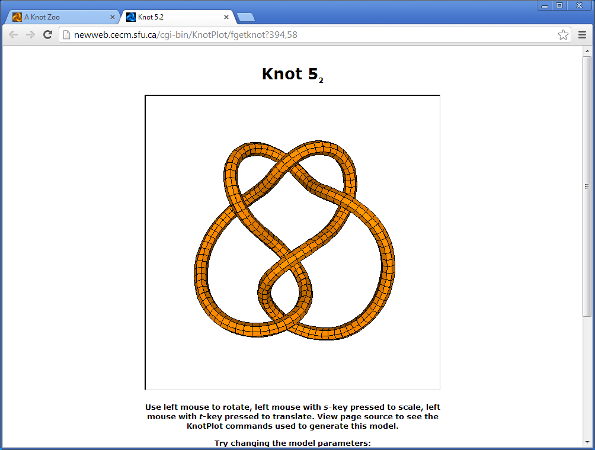
Knotplot.com

Slide 56



Knotplot.com
.
.
.

Slide 57
Knotplot.com
.
.
.

Slide 58
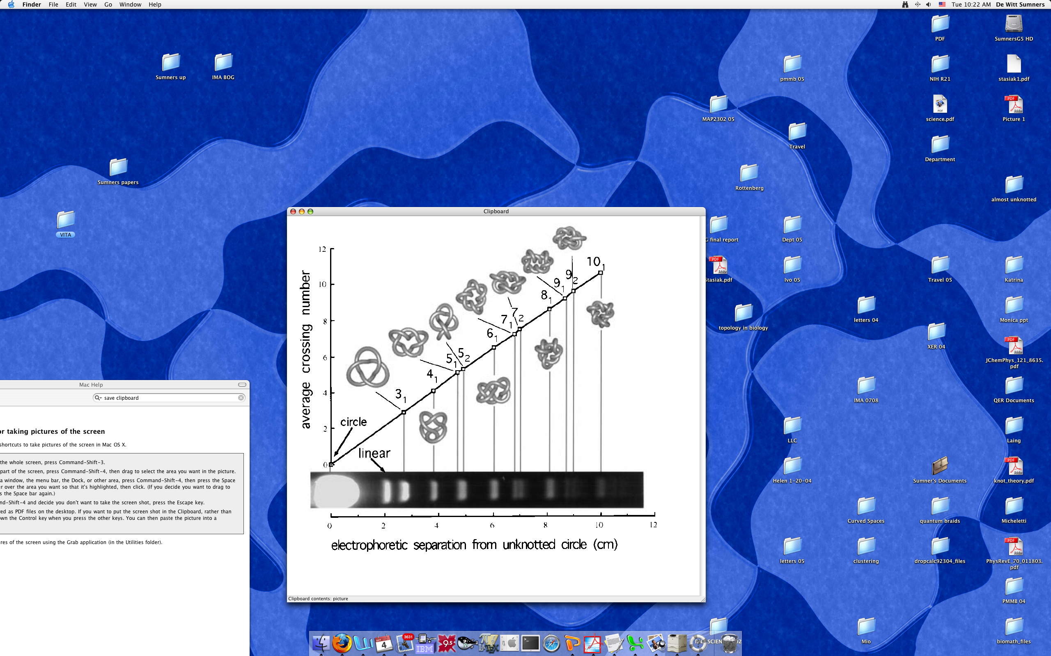
GEL VELOCITY IDENTIFIES KNOT COMPLEXITY
Vologodskii et al, JMB 278 (1988), 1

Slide 59
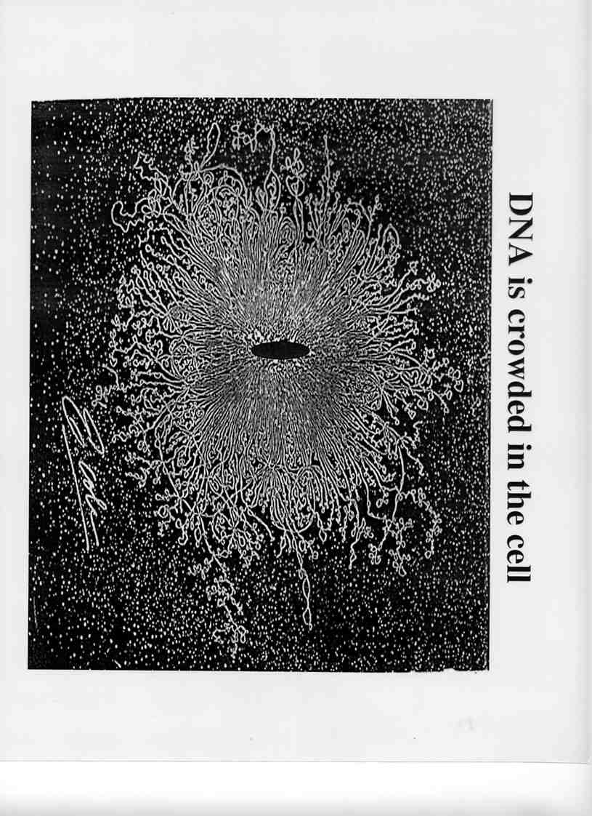
DNA is Crowded in the Cell

Slide 60
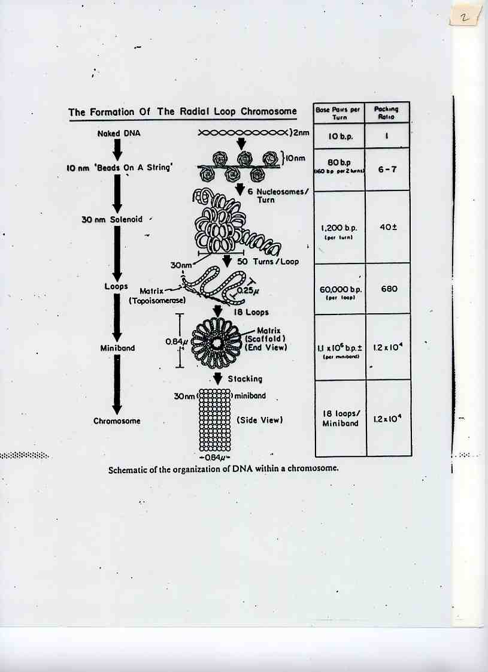
Radial Loop Chromosome

Slide 61
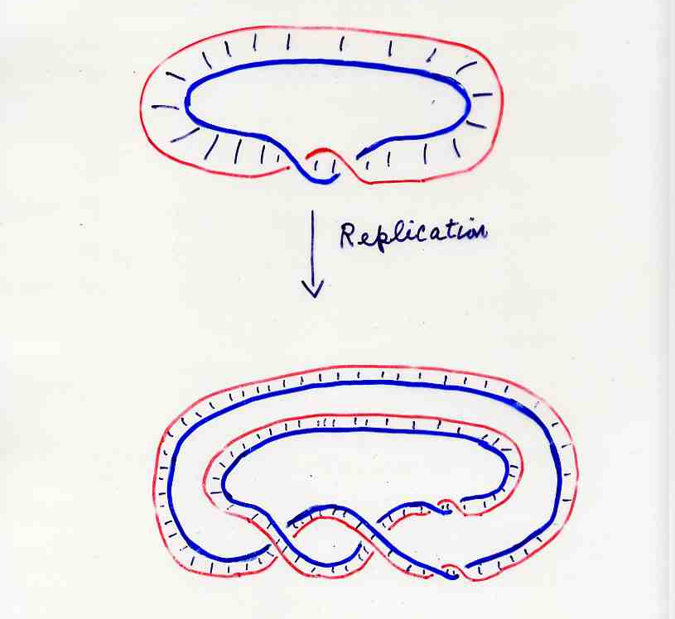
Replication Obstruction

Slide 62
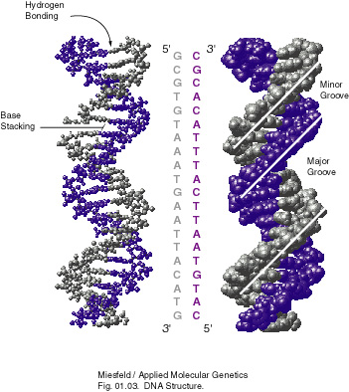
DNA Structure

Slide 63
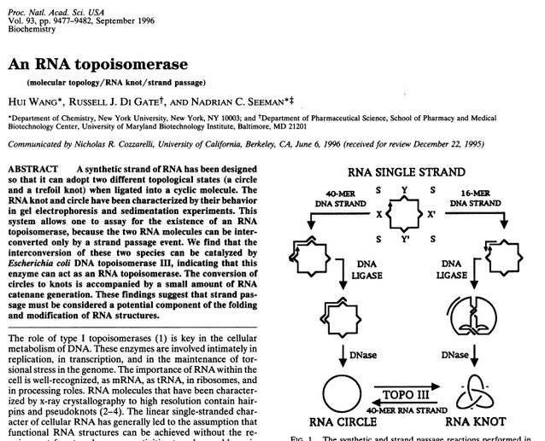
http://www.ncbi.nlm.nih.gov/pmc/articles/PMC38453/?page=1

Slide 64
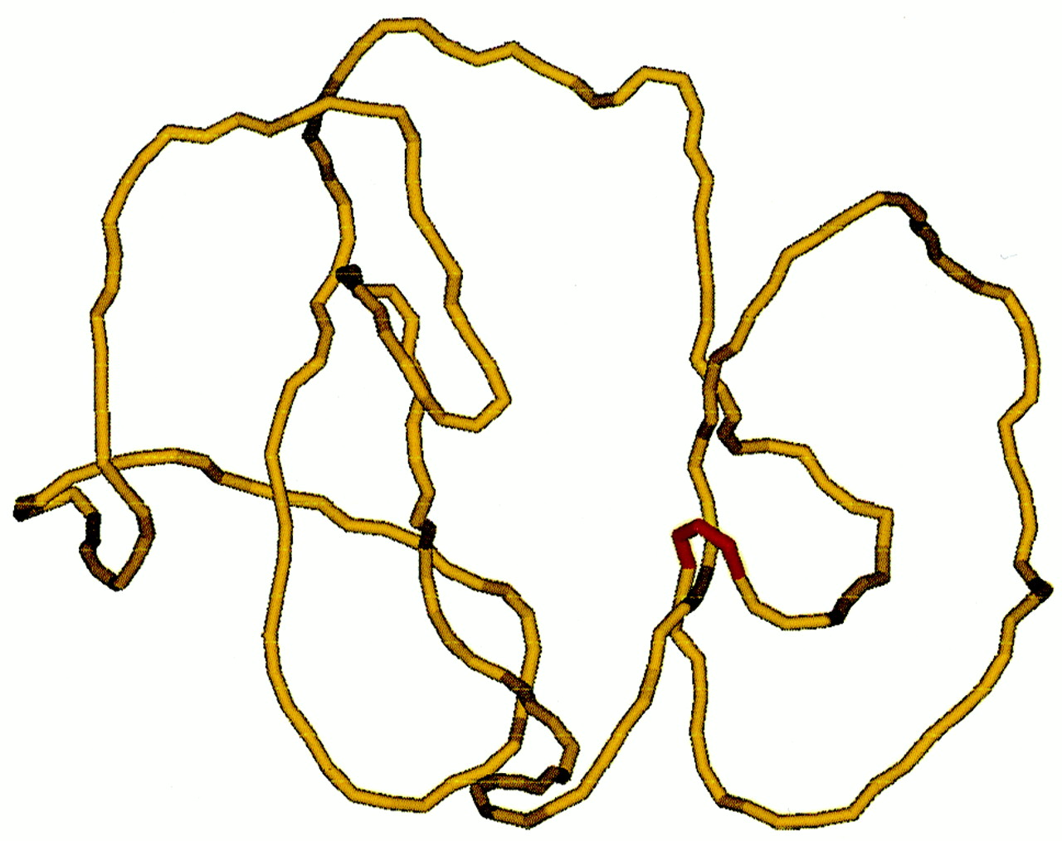
Typical simulated conformation of a knotted DNA with a hairpin G segment (red).
Vologodskii A V et al. PNAS 2001;98:3045-3049
©2001 by National Academy of Sciences
Notes:
Typical simulated conformation of a knotted DNA with a hairpin G segment (red). Another segment of the 7-kb model chain is inside the hairpin in this conformation, which was selected from the set generated by a Metropolis Monte Carlo procedure.

