Slide 1
MATH:7450 (22M:305) Topics in Topology: Scientific and Engineering Applications of Algebraic Topology
Sept 9, 2013: Create your own homology.
Fall 2013 course offered through the
University of Iowa Division of Continuing Education
Isabel K. Darcy, Department of Mathematics
Applied Mathematical and Computational Sciences, University of Iowa
http://www.math.uiowa.edu/~idarcy/AppliedTopology.html

Slide 2
Homology
3 ingredients:
1.) Objects
2.) Grading
3.) Boundary map

Slide 3
1.) OBJECTS

Slide 4
Building blocks for a simplicial complex
0-simplex = vertex = v
1-simplex = edge = {v₁, v₂}
v₁
v₂
e
2-simplex = triangle = {v₁, v₂, v₃}
v₂
e₁
e₂
v₁
v₃
e₃
Notes:
The building blocks for a simplicial complex consist of zero simplices which are zero dimensional vertices, one simplices which are one-dimensional edges, and 2-simplices which are two dimensional triangles,

Slide 5
Building blocks for a simplicial complex
0-simplex = vertex = v
1-simplex = edge
v₁
v₂
e
2-simplex = triangle
v₂
e₁
e₂
v₁
v₃
e₃
Notes:
The building blocks for a simplicial complex consist of zero simplices which are zero dimensional vertices, one simplices which are one-dimensional edges, and 2-simplices which are two dimensional triangles,

Slide 6
Building blocks for a simplicial complex
0-simplex = vertex = v
1-simplex = edge = {v₁, v₂}
2-simplex = triangle = {v₁, v₂, v₃}
Notes:
The building blocks for a simplicial complex consist of zero simplices which are zero dimensional vertices, one simplices which are one-dimensional edges, and 2-simplices which are two dimensional triangles,

Slide 7
Objects = generators
Generators = X = { x_{α} | α in A }
Let R be a ring (or field)
R[X] = { n₁x₁ + n₂x₂ + … + n_{k}x_{k} : x_{i} in R }
Ex: Z₂[X] = { n₁x₁ + n₂x₂ + … + n_{k}x_{k} : x_{i} in Z₂ }
Notes:
Complex, C = R[x]

Slide 8
A free vector space over the field F generated by the elements x₁, x₂, …, x_{k} consists of all elements of the
form
n₁x₁ + n₂x₂ + … + n_{k}x_{k}
where n_{i} in F.
Examples of a field: R = set of real numbers
Q = set of rational numbers
Z₂ = {0, 1}
Addition:
(n₁x₁ + n₂x₂ + … + n_{k}x_{k}) + (m₁x₁ + m₂x₂ + … + m_{k}x_{k})
= (n₁ + m₁) x₁ + (n₂ + m₂)x₂ + … + (n_{k} + m_{k})x_{k}
Slide from preparatory lecture 4: Addition (and free vector spaces)
Notes:
We will now define free vector space. Note that the only difference between a free vector space and free abelian group is that our coefficients need not be integers.

Slide 9
A free vector space over the field F generated by the elements x₁, x₂, …, x_{k} consists of all elements of the
form
n₁x₁ + n₂x₂ + … + n_{k}x_{k}
where n_{i} in F.
Examples of a field:
R = set of real numbers:
πx + √2 y + 3z is in R[x, y, z]
Q = set of rational numbers (i.e. fractions):
(½)x + 4y is in Q[x, y]
Z₂ = {0, 1}: 0x + 1y + 1w + 0z is in Z₂[x, y, z, w]
Slide from preparatory lecture 4: Addition (and free vector spaces)
Notes:
For example, our coefficients could be real numbers such as pi, sqrt 2 or 3
Or they could be rational numbers, fractions like ½ or 4
We will focus on Z mod 2 coefficients. In this case our coefficients are either 0 or 1
You don’t actually need to know the formal definition of a field since we will stick with Z mod 2 coefficients, but for completeness, I will quickly summarize a few definitions.

Slide 10
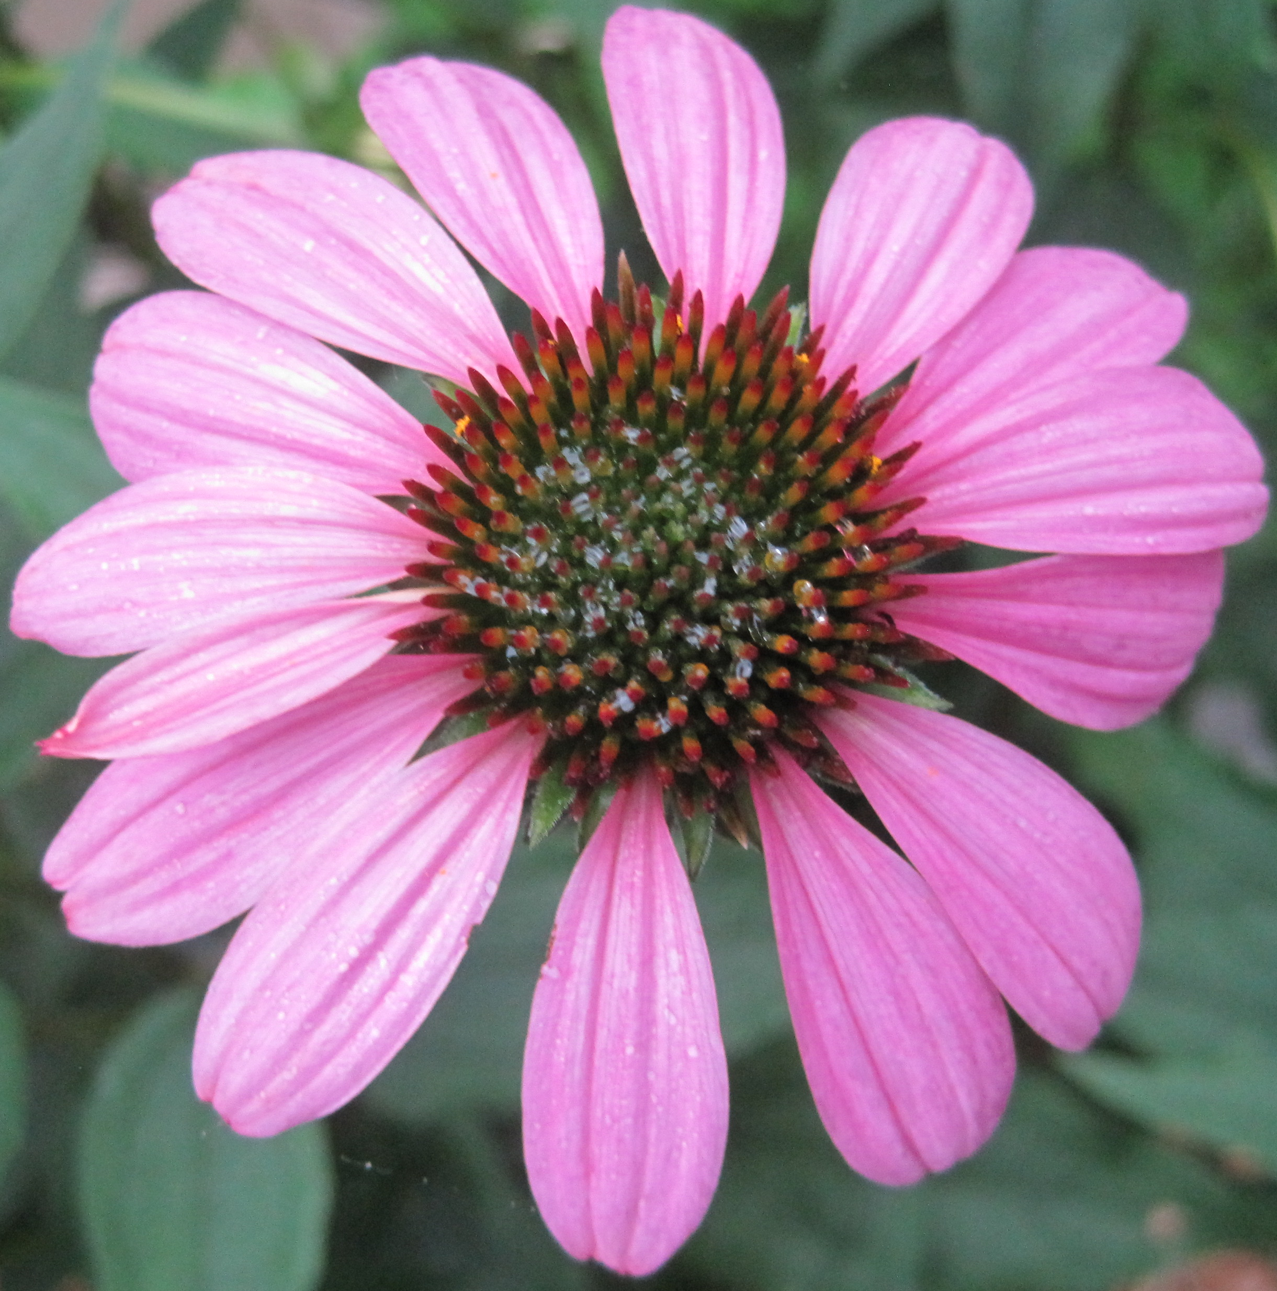
A free abelian group generated by the elements
x₁, x₂, …, x_{k} consists of all elements of the form
n₁x₁ + n₂x₂ + … + n_{k}x_{k}
where n_{i} are integers.
Example: Z[ x , x ]
4 ix + 2 I
x – 2 i
-3 x
k + n iii
Z = The set of integers = { …, -2, -1, 0, 1, 2, …}
Notes:
Note generators can be anything. This is a very important point.
Mathematical objects may be the most obvious, but what if the generators could be neurons or genes or your own discovery
Algebraic topology is a very rich large field. It you notice that some real life objects satisfy the properties needed to create a homology, then all the tools from algebraic topology become available and that could be a great discovery. In other words a simple observation could bring great results.
1tv
So what are the properties that we need. In addition to objects, we need

Slide 11
2.) GRADING

Slide 12
Grading
Grading: Each object is assigned a unique grade
Grading = Partition of R[x]
Ex: Grade = dimension
Grade 0: 0-simplex = vertex = v
v₁
v₂
e
Grade 1: 1-simplex = edge = {v₁, v₂}
v₂
Grade 2: 2-simplex = triangle = {v₁, v₂, v₃}
e₁
e₂
v₁
v₃
e₃

Slide 13
Grading
Grading: Each object is assigned a unique grade
Grading = Partition of R[x]
Ex: Grade: Cardinality
Grade 0: 0-simplex = vertex = {v}
Grade 1: 1-simplex = edge = {v₁, v₂}
Grade 2: 2-simplex = triangle = {v₁, v₂, v₃}
Grade 3: 3-simplex = tetrahedron = {v₁, v₂, v₃, v₄}

Slide 14
Grading
Grading: Each object is assigned a unique grade.
Grading = Partition of R[x].
Let X_{n} = {x₁, …, x_{k}} = generators of grade n.
C_{n} = set of n-chains = R[X_{n}]
Notes:
Vi t^2vi 1t^2vi

Slide 15
3.) BOUNDARY MAP

Slide 16
Boundary Map
_{n} : C_{n} → C_{n-1} such that ² = 0
v₁
v₂
→
v₁
v₂
→ 0
e
v₂
v₂
→
→ 0
e₁
e₂
e₁
e₂
v₁
v₃
v₁
v₃
e₃
e₃

Slide 17
Boundary Map
_{n} : C_{n} → C_{n-1} such that ² = 0
{v₁, v₂} → {v₁} + {v₂}
→ 0
{v₁, v₂, v₃} → {v₁, v₂} + {v₁, v₃}
+ {v₂, v₃}
→ 0

Slide 18
_{n+1}
_{n}
₂
₁
₀
C_{n+1} → C_{n} → C_{n-1} →. . . → C₂ → C₁ → C₀ → 0
H_{n} = Z_{n}/B_{n} = (kernel of )/ (image of )
null space of M_{n}
column space of M_{n+1}
Rank H_{n} = Rank Z_{n} – Rank B_{n}
_{n}
_{n+1}
=

Slide 19
Your name homology
3 ingredients:
1.) Objects
2.) Grading
3.) Boundary map

Slide 20
Unoriented simplicial complex using Z₂ coefficients
Grading = dimension
0-simplex = vertex = v
1-simplex = edge = {v₁, v₂}
Note that the boundary of this edge is v₂ + v₁
v₁
v₂
e
2-simplex = face = {v₁, v₂, v₃}
v₂
Note that the boundary
of this face is the cycle
e₁ + e₂ + e₃
= {v₁, v₂} + {v₂, v₃} + {v₁, v₃}
e₁
e₂
v₁
v₃
e₃
Notes:
If I use Z₂ coefficients, the Building blocks for a simplicial complex using are unoriented
Since my complexes are unoriented, we now use set notation to indicate our complexes. So an edge can be denoted by the unordered set v1v2, while a face is denoted by the unordered set v1v2v3. Since orientation doesn’t matter with Z2 coefficients, the order of the vertices in my set also does not matter.
Since 1 = -1 mod 2, I don’t need minus signs and thus we can calculate boundary using only addition and no subtraction. Thus to calculate the boundary of a face, I can remove v3 to get the boundary edge v1v2, remove v1 to get
The sum of these 3 edges is the boundary of this face. I don’t have alternating signs since 1 = -1.
Similarly the boundary of an edge, remove v1, I get v2, remove v2, I get v1 so the boundary of the edge v1v2 is the sum v2 + v1
As before the boundary of a vertex is 0 since if I remove the vertex, I have the empty set.

Slide 21
Oriented simplicial complex
0-simplex = vertex = v
Grading = dimension
1-simplex = oriented edge = (v₁, v₂)
Note that the boundary of this edge is v₂ – v₁
v₁
v₂
e
2-simplex = oriented face = (v₁, v₂, v₃)
v₂
Note that the boundary
of this face is the cycle
e₁ + e₂ + e₃
= (v₁, v₂) + (v₂, v₃) – (v₁, v₃)
= (v₁, v₂) – (v₁, v₃) + (v₂, v₃)
e₁
e₂
v₁
v₃
e₃
Notes:
Note that the boundary of the 2-dimensional face is the 1-dimensional cycle e₁ + e₂ + e₃. While the boundary of the 1-dimensional edge is the difference between it 0-dimensional boundary vertices v₂ – v₁ . A zero dimensional vertex does not have boundary. Boundary v = 0.
Note that when we use an ordered triple to represent a face, we can calculate its boundary via an alternating sum of its two dimensional boundary edges.
If I remove vertex v3, I get the edge v1v2. If I remove the edge v2, I get the edge minus v1 v3. removing the vertex v1, I get the edge V2 V3
Note that when I remove a vertex with an odd subscript, the resulting edge is added, while if I remove a vertex with an even subscript we subtract the resulting edge.
1 and 3 are both odd, so Removing v3 results in plus v1 v2, and removing v1 results in plus v2 v3
while removing v2 results in minus v1 v3 since 2 is even
Similarly when calculating the boundary of the edge v1v2, removing v1 results in plus v2 since 1 is odd while removing v2 results in minus v1 since 2 is even.
The boundary of a vertex is zero since if we remove the vertex we have nothing, zero
Note this also means that the dimension of the boundary of an object is 1 less than that of the original object.
The boundary of the 2dim face is a 1 dimensional cycle, while the boundary of 1 dimensional edge is 0-dimensional. The boundary of a 0 dimensional vertex is empty.

Slide 22
Cell complex
Building block: n-cells = { x in R^{n} : || x || ≤ 1 }
Examples: 0-cell = { x in R⁰ : ||x || < 1 }
1-cell =open interval ={ x in R : ||x || < 1 } ( )
2-cell = open disk = { x in R² : ||x || < 1 }
Grading = dimension
(n-cells) = { x in R^{n} : || x || = 1 }
_{n}
Notes:
Thus the building blocks are basically the same for both simplicial and cell complexes. But the rules for building cell complexes are much more lax than those for building simplicial complexes. We will illustrate with a couple of examples

Slide 23
Čech homology
Given U V_{α} where V_{α} open for all α in A.
Objects = finite intersections = { V_{α} : α_{i} in A }
Grading = n = depth of intersection.
( V_{α} ) = Σ V_{α}
Ex: (V_{α}) = 0, (V_{α} V_{β}) = V_{α} + V_{β}
(V_{α} V_{β} V_{γ}) = (V_{α} V_{β}) + (V_{α} V_{γ}) + (V_{β} V_{γ})
α in A
n
U
i = 1
i
( )
n
n
n
U
_{n+1}
U
i = 1
i
j = 1
i = 1
i ≠ j
i
U
₀
₁
U
U
U
U
U
₂

Slide 24
Creating the Čech simplicial complex
Notes:
We start again by adding our 0-simplices, our data points. I can indicate the threshold using a ball centered at my data point. The diameter of the ball will be my threshold, so if two balls intersect then the distance between the vertices is less than the threshold, so we connect the pair of vertices with an edge if and only if the balls intersect, so we can get edges after which we can then add all possible higher dimensional simplices.
Note how I grew my balls. As the diameter increases, my threshold which is equal to my diameter increases.

Slide 25
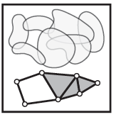
Consider X an arbitrary topological space.
Let V = {V_{i} | i = 1, …, n } where V_{i} X ,
The nerve of V = N(V) where
The k -simplices of N(V) =
nonempty intersections of
k +1 distinct elements of V .
For example,
Vertices = elements of V
Edges = pairs in V which intersect nontrivially.
Triangle = triples in V which intersect nontrivially.
http://www.math.upenn.edu/~ghrist/EAT/EATchapter2.pdf

Slide 26
Nerve Lemma: If V is a finite collection of subsets of X with all non-empty intersections of subcollections of V contractible, then N(V) is homotopic to the union of elements of V.
http://www.math.upenn.edu/~ghrist/EAT/EATchapter2.pdf

Slide 27
Creating the Vietoris Rips simplicial complex
Notes:
We start again by adding our 0-simplices, our data points. I can indicate the threshold using a ball centered at my data point. The diameter of the ball will be my threshold, so if two balls intersect then the distance between the vertices is less than the threshold, so we connect the pair of vertices with an edge if and only if the balls intersect, so we can get edges after which we can then add all possible higher dimensional simplices.
Note how I grew my balls. As the diameter increases, my threshold which is equal to my diameter increases.

Slide 29
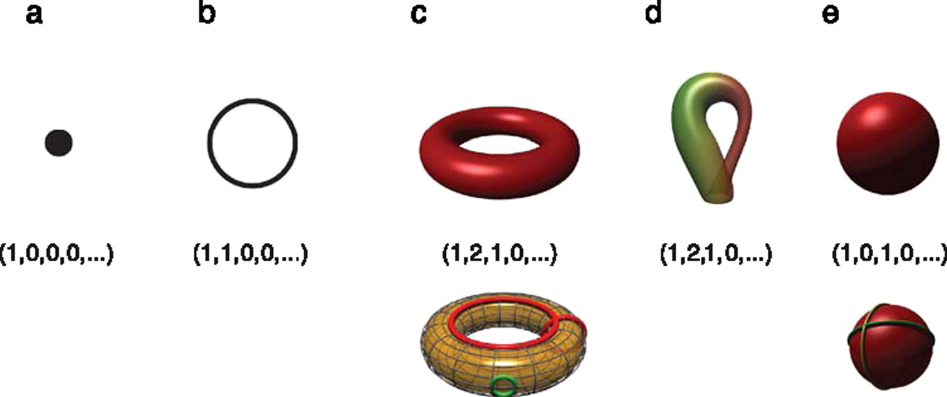
Betti numbers provide a signature of the underlying topology.
Singh G et al. J Vis 2008;8:11
©2008 by Association for Research in Vision and Ophthalmology
Notes:
Betti numbers provide a signature of the underlying topology. Illustrated in the figure are five simple objects (topological spaces) together with their Betti number signatures: (a) a point, (b) a circle, (c) a hollow torus, (d) a Klein bottle, and (e) a hollow sphere. For the case of the torus (c), the figure shows three loops on its surface. The red loops are “essential” in that they cannot be shrunk to a point, nor can they be deformed one into the other without tearing the loop. The green loop, on the other hand, can be deformed to a point without any obstruction. For the torus, therefore, we have b 1 = 2. For the case of the sphere, the loops shown (and actually all loops on the sphere) can be contracted to points, which is reflected by the fact that b 1 = 0. Both the sphere and the torus have b 2 = 1, this is due to the fact both surfaces enclose a part of space (a void).

Slide 30
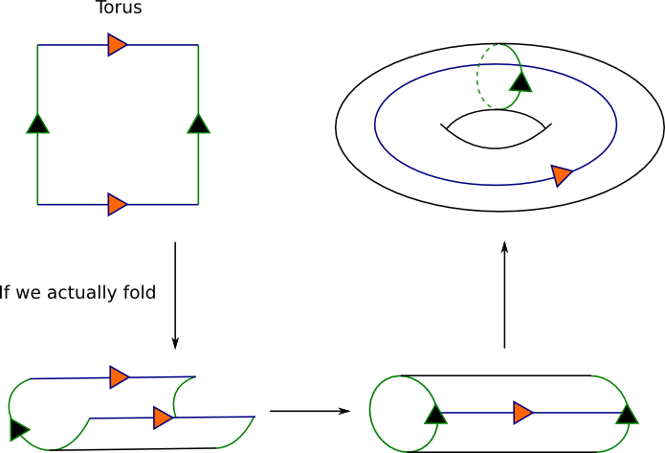
From: http://www.math.cornell.edu/~mec/Winter2009/Victor/part1.htm

Slide 31
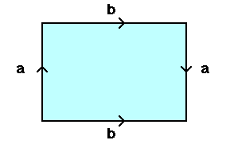
From: http://www.math.osu.edu/~fiedorowicz.1/math655/Klein2.html
Klein Bottle
From:
http://plus.maths.org/content/imaging-maths-inside-klein-bottle

Slide 32
Betti numbers provide a signature of the underlying topology.
Singh G et al. J Vis 2008;8:11
©2008 by Association for Research in Vision and Ophthalmology
Notes:
Betti numbers provide a signature of the underlying topology. Illustrated in the figure are five simple objects (topological spaces) together with their Betti number signatures: (a) a point, (b) a circle, (c) a hollow torus, (d) a Klein bottle, and (e) a hollow sphere. For the case of the torus (c), the figure shows three loops on its surface. The red loops are “essential” in that they cannot be shrunk to a point, nor can they be deformed one into the other without tearing the loop. The green loop, on the other hand, can be deformed to a point without any obstruction. For the torus, therefore, we have b 1 = 2. For the case of the sphere, the loops shown (and actually all loops on the sphere) can be contracted to points, which is reflected by the fact that b 1 = 0. Both the sphere and the torus have b 2 = 1, this is due to the fact both surfaces enclose a part of space (a void).

Slide 33
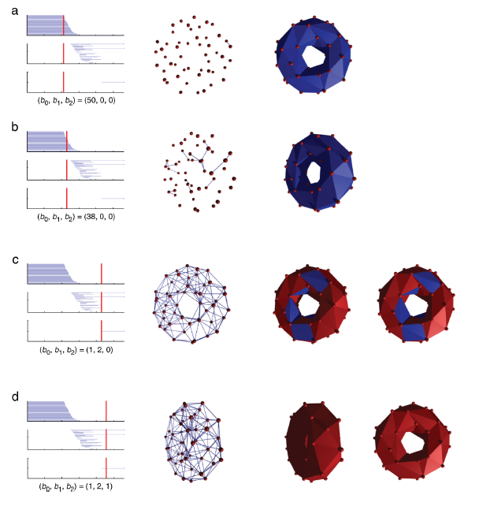
http://www.journalofvision.org/
content/8/8/11.full
Figure 4 animation

Slide 34
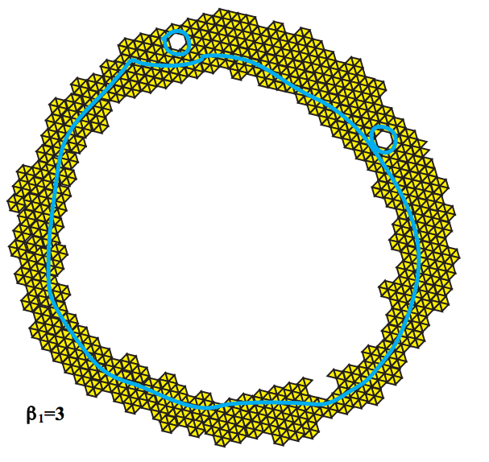
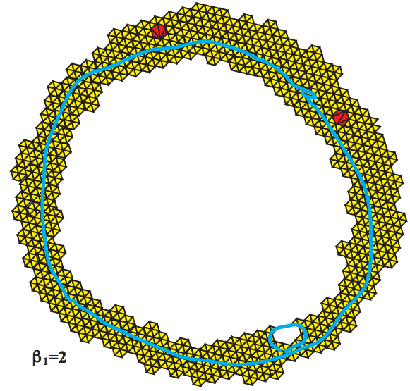
Topology and Data. Gunnar Carlsson
www.ams.org/journals/bull/2009-46-02/S0273-0979-09-01249-X

Slide 35
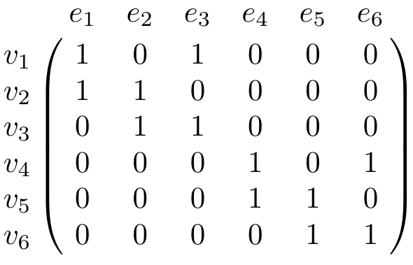
v₂
v₅
e₁
e₂
e₄
e₅
v₁
v₃
v₄
v₆
e₃
e₆

Slide 36
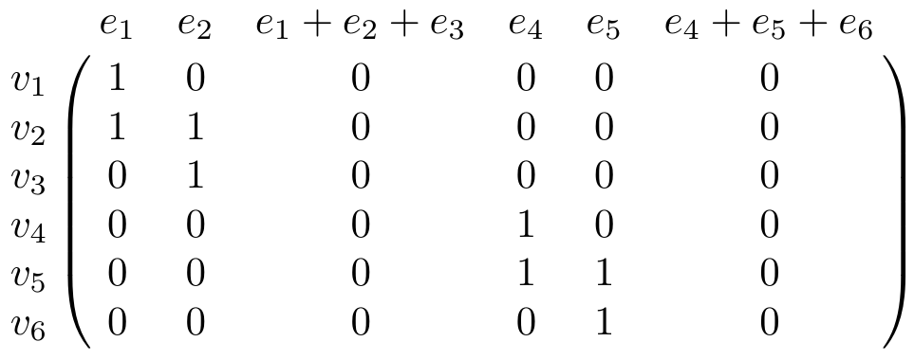
v₂
v₅
e₁
e₂
e₄
e₅
v₁
v₃
v₄
v₆
e₃
e₆

Slide 37
v₂
v₅
e₁
e₂
e₄
e₅
v₁
v₃
v₄
v₆
e₃
e₆
Z₁ = kernel of = null space of M₁
= <e₁ + e₂ + e₃, e₄ + e₅ + e₆>
o₁

Slide 38
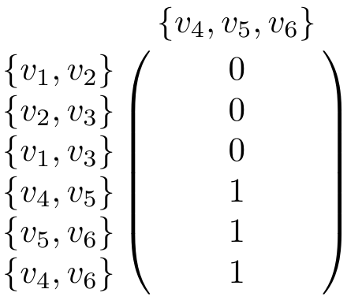
v₂
v₅
e₁
e₂
e₄
e₅
v₁
v₃
v₄
v₆
e₃
e₆

Slide 39
v₂
v₅
o₂
o₁
e₁
e₂
e₃
e₄
C₂ → C₁ → C₀
v₁
e₃
v₃
v₄
e₅
v₆
H₁ = Z₁/B₁ = (kernel of )/ (image of )
null space of M₁
column space of M₂
<e₁ + e₂ + e₃, e₄ + e₅ + e₆>
<e₄ + e₅ + e₆>
Rank H₁ = Rank Z₁ – Rank B₁ = 2 – 1 = 1
o₁
o₂
=
=

